Slide 1
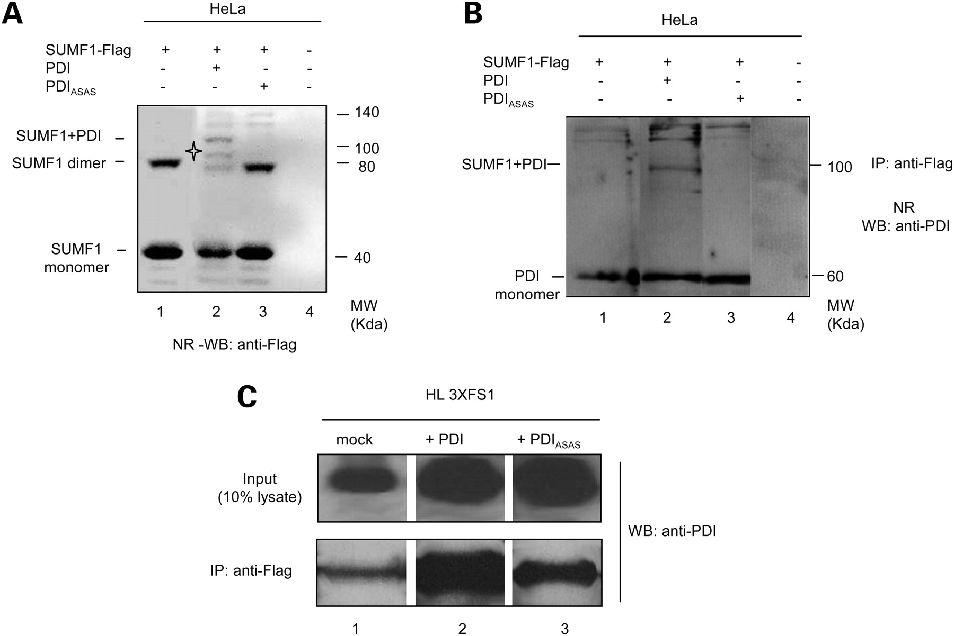
Figure 1. PDI binding to SUMF1. (A) Formation of stable PDI–SUMF1 mixed disulfides. HeLa cells were co-transfected with ...
Notes:
Figure 1. PDI binding to SUMF1. (A) Formation of stable PDI–SUMF1 mixed disulfides. HeLa cells were co-transfected with SUMF1-Flag and PDI or PDIASAS. The cells were treated with N-ethylmaleimide to quench disulfide interchange. Aliquots of the lysates were resolved by non-reducing gradient SDS–PAGE gels. The filters were revealed with anti-Flag antibody. Asterisks indicate bands corresponding to SUMF1-PDI mixed disulfides. (B–C) PDI association with SUMF1 is mediated also by non-covalent interactions. Transient (B) or stable (C, HL3xFS1 cells), HeLa transfectants expressing SUMF1-Flag were transfected with PDI or PDIASAS. Protein extracts were immunoprecipitated with anti-Flag antibody and the immunocomplexes were resolved under non-reducing (B) or reducing (C) conditions and blots probed with anti-PDI antibodies.
Unless provided in the caption above, the following copyright applies to the content of this slide: © The Author 2008. Published by Oxford University Press. All rights reserved. For Permissions, please email: journals.permissions@oxfordjournals.org

Slide 2
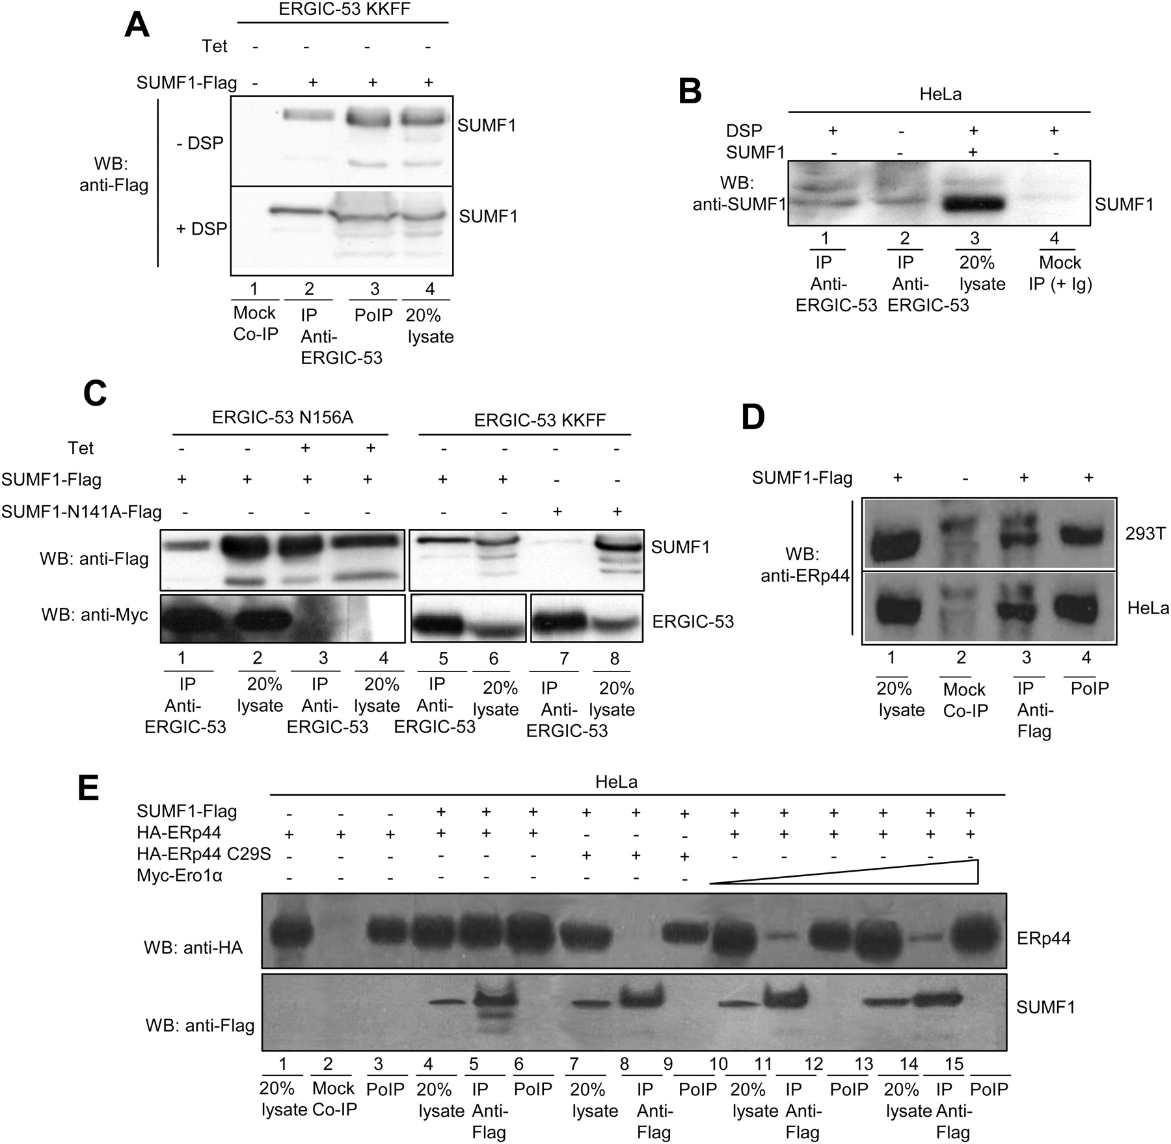
Figure 2. SUMF1 binds ERGIC-53 and ERp44 via glycan- and thiol-dependent interactions. (A) Co-precipitation between ...
Notes:
Figure 2. SUMF1 binds ERGIC-53 and ERp44 via glycan- and thiol-dependent interactions. (A) Co-precipitation between SUMF1 and ERGIC-53. KKFF cells incubated for 48 h without tetracycline to induce expression of myc-ERGIC53 were transfected with or without SUMF1-Flag and then immunoprecipitated with anti-ERGIC-53 antibodies before or after cross-linking with dithiobis(succinimidylpropionate) (DSP). Immunoprecipitates were resolved under reducing conditions and blots decorated with anti-Flag to reveal exogenous SUMF1 molecules associating with ERGIC-53. (B) Interactions between endogenous SUMF1 and ERGIC-53. Extracts from untransfected HeLa cells were immunoprecipitated as in A and blots decorated with anti-SUMF1 to detect endogenous molecules. Over-expressed SUMF1 was run in lane 3 to facilitate identification of the relevant band. (C) Binding between SUMF1 and ERGIC-53 is N-glycan dependent. ERGIC-53N156A or ERGIC-53KKFF cells were transfected with SUMF1-Flag or non-glycosylated SUMF1N141A-Flag as indicated, incubated for 48 h±tetracycline to modulate ERGIC-53 expression and cross-linked with DSP. IP and Western blotting of the immunocomplexes were carried out with the indicated antibodies. (D) Endogenous ERp44 associates with over-expressed SUMF1. HeLa and 293T cells were transfected with the SUMF1-Flag-expressing plasmid. The extracts were immunoprecipitated with anti-Flag antibodies and blots probed with anti-ERp44. (E) Over-expression of Ero1α inhibits the association between SUMF1 and ERp44. HeLa cells were transfected with SUMF1-Flag, HA-ERp44, HA-ERp44C29S and Myc-ERO1α, as indicated. Cell extracts were immunoprecipitated with anti-Flag antibodies and blots probed with anti-HA or anti-Flag.
Unless provided in the caption above, the following copyright applies to the content of this slide: © The Author 2008. Published by Oxford University Press. All rights reserved. For Permissions, please email: journals.permissions@oxfordjournals.org

Slide 3
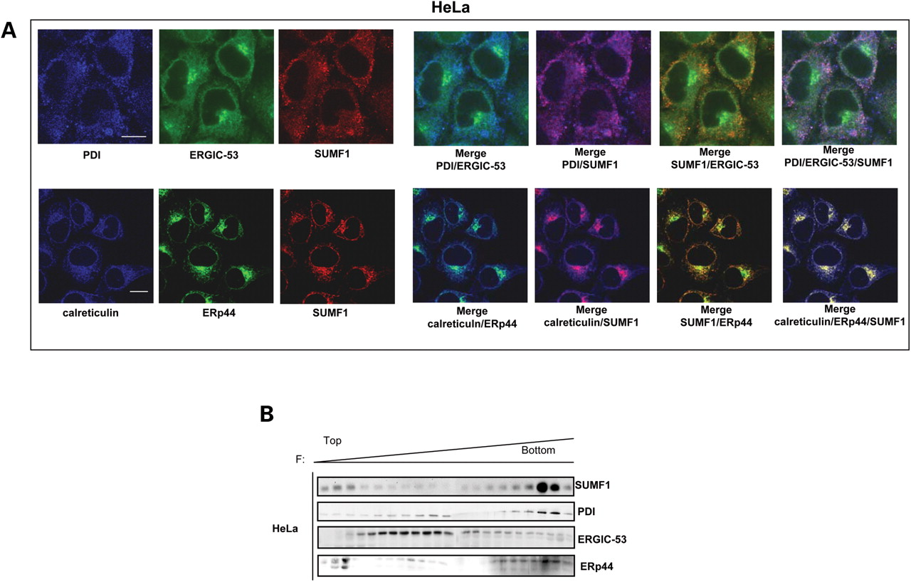
Figure 3. Subcellular distribution of SUMF1. (A) Immunofluorescence localization of SUMF1 within PDI, ERp44 and ...
Notes:
Figure 3. Subcellular distribution of SUMF1. (A) Immunofluorescence localization of SUMF1 within PDI, ERp44 and ERGIC-53 enriched compartment. HeLa cells were co-stained with fluorescent antibodies specific for SUMF1, ERp44, PDI, Calreticulin and ERGIC-53, as indicated. Scale bar, 5 µm. (B) Co-fractionation of SUMF1, ERp44, ERGIC-53 and PDI. Postnuclear cellular membranes from HeLa cells were fractionated by continuous Optiprep gradients (8–24%). Twenty different fractions were collected and resolved in SDS-gels under reducing conditions. Blots were probed for SUMF1, ERp44, ERGIC-53 or PDI, as indicated.
Unless provided in the caption above, the following copyright applies to the content of this slide: © The Author 2008. Published by Oxford University Press. All rights reserved. For Permissions, please email: journals.permissions@oxfordjournals.org

Slide 4
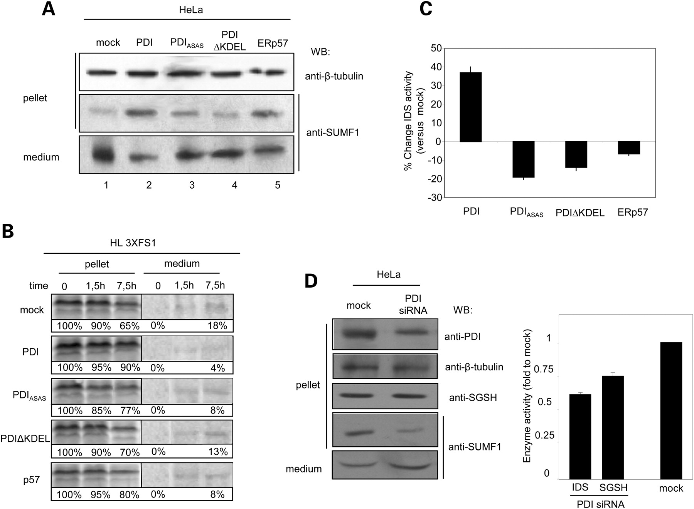
Figure 4. PDI controls ER retention and activity of SUMF1. (A and B) SUMF1 retention/secretion upon over-expression of ...
Notes:
Figure 4. PDI controls ER retention and activity of SUMF1. (A and B) SUMF1 retention/secretion upon over-expression of PDI wt, PDI mutants and ERp57. (A) HeLa cells were transfected with PDI, PDIASAS, PDIΔKDEL or ERp57 expression plasmids. Two days after transfection, proteins extracts from cellular pellets deriving from 2 × 106 cells and the correspondent media (conditioned for 16 hours) were probed with anti-SUMF1. Anti-tubulin antibodies were used as loading controls. (B) HL3xFS1 stable cells transfected with PDI, PDIASAS, PDIΔKDEL or ERp57 expression plasmids were pulsed with [35S] aminoacids for 15 min. Pellets and media were collected at the indicated chase times and immunoprecipitated with anti-Flag antibody to reveal SUMF1-Flag proteins. The amount of SUMF1 recovered in the pellet and in the medium at different chase times is quantified as the percentage of total SUMF1 present in cells at time 0 (100%). (C) PDI potentiates intracellular IDS activity. Forty-eight hours after transfection the activity of IDS was quantified in cellular extracts, and expressed as the percentage relative to the activity of mock transfected cells. (D) Silencing of PDI affects retention and activity of SUMF1. HeLa cells were mock transfected or transfected with PDI-directed siRNA expressing plasmid. Twenty-four hour after transfection cell pellets and the correspondent conditioned media were analyzed by Western-Blotting with the indicated specific antibodies (left). The IDS and SGSH activities were measured in the same extracts. Data are expressed as fold induction relative to mock transfected cells (right).
Unless provided in the caption above, the following copyright applies to the content of this slide: © The Author 2008. Published by Oxford University Press. All rights reserved. For Permissions, please email: journals.permissions@oxfordjournals.org

Slide 5
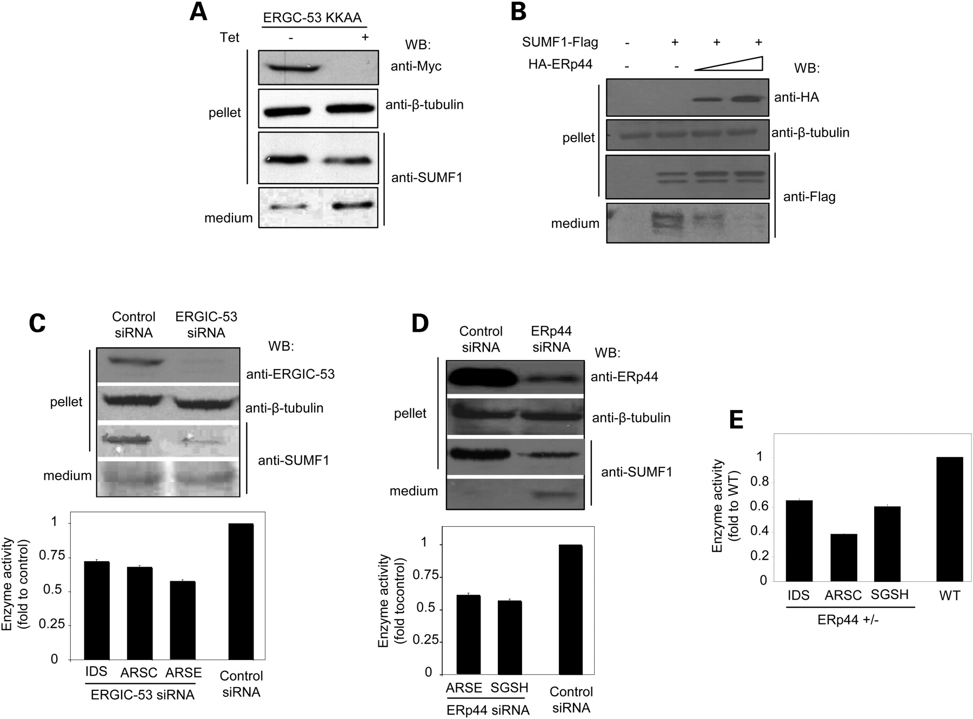
Figure 5. ERGIC-53 and ERp44 control SUMF1 traffic and activity. (A) ERGIC-53KKAA retains SUMF1 in the ER. Conditioned ...
Notes:
Figure 5. ERGIC-53 and ERp44 control SUMF1 traffic and activity. (A) ERGIC-53KKAA retains SUMF1 in the ER. Conditioned media (16 h) and lysates of KKAA cells cultured for 48 h ± tetracycline were analyzed by Western blotting with the indicated antibodies. (B) Over-expression of ERp44 inhibits SUMF1 secretion. HeLa cells were transfected with SUMF1-Flag alone or with increasing levels of HA-ERp44. Western blotting of conditioned media (16 h) and cellular extracts was carried out with the indicated antibodies. (C) Silencing ERGIC-53 causes loss of intracellular SUMF1 without increasing its secretion. HeLa cells were transfected with fluorescent ERGIC-53-directed siRNA or control duplexes. 3 days after transfection the cellular pellets and media (16 h conditioned) were probed with the indicated antibodies. Different sulfatases activities were measured in protein extracts obtained from FACS-sorted cells to enrich siRNA-treated cells. (D) Silencing ERp44 increases SUMF1 secretion. HeLa cells were transfected with fluorescent ERp44 siRNA and control duplexes. 3 days after transfection cell pellets and media (16 h conditioned) were probed with the indicated antibodies. The indicated sulfatases activities were measured in protein extracts obtained from FACS-sorted cells to enrich siRNA-treated cells. (E) Increased SUMF1 secretion in ERp44+/− ES cells. Different sulfatases activities were measured in extracts of ES trapped clones containing a single copy of ERp44 gene. The activities were compared to control ES wt cells.
Unless provided in the caption above, the following copyright applies to the content of this slide: © The Author 2008. Published by Oxford University Press. All rights reserved. For Permissions, please email: journals.permissions@oxfordjournals.org

Slide 6
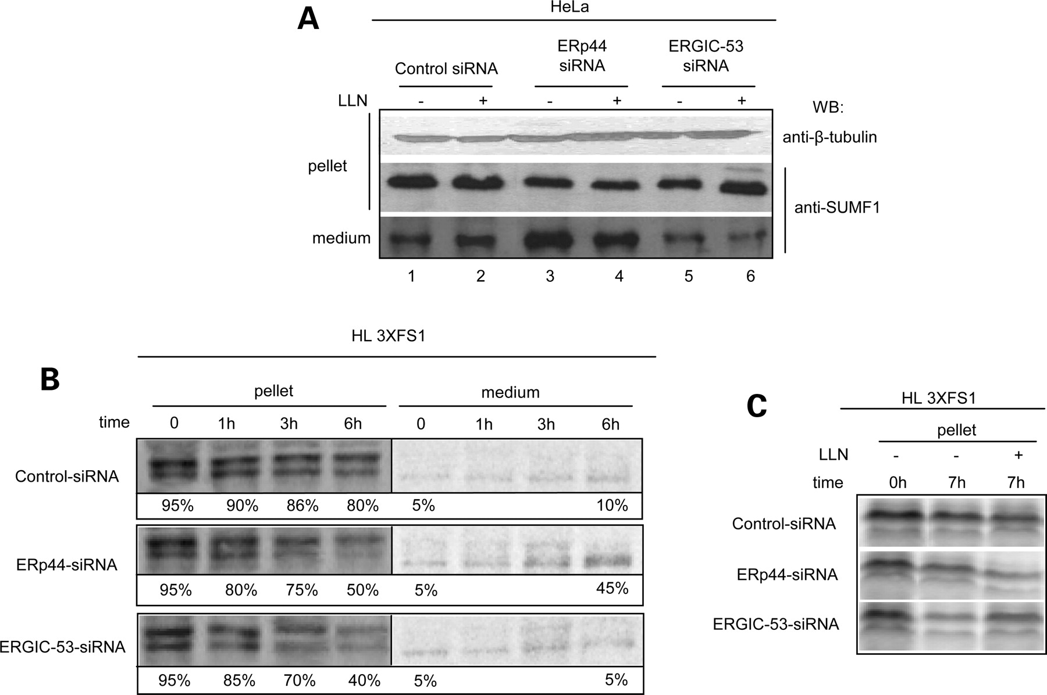
Figure 6. Different fate of SUMF1 in cells lacking ERGIC-53 or ERp44. (A) Proteasomal degradation of SUMF1 in ...
Notes:
Figure 6. Different fate of SUMF1 in cells lacking ERGIC-53 or ERp44. (A) Proteasomal degradation of SUMF1 in ERGIC-53-depleted cells. HeLa cells were transfected with ERp44- or ERGIC53-specific siRNA or control duplexes, as indicated, and cultured with or without the proteasome inhibitor LLN for 12 h. Cellular pellets and media were probed with the indicated specific antibodies. Note the increased secretion in ERp44-depleted cells, and the increased intracellular pool in LLN-treated cells only in cells silenced for ERGIC-53. (B) Increased SUMF1 secretion upon ERp44, but not ERGIC-53 silencing. HL3xFS1 stable cells were transfected with ERp44- or ERGIC53-specific siRNA or control duplexes and then pulsed, chased and handled as in Figure 4B. (C) ERGIC-53 silencing promotes proteasomal degradation of SUMF1. The lysates of cells treated as above were collected after a 7 h chase carried out in presence or absence of the proteasome inhibitor LLN.
Unless provided in the caption above, the following copyright applies to the content of this slide: © The Author 2008. Published by Oxford University Press. All rights reserved. For Permissions, please email: journals.permissions@oxfordjournals.org

Slide 7
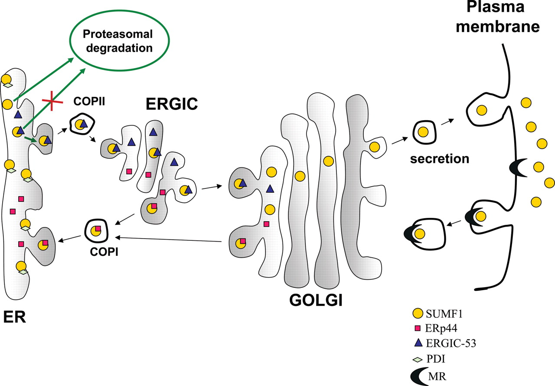
Figure 7. SUMF1 trafficking: a working model. Within the ER, SUMF1 folds and interacts with PDI. The redox activity of ...
Notes:
Figure 7. SUMF1 trafficking: a working model. Within the ER, SUMF1 folds and interacts with PDI. The redox activity of PDI is important for the SUMF1-dependent activation of sulfatases. SUMF1 also binds to ERGIC-53 through lectin–glycan interactions. This interaction protects SUMF1 form proteasomal degradation and delivers it to the cis-Golgi. Here, part of SUMF1 is retrieved by ERp44 through RDEL-dependent mechanisms and part of it can move forward and reach the medium. Secreted SUMF1 can be taken up as previously shown (8).
Unless provided in the caption above, the following copyright applies to the content of this slide: © The Author 2008. Published by Oxford University Press. All rights reserved. For Permissions, please email: journals.permissions@oxfordjournals.org

