Slide 1
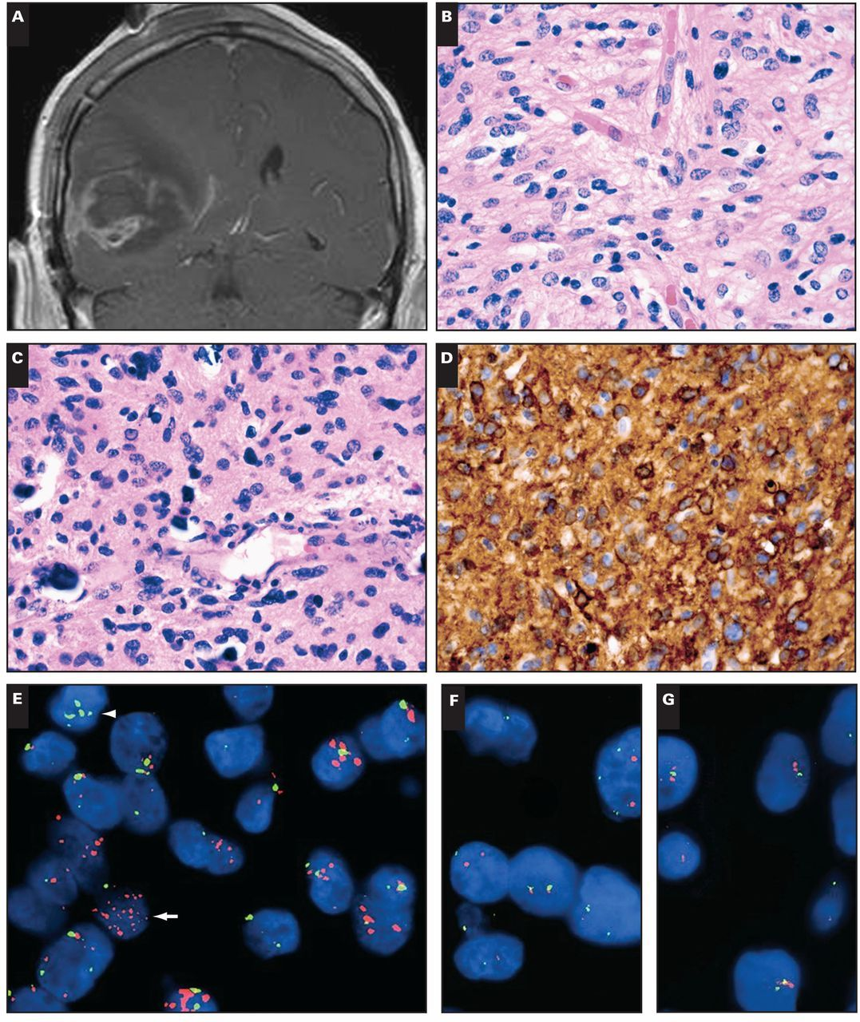
Image 1 Case 1. A 71-year-old man had a right temporal enhancing mass (A) that showed frequent mitoses and large ...
Notes:
Image 1 Case 1. A 71-year-old man had a right temporal enhancing mass (A) that showed frequent mitoses and large areas of necrosis (not shown), “chickenwire” branching capillaries and microcalcifications (B, C), and both rounded and angulated nuclei. Epidermal growth factor receptor (EGFR) immunostain was strongly positive (D), and the tumor showed scattered cells with EGFR amplification (E, arrow) but not 1p/19q codeletion (F, G). Of note, some tumor cells had polysomy 7 but not EGFR amplification (E, arrowhead). R1232H IDH1 immunostain was negative, as was IDH1/2 mutation sequencing (not shown). Despite treatment with radiation and temozolomide, the man died 4 months later. Orange signals in E, EGFR; green signals, chromosome 7 centromeric enumeration probe. In F and G, orange signals, 1p36 and 19q13; green signals, 1q25 and 19p13.
Unless provided in the caption above, the following copyright applies to the content of this slide: © American Society for Clinical Pathology

Slide 2
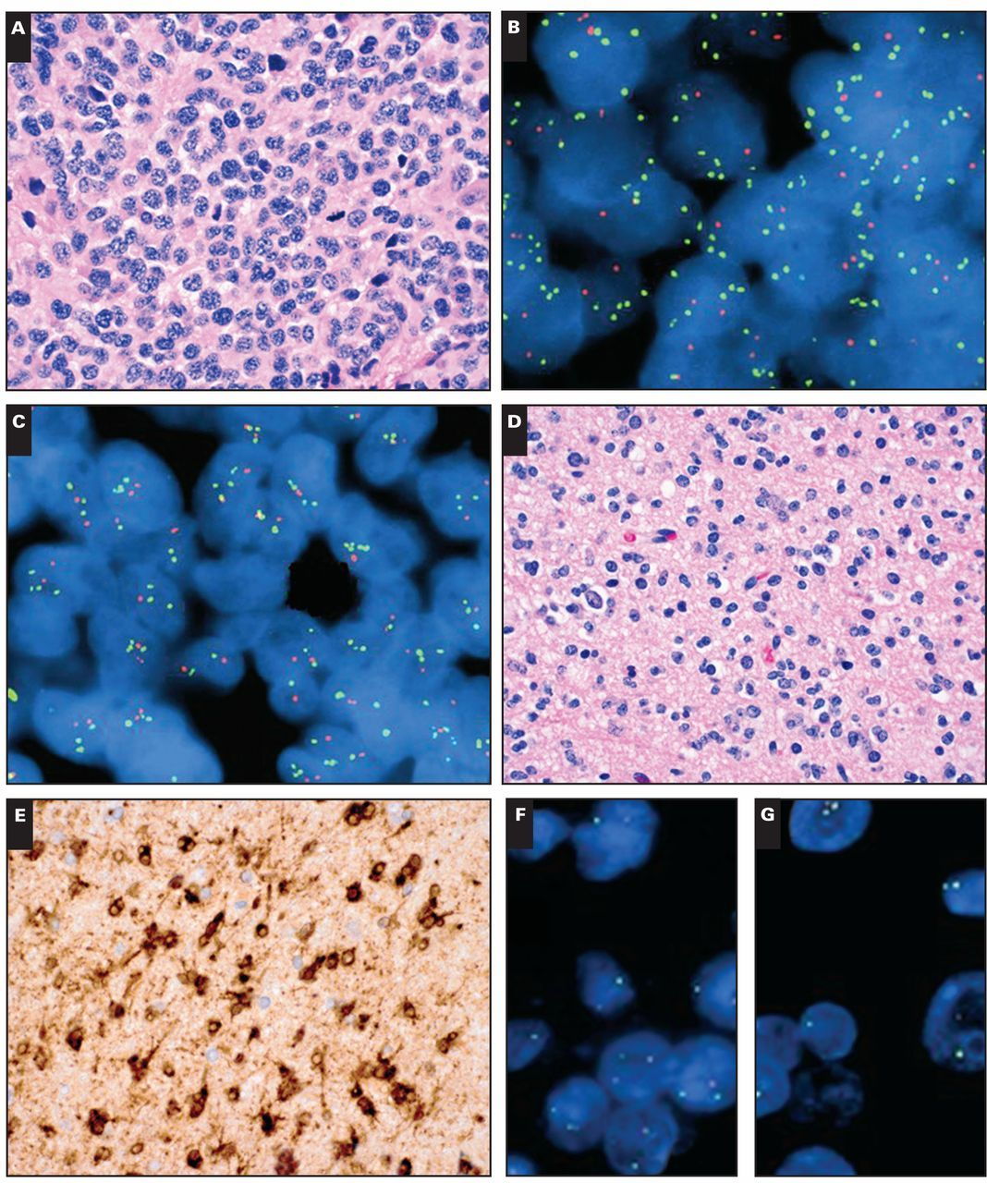
Image 2 Cases 2 (A-C) and 3 (D-G). Left frontal/sphenoid high-grade glial tumor with predominantly round cell ...
Notes:
Image 2 Cases 2 (A-C) and 3 (D-G). Left frontal/sphenoid high-grade glial tumor with predominantly round cell morphology and brisk mitotic activity (A). Fluorescence in situ hybridization (FISH) analysis of the lesion showed relative codeletion of 1p36 and 19q13 with polysomy of 1q25 and 19p13 (B, C). The tumor was negative for EGFR amplification with FISH and negative for IDH1/2 mutations with gene sequencing (not shown). Another glial tumor with round cell morphology and no mitotic activity, suggestive of World Health Organization grade II oligodendroglioma (D), showed strong immunoreactivity for R132H IDH1 (E) as well as classic 1p/19q codeletion by FISH (F, G). Orange signals, 1p36 and 19q13; green signals, 1q25 and 19p13.
Unless provided in the caption above, the following copyright applies to the content of this slide: © American Society for Clinical Pathology

Slide 3
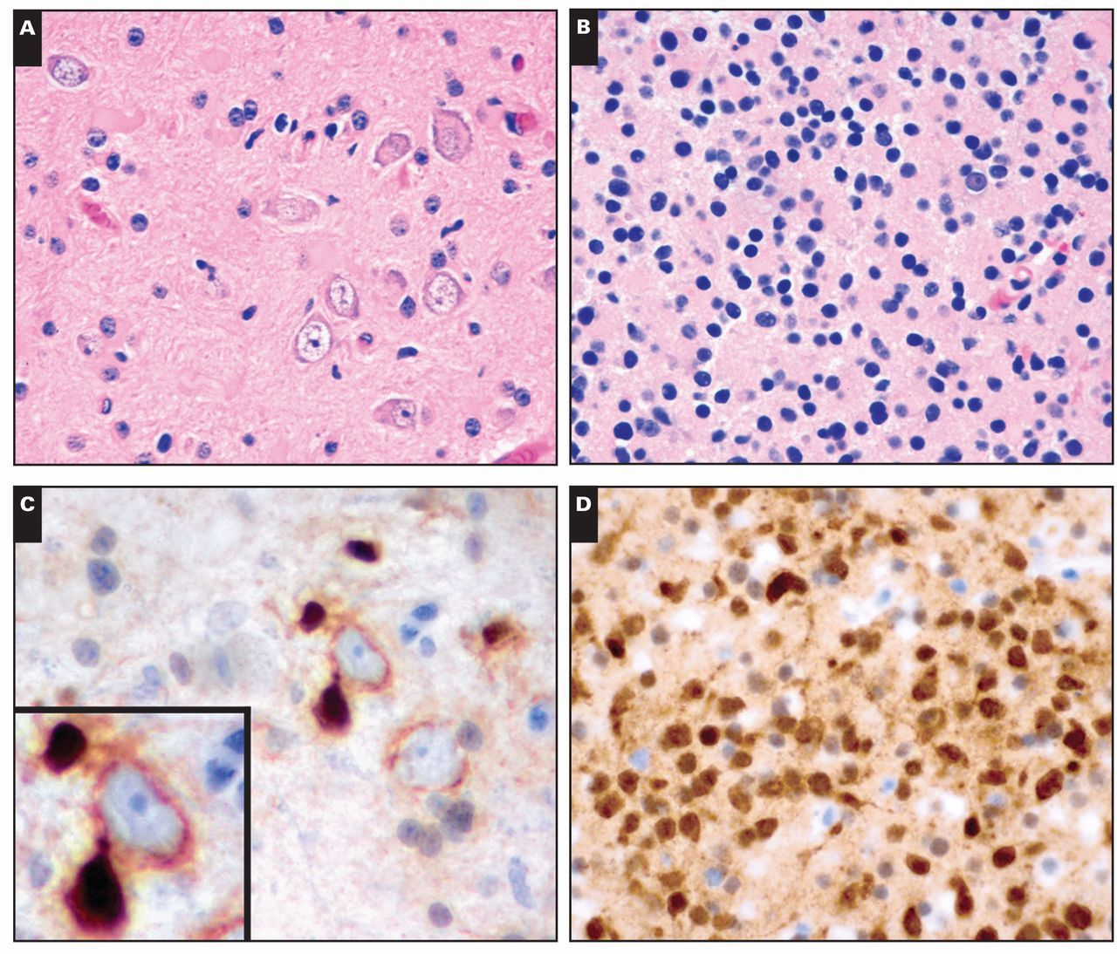
Image 3 Case 4. A 36-year-old man had a 2 × 2-cm nonenhancing mass in the left frontal lobe (radiology not shown). ...
Notes:
Image 3 Case 4. A 36-year-old man had a 2 × 2-cm nonenhancing mass in the left frontal lobe (radiology not shown). Histologic features of the initial biopsy (A) suggested a low-grade glioneuronal tumor with disordered ganglion cells, such as a dysembryoplastic neuroepithelial tumor or ganglioglioma. Four years later the tumor recurred, this time showing unequivocal grade II oligodendroglioma round cell morphology (B). Immunohistochemical staining for R132H IDH1 mutation was strongly positive in the tumor cells (D). Retrospective analysis of the original tumor also showed immunopositive cells (C), many of which were wrapping around and physically distorting immunonegative neurons (C, inset).
Unless provided in the caption above, the following copyright applies to the content of this slide: © American Society for Clinical Pathology

Slide 4
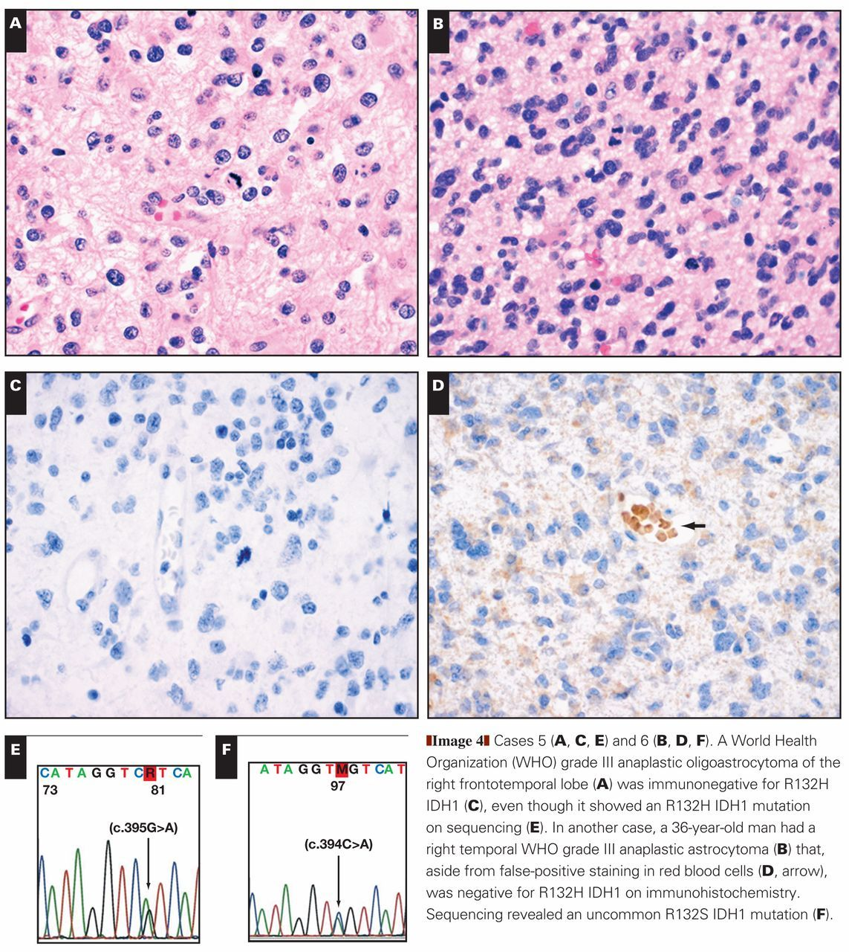
Image 4 Cases 5 (A, C, E) and 6 (B, D, F). A World Health Organization (WHO) grade III anaplastic oligoastrocytoma of ...
Notes:
Image 4 Cases 5 (A, C, E) and 6 (B, D, F). A World Health Organization (WHO) grade III anaplastic oligoastrocytoma of the right frontotemporal lobe (A) was immunonegative for R132H IDH1 (C), even though it showed an R132H IDH1 mutation on sequencing (E). In another case, a 36-year-old man had a right temporal WHO grade III anaplastic astrocytoma (B) that, aside from false-positive staining in red blood cells (D, arrow), was negative for R132H IDH1 on immunohistochemistry. Sequencing revealed an uncommon R132S IDH1 mutation (F).
Unless provided in the caption above, the following copyright applies to the content of this slide: © American Society for Clinical Pathology

Slide 5
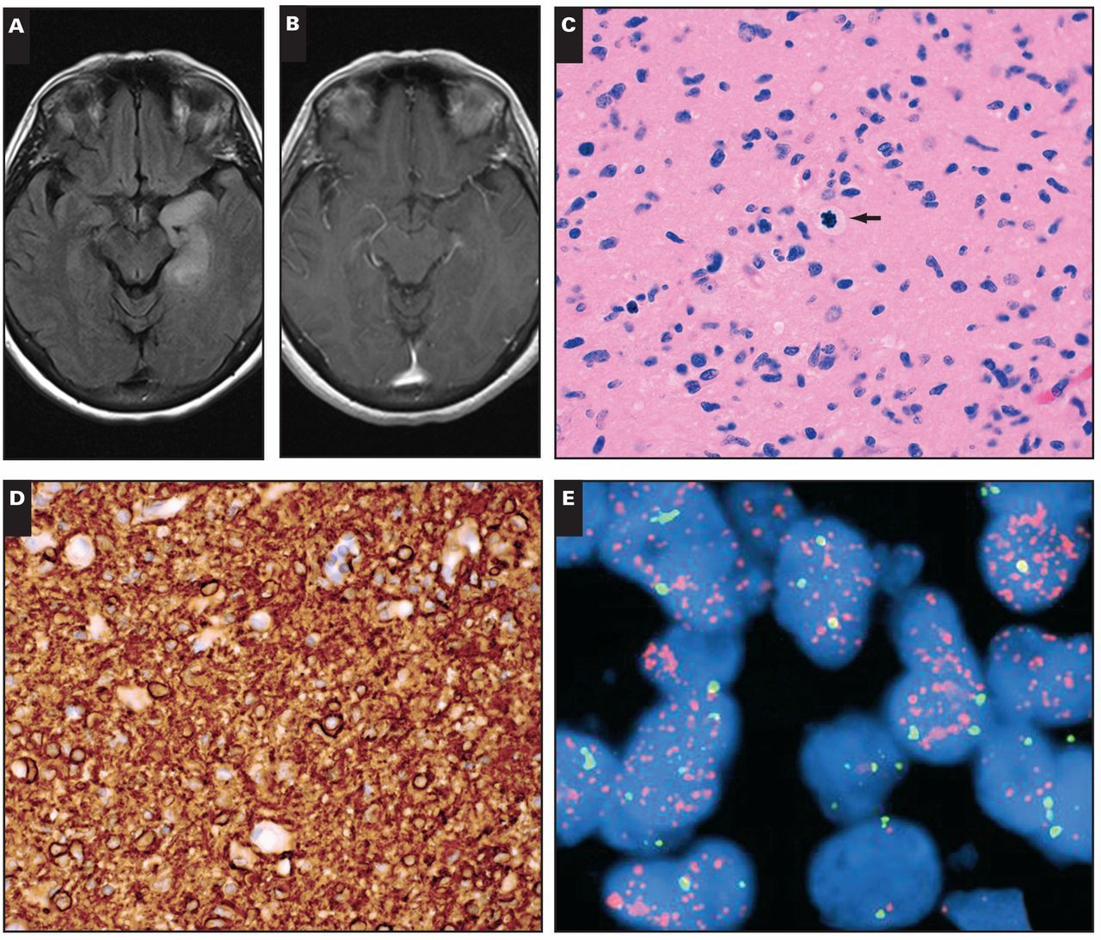
Image 5 Case 7. A 61-year-old woman with left-sided seizures was found to have a left temporal lesion that showed a ...
Notes:
Image 5 Case 7. A 61-year-old woman with left-sided seizures was found to have a left temporal lesion that showed a T2 signal but no significant contrast enhancement on T1 magnetic resonance imaging (MRI) (A, B). Histologic examination of the resection specimen showed an infiltrating glial tumor with grade III histology, including angulated atypical nuclei and readily identified mitoses (C, arrow); no microvascular proliferation or necrosis was seen. The tumor showed strong, diffuse immunohistochemical expression of EGFR (D), and EGFR was amplified (E). The tumor was negative for IDH1/2 mutations via both immunohistochemistry and polymerase chain reaction (not shown). Orange signals (E), EGFR; green signals, chromosome 7 centromeric enumeration probe.
Unless provided in the caption above, the following copyright applies to the content of this slide: © American Society for Clinical Pathology

Slide 6
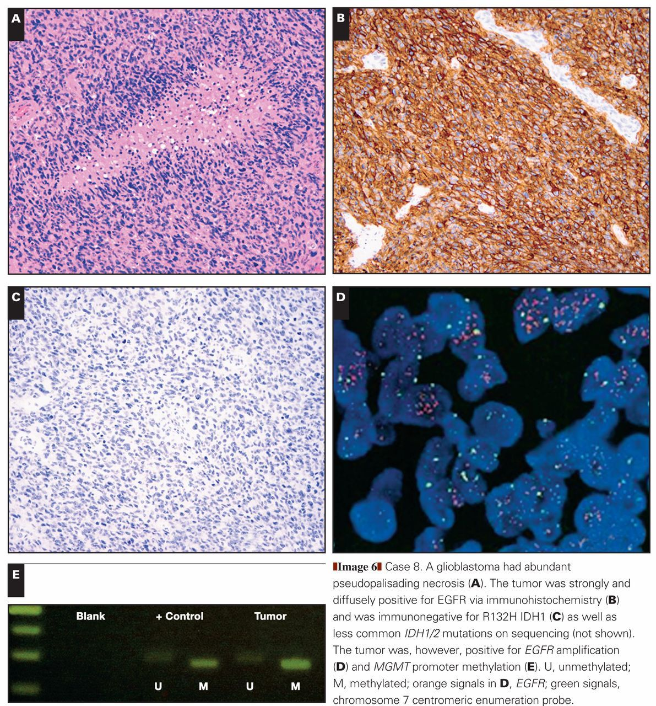
Image 6 Case 8. A glioblastoma had abundant pseudopalisading necrosis (A). The tumor was strongly and diffusely ...
Notes:
Image 6 Case 8. A glioblastoma had abundant pseudopalisading necrosis (A). The tumor was strongly and diffusely positive for EGFR via immunohistochemistry (B) and was immunonegative for R132H IDH1 (C) as well as less common IDH1/2 mutations on sequencing (not shown). The tumor was, however, positive for EGFR amplification (D) and MGMT promoter methylation (E). U, unmethylated; M, methylated; orange signals in D, EGFR; green signals, chromosome 7 centromeric enumeration probe.
Unless provided in the caption above, the following copyright applies to the content of this slide: © American Society for Clinical Pathology

Slide 7
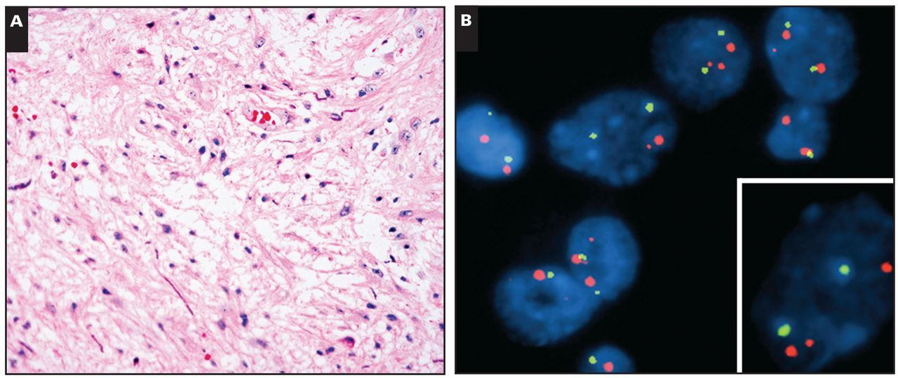
Image 7 Case 9. A 14-year-old boy had a thalamic tumor (radiology not available) that was clearly a low-grade glioma ...
Notes:
Image 7 Case 9. A 14-year-old boy had a thalamic tumor (radiology not available) that was clearly a low-grade glioma but did not show conclusive diagnostic features of a pilocytic astrocytoma (A). A BRAF rearrangement pattern was apparent on fluorescence in situ hybridization (B), with an extra smaller signal near one of the larger BRAF signals (B, inset). Orange signals, BRAF; green signals, CEP7.
Unless provided in the caption above, the following copyright applies to the content of this slide: © American Society for Clinical Pathology

