Slide 1
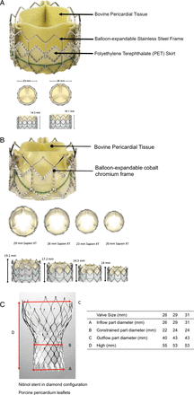
Figure 1 (A) Edwards-SAPIEN Transcatheter Heart Valve (Edwards Lifesciences). (B) Edwards-SAPIEN XT Transcatheter ...
Notes:
Figure 1 (A) Edwards-SAPIEN Transcatheter Heart Valve (Edwards Lifesciences). (B) Edwards-SAPIEN XT Transcatheter Heart Valve (Edwards Lifesciences). (C) Medtronic CoreValve™ (Medtronic).
Unless provided in the caption above, the following copyright applies to the content of this slide: Published on behalf of the European Society of Cardiology. All rights reserved. © The Author 2012. For permissions please email: journals.permissions@oup.com

Slide 2
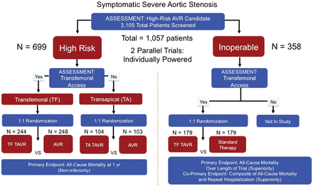
Figure 2 PARTNER trial I design.
Notes:
Figure 2 PARTNER trial I design.
Unless provided in the caption above, the following copyright applies to the content of this slide: Published on behalf of the European Society of Cardiology. All rights reserved. © The Author 2012. For permissions please email: journals.permissions@oup.com

Slide 3
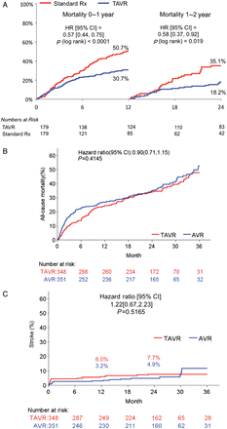
Figure 3 (A) Two-year with 1-year landmark analysis of all-cause mortality Kaplan–Meier curve in PARTNER trial cohort ...
Notes:
Figure 3 (A) Two-year with 1-year landmark analysis of all-cause mortality Kaplan–Meier curve in PARTNER trial cohort 1B. Reprinted with permission from Leon and colleagues20 and Makkar and colleagues.33 (B) Two-year all cause-mortality Kaplan–Meier curve in PARTNER trial cohort 1A. Adapted with permission from Kodali and colleagues.34 (C) Two-year stroke Kaplan–Meier curve in PARTNER trial cohort 1A. Adapted with permission from Kodali and colleagues.34
Unless provided in the caption above, the following copyright applies to the content of this slide: Published on behalf of the European Society of Cardiology. All rights reserved. © The Author 2012. For permissions please email: journals.permissions@oup.com

Slide 4
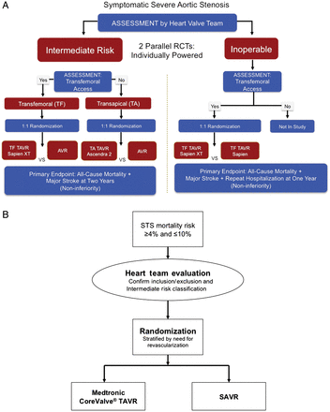
Figure 4 (A) PARTNER trial 2 design. (B) SURTAVI trial design (provided by Medtronic on 26 April 2012).
Notes:
Figure 4 (A) PARTNER trial 2 design. (B) SURTAVI trial design (provided by Medtronic on 26 April 2012).
Unless provided in the caption above, the following copyright applies to the content of this slide: Published on behalf of the European Society of Cardiology. All rights reserved. © The Author 2012. For permissions please email: journals.permissions@oup.com

Slide 5
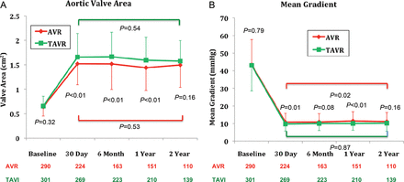
Figure 5 Two-year time trends in haemodynamics after TAVI vs. SAVR. Adapted with permission from Kodali and ...
Notes:
Figure 5 Two-year time trends in haemodynamics after TAVI vs. SAVR. Adapted with permission from Kodali and colleagues.34
Unless provided in the caption above, the following copyright applies to the content of this slide: Published on behalf of the European Society of Cardiology. All rights reserved. © The Author 2012. For permissions please email: journals.permissions@oup.com

Slide 6
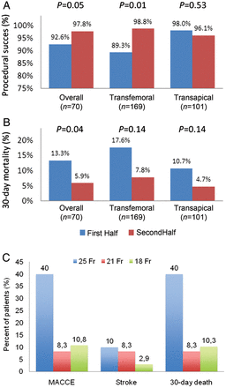
Figure 6 Effect of the learning curve on procedural success (A) and 30-day mortality (B) after TAVI. Data from ...
Notes:
Figure 6 Effect of the learning curve on procedural success (A) and 30-day mortality (B) after TAVI. Data from Gurvitch and colleagues.63 (C) Single centre experience on 136 patients comparing three generations of CoreValve™ devices. Data from Grube and colleagues.64
Unless provided in the caption above, the following copyright applies to the content of this slide: Published on behalf of the European Society of Cardiology. All rights reserved. © The Author 2012. For permissions please email: journals.permissions@oup.com

