Slide 1
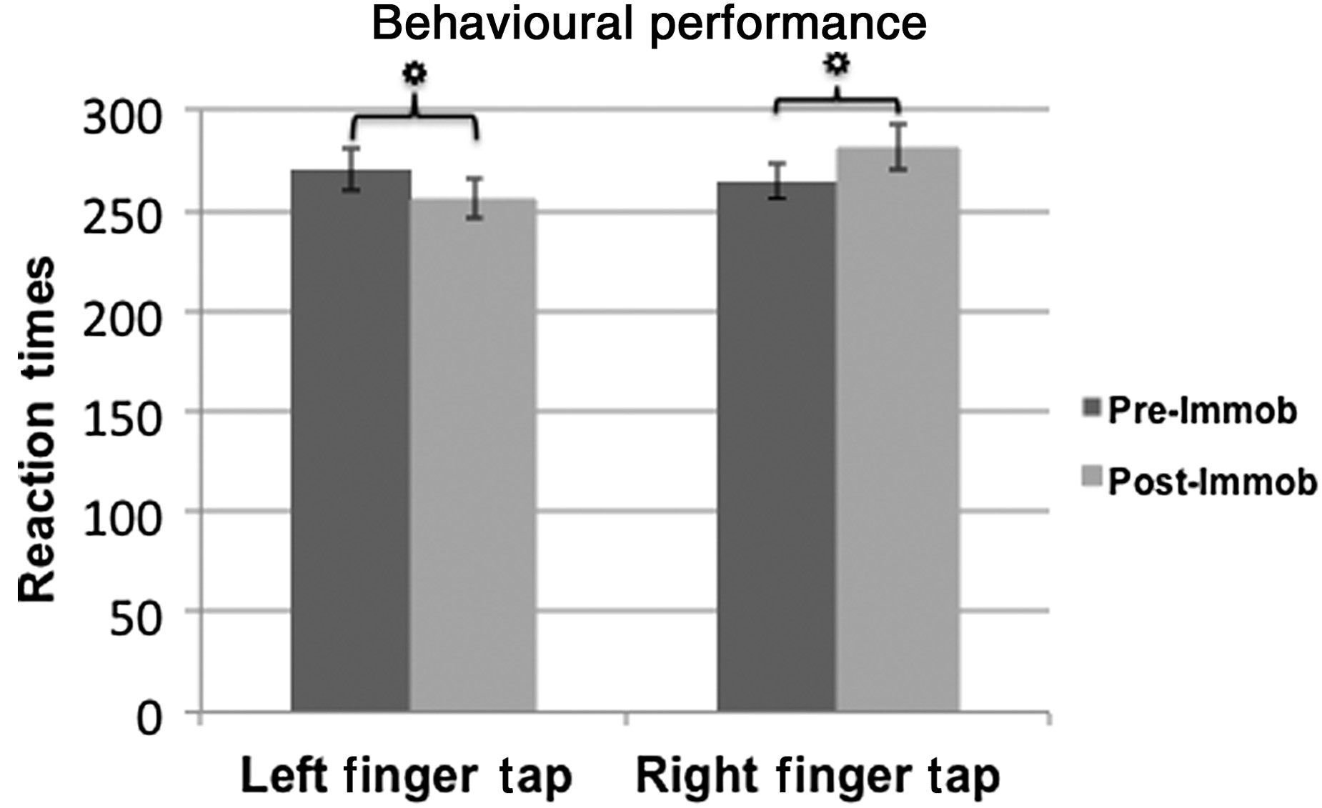
Figure 1. Performance on the Finger Tapping Task. Mean reaction times for left index finger (left bars) and right index ...
Notes:
Figure 1. Performance on the Finger Tapping Task. Mean reaction times for left index finger (left bars) and right index finger (right bars) taps. Significance in all figures is denoted by ‘asterisks’.
Unless provided in the caption above, the following copyright applies to the content of this slide: © The Author 2014. Published by Oxford University Press. All rights reserved. For Permissions, please e-mail: journals.permissions@oup.com

Slide 2
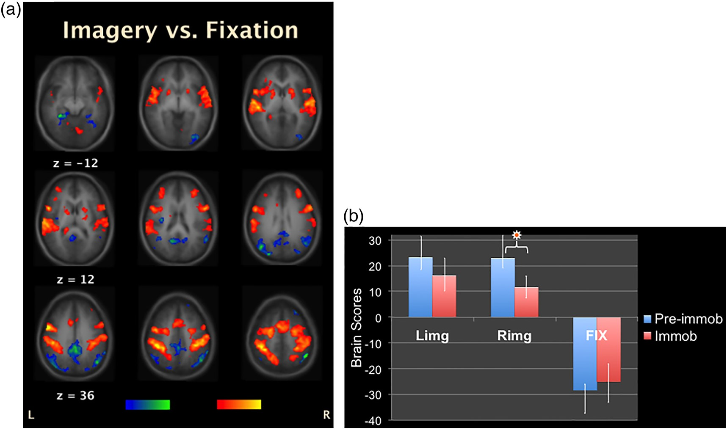
Figure 2. fMRI Whole-Brain Results: (a) A pattern of whole-brain activity depicting areas active during imagery ...
Notes:
Figure 2. fMRI Whole-Brain Results: (a) A pattern of whole-brain activity depicting areas active during imagery conditions (yellow/red) versus fixation (blue/green). (b) Brain scores related to whole-brain activity seen in (a) across the 3 conditions and 2 phases. Error bars denote 95% confidence intervals for correlations calculated from the bootstrap procedure.
Unless provided in the caption above, the following copyright applies to the content of this slide: © The Author 2014. Published by Oxford University Press. All rights reserved. For Permissions, please e-mail: journals.permissions@oup.com

Slide 3
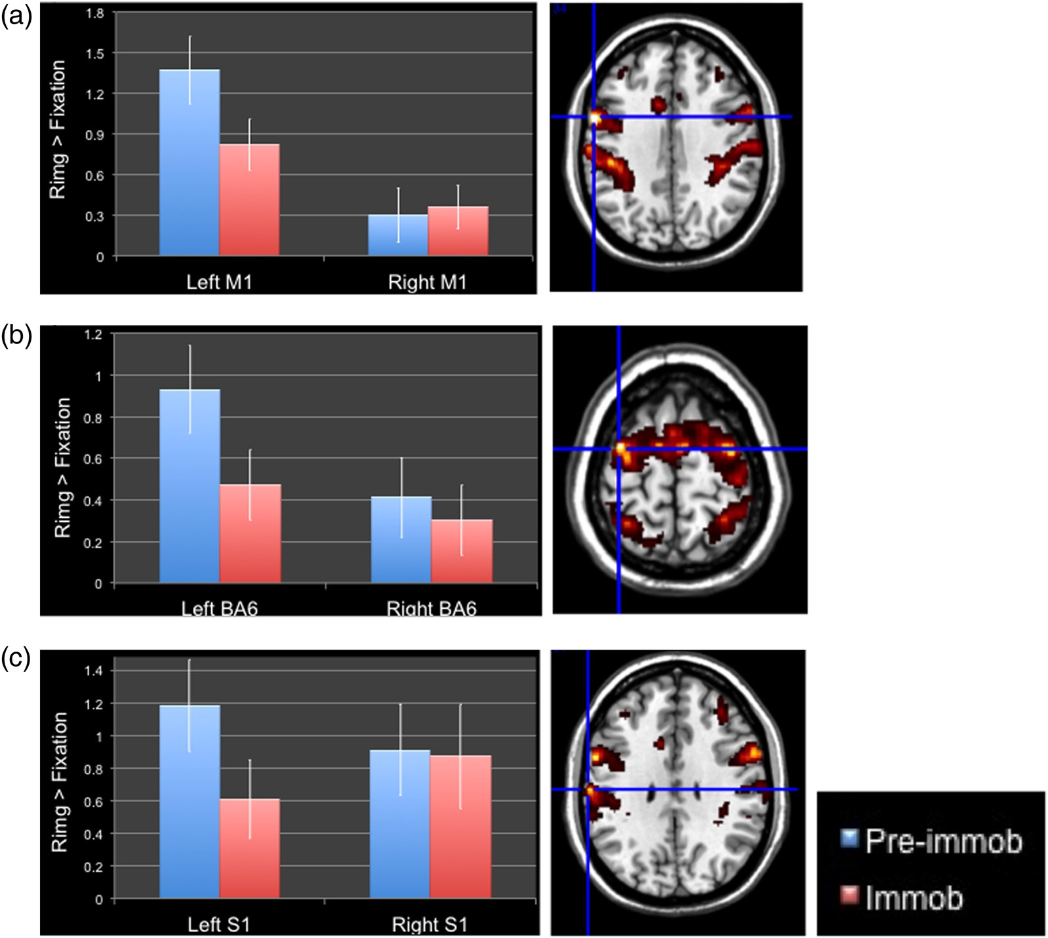
Figure 3. fMRI ROI Results: (a) M1; (b) BA6; (c) S1 activation during right-hand imagery pre-immobilization (blue bars) ...
Notes:
Figure 3. fMRI ROI Results: (a) M1; (b) BA6; (c) S1 activation during right-hand imagery pre-immobilization (blue bars) and during immobilization (red bars). Error bars denote standard error.
Unless provided in the caption above, the following copyright applies to the content of this slide: © The Author 2014. Published by Oxford University Press. All rights reserved. For Permissions, please e-mail: journals.permissions@oup.com

Slide 4
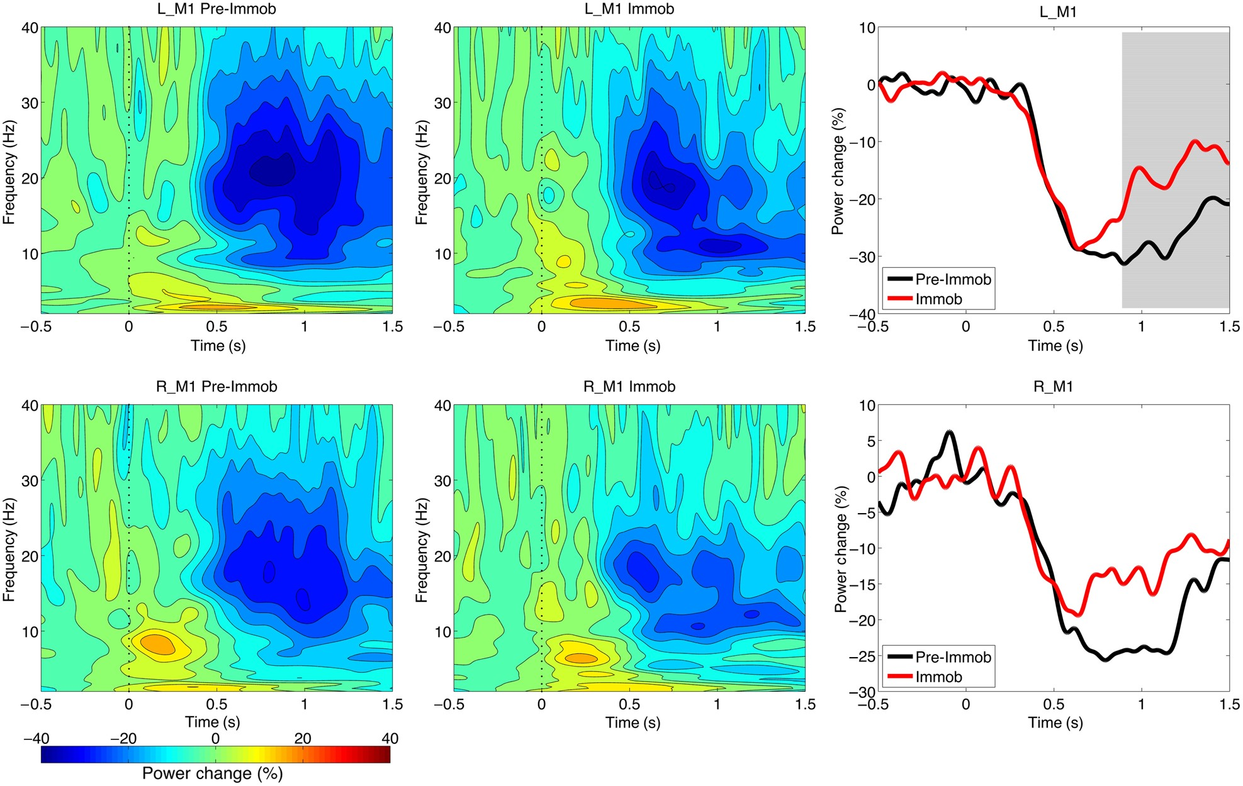
Figure 4. MEG Results: Effects of hand immobilization on ERD in the beta frequency band (13–30 Hz) in left and right ...
Notes:
Figure 4. MEG Results: Effects of hand immobilization on ERD in the beta frequency band (13–30 Hz) in left and right M1. Time–frequency plots (on the left) show a reduced ERD and power envelopes (on the right) show a significantly earlier beta-synchronization (gray area) in left M1 contralateral to the immobilized hand.
Unless provided in the caption above, the following copyright applies to the content of this slide: © The Author 2014. Published by Oxford University Press. All rights reserved. For Permissions, please e-mail: journals.permissions@oup.com

