Slide 1
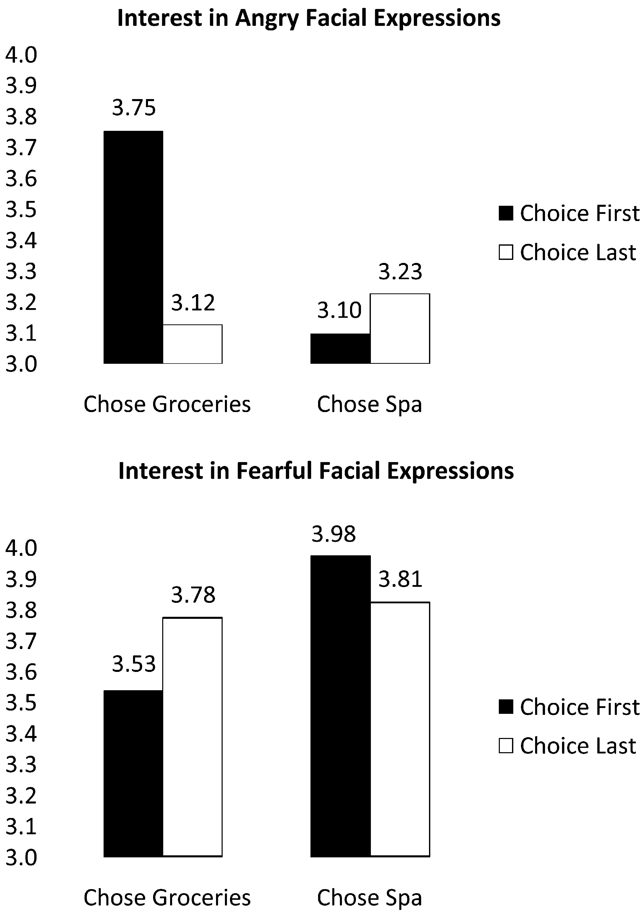
Figure 1. Interest in Angry and Fearful Facial Expressions Before versus After Resisting Temptation (Choosing ...
Notes:
Figure 1. Interest in Angry and Fearful Facial Expressions Before versus After Resisting Temptation (Choosing Groceries) and Yielding to Temptation (Choosing Spa): Experiment 2
Unless provided in the caption above, the following copyright applies to the content of this slide: © 2011 by Journal of Consumer Research, Inc.

Slide 2
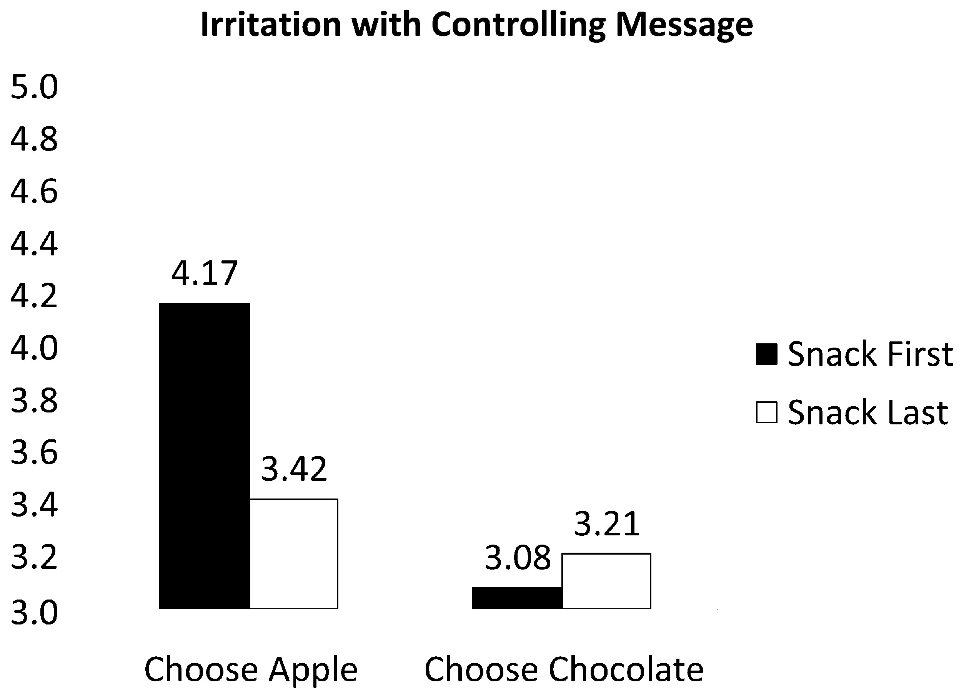
Figure 2. Mean Irritation with Controlling Appeal: Experiment 3
Notes:
Figure 2. Mean Irritation with Controlling Appeal: Experiment 3
Unless provided in the caption above, the following copyright applies to the content of this slide: © 2011 by Journal of Consumer Research, Inc.

Slide 3
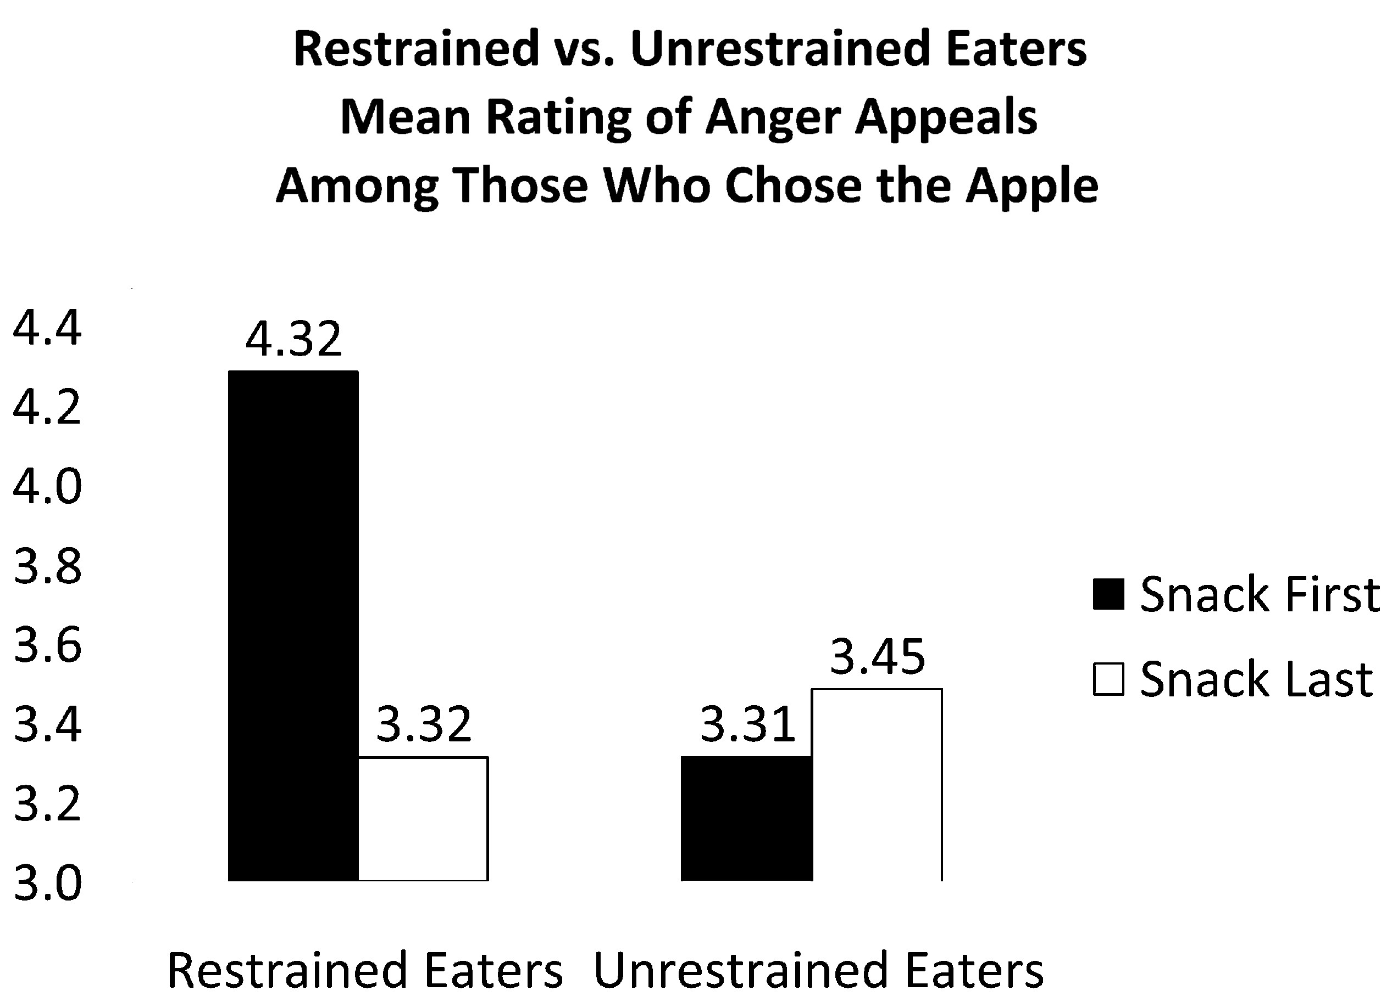
Figure 4. Endorsement of Anger-Framed Appeals among Restrained (at 1 SD above Mean Restraint) and Unrestrained (at 1 SD ...
Notes:
Figure 4. Endorsement of Anger-Framed Appeals among Restrained (at 1 SD above Mean Restraint) and Unrestrained (at 1 SD below Mean Restraint) Eaters Choosing the Apple: Experiment 4
Unless provided in the caption above, the following copyright applies to the content of this slide: © 2011 by Journal of Consumer Research, Inc.

Slide 4
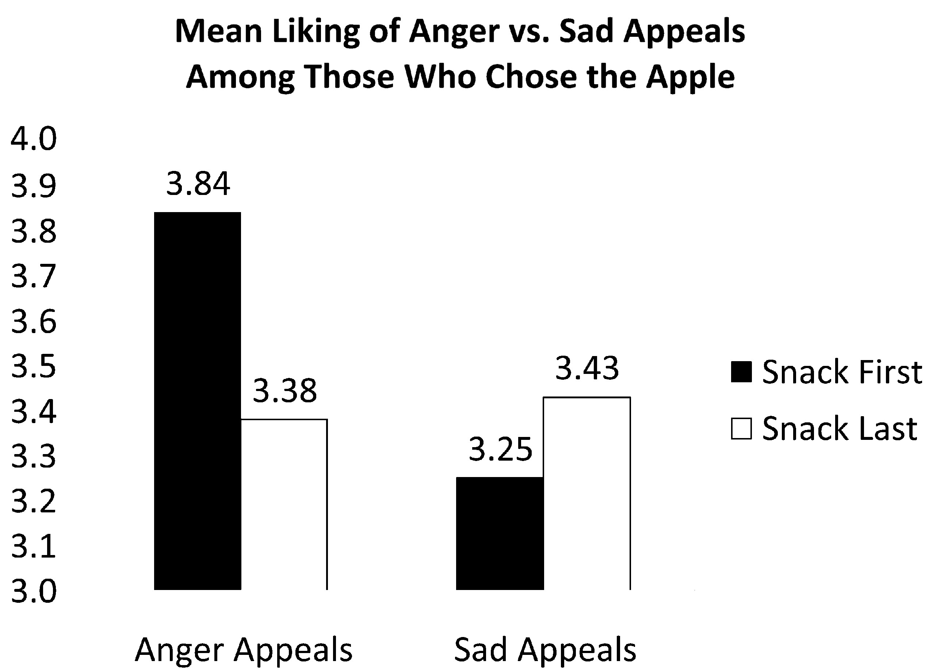
Figure 3. Endorsement of Anger- and Sadness-Framed Appeals Before versus After Choosing the Apple: Experiment 4
Notes:
Figure 3. Endorsement of Anger- and Sadness-Framed Appeals Before versus After Choosing the Apple: Experiment 4
Unless provided in the caption above, the following copyright applies to the content of this slide: © 2011 by Journal of Consumer Research, Inc.

