Slide 1
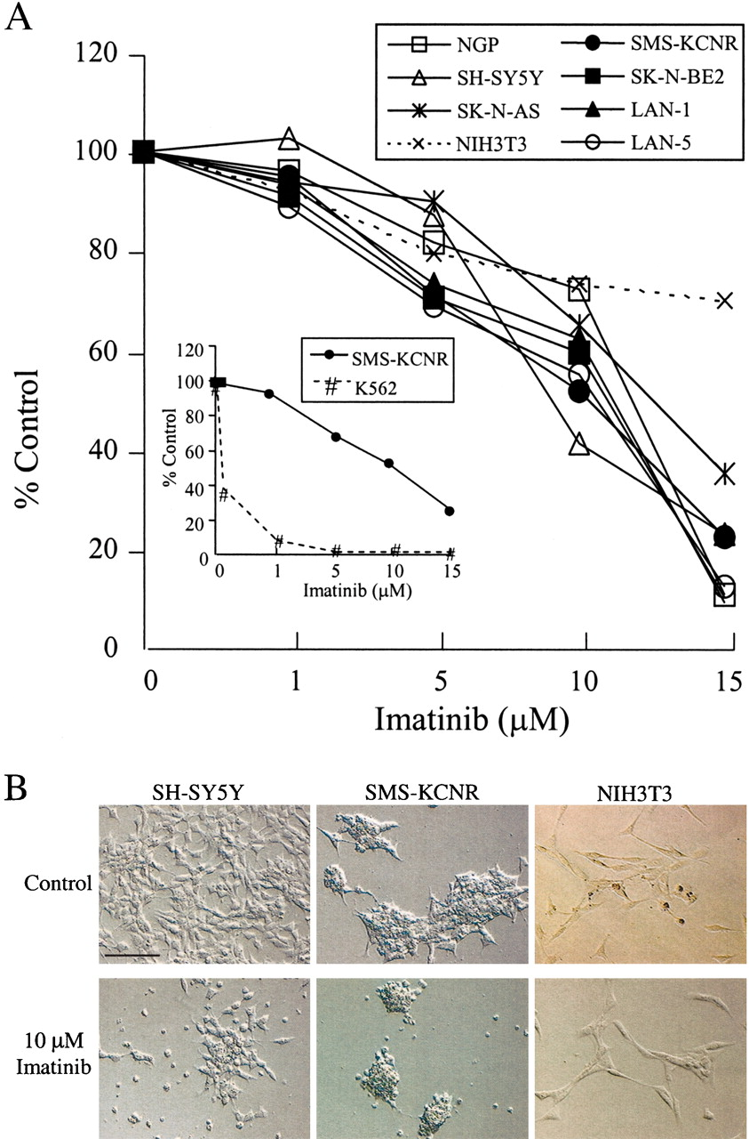
Fig. 1. Effect of imatinib on the growth of neuroblastoma cell lines. A) Dose-dependent inhibition of the growth of ...
Notes:
Fig. 1. Effect of imatinib on the growth of neuroblastoma cell lines. A) Dose-dependent inhibition of the growth of neuroblastoma cell lines by imatinib. Seven neuroblastoma cell lines (solid lines) and the control cell line NIH3T3 (dashed line) were plated at 1 × 105 cells per well on six-well plates and incubated for 4 days with imatinib at the indicated concentrations. Viable cells were counted by trypan blue exclusion and plotted as a percentage of the value obtained for medium-treated control neuroblastoma cells. Each point represents the mean value for each of the three wells. Similar results were obtained in three separate experiments. Inset: Human chronic myelogenous leukemia CCL-243 (K562) cells and human neuroblastoma SMS-KCNR cells were plated at 5 × 103 cells per well in a 96-well microtiter plate and incubated for 4 days with imatinib at the indicated concentrations. The 3-(4,5-dimethylthiazol-2-yl)-2,5-diphenyltetrazolium bromide (MTT) assay was used to assess relative cell numbers, which were plotted as a percentage of cells treated with control medium. Each point is the mean for six replicate wells and is representative of one of two independent experiments performed. B) Representative morphologic changes observed in SMS-KCNR, SH-SY5Y, and NIH3T3 cells after 4 days of treatment with 10 μM imatinib or media control (Control). Scale bar = 50 μm.
Unless provided in the caption above, the following copyright applies to the content of this slide: © Oxford University Press

Slide 2
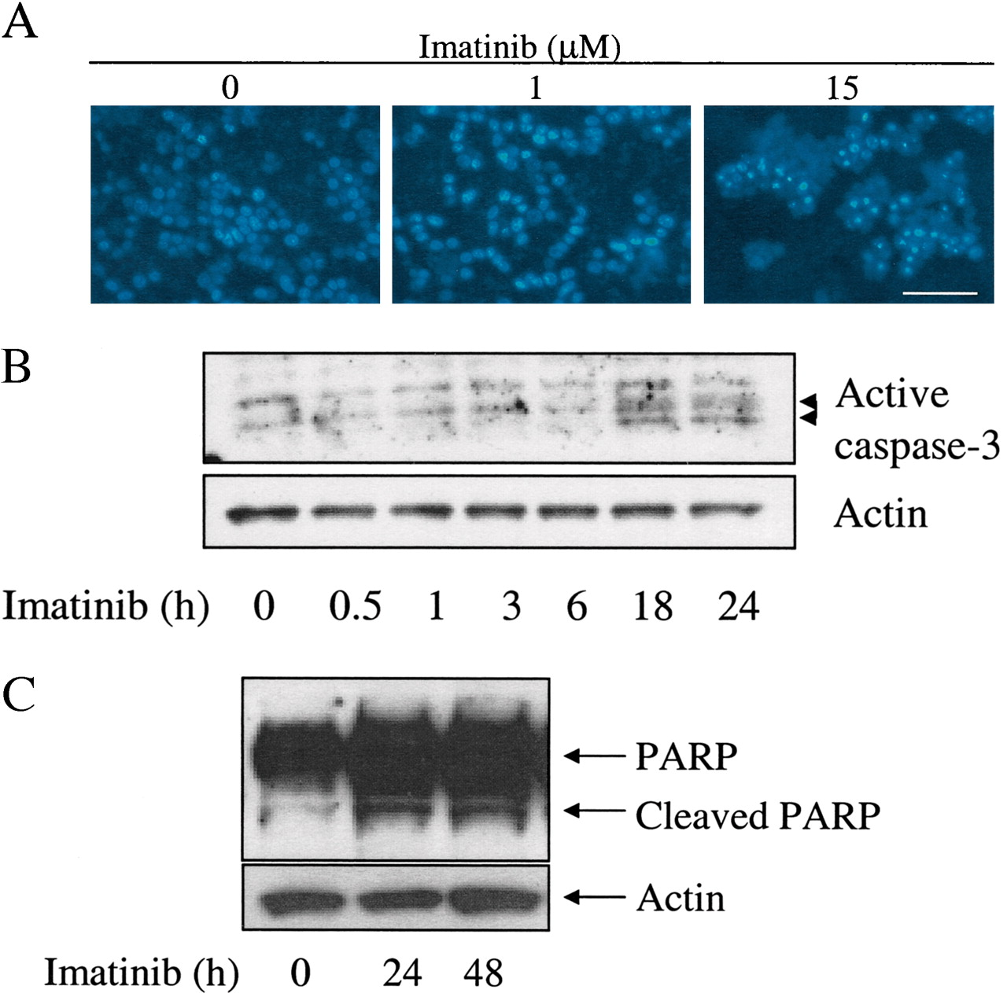
Fig. 2. Effect of imatinib on apoptosis in neuroblastoma cells. A) SMS-KCNR cells seeded on 96-well plates were ...
Notes:
Fig. 2. Effect of imatinib on apoptosis in neuroblastoma cells. A) SMS-KCNR cells seeded on 96-well plates were treated with media control (0 μM) or the indicated concentration of imatinib for 48 hours, stained with Hoechst 33342 for 30 minutes at 37 °C in the dark, and observed with a fluorescence microscope. Scale bar = 50 μm. B and C) SMS-KCNR cells (2 × 106) were plated on 100-mm dishes, treated with 15 μM imatinib for the indicated times, and then used to make protein lysates. The protein lysates were resolved by electrophoresis and immunoblotted with antibodies to caspase-3, poly(ADP-ribose)-polymerase (PARP), and actin. Active (i.e., cleaved) caspase-3 is indicated in B by the two arrows.
Unless provided in the caption above, the following copyright applies to the content of this slide: © Oxford University Press

Slide 3
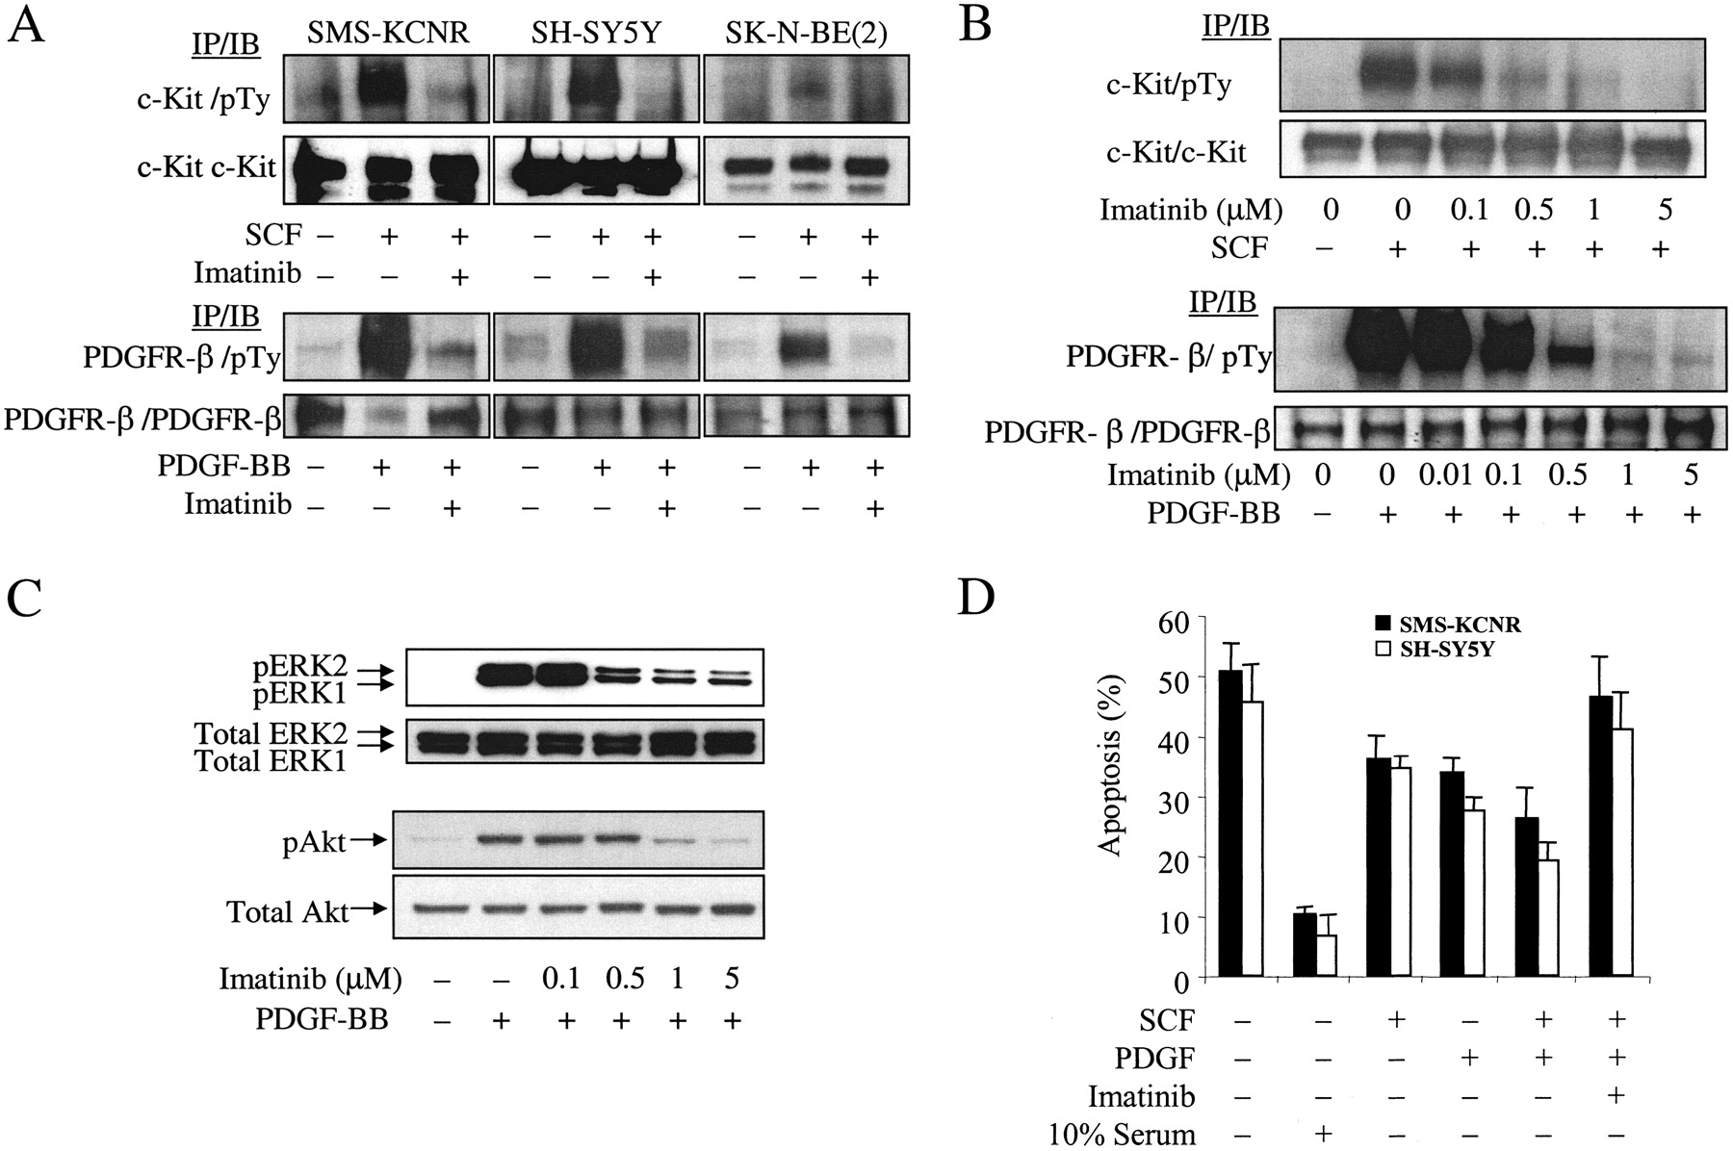
Fig. 3. Effect of imatinib on c-Kit and platelet-derived growth factor receptor (PDGFR) phosphorylation. A and B) ...
Notes:
Fig. 3. Effect of imatinib on c-Kit and platelet-derived growth factor receptor (PDGFR) phosphorylation. A and B) Neuroblastoma SMS-KCNR, SH-SY5Y, and SK-N-BE2 cells (2 × 106) were plated on 100-mm dishes, incubated for 24 hours in medium containing 10% fetal calf serum, and then incubated in medium containing 0.1% fetal calf serum for 6 hours (i.e., serum starvation conditions). The cells were then incubated for an additional 30 minutes in the absence (–) or presence (+) of imatinib at 1 μM (A) or at the indicated concentrations (B), followed by treatment with either SCF at 50 ng/mL, 50 ng/mL PDGF-BB, or media control for 5 minutes. Protein lysates were then prepared, and 1 mg of each lysate was immunoprecipitated (IP) with either anti-c-Kit antibody or anti-PDGFR-β antibody, resolved by sodium dodecyl sulfate–polyacrylamide gel electrophoresis, and immunoblotted (IB) with an anti-phospho-tyrosine antibody (pTy), an anti-c-Kit antibody, or an anti-PDGFR-β antibody. C) After serum starvation, cells were pre-incubated for 30 minutes with imatinib at the indicated concentrations or media control, followed by treatment with 50 ng/mL PDGF-BB for 5 minutes. Protein lysates were prepared, and 40 μg of each lysate was resolved by electrophoresis, transferred to membranes, and probed with the indicated antibodies. D) SMS-KCNR cells (solid bars) and SH-SY5Y cells (open bars) (1 × 106) were plated on 60-mm dishes. The medium was changed to 0.1% serum-containing medium for 24 hours, and the cells were pre-incubated for 30 minutes with either 1 μM imatinib (+) or medium (–) followed by treatment for 24 hours in medium containing 0.1% fetal bovine serum either alone or supplemented with SCF (50 ng/mL) or PDGF-BB (50 ng/mL). Cells were stained with propidium iodide and subjected to fluorescence-activated cell sorter analysis to quantify the percentage of apoptotic cells (i.e., those in the sub-G1 fraction). Each experimental point was performed in duplicate, and the experiment was performed twice. Data are presented as the mean value (n = 4), and error bars represent 95% confidence intervals.
Unless provided in the caption above, the following copyright applies to the content of this slide: © Oxford University Press

Slide 4
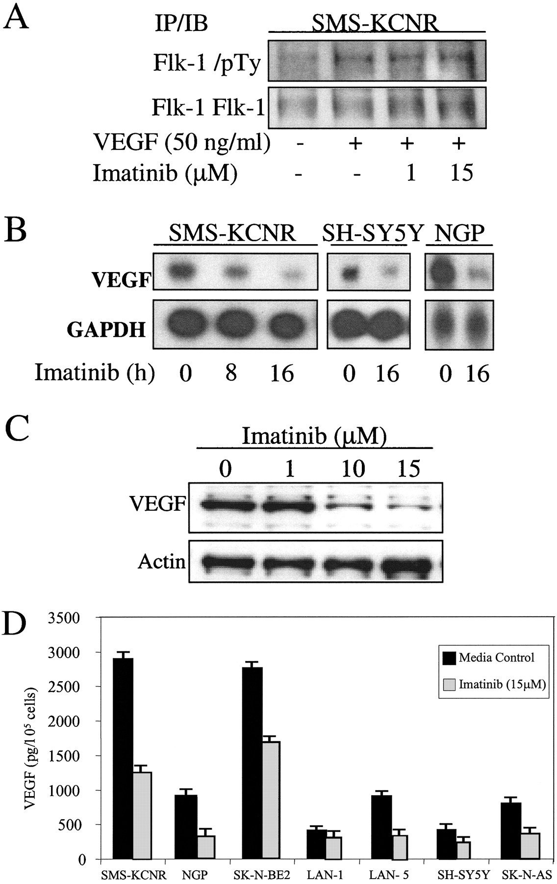
Fig. 4. Effect of imatinib on vascular endothelial growth factor (VEGF) expression in neuroblastoma cells. A) ...
Notes:
Fig. 4. Effect of imatinib on vascular endothelial growth factor (VEGF) expression in neuroblastoma cells. A) SMS-KCNR cells were pre-incubated for 30 minutes with 1 or 15 μM imatinib or medium (–), then incubated for 5 minutes in the presence (+) or absence (–) of 50 ng/mL VEGF. Protein lysates were prepared, and 1 mg of each lysate was immunoprecipitated (IP) with an anti-Flk-1 antibody and immunoblotted (IB) with an anti-phospho-tyrosine antibody (pTy) or an anti-Flk-1 antibody. B) SMS-KCNR, SH-SY5Y, and NGP cells were plated on 100-mm dishes in medium containing 10% fetal calf serum and treated with 15 μM imatinib for the indicated times. Total RNA was isolated, and 25 μg of each RNA sample was subjected to northern blot analysis to detect VEGF mRNA and glyceraldehyde-3-phosphate dehydrogenase (GAPDH) mRNA. C) SMS-KCNR cells (2 × 106) were plated on 100-mm dishes and incubated for 24 hours with the indicated concentrations of imatinib. Protein lysates were prepared, and 40 μg of each lysate was electrophoresed under nonreducing conditions and immunoblotted with an anti-VEGF antibody and an anti-actin antibody. D) Neuroblastoma cells (2 × 105) were plated on 12-well plates, treated for 24 hours with 15 μM imatinib (solid bars) or medium (shaded bars) in 10% serum-containing medium. The growth media were then collected from each well, and the concentration of VEGF in each medium was measured by an enzyme-linked immunosorbent assay. The number of viable cells in each well was determined by using the trypan blue dye exclusion assay.
Unless provided in the caption above, the following copyright applies to the content of this slide: © Oxford University Press

Slide 5
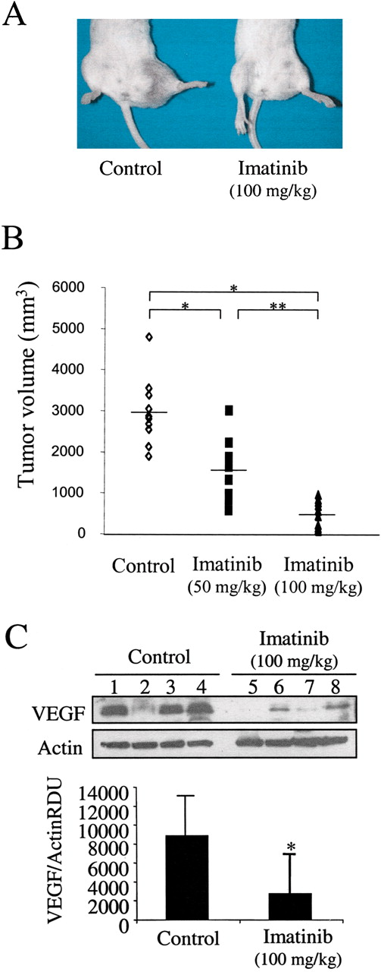
Fig. 5. Effect of imatinib on in vivo neuroblastoma tumor growth. Intramuscular xenografts were established in SCID ...
Notes:
Fig. 5. Effect of imatinib on in vivo neuroblastoma tumor growth. Intramuscular xenografts were established in SCID mice by injecting neuroblastoma SMS-KCNR cells. Seven days after the injection, mice received either imatinib at 100 mg/kg (n = 10), imatinib at 200 mg/kg (n = 10), or control vehicle (phosphate-buffered saline) alone (n = 10) by oral gavage every 12 hours for 14 days. Tumors volumes were determined on day 14 of treatment, and the tumors were excised and used to make protein lysates. This experiment was repeated twice. Results of a representative experiment are shown. A) Effect of imatinib at 100 mg/kg on the in vivo growth of neuroblastomas. B) A comparison of tumor volume among the three treatment groups. Representative data from two individual experiments are shown. The symbols represent the values determined for each animal receiving the indicated treatment, and the horizontal bars indicate the mean tumor volumes. *P<.001 and **P = .001; statistical significance was determined by one-way analysis of variance using a post-test Bonferroni comparison of groups (30). C) Upper panels: Protein lysates (40 μg) obtained from four randomly selected xenograft tumors were electrophoresed and immunoblotted sequentially with an anti-VEGF antibody and an anti-actin antibody. Lower panel: Band densities were quantified by computed image analysis using NIH Image software (40). The relative levels of VEGF protein expressed in the tumors were normalized to the relative level of actin expression in the samples, and the mean value for the ratios of four representative tumor samples from the control group or the group treated with imatinib at 100 mg/kg is expressed in relative densitometric units (RDU). Error bars correspond to 95% confidence intervals. *P = .028, Student's unpaired t test.
Unless provided in the caption above, the following copyright applies to the content of this slide: © Oxford University Press

