Slide 1
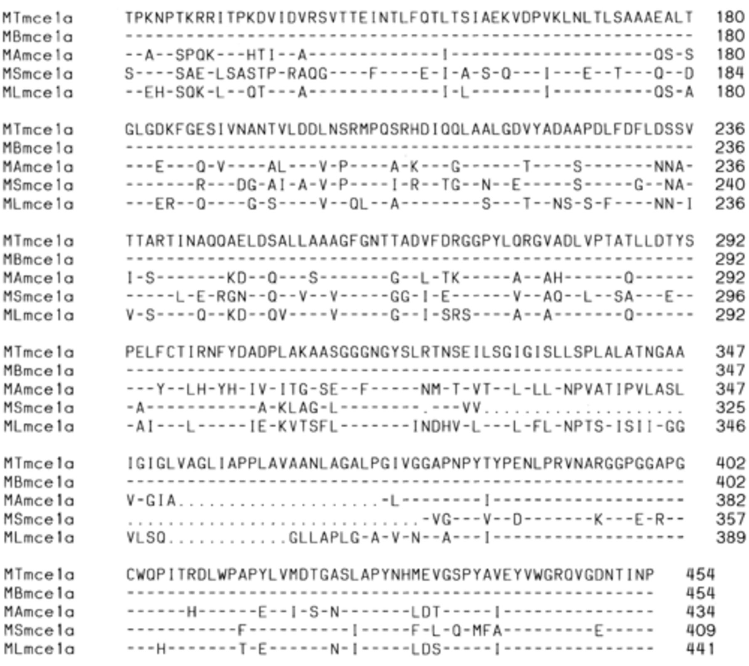
Figure 1 Alignment of the mycobacterial Mce1a proteins. Partial protein sequence starting at position 106 of M. ...
Notes:
Figure 1 Alignment of the mycobacterial Mce1a proteins. Partial protein sequence starting at position 106 of M. tuberculosis MTmce1a was aligned with the deduced sequences from M. bovis (MBmce1a), M. avium (MAmce1a), M. smegmatis (MSmce1a), and M. leprae (MLmce1a) using the Clustal method. Identical amino acids are indicated by a hyphen. Deleted regions are indicated by dots.
Unless provided in the caption above, the following copyright applies to the content of this slide: © 2002 Federation of European Microbiological Societies.

Slide 2
Figure 2 The primer set designed for the amplification of MTmce4a 379-bp PCR products was used to assess the presence ...
Notes:
Figure 2 The primer set designed for the amplification of MTmce4a 379-bp PCR products was used to assess the presence of mce4a gene from different mycobacterial species. Lane 1, molecular mass marker; lane 2, M. gastri; lane 3, M. interjectum; lane 4, M. szulgai; lane 5, M. celatum; lane 6, M. noncromogenicum; lane 7, M. confluentis; lane 8, M. gastri; lane 9, M. bovis; lane 10, M. simiae; lane 11, M. scrofulaceum; lane 12, M. xenopi; lane 13, M. avium; lane 14, M. mucogenicum; lane 15, M. obuense; lane 16, M. shimoidei; lane 17, M. szulgai; lane 18, M. terrae; lane 19, M. interjectum; lane 20, M. chelonae; lane 21, M. fortuitum; lane 22, M. fortuitum; lane 23, M. gordonae; lane 24, M. smegmatis; lane 25, M. tuberculosis, and lane 26, negative control.
Unless provided in the caption above, the following copyright applies to the content of this slide: © 2002 Federation of European Microbiological Societies.

Slide 3
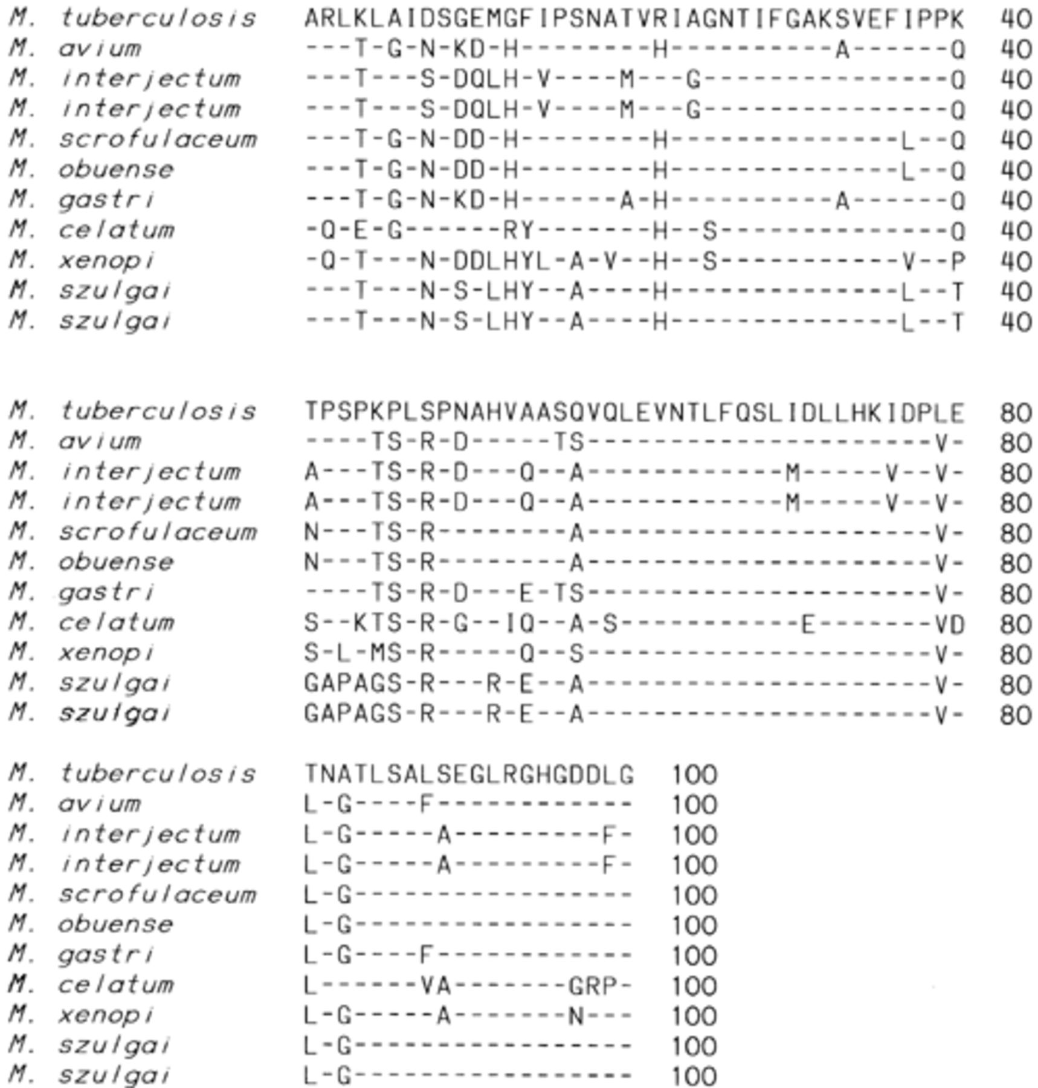
Figure 3 Amino acid sequences deduced from the mce4a gene segments of 10 strains representing eight mycobacterial ...
Notes:
Figure 3 Amino acid sequences deduced from the mce4a gene segments of 10 strains representing eight mycobacterial species aligned with M. tuberculosis mce1a partial protein sequence. Amino acids are noted only where different from those in M. tuberculosis; identical amino acids are shown by a hyphen.
Unless provided in the caption above, the following copyright applies to the content of this slide: © 2002 Federation of European Microbiological Societies.

Slide 4
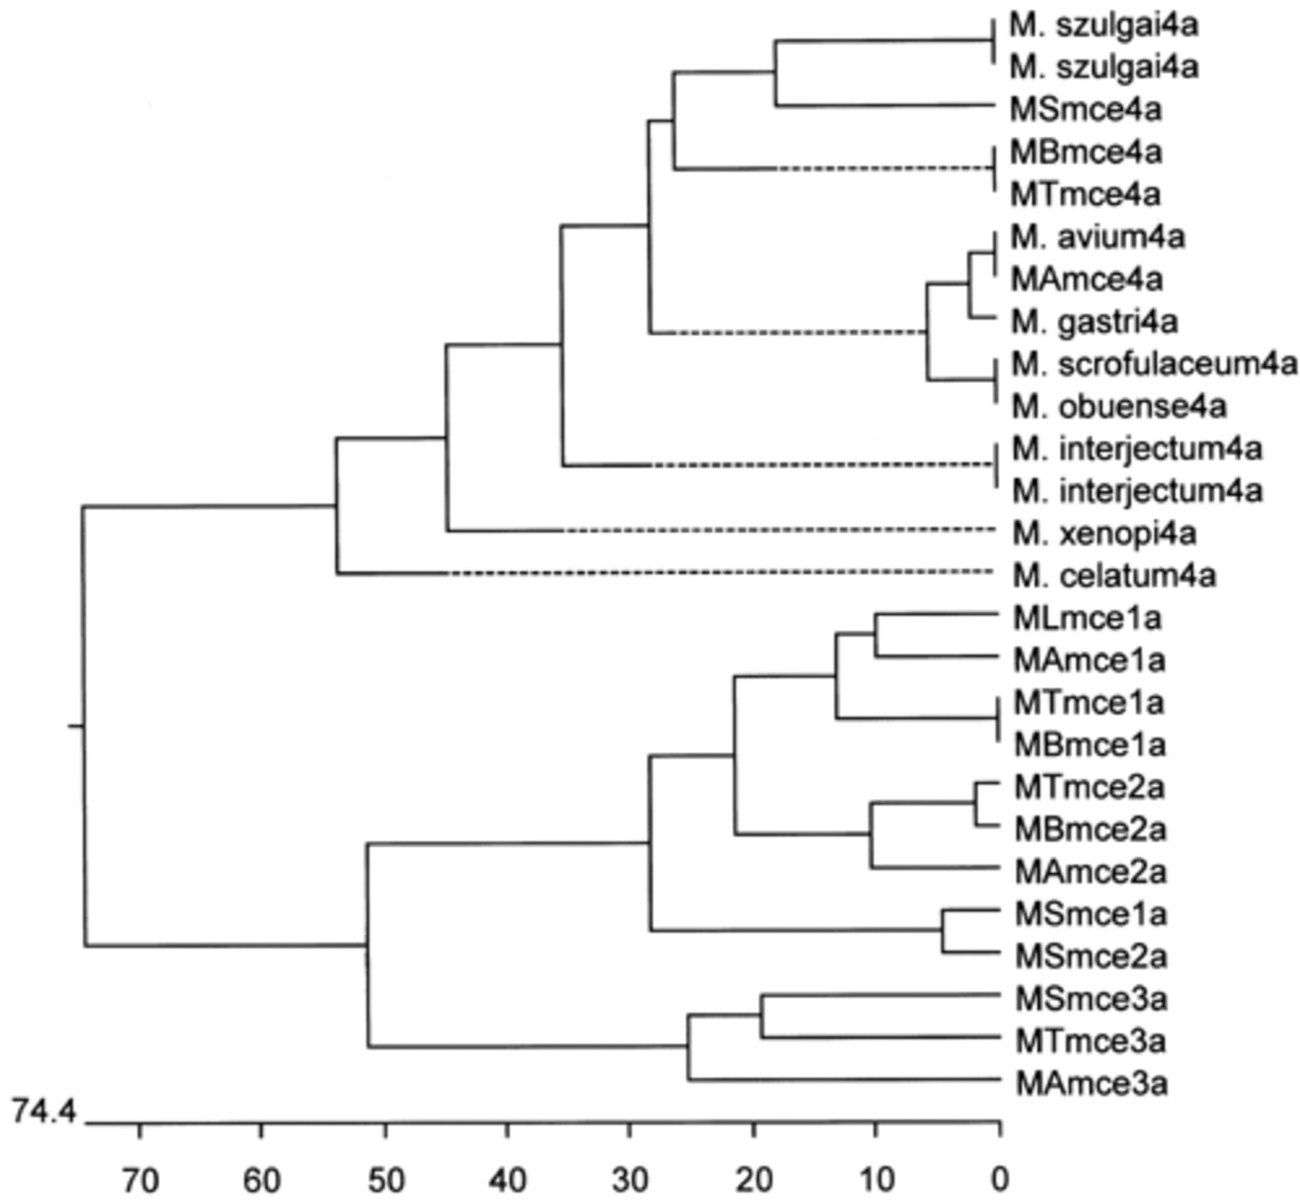
Figure 4 Relationships among the Mce proteins of different species of mycobacteria. Deduced sequences of mce4a PCR ...
Notes:
Figure 4 Relationships among the Mce proteins of different species of mycobacteria. Deduced sequences of mce4a PCR products from two strains of M. szulgai, M. interjectum, and one strain of M. avium, M. scrofulaceum, M. gastri, M. obuense, M. celatum and M. xenopi were aligned with the corresponding partial sequences of MTmce1a, MTmce2a, MTmce3a, MTmce4a, MBmce1a, MBmce2a, MBmce4a, MAmce1a, MAmce2a, MAmce3a, MAmce4a, MLmce1a, MSmce1a, MSmce3a and MSmce4a proteins. The partial sequences, delineated as MT, MA, MB, ML and MS were obtained from the Sanger Center for genomic sequences; http://www.sanger.ac.uk/l and Institute for genomic research; http://www.tigr.org. Divergence in amino acid sequences among various proteins is indicated below.
Unless provided in the caption above, the following copyright applies to the content of this slide: © 2002 Federation of European Microbiological Societies.

