Slide 1
1 Schematic process flux within the activated sludge tank and localization of the sampling sites. ...
Notes:
1 Schematic process flux within the activated sludge tank and localization of the sampling sites. Abbreviations: ISV, internal sludge flow; RSV, return sludge flow; 1–5, sampling sites.
Unless provided in the caption above, the following copyright applies to the content of this slide: © 1998 Federation of European Microbiological Societies. Published by Elsevier Science B.V.

Slide 2
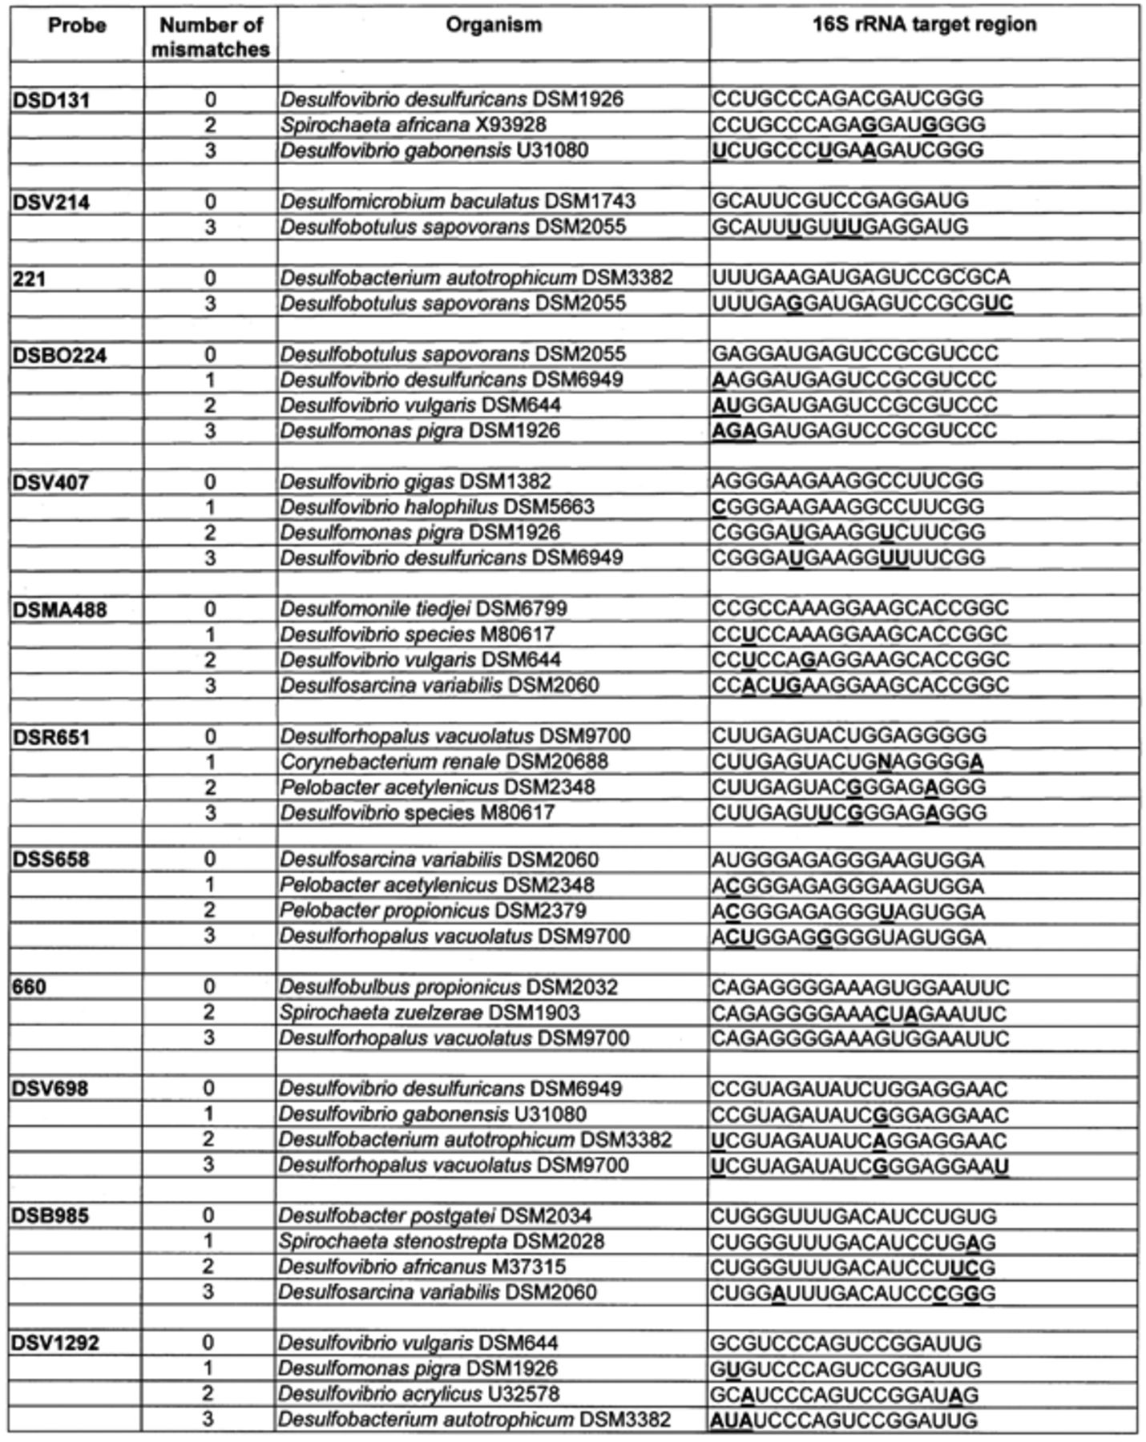
2 Difference alignments of the 16S rRNA target regions for the SRB-specific oligonucleotides. Indicated are the ...
Notes:
2 Difference alignments of the 16S rRNA target regions for the SRB-specific oligonucleotides. Indicated are the sequences for the respective target (0 mismatch) and non-target species (1–3 mismatches). Positions that differ from the homologous sequence are underlined in bold type.
Unless provided in the caption above, the following copyright applies to the content of this slide: © 1998 Federation of European Microbiological Societies. Published by Elsevier Science B.V.

Slide 3
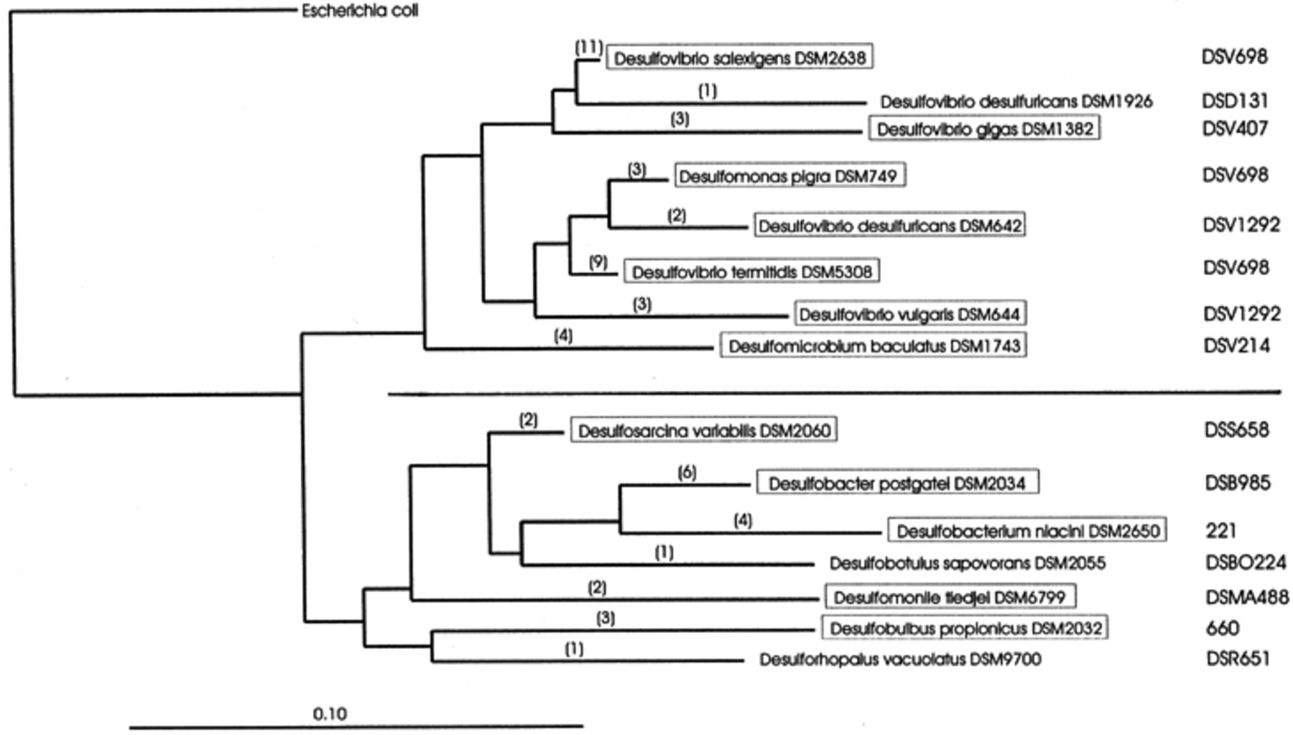
3 16S rRNA based schematic phylogenetic tree reflecting the relationships of SRB within the Desulfovibrionaceae ...
Notes:
3 16S rRNA based schematic phylogenetic tree reflecting the relationships of SRB within the Desulfovibrionaceae (upper branch) and Desulfobacteriaceae (lower branch) and the lineages targeted by the respective oligonucleotides. For each lineage one representative strain is indicated, numbers in brackets give the SRB encompassed by the respective probe. The scale bar corresponds to 0.1 substitutions per nucleotide position.
Unless provided in the caption above, the following copyright applies to the content of this slide: © 1998 Federation of European Microbiological Societies. Published by Elsevier Science B.V.

Slide 4
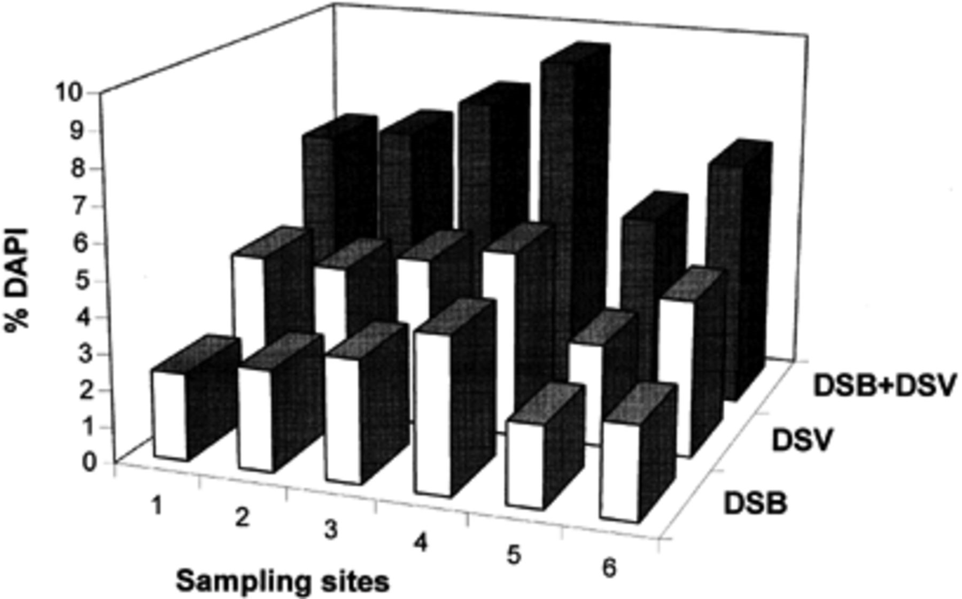
4 In situ distribution and abundance of members of the families Desulfobacteriaceae and Desulfovibrionaceae ...
Notes:
4 In situ distribution and abundance of members of the families Desulfobacteriaceae and Desulfovibrionaceae within the activated sludge process. In situ cell counts obtained with the specific probes were standardized over total cell counts, determined by DAPI-staining. DSB: total of specific counts obtained with probes DSBO224, DSMA488, DSR651, DSS658 and DSB985. DSV: total of specific counts obtained with probes DSD131, DSV214, DSV407, DSV698 and DSV1292.
Unless provided in the caption above, the following copyright applies to the content of this slide: © 1998 Federation of European Microbiological Societies. Published by Elsevier Science B.V.

Slide 5
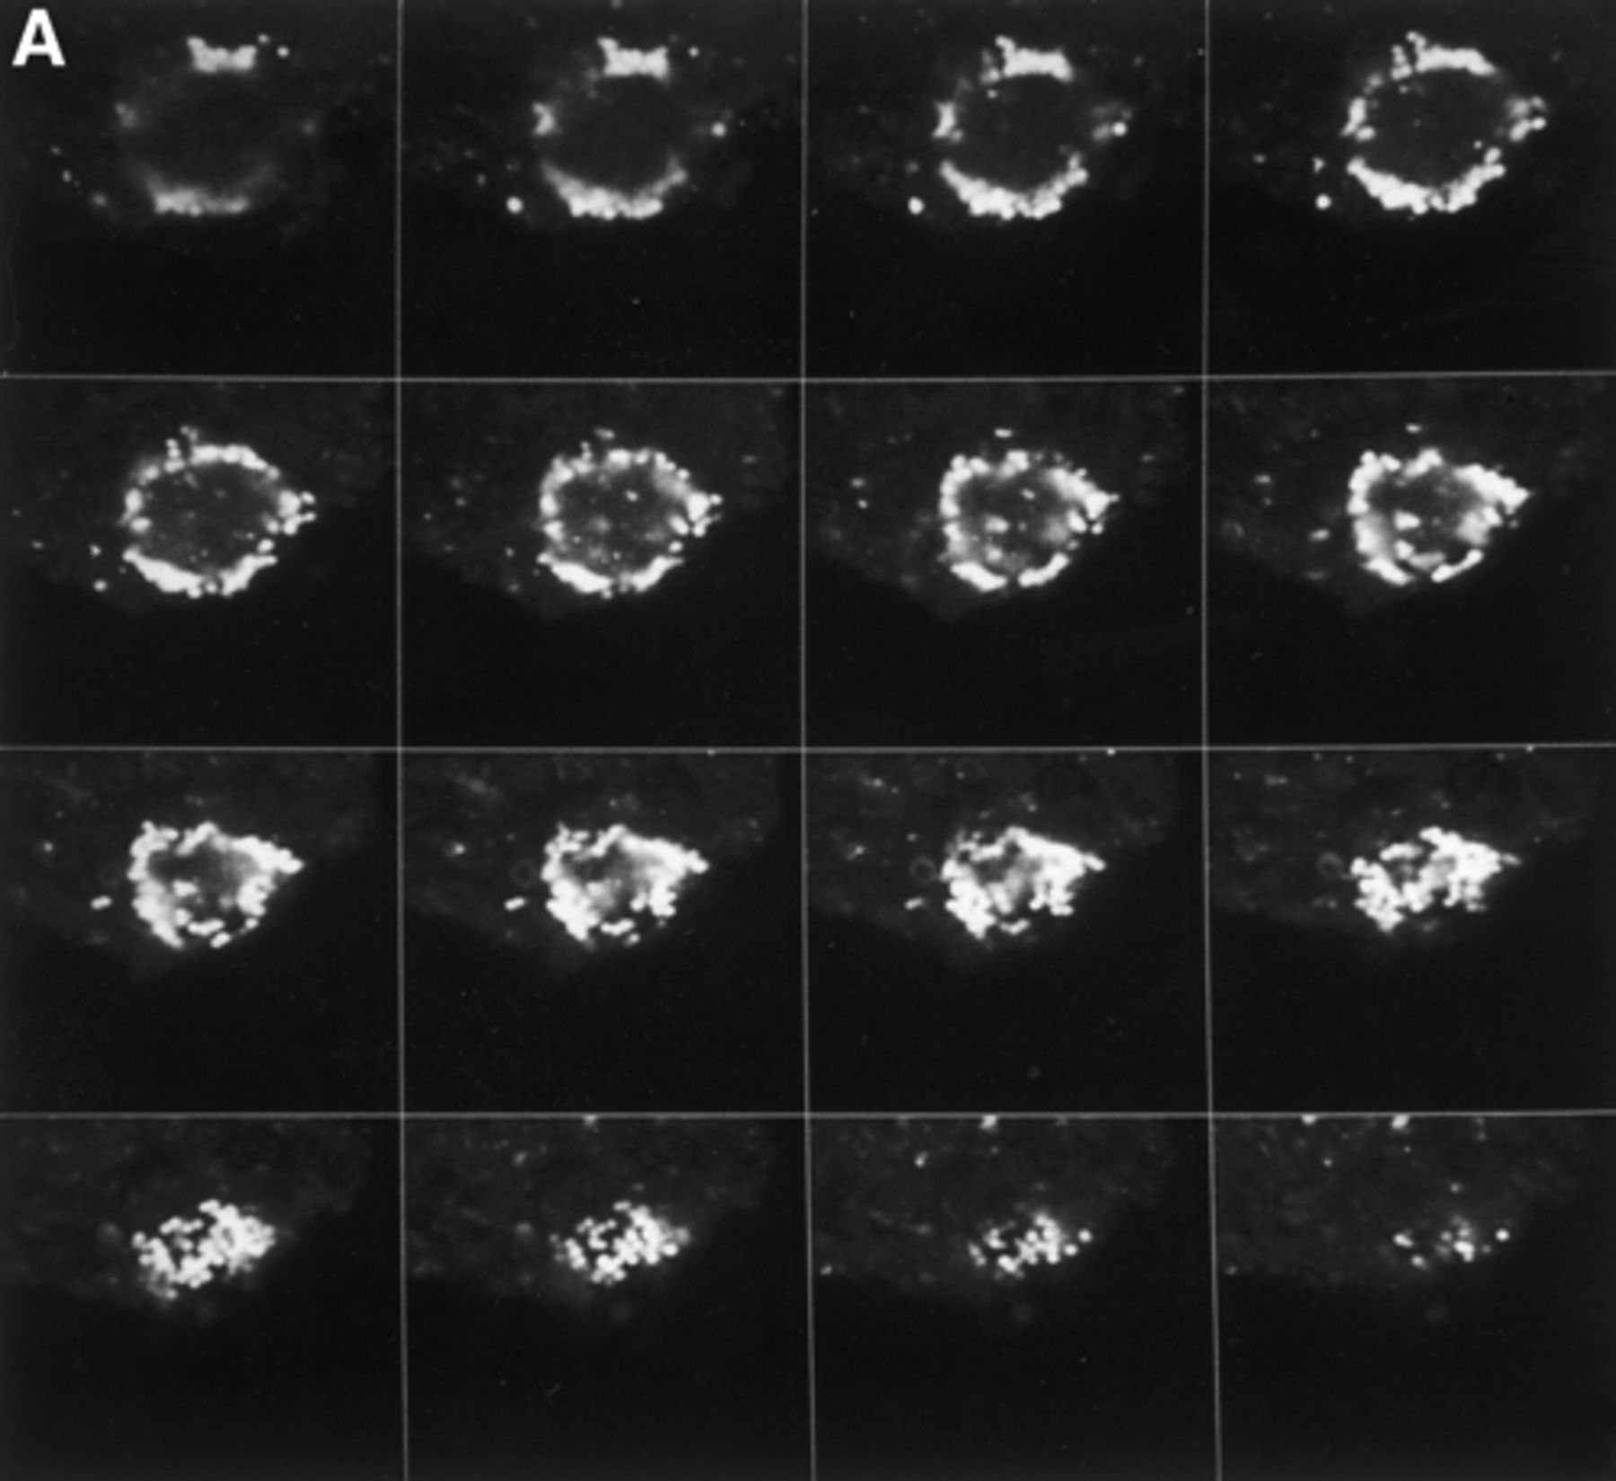
5 CLSM micrographs of activated sludge flocs after in situ hybridizations with CY3-labelled SRB probes. ...
Notes:
5 CLSM micrographs of activated sludge flocs after in situ hybridizations with CY3-labelled SRB probes. Confocal sections were scanned along optical XY axis with increments of 0.5 μm. A: Gallery of 16 optical sections scanned in distances of 0.5 μm representing the spatial distribution of Desulfobacteriaceae around the solid core of an activated sludge floc after hybridization with Cy3-labelled probe DSS658. B: Transparent projection of all 24 confocal sections scanned in distances of 0.5 μm resulting in an extended focus image of the microcolony of cells strongly hybridizing with probe DSS658 within the activated sludge floc. C: Transparent projection of confocal sections after hybridization with probes DSV698 and DSV1292 reflecting the disperse arrangement of Desulfovibrionaceae within the activated sludge floc. All photomicrographs were done at a magnification of ×1000, bar=10 μm.
Unless provided in the caption above, the following copyright applies to the content of this slide: © 1998 Federation of European Microbiological Societies. Published by Elsevier Science B.V.

