Slide 1
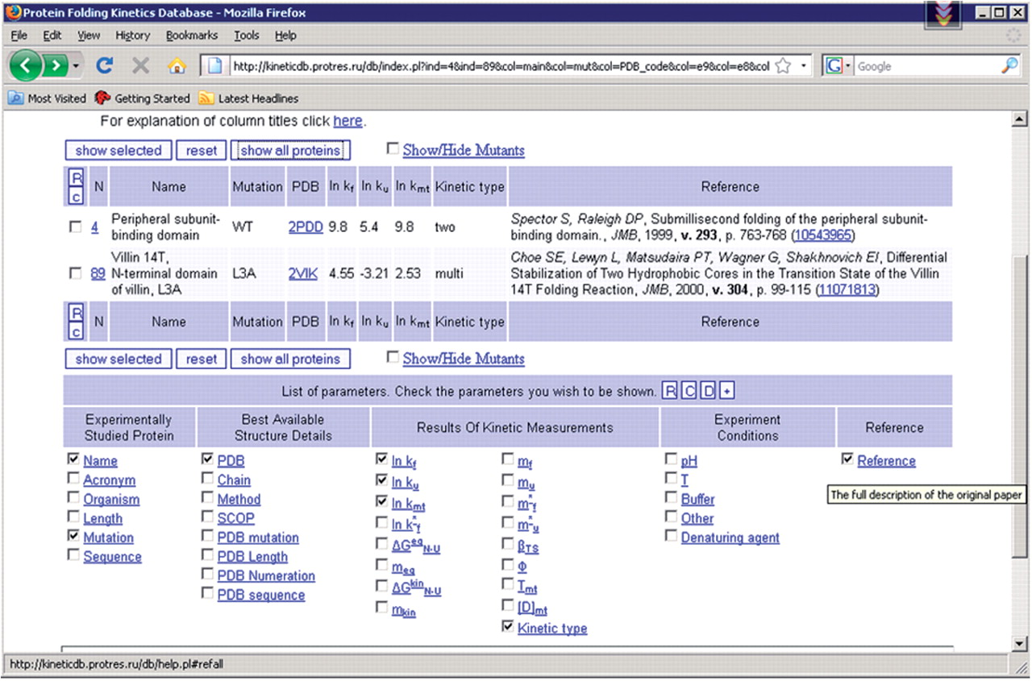
Figure 1. Screenshot of the central part of the page with the list of proteins. There is the menu for displaying ...
Notes:
Figure 1. Screenshot of the central part of the page with the list of proteins. There is the menu for displaying different parameters as well as the table with protein folding kinetics measurements.
Unless provided in the caption above, the following copyright applies to the content of this slide: © 2008 The Author(s)This is an Open Access article distributed under the terms of the Creative Commons Attribution Non-Commercial License (http://creativecommons.org/licenses/by-nc/2.0/uk/) which permits unrestricted non-commercial use, distribution, and reproduction in any medium, provided the original work is properly cited.

Slide 2
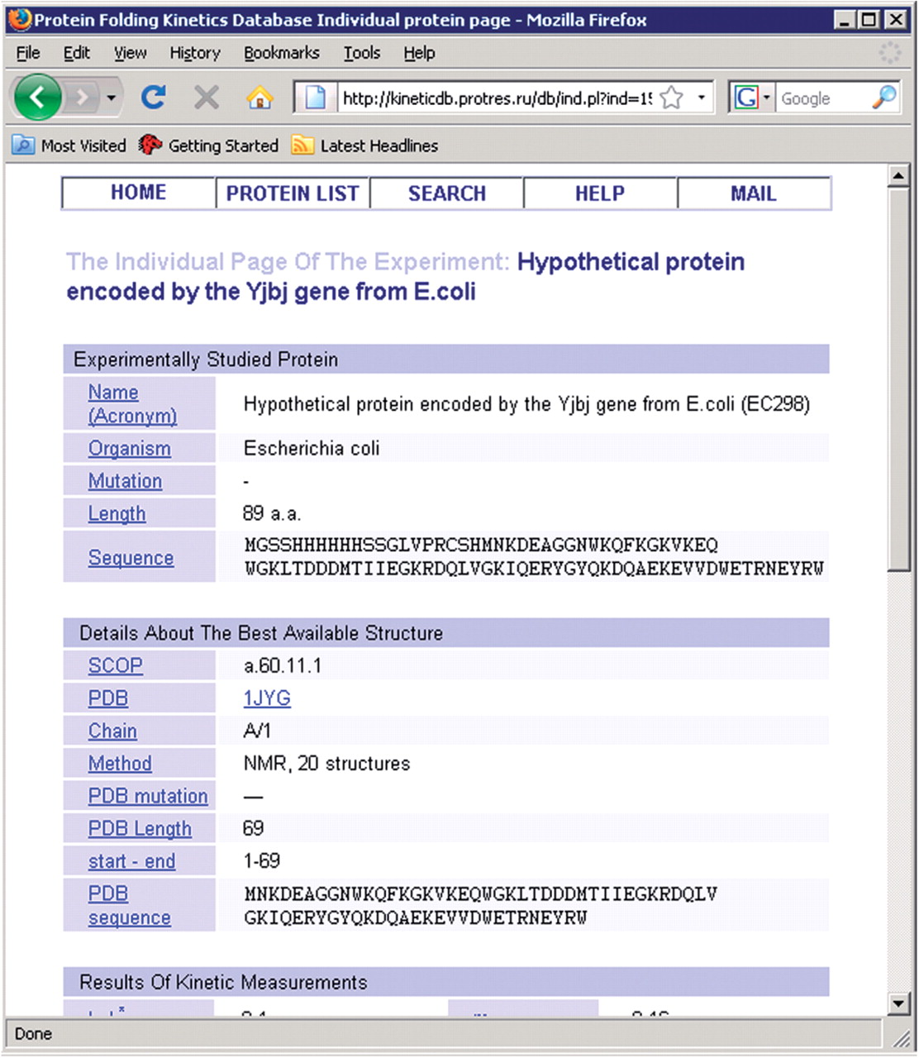
Figure 2. Screenshot of part of an individual page with an example of protein folding kinetic measurement.
Notes:
Figure 2. Screenshot of part of an individual page with an example of protein folding kinetic measurement.
Unless provided in the caption above, the following copyright applies to the content of this slide: © 2008 The Author(s)This is an Open Access article distributed under the terms of the Creative Commons Attribution Non-Commercial License (http://creativecommons.org/licenses/by-nc/2.0/uk/) which permits unrestricted non-commercial use, distribution, and reproduction in any medium, provided the original work is properly cited.

