Slide 1
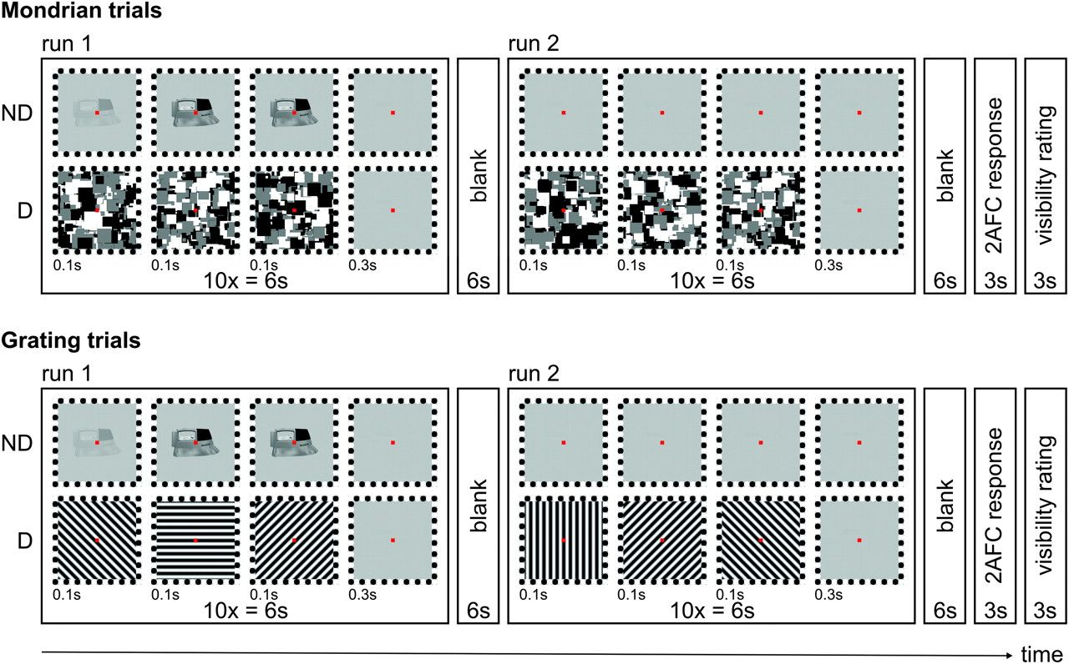
Figure 1. The CFS paradigm. Images of tools were presented to subjects’ nondominant eye (ND) using polarizing filters ...
Notes:
Figure 1. The CFS paradigm. Images of tools were presented to subjects’ nondominant eye (ND) using polarizing filters and glasses, while Mondrian masks (upper panel) or grating masks (lower panel) were presented to the dominant eye (D). Tool stimuli were either presented in the first or second run of 6 s each. After each trial, subjects were asked to make a forced-choice guess (2AFC) in which run they had detected the tool and rate the visibility of the target stimulus on a 3-point scale (1 = nothing detected, 2 = tool parts, 3 = whole tool).
Unless provided in the caption above, the following copyright applies to the content of this slide: © The Author 2011. Published by Oxford University Press. All rights reserved. For permissions, please e-mail: journals.permissions@oup.com

Slide 2
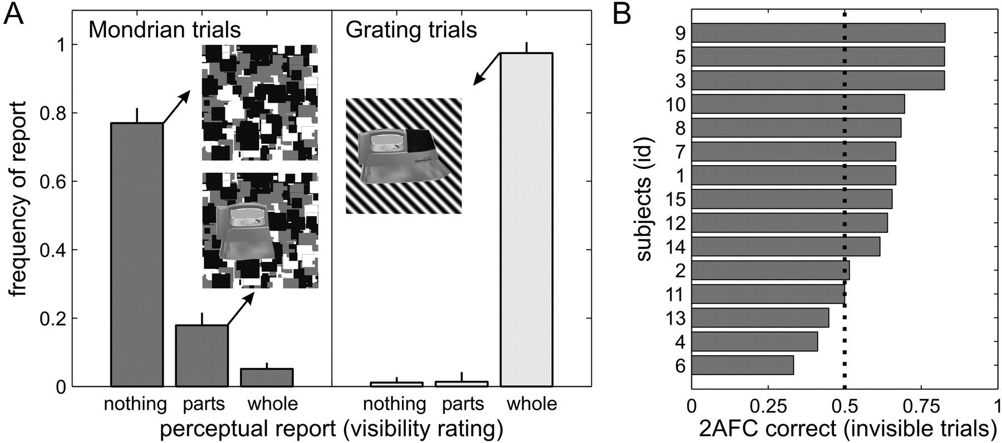
Figure 2. Behavioral results. (A) Results of subjective visibility ratings. In the Mondrian condition, subjects ...
Notes:
Figure 2. Behavioral results. (A) Results of subjective visibility ratings. In the Mondrian condition, subjects reported that they had not detected any tool stimulus in 77% of trials. Reports of tool parts and fully visible tools were less frequent (18% and 5%). In trials with sinusoidal gratings, subjects primarily reported perceiving the whole tool stimulus (98%), while the other visibility ratings were rare (1% each). Insets represent the 3 perceptual states analyzed in this study: “tools invisible” and “tool parts visible” in Mondrian trials (on the left), “tools visible” in grating trials (on the right). (B) Correct 2AFC performance in invisible tool trials (Mondrian masks) across all subjects. The dotted line represents 2AFC chance level (50%).
Unless provided in the caption above, the following copyright applies to the content of this slide: © The Author 2011. Published by Oxford University Press. All rights reserved. For permissions, please e-mail: journals.permissions@oup.com

Slide 3
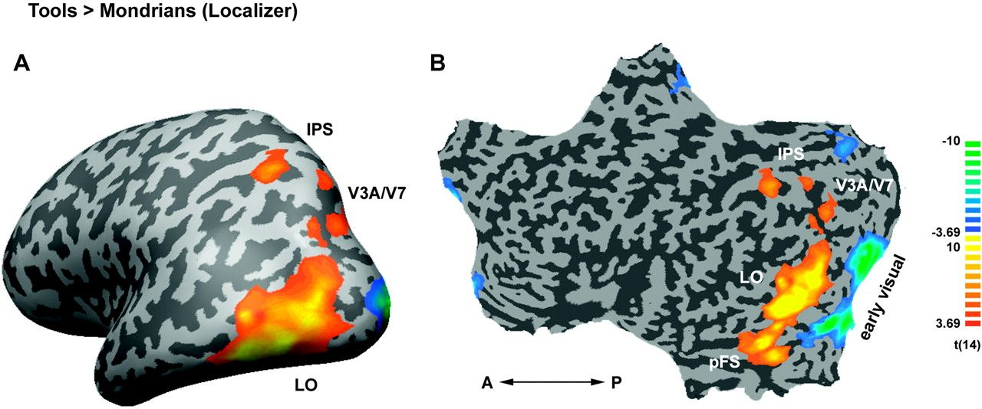
Figure 3. Multisubject fMRI results of the localizer experiment (N = 15). Tool-sensitive areas are projected on an ...
Notes:
Figure 3. Multisubject fMRI results of the localizer experiment (N = 15). Tool-sensitive areas are projected on an inflated (A) and flattened (B) left brain hemisphere of a single subject. The statistical group map is based on the localizer experiment and was obtained by mapping the contrast Tools > Mondrians at P < 0.05 (FDR corrected). ROI were identified individually for each subject in the ventral stream (LO, pFS), in the dorsal stream (IPS, V3A/V7) and in early visual cortex. Note that early visual cortex showed preferential activation to the Mondrian mask (A = anterior, P = posterior).
Unless provided in the caption above, the following copyright applies to the content of this slide: © The Author 2011. Published by Oxford University Press. All rights reserved. For permissions, please e-mail: journals.permissions@oup.com

Slide 4
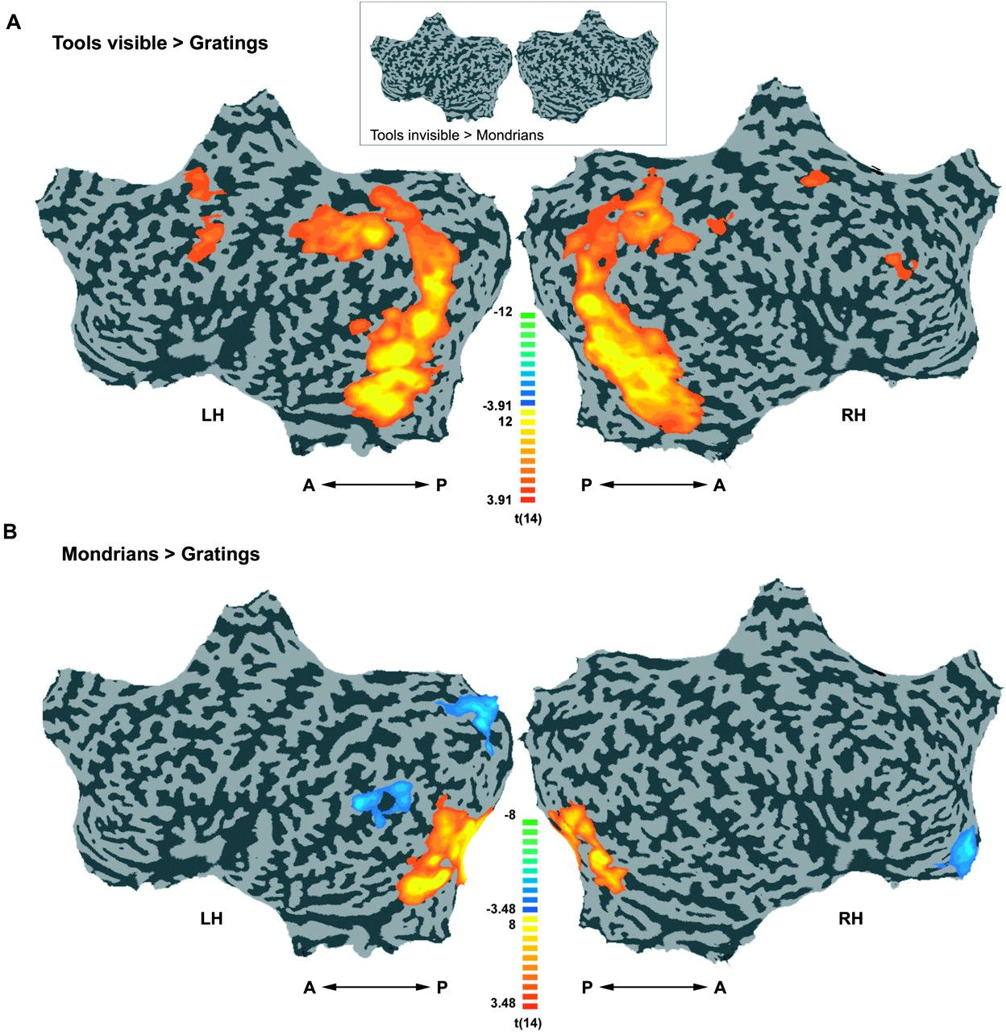
Figure 4. Multisubject fMRI activation (N = 15). (A) Flattened cortical surface maps for the left and right hemisphere ...
Notes:
Figure 4. Multisubject fMRI activation (N = 15). (A) Flattened cortical surface maps for the left and right hemisphere depicting preferential activation to tool stimuli in the visible condition (contrast “Tools visible > Gratings”, P Mondrians,” P < 0.05, FDR corrected). At this statistical threshold, and also at a more lenient threshold (P Gratings”, P < 0.05, FDR corrected). Significant differences were restricted to voxels in early visual cortex (A = anterior, P = posterior).
Unless provided in the caption above, the following copyright applies to the content of this slide: © The Author 2011. Published by Oxford University Press. All rights reserved. For permissions, please e-mail: journals.permissions@oup.com

Slide 5
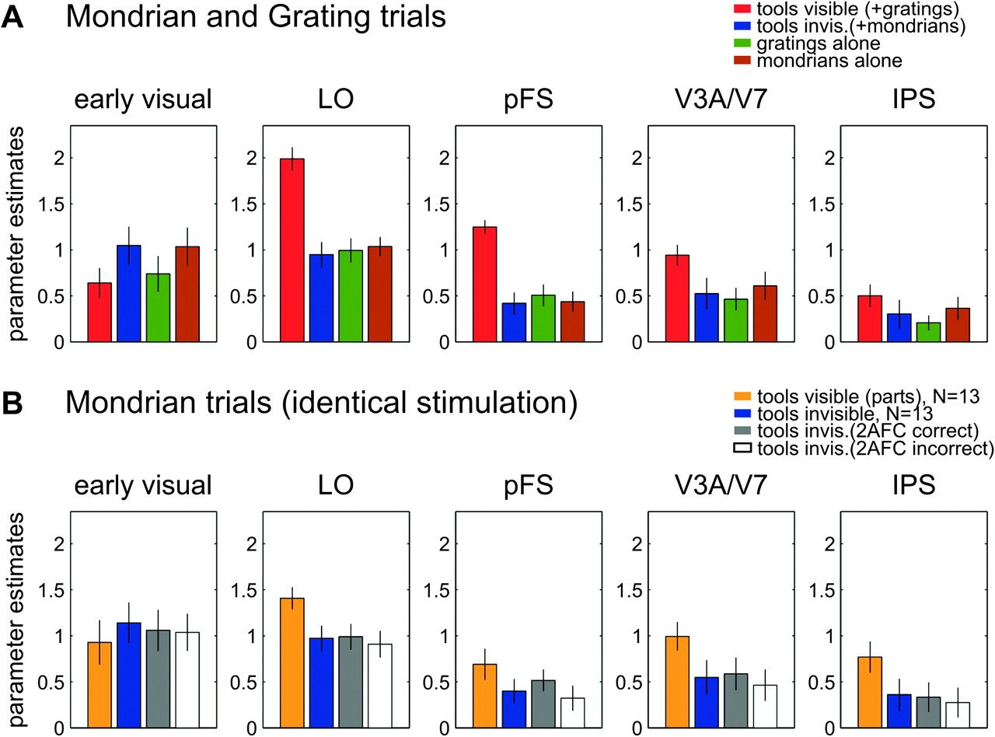
Figure 5. Results from the ROI analysis. Data from small ROIs are shown (between 27 and 36 functional voxels). (A) ...
Notes:
Figure 5. Results from the ROI analysis. Data from small ROIs are shown (between 27 and 36 functional voxels). (A) Results of the first analysis: comparing invisible and visible conditions in Mondrian and grating mask trials. Red bars represent parameter estimates for “tools visible” trials (tools + gratings); blue bars: “tools invisible” trials (tools + Mondrians); green bars: sinusoidal gratings alone; brown bars: Mondrian stimuli alone. (B) Results of the second analysis: comparing invisible and visible (tool parts) conditions in identical Mondrian mask trials. Orange bars represent parameter estimates for “tool parts visible” trials (N = 13); blue bars: “tools invisible” trials (N = 13); gray bars: “tools invisible” trials with correct 2AFC response (N = 15); white bars: “tools invisible” trials with false 2AFC response (N = 15). Error bars represent ± standard error of the mean. ROI: LO = lateral occipital area, pFS = posterior fusiform gyrus, IPS = intra-parietal sulcus.
Unless provided in the caption above, the following copyright applies to the content of this slide: © The Author 2011. Published by Oxford University Press. All rights reserved. For permissions, please e-mail: journals.permissions@oup.com

