Slide 1
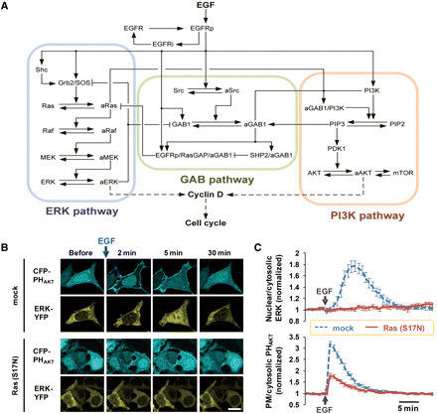
Figure 1 The reconstruction of the ERK and PI3K signaling network and experimental validation. (A) The scheme of ...
Notes:
Figure 1 The reconstruction of the ERK and PI3K signaling network and experimental validation. (A) The scheme of combined signaling network of Ras-Raf-MEK-ERK and PI3K-Akt pathways. The reactions are described in Section IV of Supplementary material. (B) After EGF (10 nM) stimulation, CFP-PHAkt and ERK-YFP are translocated to the plasma membrane and nucleus, respectively. This translocation of CFP-PHAkt and ERK-YFP is remarkably decreased or completely blocked, respectively, in the cells expressing Ras (S17N). Scale bar represents 20 µm. (C) Quantitative measurement of the ratio of nuclear to cytosolic ERK and plasma membrane to cytosolic PHAkt (normalized to the initial value) in B. Data represent the mean ± SEM (n> 10).
Unless provided in the caption above, the following copyright applies to the content of this slide: © The Author (2012). Published by Oxford University Press on behalf of Journal of Molecular Cell Biology, IBCB, SIBS, CAS. All rights reserved

Slide 2
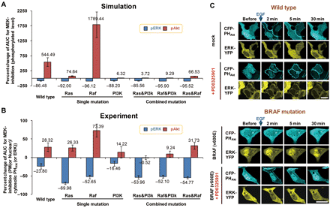
Figure 2 MEK inhibition causes the sustained PI3K activation. (A) A percent change in AUC for MEK inhibitor, which is ...
Notes:
Figure 2 MEK inhibition causes the sustained PI3K activation. (A) A percent change in AUC for MEK inhibitor, which is defined as the difference between the AUCs of the phospho-Akt (or phospho-ERK) before and after MEK inhibitor treatment normalized with respect to the AUC of the phospho-Akt (or phospho-ERK, respectively) before MEK inhibitor treatment. AUC was calculated using the time course data of the phospho-ERK and -Akt shown in Supplementary Figures S4B (single mutation cases) and Supplementary Data (combined mutation cases). Data represent the means of repetitive simulation trials (n= 30) with 30% random perturbation of parameter values. Each error bar indicates the standard error. The blue bar (the negative values) indicates the phospho-ERK level and the red bar (the positive values) indicates the phospho-Akt level. (B) The percent change in AUC for MEK inhibitor treatment (Experiment). AUC was calculated using the time course data of the phospho-ERK and -Akt shown in Supplementary Figures S4B (single mutation cases) and S5B (combined mutation cases). Experimental measurements denote the ratio of nuclear to cytosolic ERK and the ratio of plasma membrane to cytosolic PHAkt, after 30 min from EGF (10 nM) stimulation. Data represent the mean ± SEM (n> 10). (C) After EGF (10 nM) stimulation, the translocation of CFP-PHAkt is sustained in the cells pre-incubated with PD0325901 (50 nM) for 30 min. The expression of BRAF (V600E) inhibits EGF (10 nM) induced translocation of CFP-PHAkt and it is released by pre-incubation of PD0325901 (50 nM) for 30 min. Scale bar represents 20 μm.
Unless provided in the caption above, the following copyright applies to the content of this slide: © The Author (2012). Published by Oxford University Press on behalf of Journal of Molecular Cell Biology, IBCB, SIBS, CAS. All rights reserved

Slide 3
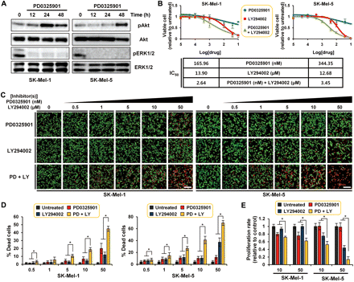
Figure 3 Combined blockage of PI3K-Akt activation shows the synergistic effects suggesting the role of PI3K pathway ...
Notes:
Figure 3 Combined blockage of PI3K-Akt activation shows the synergistic effects suggesting the role of PI3K pathway for the resistance to MEK inhibitor in BRAF-mutant melanoma cells. (A) Western blotting analysis of SK-Mel-1 and SK-Mel-5 following the treatment with PD0325901 (50 nM). Time point is indicated above the phospho-Akt. (B) SK-Mel-1 and SK-Mel-5 cells were treated with the indicated concentrations for 48 h and cell viability was determined. Cell viability is shown relative to the untreated control. The IC50 for PD0325901 or LY294002 alone and in combination are shown in a tabular form. (C) Live/dead assays of SK-Mel-1 or SK-Mel-5 cells treated with the indicated concentrations of PD0325901 or LY294002 alone or in combination for 48 h. The cells were double stained with Calcein AM and ethidium homodimer-1 (EthD-1). The Calcein AM and EthD-1 mixture show live cells in green and dead cells in red, respectively. Scale bar represents 20 µm. (D) Quantitative measurements of dead cell percentage. Data represent the mean ± SD (n> 10, at least >2000 cells were counted). *P 10). *P< 0.001.
Unless provided in the caption above, the following copyright applies to the content of this slide: © The Author (2012). Published by Oxford University Press on behalf of Journal of Molecular Cell Biology, IBCB, SIBS, CAS. All rights reserved

Slide 4
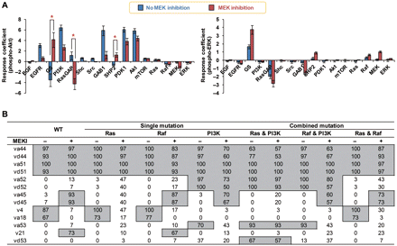
Figure 4 Biochemical control analysis. (A) RCA (WT case). Data represent the means of repetitive simulation trials (n= ...
Notes:
Figure 4 Biochemical control analysis. (A) RCA (WT case). Data represent the means of repetitive simulation trials (n= 30) with 30% random perturbation of parameter values. Each error bar indicates the standard error. The blue bar indicates the response coefficient in the absence of the MEK inhibitor and the red bar in the presence of the MEK inhibitor. Asterisk indicates the change in the functional effect before and after MEK inhibitor treatment. (B) CCA. Data represent the frequency (i.e. how many times the selected process is ranked in top 10% of each CCA). For instance, va44 was ranked in top 10% for 29 times over 30 CCAs, so it has the value of 97. Data were obtained by repetitive CCAs (n= 30) over 20% random perturbation of parameter values.
Unless provided in the caption above, the following copyright applies to the content of this slide: © The Author (2012). Published by Oxford University Press on behalf of Journal of Molecular Cell Biology, IBCB, SIBS, CAS. All rights reserved

Slide 5
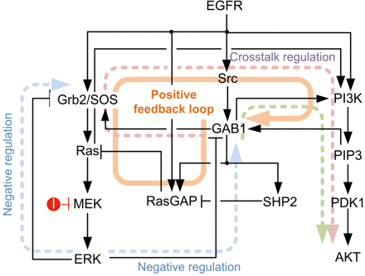
Figure 5 The reorganization of signal flux evoked by the MEK inhibitor treatment. Sandy brown-colored line indicates ...
Notes:
Figure 5 The reorganization of signal flux evoked by the MEK inhibitor treatment. Sandy brown-colored line indicates the newly activated route of EGF signal in response to MEK inhibition, which leads to the sustained activation of Akt. Light blue-colored line denotes the negative feedback loops which are disrupted by MEK inhibitor and light green-colored line shows the nominal route of Akt activation.
Unless provided in the caption above, the following copyright applies to the content of this slide: © The Author (2012). Published by Oxford University Press on behalf of Journal of Molecular Cell Biology, IBCB, SIBS, CAS. All rights reserved

Slide 6
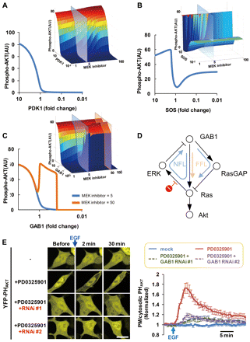
Figure 6 Steady-state response curves of pAkt amplitude for different concentration levels of other major molecules ...
Notes:
Figure 6 Steady-state response curves of pAkt amplitude for different concentration levels of other major molecules under MEK inhibition. (A–C) The steady-state level change of pAkt amplitude along with the concentration of PDK1 (A), SOS (B), GAB1 (C) respectively, under MEK inhibition. Blue line indicates the response curve of pAkt when inhibiting 80% of MEK and orange line for 98% inhibition of MEK. (D) The structure of signaling network responsible for the dynamic response of pAkt when lowering GAB1. (E) After EGF (10 nM) stimulation, the blockage of GAB1 expression by RNAi reduced the translocation of YFP-PHAkt in the cells expressing BRAF (V600E) and pre-incubated with PD0325901 (50 nM) for 30 min. Scale bar represents 20 μm (left panel). Quantitative measurement of the ratio of plasma membrane to cytosolic PHAkt (normalized to the initial value) in the right panel. Data represent the mean ± SEM (n > 20).
Unless provided in the caption above, the following copyright applies to the content of this slide: © The Author (2012). Published by Oxford University Press on behalf of Journal of Molecular Cell Biology, IBCB, SIBS, CAS. All rights reserved

