Slide 1
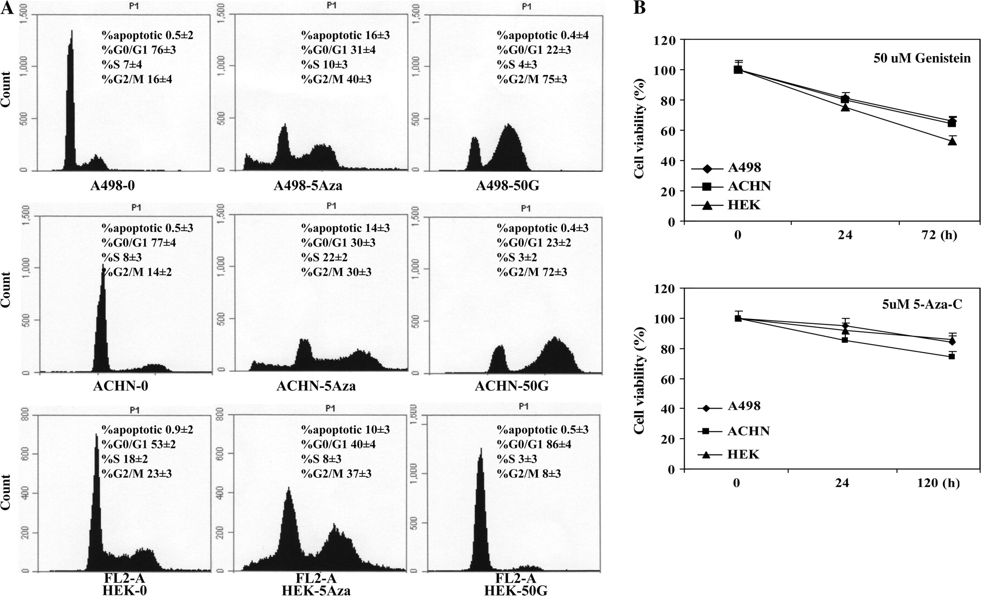
Fig. 1. Effect of genistein on cell cycle progression. DNA content and cell cycle progression were analyzed by flow ...
Notes:
Fig. 1. Effect of genistein on cell cycle progression. DNA content and cell cycle progression were analyzed by flow cytometry. ( A ) The two peaks in the fluorescence-activated cell sorting diagrams indicate G 0 –G 1 and G 2 –M cells with S phase cells between peaks. Sub G 1 fractions represent cells with fragmented DNA or apoptotic cells. The main panel shows a single representative result, whereas the numerical values are the mean ± SD of three experiments. ( B ) The 3-(4,5-dimethylthiazole-2-yl)-2,5-biphenyl tetrazolium bromide cell proliferation assay results. The data expressed in the graph is the mean ± SE of three independent experiments. Declines in cell viability were statistically significant (* P < 0.05).
Unless provided in the caption above, the following copyright applies to the content of this slide: © The Author 2009. Published by Oxford University Press. All rights reserved. For Permissions, please email: journals.permissions@oxfordjournals.org

Slide 2
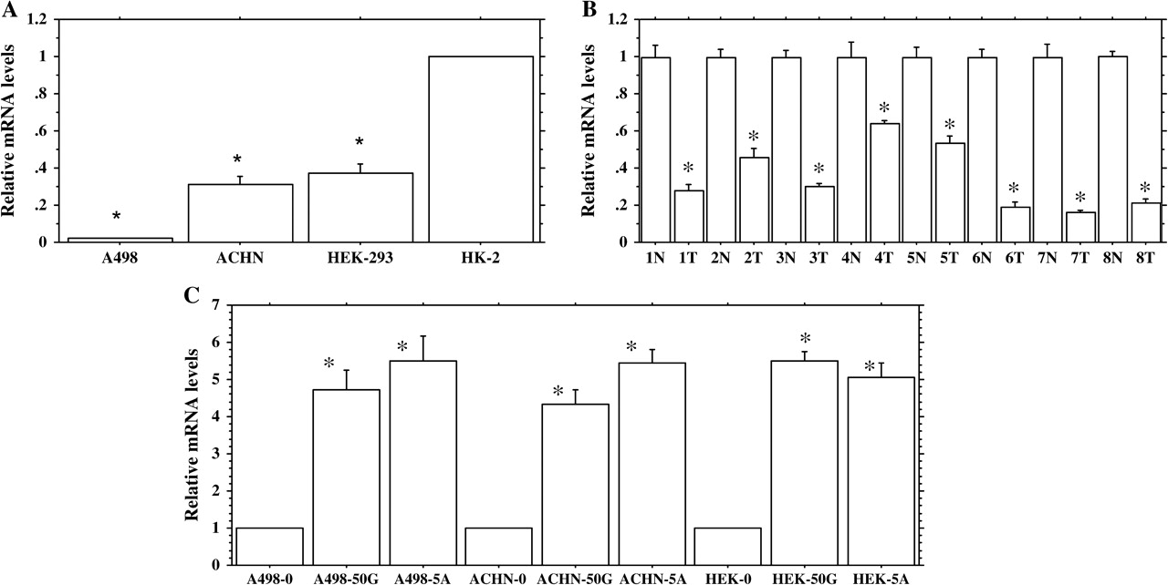
Fig. 2. BTG3 expression profile. ( A ) Expression profile of BTG3 in renal cancer (RCC) and ...
Notes:
Fig. 2. BTG3 expression profile. ( A ) Expression profile of BTG3 in renal cancer (RCC) and non-malignant-immortalized kidney cells. ( B ) Expression profile of BTG3 in renal carcinoma (T) and normal (N) clinical samples. ( C ) Relative expression profile of BTG3 gene following treatment with 0 and 50 μM genistein (50G) and 5 μM 5-Aza-2′-deoxycytidine (5A). Relative quantification was performed by quantitative real-time PCR using the following formula: Fold change in gene expression, 2 −ΔΔCt = 2−[▵Ct (genistein-/5Aza-C-treated samples) − ΔCt (untreated control)] , where ΔCt = Ct (detected genes) − Ct (GAPDH) and Ct represents threshold cycle number. For untreated controls data were normalized to 1. Data are in triplicate from three independent experiments. All data are expressed as the mean ± SE (bars). *Statistically significant at P < 0.05.
Unless provided in the caption above, the following copyright applies to the content of this slide: © The Author 2009. Published by Oxford University Press. All rights reserved. For Permissions, please email: journals.permissions@oxfordjournals.org

Slide 3
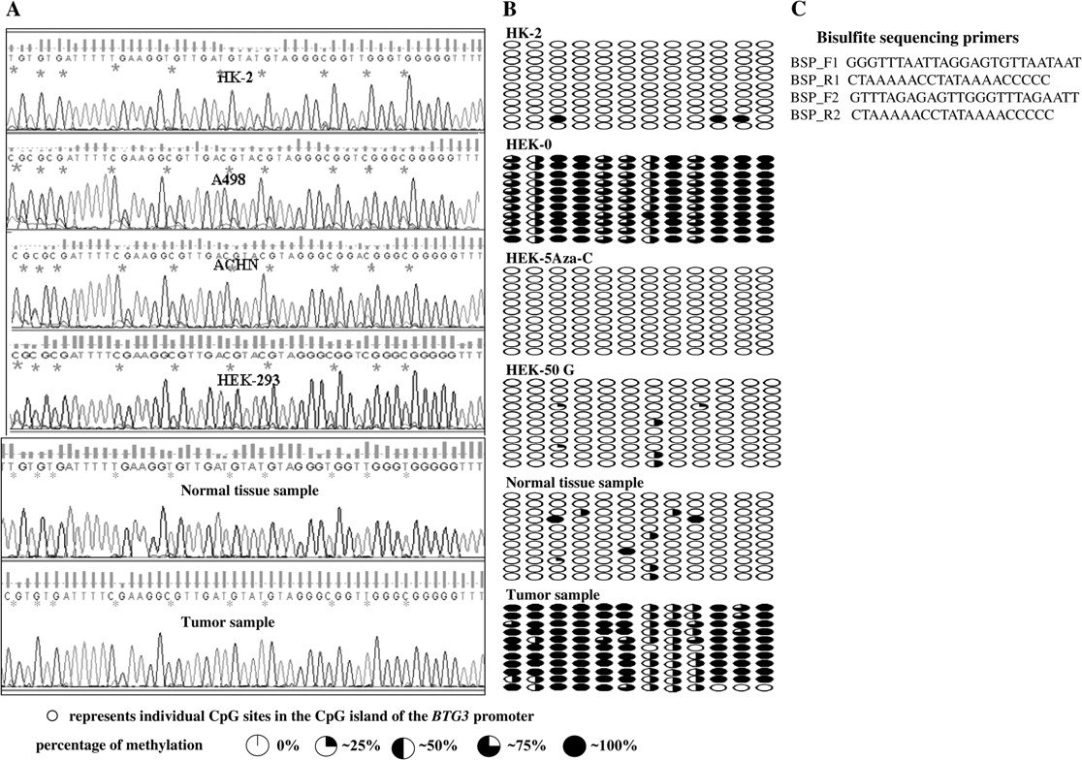
Fig. 3. BTG3 promoter methylation status. (A) DNA sequencing results showing the BTG3 promoter methylation status in ...
Notes:
Fig. 3. BTG3 promoter methylation status. (A) DNA sequencing results showing the BTG3 promoter methylation status in untreated HK2, A498, ACHN, HEK-293 cell lines and representative figures showing promoter methylation status in normal and cancer tissues. The symbol “*” indicates individual CpG sites. Bisulfite modification of the DNA was performed that changes the unmethylated cytosines to thymine thus represented by ‘TG’ in the sequence, whereas the methylated cytosines remain unchanged and thus represented by ‘CG’ in the sequences. For cell lines, a single primer set (BSP_F2–R2) was used for bisulfite modified polymerase chain reaction (BS-PCR), whereas a nested PCR was performed for tissue samples using two primer sets BSP_F1–R1 and BSP_F2–R2. ( B ) Sequencing results showing methylation status in 10 clones of HK-2, treated and untreated cancer cell line (HEK-293), normal tissue sample and a tumor sample. First row represents the parent PCR product and the remaining rows represent 10 clones of this product. Primer set F1R1 and F3R3 were used for all the samples that were cloned. ( C ) Sequences of primers used for BS-PCR.
Unless provided in the caption above, the following copyright applies to the content of this slide: © The Author 2009. Published by Oxford University Press. All rights reserved. For Permissions, please email: journals.permissions@oxfordjournals.org

Slide 4
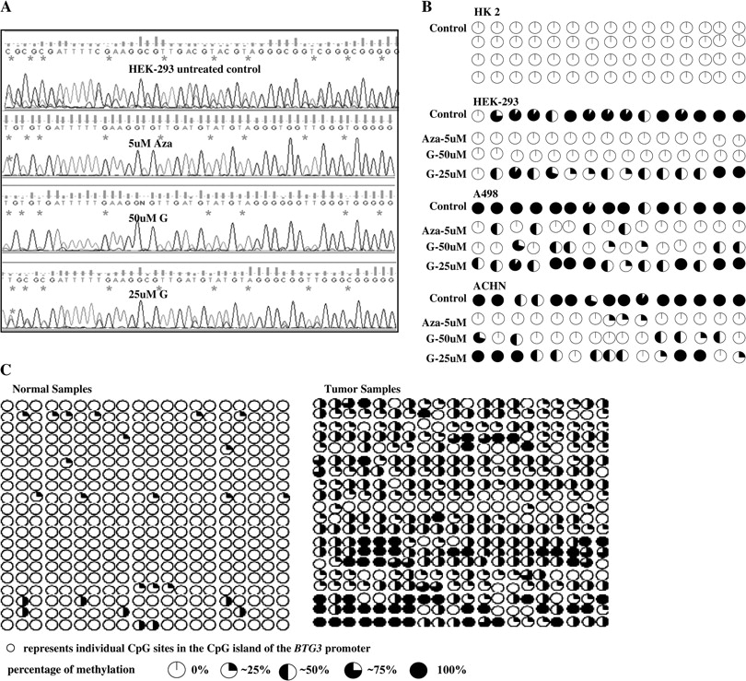
Fig. 4. Effect of genistein and 5Aza-C on BTG3 methylation. ( A ). Representative sequencing results showing the ...
Notes:
Fig. 4. Effect of genistein and 5Aza-C on BTG3 methylation. ( A ). Representative sequencing results showing the effect of 5Aza-C (AZ) and genistein (G) on promoter methylation of the BTG3 gene. ( B ) Summarized results showing demethylation of CpG sites by 5Aza-C (Aza) and genistein (G) treatments in three RCC cell lines and a HK-2. ( C ) Summarized results showing promoter methylation status in 20 pairs of normal and tumor samples. Each pair was obtained from the same patient and microdissected by a certified pathologist into normal and tumor. The symbols open circle and asterisk indicate individual CpG sites in the CpG island. Bisulfite modification of the DNA was performed that changes the unmethylated cytosines to thymine thus represented by ‘TG’ in the sequence whereas the methylated cytosines remain unchanged and thus represented by ‘CG’ in the sequences. For cell lines, a single primer set (BSP_F2–R2) was used for BS-PCR whereas a nested PCR was performed for tissue samples using two primer sets BSP_F1–R1 and BSP_F2–R2.
Unless provided in the caption above, the following copyright applies to the content of this slide: © The Author 2009. Published by Oxford University Press. All rights reserved. For Permissions, please email: journals.permissions@oxfordjournals.org

Slide 5
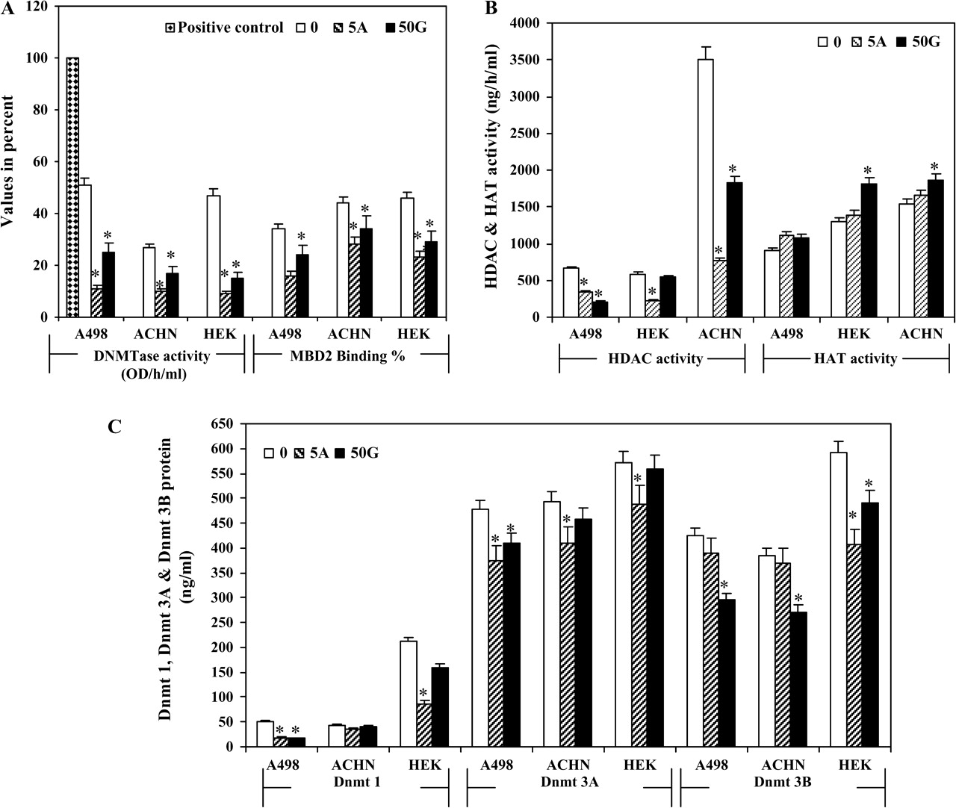
Fig. 5. Enzymatic activity assays. ( A ) Percent methyltransferase activity and MBD2-binding activity expressed as ...
Notes:
Fig. 5. Enzymatic activity assays. ( A ) Percent methyltransferase activity and MBD2-binding activity expressed as binding percent. Positive control was provided with the assay kit. ( B ) HAT and HDAC activity (ng/h/ml). ( C ) DNMT proteins expressed in ng/ml were calculated by formula [OD (sample−blank)/slope) × sample dilution]. Untreated control (0), 50 μM Genistein (50G), 5 μM 5Aza-2′-deoxycytidine (5A).
Unless provided in the caption above, the following copyright applies to the content of this slide: © The Author 2009. Published by Oxford University Press. All rights reserved. For Permissions, please email: journals.permissions@oxfordjournals.org

Slide 6
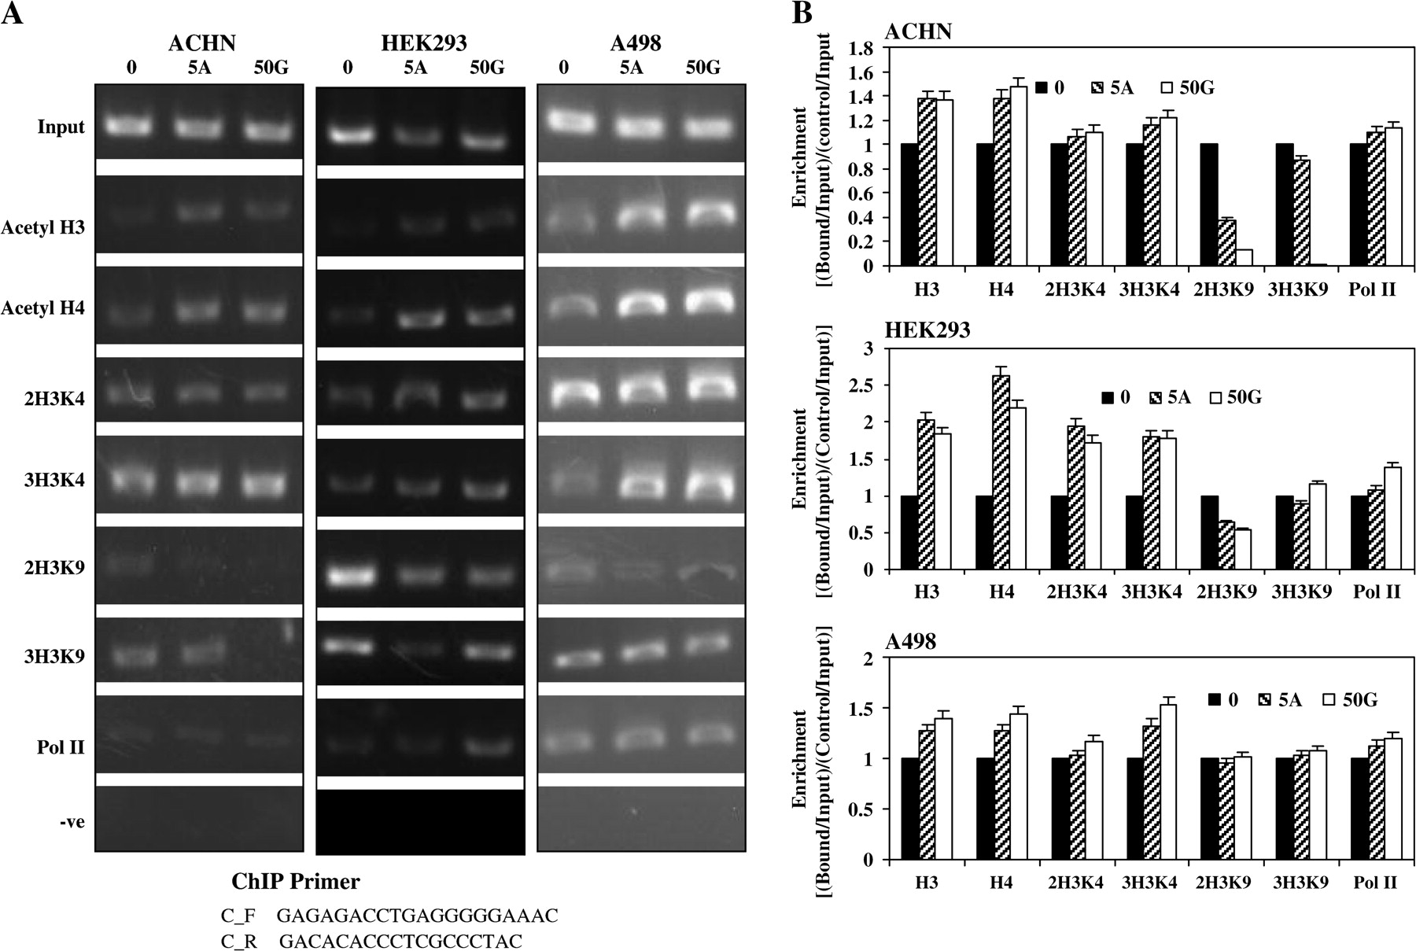
Fig. 6. Histone modifications. ( A ) Effect of genistein and 5Aza-C on the histone modifications of the BTG3 ...
Notes:
Fig. 6. Histone modifications. ( A ) Effect of genistein and 5Aza-C on the histone modifications of the BTG3 promoter. ChIP assay was performed on cells after treatment with 50 μM/l genistein and 5 μM/l 5Aza-C. Untreated control (0), 5Aza-C (5A), 50 μM Genistein (50G). ( B ) Histone modification enrichment data calculated from the corresponding DNA fragments amplified by PCR at annealing temperature of 60°C for a total of 28 cycles; bars, error ± standard deviation. The amplified DNA was electrophoresed in a 2% agarose gel and visualized by staining with ethidium bromide. The ImageJ Software version 1.36b ( http://rsb.info.nih.gov/ij/ ) was used for optical densitometry. Enrichment was calculated as the ratio between the net intensity of each bound sample normalized to its input sample and the vehicle control sample normalized to vehicle control input samples (Bound sample/Bound sample Input)/(Vehicle control sample/Vehicle control Input).
Unless provided in the caption above, the following copyright applies to the content of this slide: © The Author 2009. Published by Oxford University Press. All rights reserved. For Permissions, please email: journals.permissions@oxfordjournals.org

