Slide 1
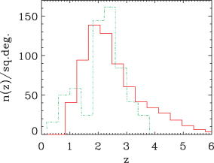
Figure 1 Comparison of the redshift distribution of sources with S_{850 μm} > 5 mJy yielded by the Granato et ...
Notes:
Figure 1 Comparison of the redshift distribution of sources with S850 μm > 5 mJy yielded by the Granato et al. (2004) model (solid histogram) with the observational estimate by Chapman et al. (2005, dot–dashed line). The numbers of sources per bin of Chapman et al. (2005) have been rescaled to a surface density N(S850 μm > 5 mJy) = 620 deg−2 (Scott et al. 2002). As pointed out by Chapman et al. (2005), the dip at z≃ 1.5 and the high-z cut-off in the data are likely due to the radio and optical selections.
Unless provided in the caption above, the following copyright applies to the content of this slide: © 2007 The Authors. Journal compilation © 2007 RAS

Slide 2
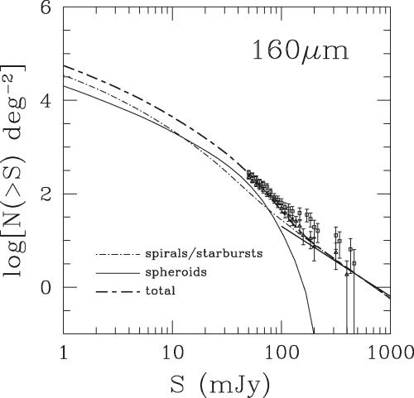
Figure 2 Model 160 μm integral counts compared with the Spitzer counts by Dole et al. (2004, squares) and Frayer et ...
Notes:
Figure 2 Model 160 μm integral counts compared with the Spitzer counts by Dole et al. (2004, squares) and Frayer et al. (2006a, triangles). The heavy solid line on the lower left-hand corner shows the count estimate by Serjeant & Harrison (2005).
Unless provided in the caption above, the following copyright applies to the content of this slide: © 2007 The Authors. Journal compilation © 2007 RAS

Slide 3
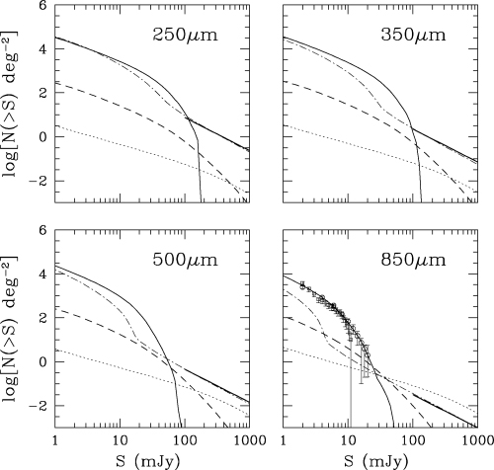
Figure 3 Predicted counts of high-z protospheroidal galaxies (solid line), late-type (starburst plus normal spiral) ...
Notes:
Figure 3 Predicted counts of high-z protospheroidal galaxies (solid line), late-type (starburst plus normal spiral) galaxies (dot–dashed line), and radio sources (dotted line). The dashed line shows the predicted counts of strongly lensed protospheroidal galaxies. The 850-μm data are from Coppin et al. (2006, circles) and Scott et al. (2006, squares). The heavy solid line on the lower right-hand corner of each panel shows the count estimates by Serjeant & Harrison (2005).
Unless provided in the caption above, the following copyright applies to the content of this slide: © 2007 The Authors. Journal compilation © 2007 RAS

Slide 4
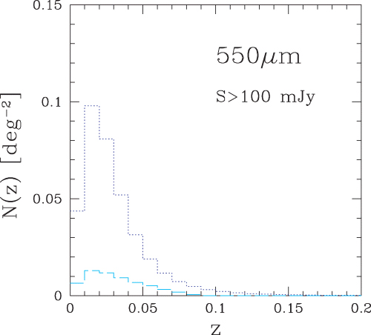
Figure 4 Redshift distribution of spiral (dotted) and starburst (dashed) galaxies brighter than 100 mJy at 550 μm, for ...
Notes:
Figure 4 Redshift distribution of spiral (dotted) and starburst (dashed) galaxies brighter than 100 mJy at 550 μm, for Δz= 0.01, according to the model described in the text.
Unless provided in the caption above, the following copyright applies to the content of this slide: © 2007 The Authors. Journal compilation © 2007 RAS

Slide 5
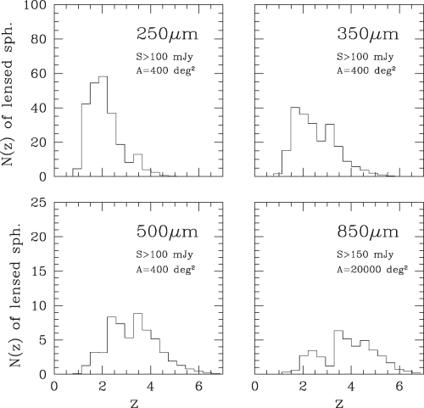
Figure 5 Predicted redshift distributions in bins of Δz= 0.36 of strongly lensed galaxies brighter than 100 mJy in the ...
Notes:
Figure 5 Predicted redshift distributions in bins of Δz= 0.36 of strongly lensed galaxies brighter than 100 mJy in the 3 Herschel/SPIRE channels (250, 350 and 550 μm) over an area of 400 deg2, and brighter that 150 mJy (the flux limit of the SCUBA-2 SASSy survey) at 850 μm over an area of 20 000 deg2, based on the Granato et al. (2004) model, updated as described in the text.
Unless provided in the caption above, the following copyright applies to the content of this slide: © 2007 The Authors. Journal compilation © 2007 RAS

Slide 6
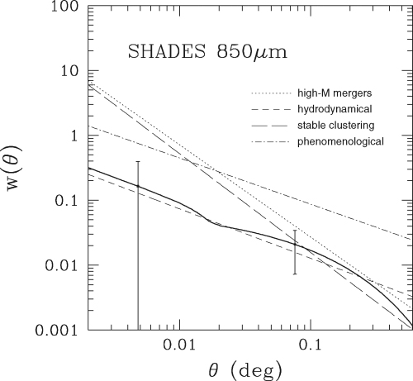
Figure 6 Comparison of the angular correlation function of SHADES sources predicted by the model adopted in this paper ...
Notes:
Figure 6 Comparison of the angular correlation function of SHADES sources predicted by the model adopted in this paper (solid line with 1σ error bars) with the best fitting power laws of the sky-averaged correlation functions predicted by the four models studied by van Kampen et al. (2005).
Unless provided in the caption above, the following copyright applies to the content of this slide: © 2007 The Authors. Journal compilation © 2007 RAS

Slide 7
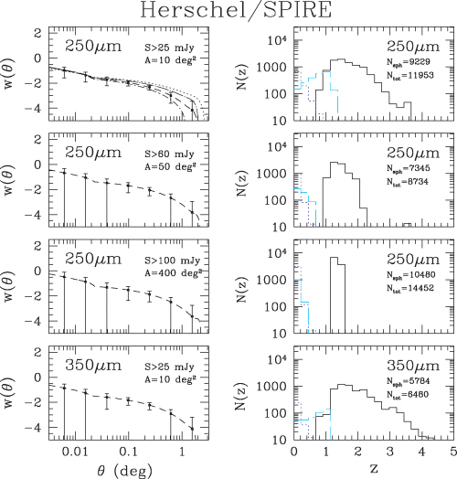
Figure 7 Predicted angular correlation function, with its uncertainties (3σ Poisson error bars), of protospheroids ...
Notes:
Figure 7 Predicted angular correlation function, with its uncertainties (3σ Poisson error bars), of protospheroids detected by 250-μm surveys to flux limits of 25, 60 and 100 mJy, over areas of 10, 50 and 100 deg2, respectively, and by a 350-μm survey of 10 deg2 to a flux limit of 25 mJy, averaged over bins Δ log (θ) = 0.4. The dilution of the signal due to the other, weakly clustered, source populations is taken into account. The corresponding predicted numbers of detected sources and their redshift distributions for redshift bins of Δz= 0.23 are also shown. The predicted redshift distributions of spiral and starburst galaxies (dotted and dashed histograms, respectively) are also shown. Surveys at 350 μm to flux limits of 60 and 100 mJy over areas of 50 and 400 deg2 would provide only very weak constraints on w(θ). Deep surveys, reaching the estimated confusion limits at 250 and 350 μm, can provide useful constraints on cosmological parameters, as illustrated by the top left-hand panels where, in addition to the predicted w(θ) for our reference cosmological model, with Ωm= 0.3 and Ωb= 0.047 (dashed line), we show the effect of different choices of these two parameters: Ωm= 0.15 and Ωb= 0.045 (dotted line); Ωm= 0.27 and Ωb= 0. (dot–short-dashed line); Ωm= 0.27 and Ωb= 0.09 (dot–long-dashed line).
Unless provided in the caption above, the following copyright applies to the content of this slide: © 2007 The Authors. Journal compilation © 2007 RAS

Slide 8
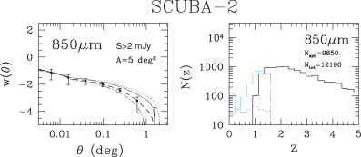
Figure 8 Predicted angular correlation function, with its uncertainties (3σ Poisson error bars), of protospheroids ...
Notes:
Figure 8 Predicted angular correlation function, with its uncertainties (3σ Poisson error bars), of protospheroids detected by the 850-μm SCUBA-2 survey of 2 deg2 to a detection limit of 2 mJy, and the corresponding redshift distribution. The dilution of the signal due to the other, weakly clustered, source populations is taken into account. The predicted redshift distributions of spiral and starburst galaxies (dotted and dashed histograms, respectively) are also shown. We have used bins of Δ log (θ) = 0.2 and Δz= 0.23. The different lines in the left-hand panel correspond to the same choices of the cosmological parameters Ωm and Ωb as in Fig. 7.
Unless provided in the caption above, the following copyright applies to the content of this slide: © 2007 The Authors. Journal compilation © 2007 RAS

Slide 9
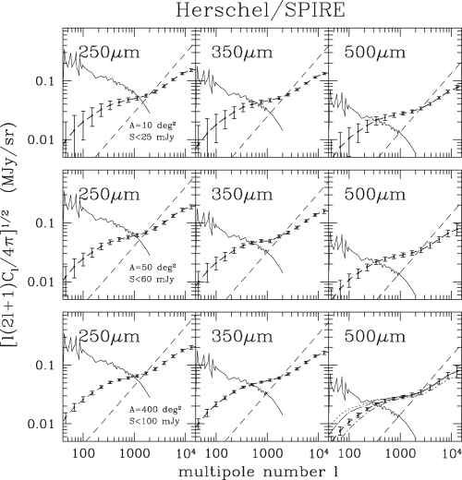
Figure 9 Power spectra of background fluctuations due to clustering of protospheroidal galaxies below the detection ...
Notes:
Figure 9 Power spectra of background fluctuations due to clustering of protospheroidal galaxies below the detection limit compared with the power spectra of the diffuse Galactic dust emission and of Poisson fluctuations. The ‘data’ points refer, from top to bottom panel, to Herschel/SPIRE surveys of 10, 50 and 400 deg2 with detection limits of 25, 60 and 100 mJy, respectively, for all channels (250, 350 and 550 μm). The error bars are estimated from equation (9), averaging over bins of Δℓ= 0.4ℓ. The broken lines show the power spectra of Galactic dust emission based on the Finkbeiner et al. (1999) model, averaged over a particularly dust-free 400-deg2 area centred at l≃ 245°, b≃−50°. The dashed lines show the Poisson contributions of extragalactic point sources below the detection limits. In the bottom right-hand panels, we show, in addition to the predicted power spectrum for our reference cosmological model, with Ωm= 0.3 and Ωb= 0.047 (dashed line), the effect of different choices of these 2 parameters: Ωm= 0.15 and Ωb= 0.045 (dotted line); Ωm= 0.27 and Ωb= 0. (dot-short dashed line); Ωm= 0.27 and Ωb= 0.09 (dot–long-dashed line).
Unless provided in the caption above, the following copyright applies to the content of this slide: © 2007 The Authors. Journal compilation © 2007 RAS

Slide 10
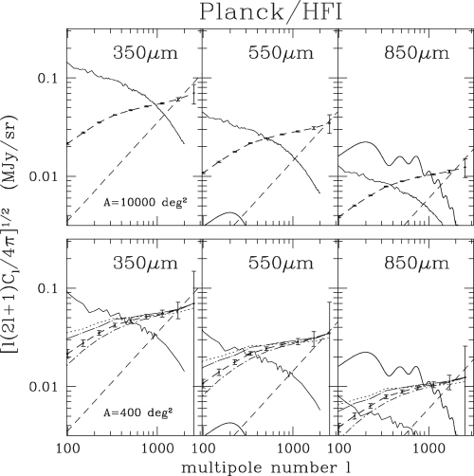
Figure 10 Power spectra of background fluctuations due to clustering of protospheroidal galaxies below the detection ...
Notes:
Figure 10 Power spectra of background fluctuations due to clustering of protospheroidal galaxies below the detection limit in the high frequency Planck/HFI surveys (points with error bars for bins Δℓ= 0.4ℓ) compared with the power spectra of the diffuse Galactic dust emission (broken lines), of Poisson fluctuations due to extragalactic point sources below the detection limits (dashed lines), and of the CMB (solid line, visible in the 850-μm panel, and in the bottom left-hand corner of the 550-μm panel). The dust power spectra are based on the Finkbeiner et al. (1999) model; the upper set of panels refer to the ≃9650 deg2 at |b| > 50°, the lower set refers to the 400-deg2 low-dust region centred at l≃ 245°, b≃−50°. In the bottom panels, we show, in addition to the predicted power spectrum for our reference cosmological model, with Ωm= 0.3 and Ωb= 0.047 (dashed line), the effect of different choices of these two parameters: Ωm= 0.15 and Ωb= 0.045 (dotted line); Ωm= 0.27 and Ωb= 0. (dot–short-dashed line); Ωm= 0.27 and Ωb= 0.09 (dot–long-dashed line).
Unless provided in the caption above, the following copyright applies to the content of this slide: © 2007 The Authors. Journal compilation © 2007 RAS

