Slide 1
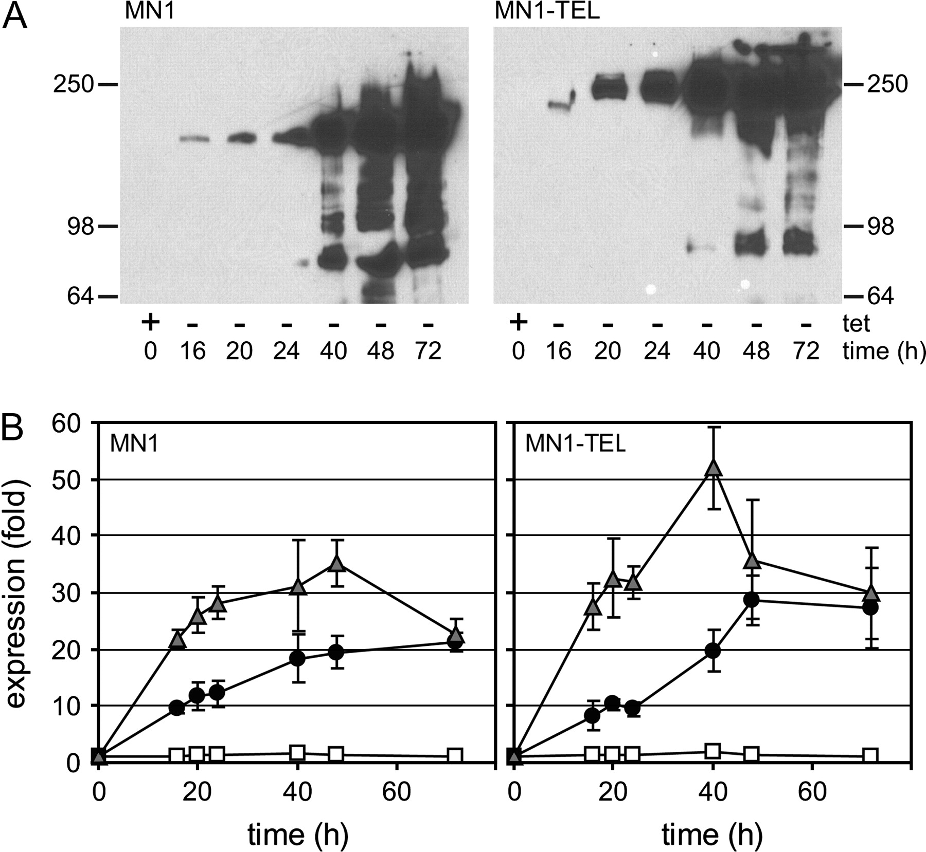
Fig. 1. Induction of MN1 and MN1–TEL expression in U937T cells. The expression of MN1 and MN1–TEL was induced by ...
Notes:
Fig. 1. Induction of MN1 and MN1–TEL expression in U937T cells. The expression of MN1 and MN1–TEL was induced by withdrawal of tetracycline for 16, 20, 24, 40, 48 and 72 h, after which samples were collected for western blotting and real-time qPCR. The cells collected at 0 h were grown in the presence of tetracycline and without the addition of ATRA. ( A ) Assessment of the expression of MN1 or MN1–TEL by western blot, using an antibody raised against the N-terminal part of MN1 (2F2). ( B ) Assessment of the levels of MN1 and MN1–TEL messenger RNA expression by qPCR. The qPCR results were normalized, using the messenger RNA levels of POLR2A, and are presented relative to those in the presence of only the tet-repressor: white squares: +tet and +ATRA; black circles: −tet, no ATRA; gray triangles: −tet and +ATRA).
Unless provided in the caption above, the following copyright applies to the content of this slide: © The Author 2008. Published by Oxford University Press. All rights reserved. For Permissions, please email: journals.permissions@oxfordjournals.org

Slide 2
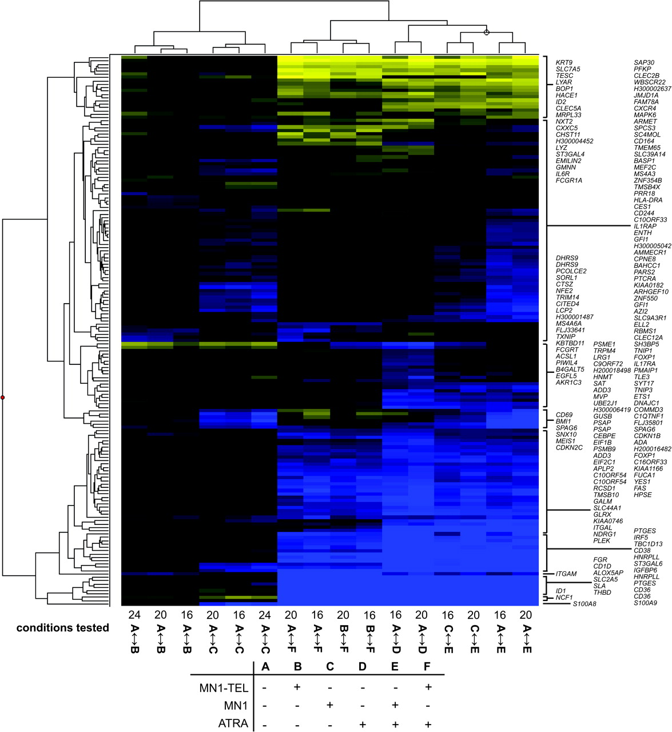
Fig. 2. A selected set of 165 reporters cluster together for subsequent time points of MN1 or MN1–TEL expression ...
Notes:
Fig. 2. A selected set of 165 reporters cluster together for subsequent time points of MN1 or MN1–TEL expression and/or ATRA treatment in U937 cells. The log2 ratios of changes in expression between the conditions indicated were subjected to unsupervised hierarchical clustering. The conditions tested on the different arrays are indicated at the bottom with numbers (16, 20 or 24) and letter codes A–F. Numbers correspond to hours after induction of MN1 or MN1–TEL. The table underneath the figure explains the letter codes (+: presence of MN1 or MN1–TEL or ATRA; −: absence of MN1 or MN1–TEL or ATRA). For instance, A ↔ B means that a sample with induced MN1–TEL expression is hybridized against a sample without MN1–TEL expression. Blue color represents stimulation and yellow repression.
Unless provided in the caption above, the following copyright applies to the content of this slide: © The Author 2008. Published by Oxford University Press. All rights reserved. For Permissions, please email: journals.permissions@oxfordjournals.org

Slide 3
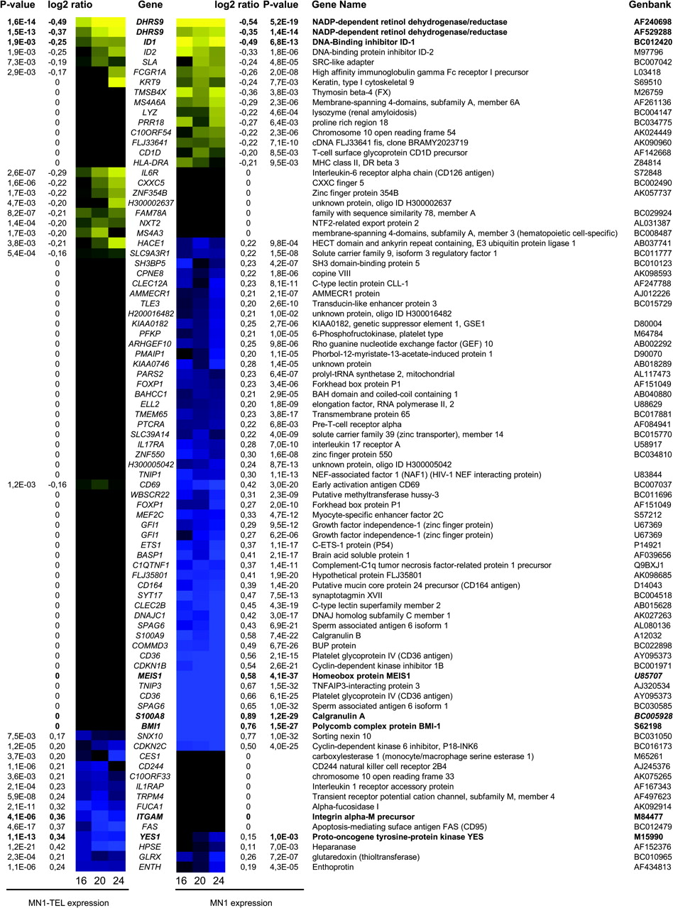
Fig. 3. Genes regulated by MN1 and MN1–TEL. The clustering analysis was performed with expression data from the ...
Notes:
Fig. 3. Genes regulated by MN1 and MN1–TEL. The clustering analysis was performed with expression data from the three different time points (16, 20 and 24 h after induction of MN1 or MN1–TEL). All genes listed show a significant change in expression (log2 ratio ≤0.2 or ≥0.2) for all three separate time points. The listed log2 ratios together with the P -value are calculated from combined time points. Genes indicated in bold are used for qPCR analyses ( Figure 5 and 6 and supplementary Figure 5 is available at Carcinogenesis Online). Blue represents stimulation and yellow repression.
Unless provided in the caption above, the following copyright applies to the content of this slide: © The Author 2008. Published by Oxford University Press. All rights reserved. For Permissions, please email: journals.permissions@oxfordjournals.org

Slide 4
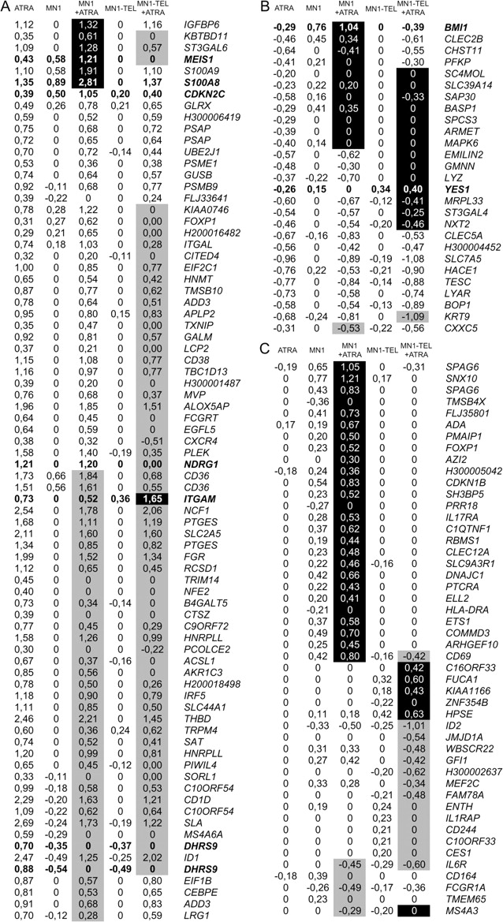
Fig. 4. ATRA-regulated genes and the influence of MN1 and MN1–TEL on their expression. Log2 ratios of changes in ...
Notes:
Fig. 4. ATRA-regulated genes and the influence of MN1 and MN1–TEL on their expression. Log2 ratios of changes in expression are indicated for ATRA treatment, MN1 or MN1–TEL induction and the combination of MN1 or MN1–TEL induction and ATRA treatment. Black or gray background represents a synergistic induction or repression of ATRA effects (cutoff value log2 ratio 0.2). ( A ) ATRA-stimulated genes. ( B ) ATRA-repressed genes. ( C ) Genes not influenced by ATRA treatment alone, but affected by the combination of ATRA and MN1 or MN1–TEL. Gene names and Genbank number are shown in supplementary Table 2 (available at Carcinogenesis Online). Genes indicated in bold are used for qPCR analyses ( Figures 5 , 6 and supplementary Figure 5 is available at Carcinogenesis Online).
Unless provided in the caption above, the following copyright applies to the content of this slide: © The Author 2008. Published by Oxford University Press. All rights reserved. For Permissions, please email: journals.permissions@oxfordjournals.org

Slide 5
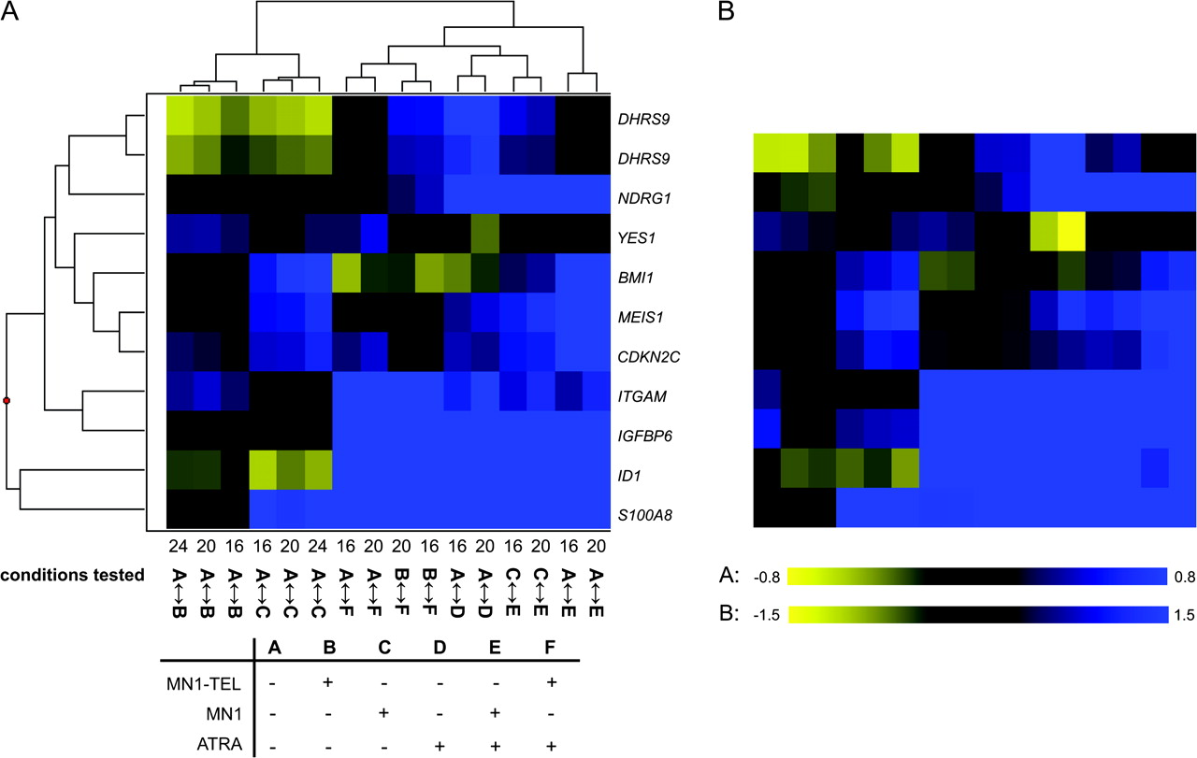
Fig. 5. Comparison of microarray and qPCR results. The RNA samples used for microarray analysis were also used for ...
Notes:
Fig. 5. Comparison of microarray and qPCR results. The RNA samples used for microarray analysis were also used for qPCR analysis. Expression levels were determined relative to a standard curve and used without further normalization. The results were compared with the corresponding microarray data by expressing the qPCR data as mean log2 ratios. ( A ) Unsupervised hierarchical clustering of the microarray data (log2 ratios) for the genes selected for qPCR validation. The conditions tested on the different arrays are indicated at the bottom with numbers (16, 20 or 24) and letter codes A–F. A detailed explanation is given in legend of Figure 2 . ( B ) Heat map of the qPCR data in the order corresponding to the unsupervised hierarchical clustering of the microarray data. Blue color represents stimulation and yellow repression.
Unless provided in the caption above, the following copyright applies to the content of this slide: © The Author 2008. Published by Oxford University Press. All rights reserved. For Permissions, please email: journals.permissions@oxfordjournals.org

Slide 6
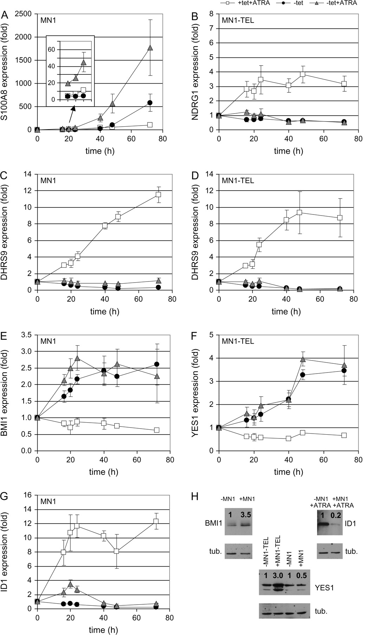
Fig. 6. Time dependence of effects of MN1 and MN1–TEL on expression levels and validation of qPCR results by western ...
Notes:
Fig. 6. Time dependence of effects of MN1 and MN1–TEL on expression levels and validation of qPCR results by western blot. MN1 and MN1–TEL expression were induced by tetracycline release in the presence or absence of ATRA. In parallel with the RNA samples used for the microarray hybridizations (16, 20 and 24 h), samples were also collected and analyzed with qPCR for time point 0 h and longer incubation times of 40, 48 and 72 h. The qPCR results were normalized, using the messenger RNA levels of POLR2A , and are presented relative to those in the presence of only the tet repressor: white squares: +tet and +ATRA; black circles: −tet, no ATRA; gray triangles: −tet and +ATRA. The results are shown only for the cell line indicated in the upper left corner of each graph. ( A ) S100A8 (MN1 cell line), ( B ) NDRG1 (MN1–TEL cell line), ( C ) DHRS9 (MN1 cell line), ( D ) DHRS9 (MN1–TEL cell line), ( E ) BMI1 (MN1 cell line) and ( F ) YES1 (MN1–TEL cell line). Three of the target genes (BMI1, ID1 and YES1) were analyzed on the protein level. Time points after induction of MN1 or MN1–TEL expression and treatments were chosen (BMI1, 24 h; YES1, 48 h and ID1 72 h) and protein levels detected and quantified. Protein expression levels (indicated with a ratio above the signal) were calculated relative to the amount of β-tubulin present in the sample and the non-induced sample. tub. = tubulin.
Unless provided in the caption above, the following copyright applies to the content of this slide: © The Author 2008. Published by Oxford University Press. All rights reserved. For Permissions, please email: journals.permissions@oxfordjournals.org

