Slide 1
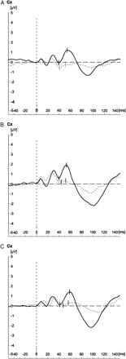
Fig. 1. (A) Grand Average S1 and S2 P50 Waveforms Patients (n = 53). (B) Grand Average S1 and S2 P50 Waveforms ...
Notes:
Fig. 1. (A) Grand Average S1 and S2 P50 Waveforms Patients (n = 53). (B) Grand Average S1 and S2 P50 Waveforms Siblings (n = 27). (C) Grand Average S1 and S2 P50 Waveforms Controls (n = 28).
Unless provided in the caption above, the following copyright applies to the content of this slide: © The Author 2007. Published by Oxford University Press on behalf of the Maryland Psychiatric Research Center. All rights reserved. For permissions, please email: journals.permissions@oxfordjournals.org.

