Slide 1
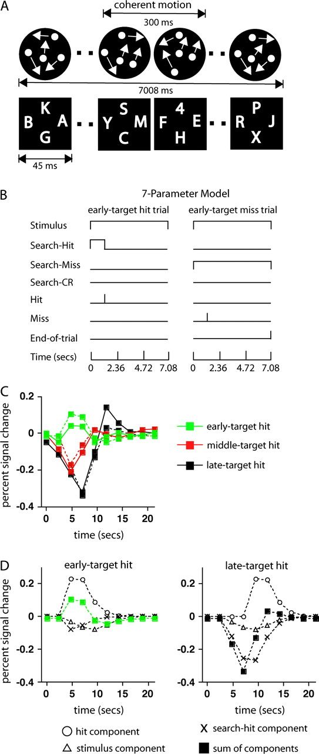
Figure 1. (A) Stimulus display and procedure for the digit and motion tasks. (B) Illustration of the assumed temporal ...
Notes:
Figure 1. (A) Stimulus display and procedure for the digit and motion tasks. (B) Illustration of the assumed temporal waveforms on an early-target hit trial and an early-target miss trial for each of the processes from the 7-parameter model. (C) Group-averaged time course in a region of R SMG during early-, middle-, and late-target hit trials. The solid lines indicate the estimated time courses, and the dotted lines show the time courses obtained by fitting the 7-parameter process model to the time courses. (D) The time course of the BOLD signal due to the stimulus, search-hit, and hit components from the 7-parameter model during early-target (left graph) and late-target (right graph) trials. These component time courses were obtained by fitting the model parameters directly to the estimated time courses. The filled squares in each graph (green in the left graph, black in the right graph, to match the corresponding functions in the graph in C) show the overall time course predicted by the model, which is the sum of the 3 component functions and a very small constant term (−0.013 for this ROI). This overall time course is the same as the fitted time course given by the dotted lines in C.
Unless provided in the caption above, the following copyright applies to the content of this slide: © The Author 2007. Published by Oxford University Press. All rights reserved. For permissions, please e-mail: journals.permissions@oxfordjournals.org

Slide 2
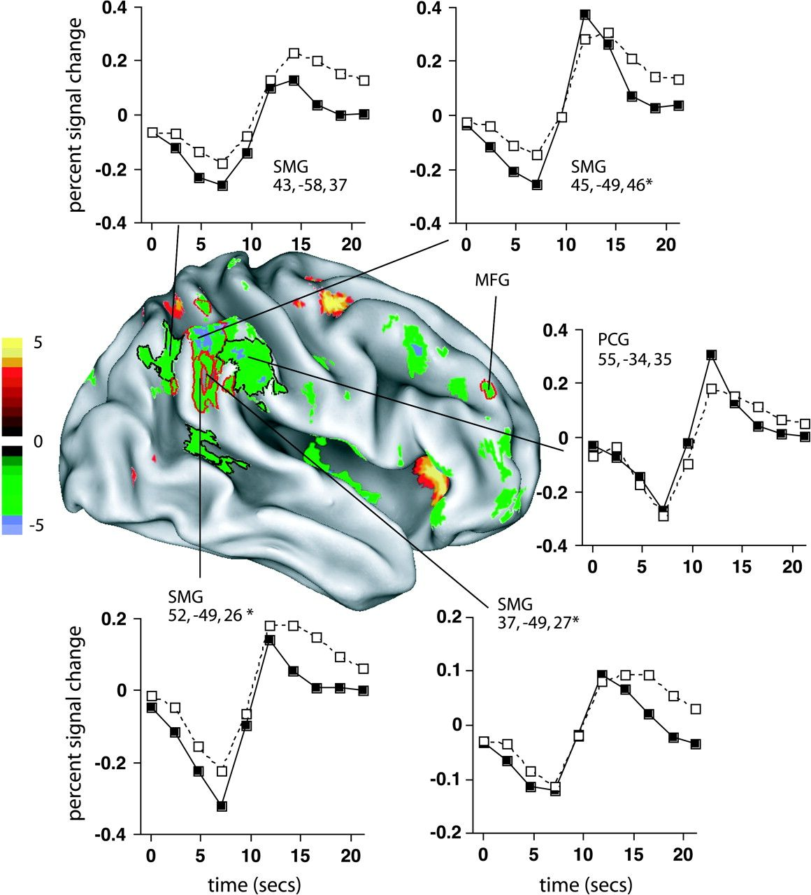
Figure 2. The multiple-comparison corrected z-map displays voxels that showed significant search-related deactivations ...
Notes:
Figure 2. The multiple-comparison corrected z-map displays voxels that showed significant search-related deactivations (cool colors) and search-related activations (warm colors) based on a contrast that combined the search-hit and search-miss parameters from the 7-parameter model. The z-scores are indicated by the color scale. The graphs show group-averaged time courses from the no-assumptions model. TPJ ROIs that showed a significant mean BOLD-detection relationship are indicated by an asterisk and are outlined in the statistical map in red. The other, nonsignificant ROIs in the TPJ, as well as a more anterior region in the postcentral gyrus (PCG), are outlined in black. The MFG region outlined in red showed a significant mean BOLD-detection relationship in a post hoc analysis over all regions showing significant search-related deactivations. SMG = supramarginal gyrus, MFG = middle frontal gyrus, PCG = postcentral gyrus, STS = superior temporal sulcus.
Unless provided in the caption above, the following copyright applies to the content of this slide: © The Author 2007. Published by Oxford University Press. All rights reserved. For permissions, please e-mail: journals.permissions@oxfordjournals.org

Slide 3
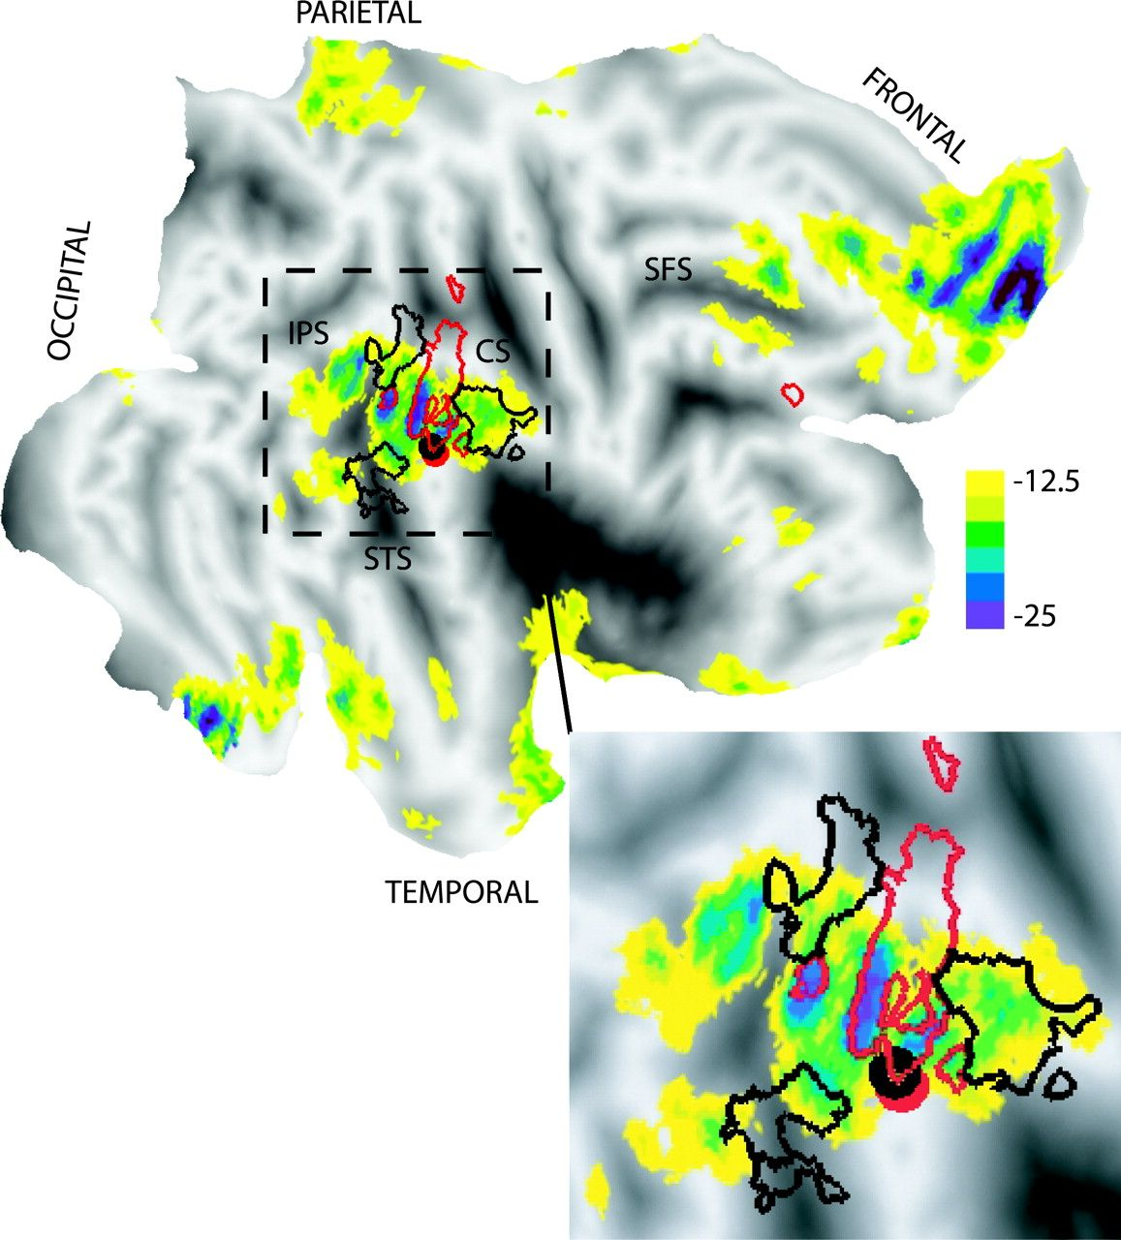
Figure 3. A flat map of right hemisphere regions that deactivate across a wide range of cognitive tasks. The original ...
Notes:
Figure 3. A flat map of right hemisphere regions that deactivate across a wide range of cognitive tasks. The original results of Shulman et al. (1997) have been recomputed by Buckner et al. (2005). The color scale represents the difference in PET counts between the active task condition and a resting condition. The red outlines superimposed on this map indicate the envelope of the borders of the ROIs in Figure 2 that showed a significant mean BOLD-detection relationship, whereas the superimposed black outlines indicate the ROIs from Figure 2 in which no significant relationship was present. The red disk indicates the R SMG focus from Todd et al. (2005), and the overlapping black disk the R SMG focus from Serences et al. (2005). This overlap reflects the highly similar spatial location of the 2 foci. The insert shows an expanded view of the TPJ. CS = central sulcus, IPS = intraparietal suclus, SFS = superior frontal sulcus, STS = superior temporal sulcus.
Unless provided in the caption above, the following copyright applies to the content of this slide: © The Author 2007. Published by Oxford University Press. All rights reserved. For permissions, please e-mail: journals.permissions@oxfordjournals.org

