Slide 1
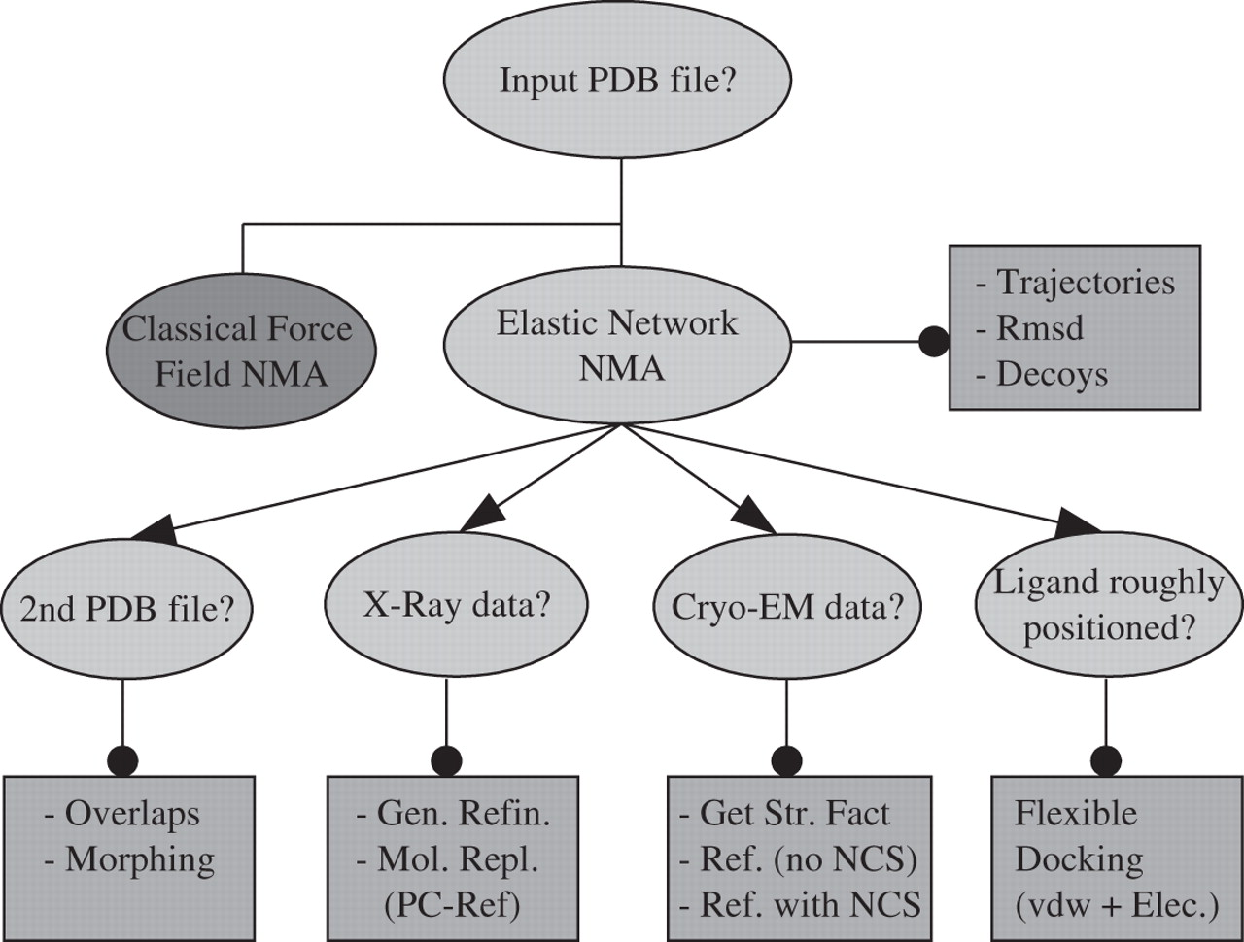
Figure 1 Flow chart of the NOMAD-Ref server.
Notes:
Figure 1 Flow chart of the NOMAD-Ref server.
Unless provided in the caption above, the following copyright applies to the content of this slide: © The Author 2006. Published by Oxford University Press. All rights reserved The online version of this article has been published under an open access model. Users are entitled to use, reproduce, disseminate, or display the open access version of this article for non-commercial purposes provided that: the original authorship is properly and fully attributed; the Journal and Oxford University Press are attributed as the original place of publication with the correct citation details given; if an article is subsequently reproduced or disseminated not in its entirety but only in part or as a derivative work this must be clearly indicated. For commercial re-use, please contact journals.permissions@oxfordjournals.org

Slide 2
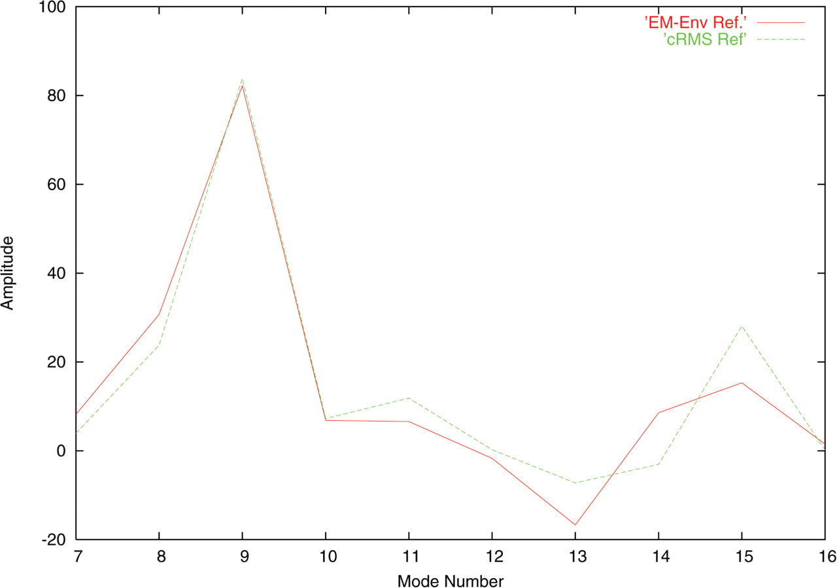
Figure 2 Refinement of the first 10 lowest frequency amplitudes of citrate synthase open form (5CSC) based on ...
Notes:
Figure 2 Refinement of the first 10 lowest frequency amplitudes of citrate synthase open form (5CSC) based on simulated Cryo-EM data at 15 Å resolution for the closed form (6SCS). In green, the control experiment is made by conducting the refinement against a cRMS score between the two forms.
Unless provided in the caption above, the following copyright applies to the content of this slide: © The Author 2006. Published by Oxford University Press. All rights reserved The online version of this article has been published under an open access model. Users are entitled to use, reproduce, disseminate, or display the open access version of this article for non-commercial purposes provided that: the original authorship is properly and fully attributed; the Journal and Oxford University Press are attributed as the original place of publication with the correct citation details given; if an article is subsequently reproduced or disseminated not in its entirety but only in part or as a derivative work this must be clearly indicated. For commercial re-use, please contact journals.permissions@oxfordjournals.org

Slide 3
Figure 3 Receptor-ligand docking refinement for glutamine-binding protein (1GGG/1WDN). ( A ) Intermolecular soft-core ...
Notes:
Figure 3 Receptor-ligand docking refinement for glutamine-binding protein (1GGG/1WDN). ( A ) Intermolecular soft-core nonbonded energy landscape as a function of the two first non-rigid-body normal mode amplitudes. ( B ) Ligand docked with initial (open) receptor conformation (red) superimposed on closed state (blue)—5.33 Å cRMS. ( C ) Receptor structure refined using the five lowest normal modes compared to the target closed state—2.16 Å cRMS. The five degrees of freedom reduce the cRMS by a factor two.
Unless provided in the caption above, the following copyright applies to the content of this slide: © The Author 2006. Published by Oxford University Press. All rights reserved The online version of this article has been published under an open access model. Users are entitled to use, reproduce, disseminate, or display the open access version of this article for non-commercial purposes provided that: the original authorship is properly and fully attributed; the Journal and Oxford University Press are attributed as the original place of publication with the correct citation details given; if an article is subsequently reproduced or disseminated not in its entirety but only in part or as a derivative work this must be clearly indicated. For commercial re-use, please contact journals.permissions@oxfordjournals.org

