Slide 1
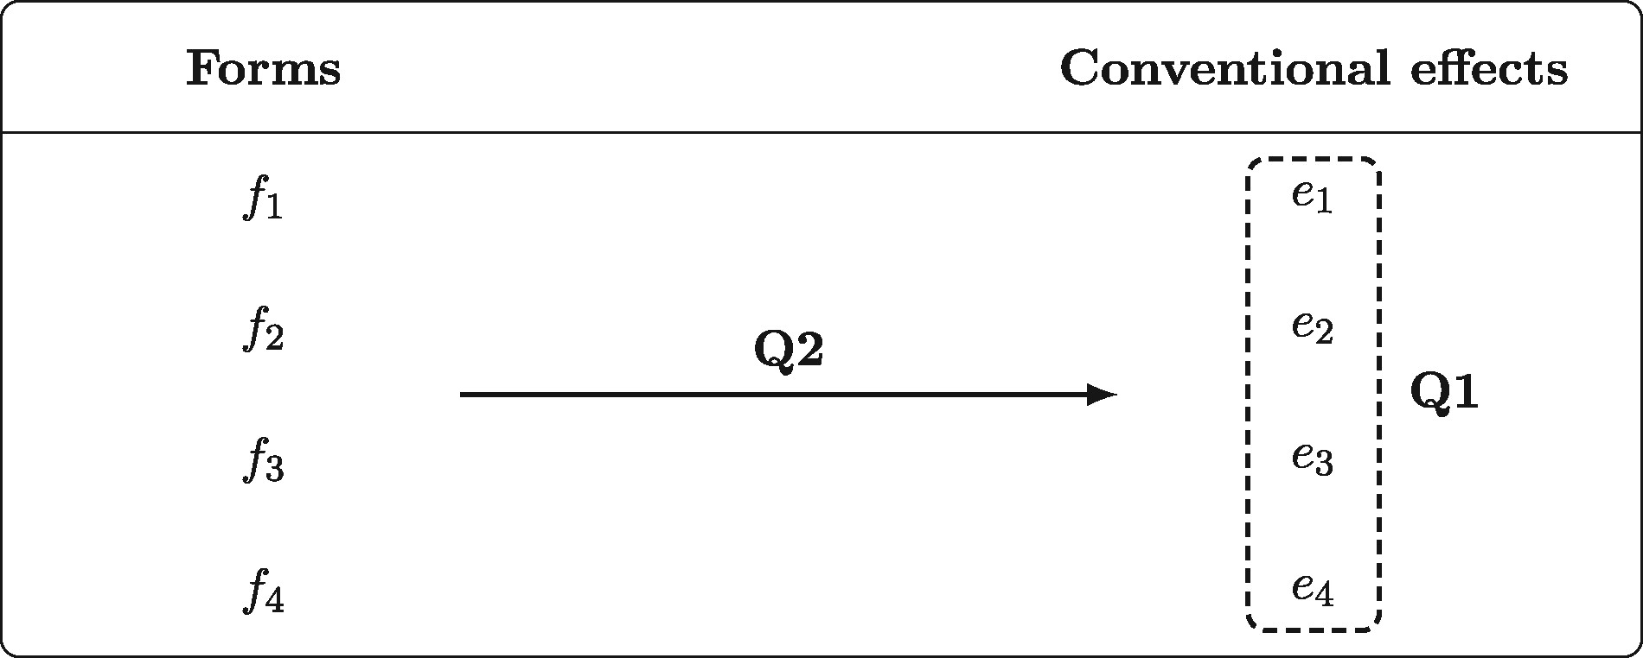
Figure 1 Visualization of the main questions to be addressed.
Notes:
Figure 1 Visualization of the main questions to be addressed.
Unless provided in the caption above, the following copyright applies to the content of this slide: © The Author 2017. Published by Oxford University Press. All rights reserved. For Permissions, please email: journals.permissions@oup.com

Slide 2
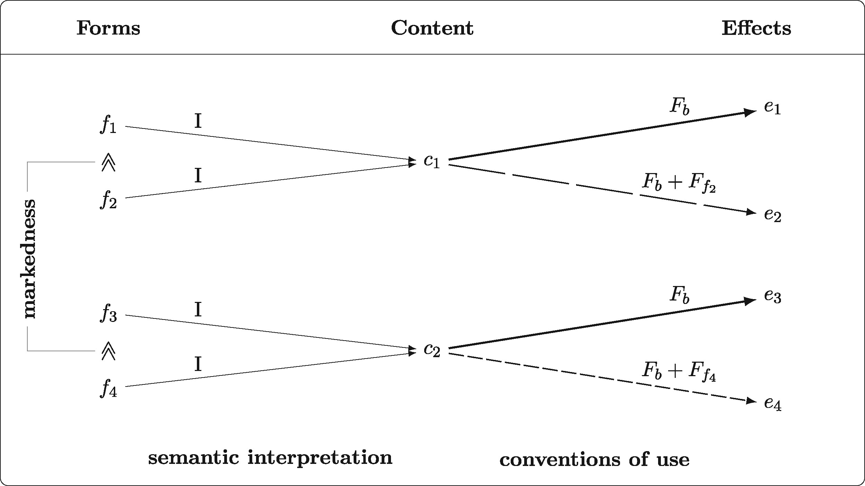
Figure 2 Division of labor between semantic interpretation and conventions of use on our account.
Notes:
Figure 2 Division of labor between semantic interpretation and conventions of use on our account.
Unless provided in the caption above, the following copyright applies to the content of this slide: © The Author 2017. Published by Oxford University Press. All rights reserved. For Permissions, please email: journals.permissions@oup.com

Slide 3
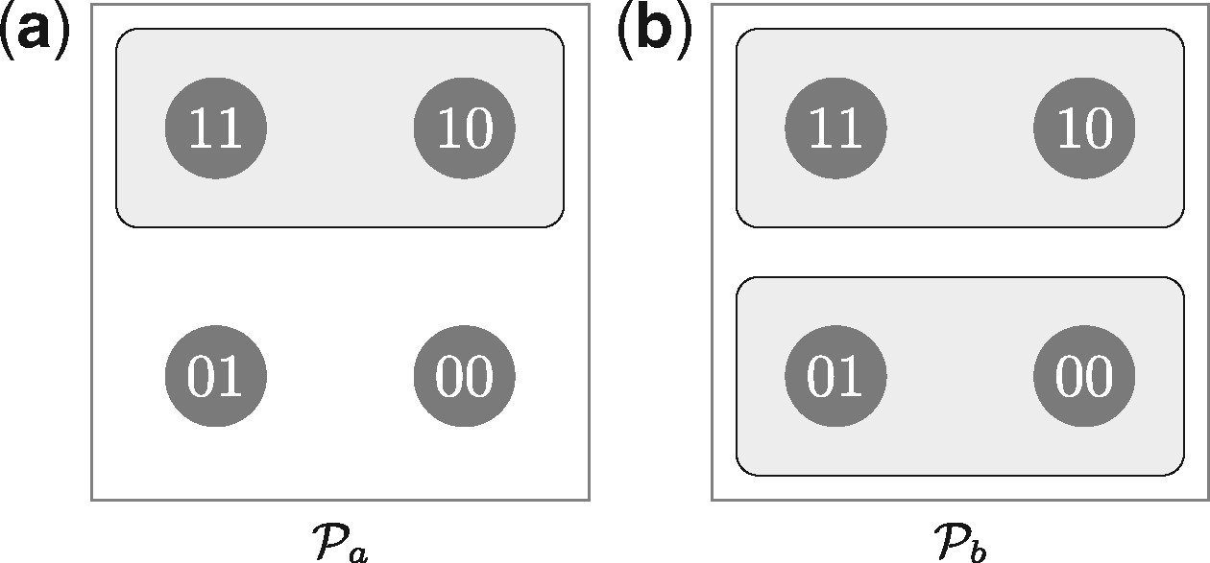
Figure 3 Two simple propositions, depicting only alternatives.
Notes:
Figure 3 Two simple propositions, depicting only alternatives.
Unless provided in the caption above, the following copyright applies to the content of this slide: © The Author 2017. Published by Oxford University Press. All rights reserved. For Permissions, please email: journals.permissions@oup.com

Slide 4
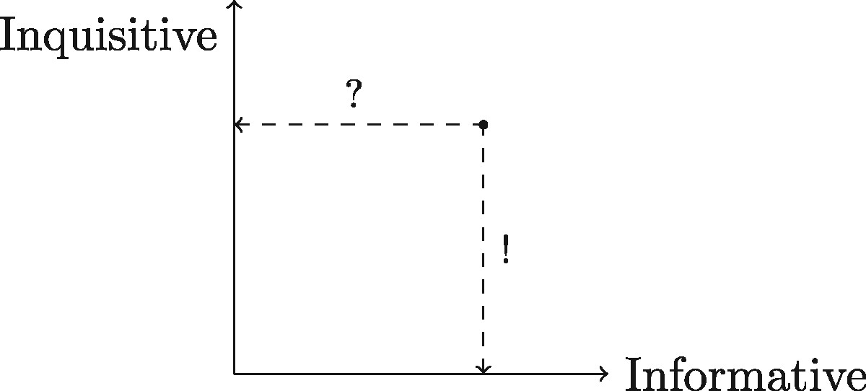
Figure 4 Projection operators.
Notes:
Figure 4 Projection operators.
Unless provided in the caption above, the following copyright applies to the content of this slide: © The Author 2017. Published by Oxford University Press. All rights reserved. For Permissions, please email: journals.permissions@oup.com

Slide 5
Figure 5 Projection operators applied to a proposition that is both informative and inquisitive.
Notes:
Figure 5 Projection operators applied to a proposition that is both informative and inquisitive.
Unless provided in the caption above, the following copyright applies to the content of this slide: © The Author 2017. Published by Oxford University Press. All rights reserved. For Permissions, please email: journals.permissions@oup.com

Slide 6
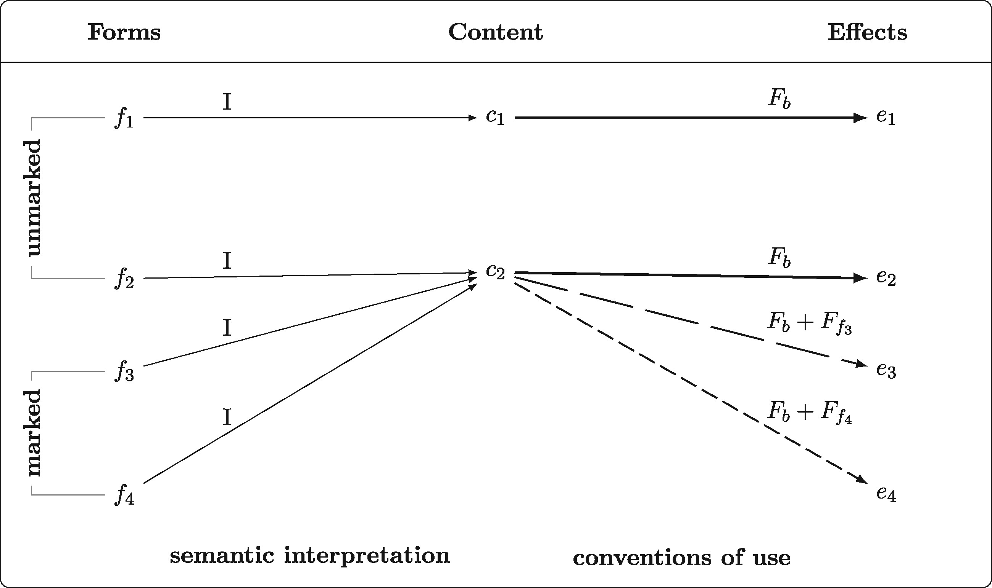
Figure 6 Division of labor between semantic interpretation and conventions of use on our account.
Notes:
Figure 6 Division of labor between semantic interpretation and conventions of use on our account.
Unless provided in the caption above, the following copyright applies to the content of this slide: © The Author 2017. Published by Oxford University Press. All rights reserved. For Permissions, please email: journals.permissions@oup.com

