Slide 1
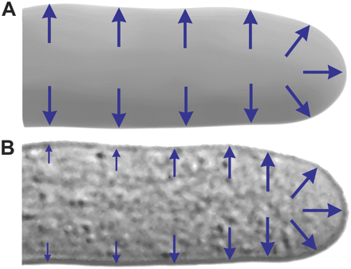
Fig. 1. Theory and modelling of pollen tube cytoplasm and osmotic pressure. (A) A semi-cylindrical viscoelastic ...
Notes:
Fig. 1. Theory and modelling of pollen tube cytoplasm and osmotic pressure. (A) A semi-cylindrical viscoelastic continuum. The classic model of pollen tube growth simplified biological complexity by approximating the cytoplasm as composed of a single-phase viscoelastic continuum, in which osmotic pressure propagates equally and instantaneously throughout all parts of the cell. In this coarse approximation, osmotic pressure is uniform throughout all parts of the cell and distributed equally and uniformly along the entire plasma membrane (blue arrows). (B) A living pollen tube. The newly emerging hydrodynamic model of pollen tube growth considers a living cell with a crowded cytoplasm consisting of two distinct phases: a solid phase of vesicles, organelles, endomembrane networks, cytoskeletal polymers, and particulate matter; and a fluid phase composed of water, ions, soluble proteins, and metabolites. Theory and experiment agree that the cytoplasm of living cells conforms to a fluid-filled poroelastic network, in which propagation of osmotic pressure is highly dependent on the local hydraulic and electrical conductivity, the local mesh density and channel size, and the elastic contraction of the porous network. In living cells, theory and experiment have conclusively demonstrated that non-equilibrium osmotic pressure exists on physiologically relevant temporal and spatial scales. In the new hydrodynamic model of pollen tube growth, spatial non-equilibrium osmotic pressure is predicted to be highest near the apex and diminish toward the distal tube (blue arrows).
Unless provided in the caption above, the following copyright applies to the content of this slide: © The Author [2010]. Published by Oxford University Press [on behalf of the Society for Experimental Biology]. All rights reserved. For Permissions, please e-mail: journals.permissions@oxfordjournals.org

Slide 2
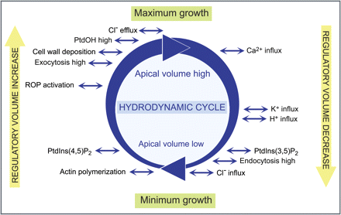
Fig. 2. Integration of signalling and structural networks regulating pollen tube growth. Temporal asymmetries in cell ...
Notes:
Fig. 2. Integration of signalling and structural networks regulating pollen tube growth. Temporal asymmetries in cell osmotic pressure exist due to metabolism and thermodynamic non-equilibrium, which induce continual fluctuations in osmotic potential across the plasma membrane. This induces hydrodynamic flow into or out of the cell, and affects the mechanical/chemical status of the plasma membrane, cellular ionic strength, concentrations of specific ions, macromolecular crowding, and proximity of protein-binding partners. Signalling cascades and structural elements that are involved in stabilizing cell volume and pressure are activated, in a network of coupled reactions that control regulatory volume decrease in response to cell swelling and regulatory volume increase in response to cell shrinking. Experimental data in tobacco pollen tubes show that hydrodynamics behaves as a limit cycle oscillator that entrains growth rate oscillation frequencies. Thus, the hydrodynamic cycle has the potential to function as a travelling wave that integrates the network of coupled oscillators that are involved in pollen tube growth. Each element in the network could be activated in response to a certain osmotic status and input from other elements in the network. The illustration presents a selection of key signalling cascades and structural elements involved in pollen tube growth.
Unless provided in the caption above, the following copyright applies to the content of this slide: © The Author [2010]. Published by Oxford University Press [on behalf of the Society for Experimental Biology]. All rights reserved. For Permissions, please e-mail: journals.permissions@oxfordjournals.org

Slide 3
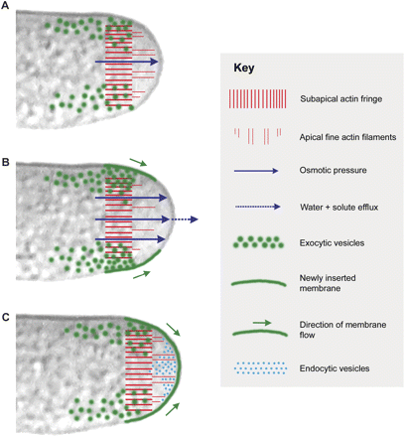
Fig. 3. The hydrodynamic model of pollen tube growth. For simplicity, only eight elements of the entire growth ...
Notes:
Fig. 3. The hydrodynamic model of pollen tube growth. For simplicity, only eight elements of the entire growth network are depicted as defined in the key. Temporal and spatial asymmetries in osmotic pressure are proposed to drive pollen tube growth in a process with similarities to blebbing. (A) Intermediate osmotic pressure. Mass flow and hydraulic conductivity establish vectorial hydrodynamic flux toward the apex. Increasing osmotic pressure in the apical region will differentially exert localized pressure effects depending on plasma membrane attachment to the local cytoplasmic architecture. The apical dome presents an osmotic sink due to exclusion of larger vesicles, organelles, endomembrane networks, and extensively bundled actin cables, and due to hydraulic and elastic contraction of the rest of the cytoplasm. (B) High osmotic pressure. Increasing pressure on the apical plasma membrane will exploit any weak point, force it to bulge outward, and detach the local area from any underlying cytoplasmic architectures. The entire local area then becomes a weak point for further membrane detachment, enabling increased hydrodynamic flow and stretching of the membrane. The increased stretch and flow elongate the newly inserted membrane in the growth zone toward the apex. (C) Low osmotic pressure after hydrodynamic unloading at the apex and apical volume decrease. Newly inserted membrane flows toward the apex where it is internalized for recycling by smooth vesicle endocytosis. The actin networks comprising the subapical fringe undergo an anterograde shift; nothing is known about how this occurs but it probably involves net polymerization. There is a net increase (net polymerization) in apical fine actin filaments and these extend between the subapical fringe and the apical plasma membrane. Endocytic and endosomal trafficking undergo increases during this phase. For simplicity, endocytosis at the apex is depicted only at this phase (C), but experimental evidence shows that it is essentially constitutive.
Unless provided in the caption above, the following copyright applies to the content of this slide: © The Author [2010]. Published by Oxford University Press [on behalf of the Society for Experimental Biology]. All rights reserved. For Permissions, please e-mail: journals.permissions@oxfordjournals.org

