Slide 1
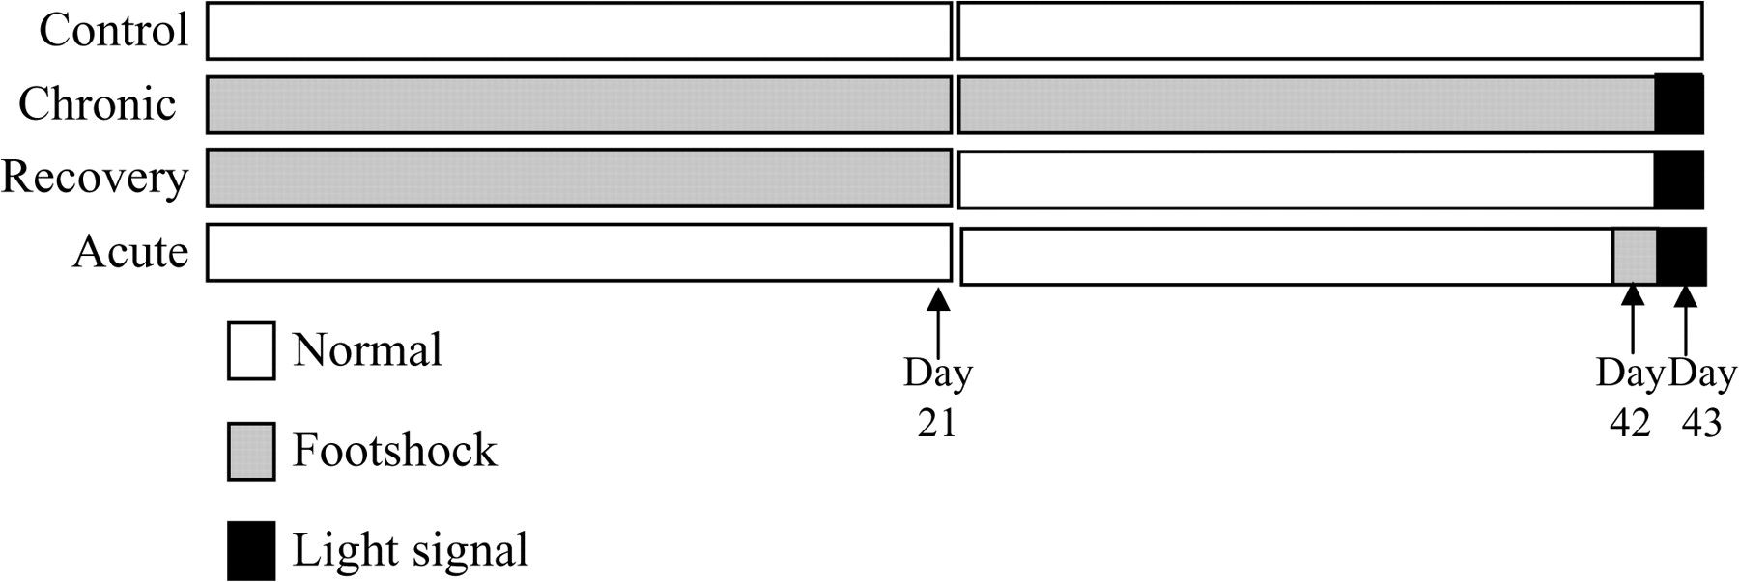
Figure 1. Schematic overview of the 43-day protocol. Control: rats were subjected to no footshock. Acute: rats received ...
Notes:
Figure 1. Schematic overview of the 43-day protocol. Control: rats were subjected to no footshock. Acute: rats received 6 footshocks on day 42, and were exposed to the footshock box with the light stimulus only on day 43. Recovery: rats received footshocks daily for 3 weeks followed by a 3-week period with no footshock, and on day 43 were exposed to the footshock box with the light only. Chronic: rats received footshocks daily for 3 weeks followed by 3 weeks of alternating days of exposure to the footshock box with footshocks and without receiving footshock, and on day 43 were exposed to the footshock box with the light only.
Unless provided in the caption above, the following copyright applies to the content of this slide: © The Author 2008. Published by Oxford University Press. All rights reserved. For permissions, please e-mail: journals.permissions@oxfordjournals.org

Slide 2
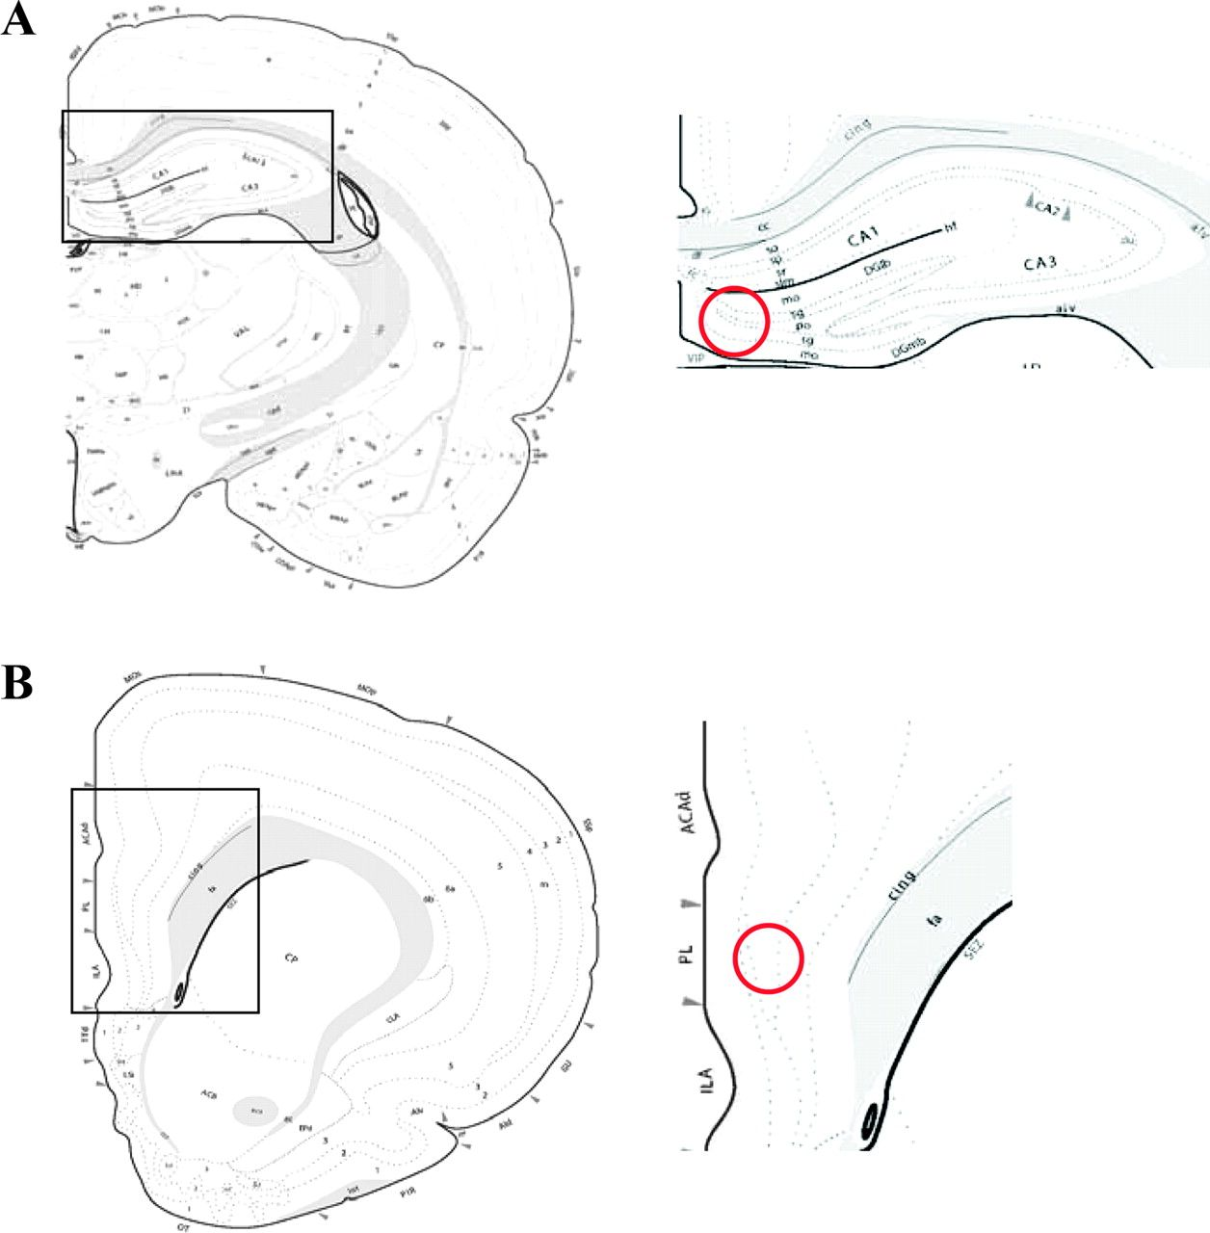
Figure 2. Atlas image represents the approximate brain level where DG and PFC was analyzed. (A) DG (DG-sg); (B) PFC ...
Notes:
Figure 2. Atlas image represents the approximate brain level where DG and PFC was analyzed. (A) DG (DG-sg); (B) PFC (PL). The expression of CREB and pCREB was examined by Western blot or immunohistochemistry in the field circled by the red ring.
Unless provided in the caption above, the following copyright applies to the content of this slide: © The Author 2008. Published by Oxford University Press. All rights reserved. For permissions, please e-mail: journals.permissions@oxfordjournals.org

Slide 3
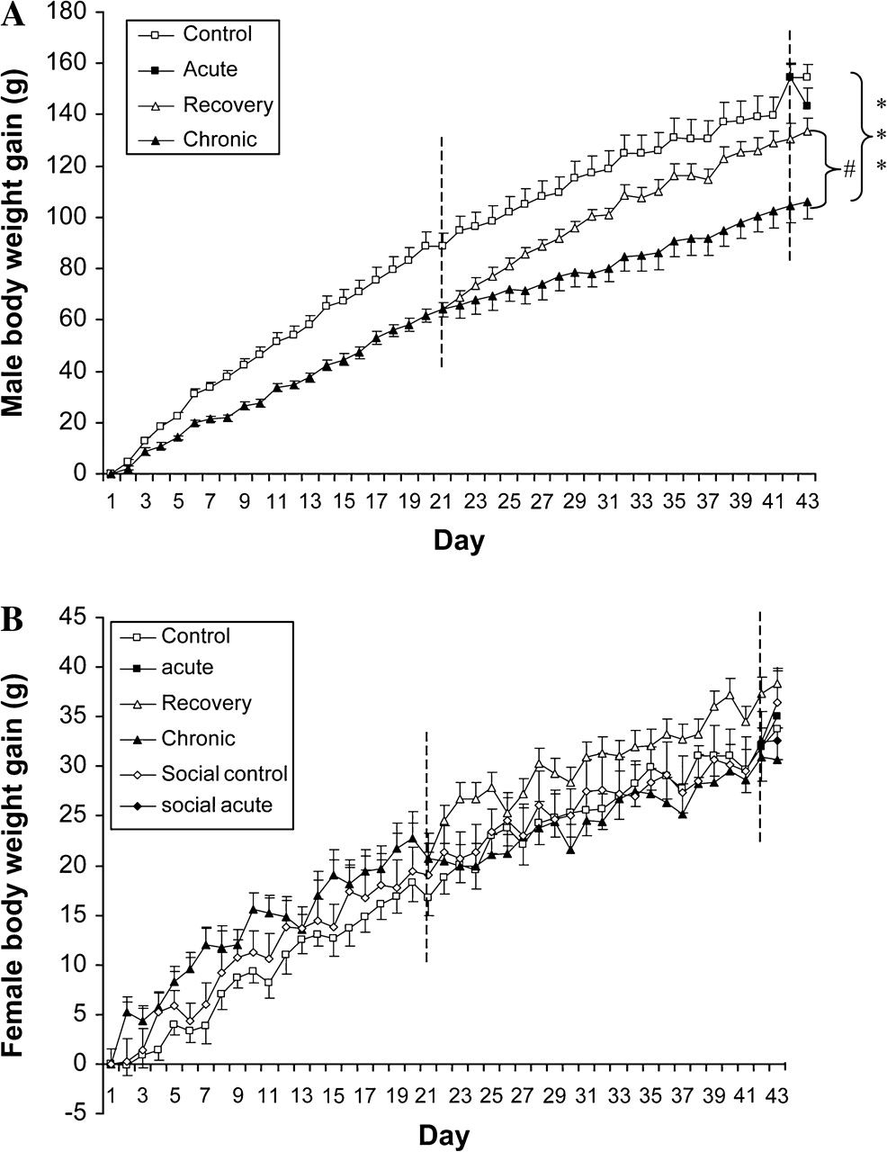
Figure 3. Effects of stress, recovery after long-term stress and social housing on body weight gain of male rats (A) ...
Notes:
Figure 3. Effects of stress, recovery after long-term stress and social housing on body weight gain of male rats (A) and female rats (B). Data were expressed as mean ± SEM, n = 8. #P ≤ 0.05, recovery group versus chronic stress group; ***P ≤ 0.001 control group versus chronic stress group.
Unless provided in the caption above, the following copyright applies to the content of this slide: © The Author 2008. Published by Oxford University Press. All rights reserved. For permissions, please e-mail: journals.permissions@oxfordjournals.org

Slide 4
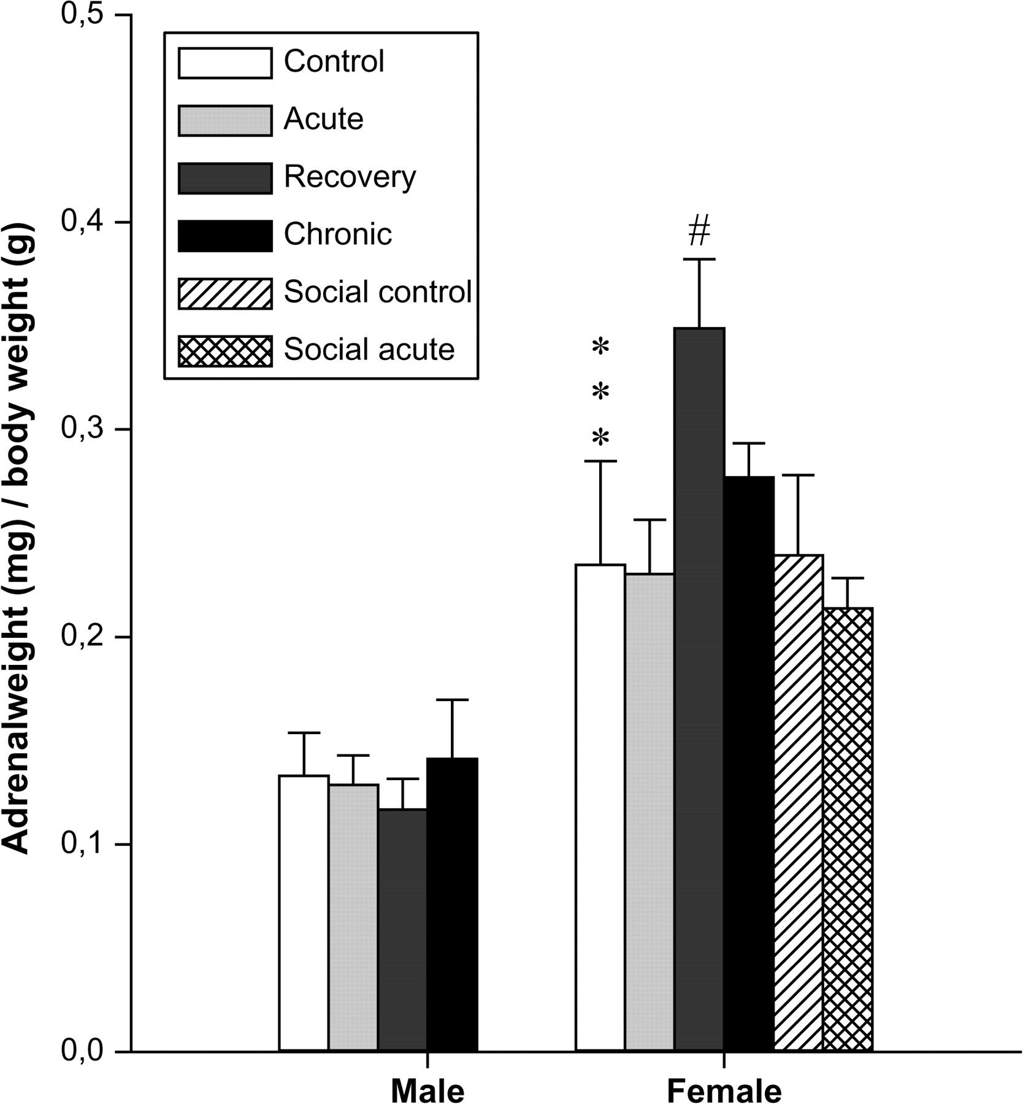
Figure 4. Effects of stress, recovery after long-term stress and social housing on adrenal weight measured on day 43 in ...
Notes:
Figure 4. Effects of stress, recovery after long-term stress and social housing on adrenal weight measured on day 43 in male rats and female rats. Data were expressed as mean ± SEM, n = 5. ***P ≤ 0.001 versus control male group; #P < 0.05 versus control female group.
Unless provided in the caption above, the following copyright applies to the content of this slide: © The Author 2008. Published by Oxford University Press. All rights reserved. For permissions, please e-mail: journals.permissions@oxfordjournals.org

Slide 5
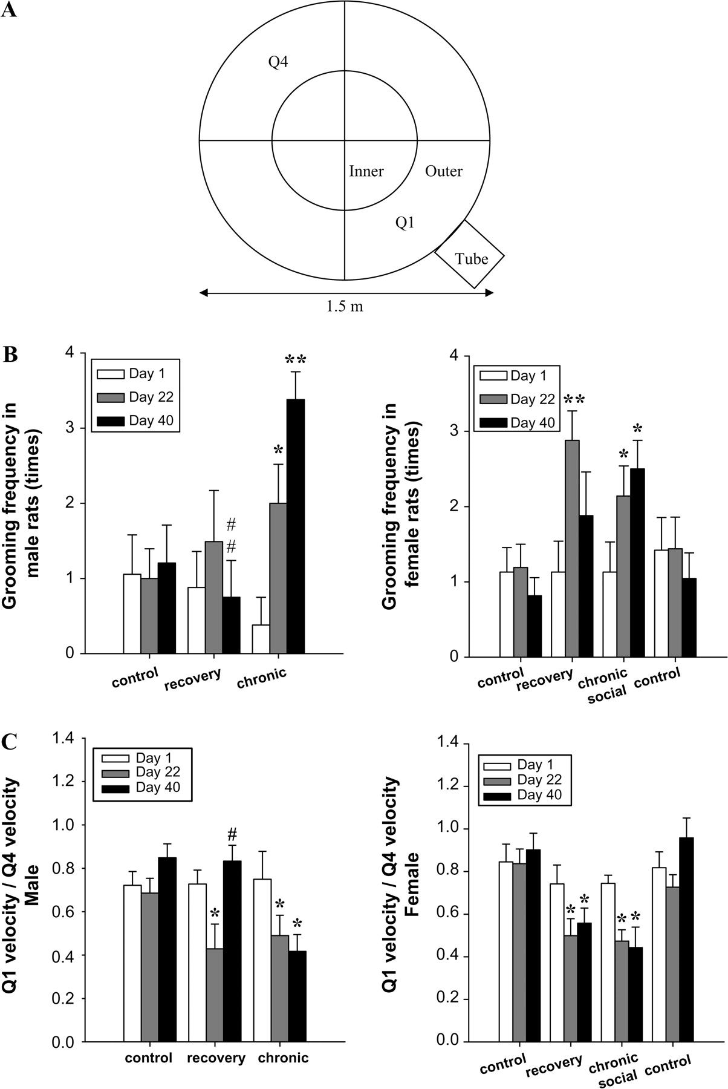
Figure 5. Effects of stress, recovery after long-term stress and social housing on behavior of male rats and female ...
Notes:
Figure 5. Effects of stress, recovery after long-term stress and social housing on behavior of male rats and female rats. (A) Atlas of the arena in which OF test was performed, the arena was divided into outer and inner parts, each part was further divided into Q1, Q2, Q3, and Q4 sections. (B) Effects of stress, recovery and social housing on grooming frequency during the whole arena. (C) Effects of stress, recovery, and social housing on the velocity in outer Q1 and outer Q4. Data were expressed as mean ± SEM, n = 8. *P ≤ 0.05, **P ≤ 0.01 within group, #P ≤ 0.05, # #P ≤ 0.01 versus male chronic stress group.
Unless provided in the caption above, the following copyright applies to the content of this slide: © The Author 2008. Published by Oxford University Press. All rights reserved. For permissions, please e-mail: journals.permissions@oxfordjournals.org

Slide 6
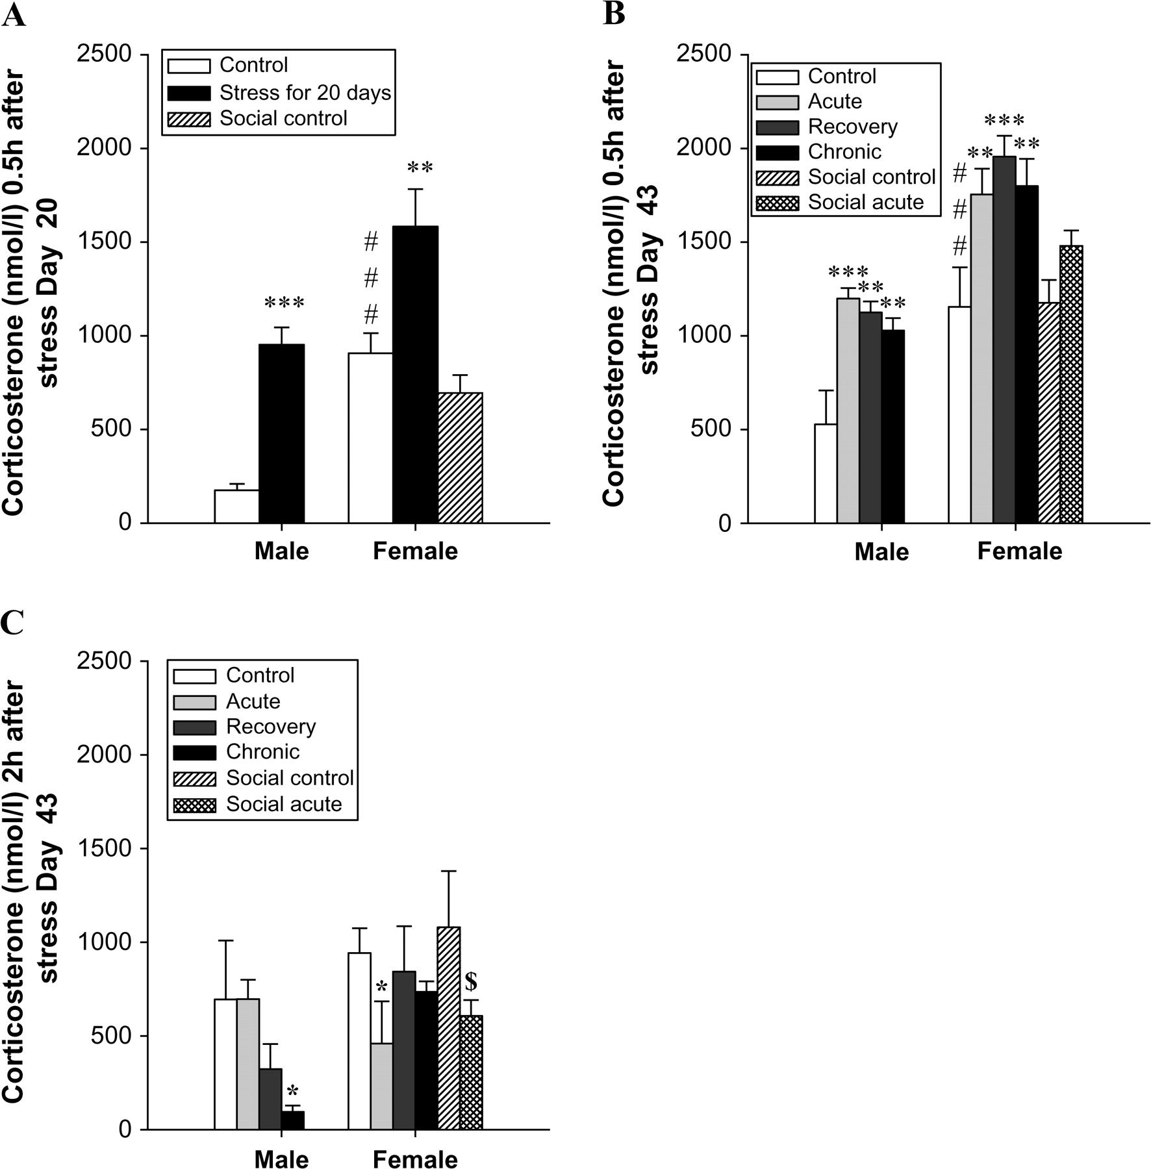
Figure 6. Effects of stress, recovery and social housing on plasma corticosterone levels measured (A) 0.5 h after ...
Notes:
Figure 6. Effects of stress, recovery and social housing on plasma corticosterone levels measured (A) 0.5 h after stress on day 22 (n = 8), (B) 0.5 h (n = 5), and (C) 2 h (n = 3) after exposure to the footshock box with the light only on day 43. Data were expressed as mean ± SEM. *P < 0.05, **P < 0.01, ***P < 0.001 versus control group; ###P < 0.001 versus male control group; $P < 0.05 versus social female control group.
Unless provided in the caption above, the following copyright applies to the content of this slide: © The Author 2008. Published by Oxford University Press. All rights reserved. For permissions, please e-mail: journals.permissions@oxfordjournals.org

Slide 7
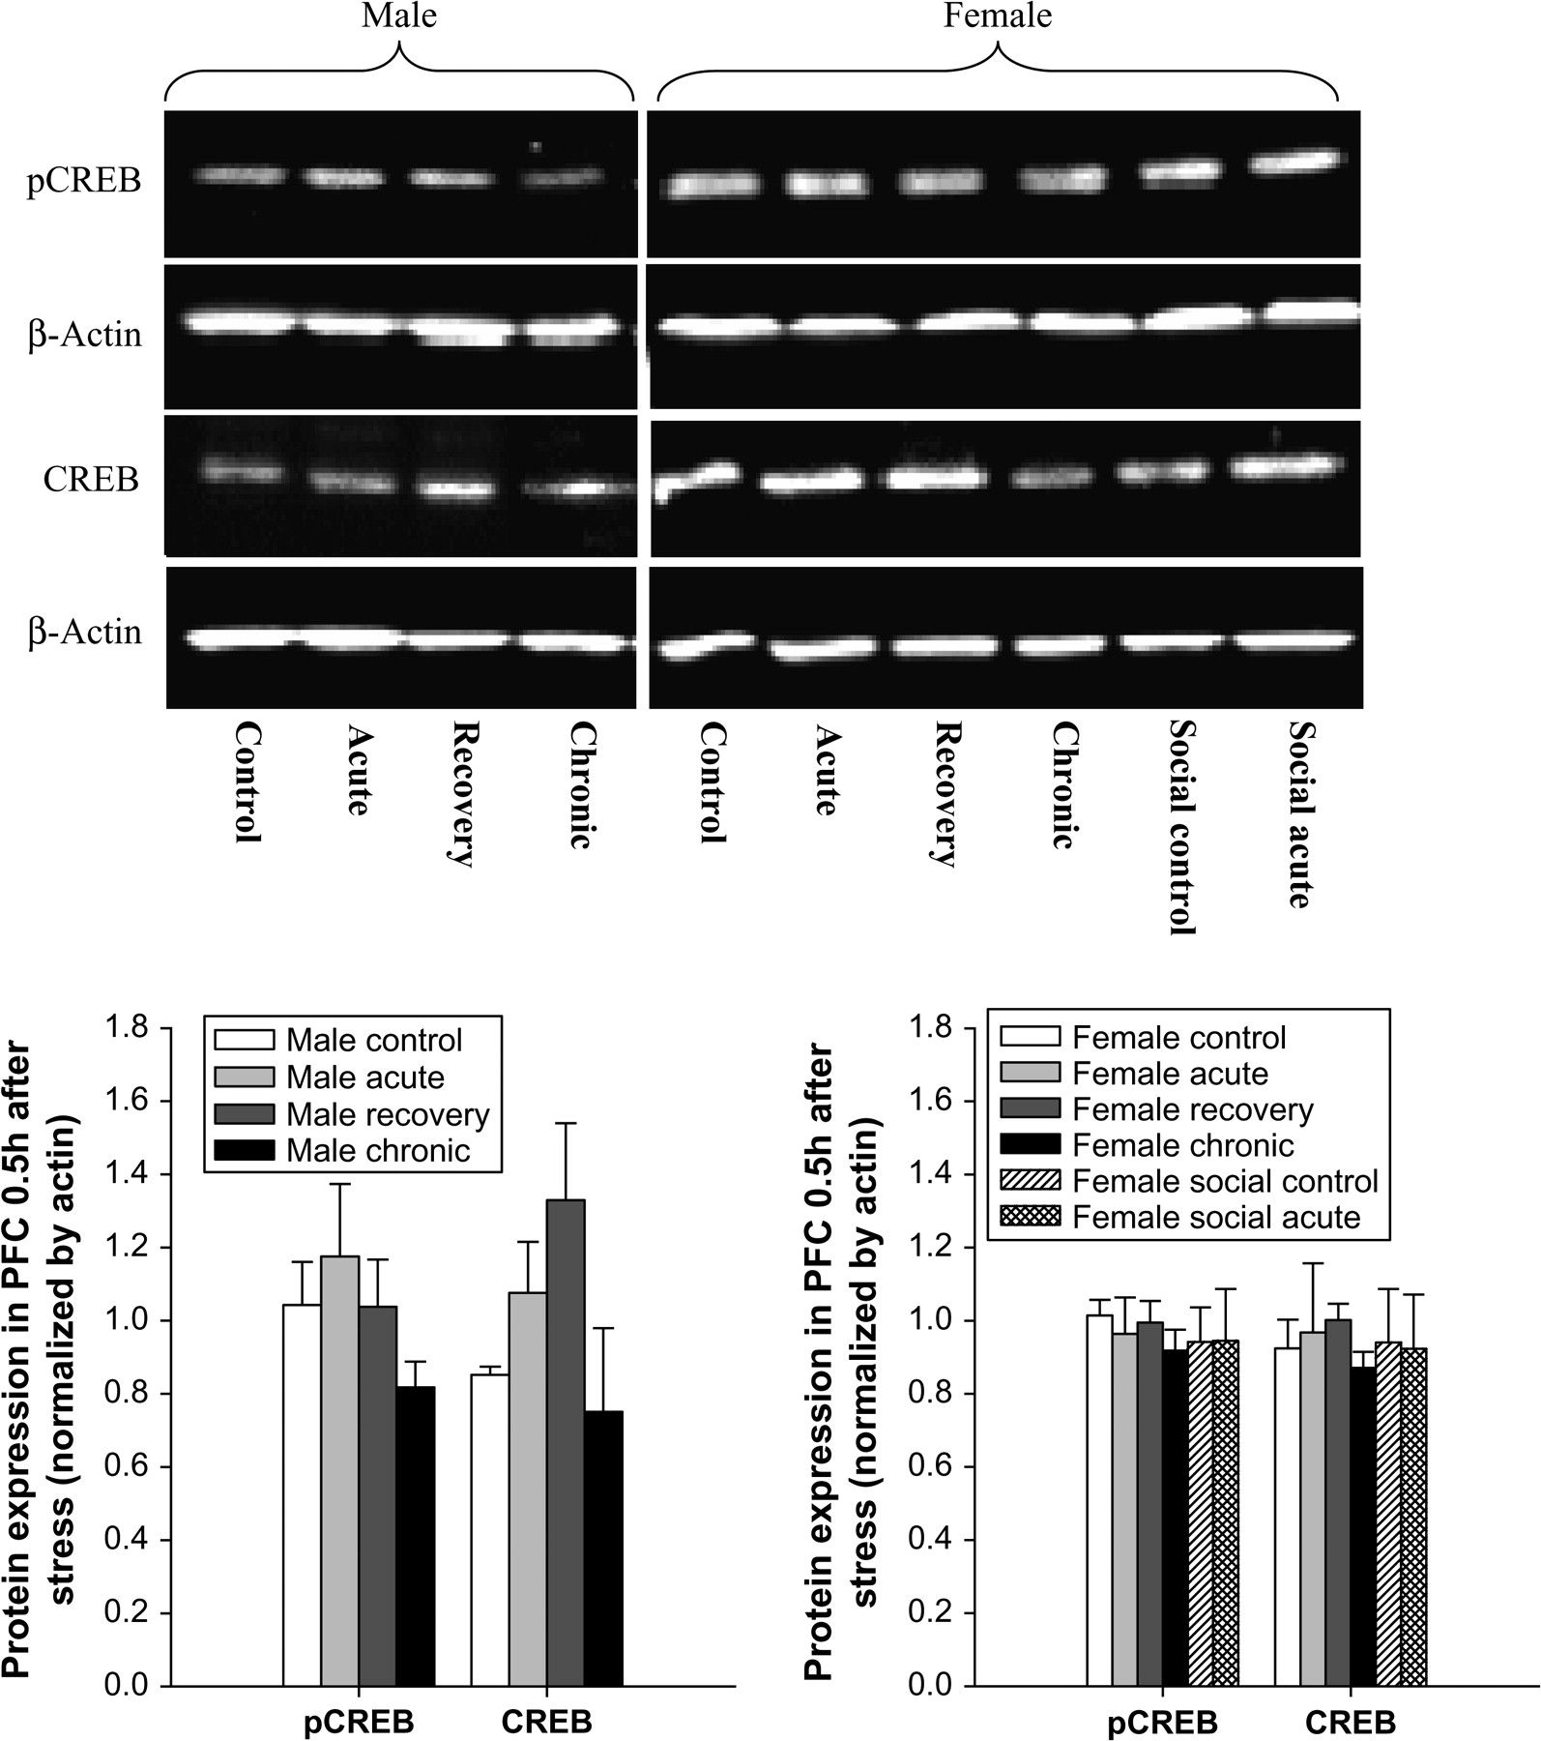
Figure 7. Expression of pCREB and CREB measured by Western blot (n = 5) in PFC (PL) of male rats and female rats 0.5 h ...
Notes:
Figure 7. Expression of pCREB and CREB measured by Western blot (n = 5) in PFC (PL) of male rats and female rats 0.5 h after exposure to the footshock box with the light only on day 43. The intensity of Western bands was quantified with a densitometric scanner and each column represented the group means ± SEM of 4 determinations. Stress, recovery and social housing had no significant effect on the expression of pCREB and CREB in PL 0.5 h after exposure to the footshock box.
Unless provided in the caption above, the following copyright applies to the content of this slide: © The Author 2008. Published by Oxford University Press. All rights reserved. For permissions, please e-mail: journals.permissions@oxfordjournals.org

Slide 8
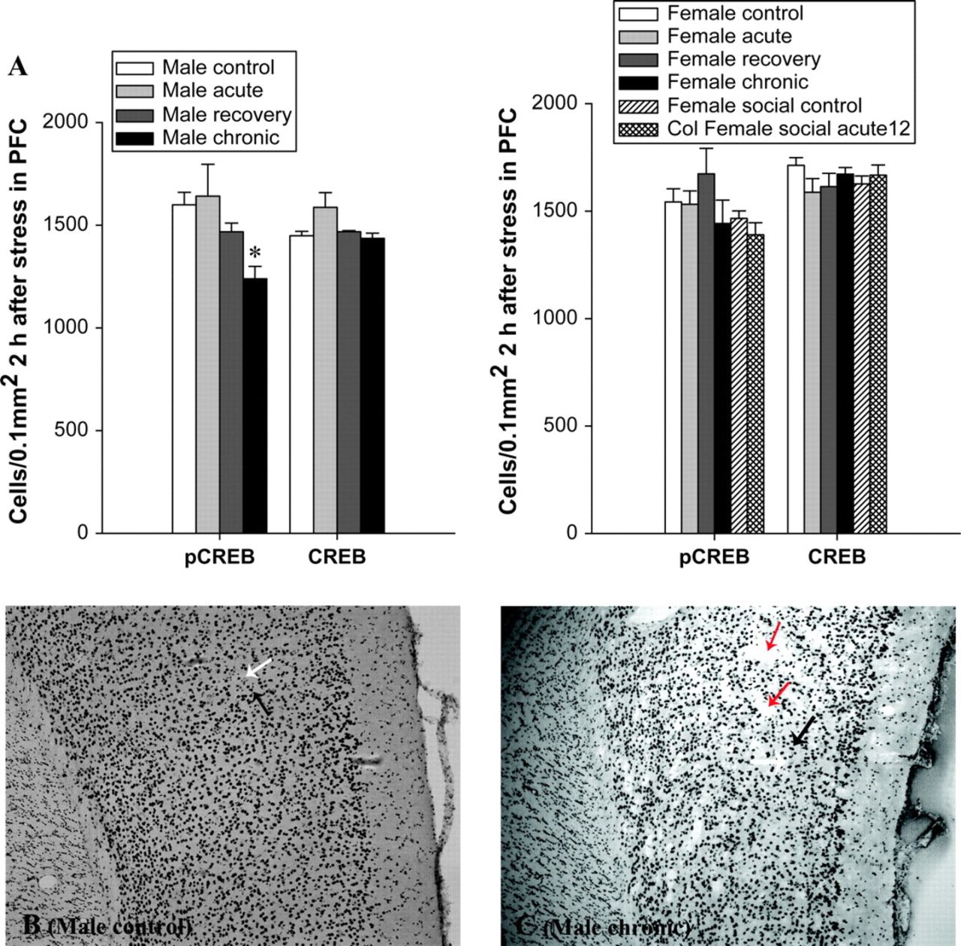
Figure 8. Number of cells expressing pCREB and CREB in PFC (PL) measured by immunohistochemistry in male rats and ...
Notes:
Figure 8. Number of cells expressing pCREB and CREB in PFC (PL) measured by immunohistochemistry in male rats and female rats 2 h after exposure to the footshock box with the light only on day 43. (A) Number of cells expressing pCREB and CREB 2 h after exposure to the stress box on day 43 in male and female PL, *P < 0.05 versus control group. (B) Representative photomicrographs of pCREB ir in the PL of control male rats (×100). (C) Representative photomicrographs of pCREB ir in the PL of male rats exposed to chronic stress (×100), “patches” were clearly observed (red arrow) in chronically stressed male rats. The filled arrows pointed to cells that were counted as labeled (positive), and open arrows pointed to cells that were counted as unlabeled (negative).
Unless provided in the caption above, the following copyright applies to the content of this slide: © The Author 2008. Published by Oxford University Press. All rights reserved. For permissions, please e-mail: journals.permissions@oxfordjournals.org

Slide 9
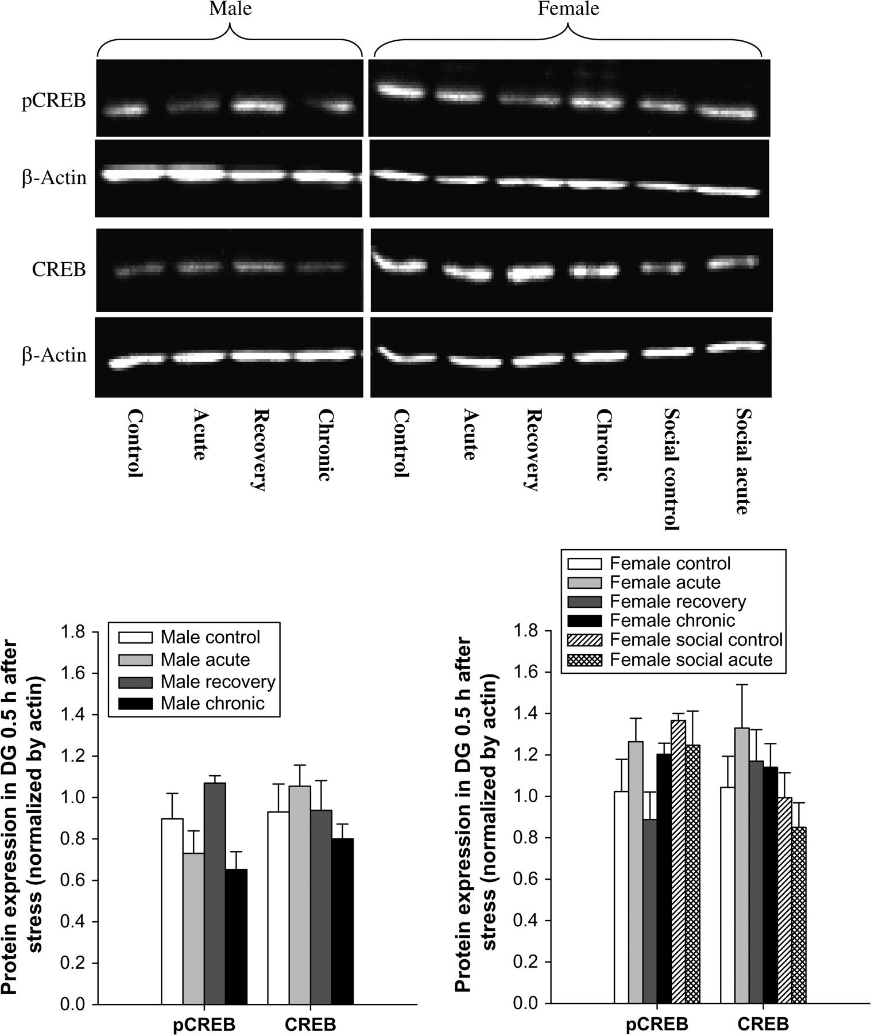
Figure 9. Expression of pCREB and CREB measured by Western blot (n = 5) in DG (DG-sg) of male rats and female rats 0.5 ...
Notes:
Figure 9. Expression of pCREB and CREB measured by Western blot (n = 5) in DG (DG-sg) of male rats and female rats 0.5 h after exposure to the footshock box with the light only on day 43. The intensity of Western bands was quantified with a densitometric scanner and each column represented the group means ± SEM of 4 determinations. Stress, recovery and social housing had no significant effect on the expression of pCREB and CREB in DG-sg 0.5 h after exposure to the footshock box.
Unless provided in the caption above, the following copyright applies to the content of this slide: © The Author 2008. Published by Oxford University Press. All rights reserved. For permissions, please e-mail: journals.permissions@oxfordjournals.org

Slide 10
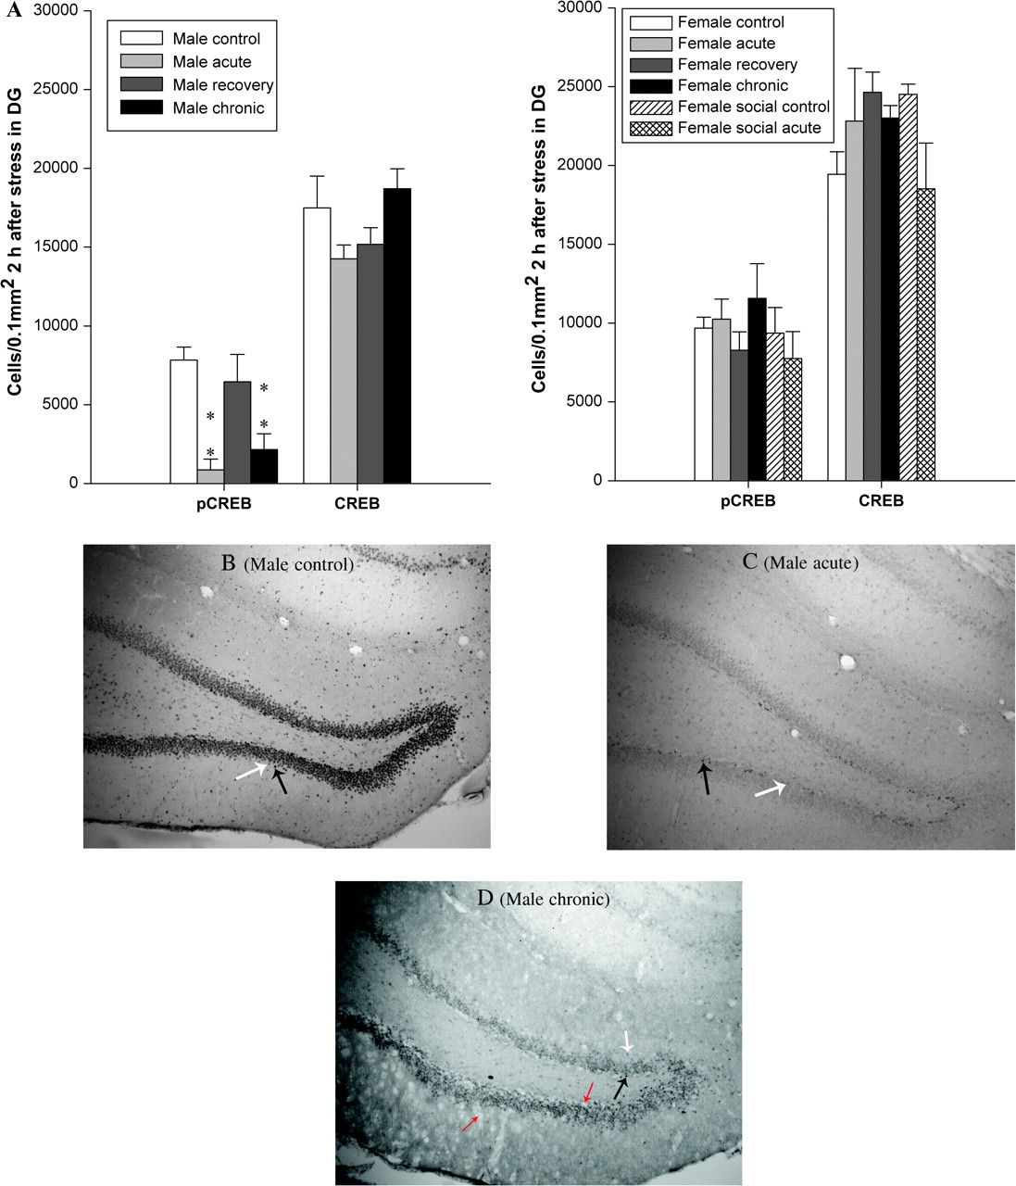
Figure 10. Number of cells expressing pCREB and CREB in the DG (DG-sg) measured by immunohistochemistry in male rats and ...
Notes:
Figure 10. Number of cells expressing pCREB and CREB in the DG (DG-sg) measured by immunohistochemistry in male rats and female rats 2 h after exposure to the footshock box with the light only on day 43. (A) Number of pCREB- and CREB-positive cells 2 h after exposure to the stress box on day 43 in male and female DG-sg, **P < 0.01 versus male control group. (B) Representative photomicrographs of pCREB ir in the DG-sg in control male rats (×100). (C) Representative photomicrographs of pCREB ir in the DG-sg in male rats exposed to acute stress (×100). (D) Representative photomicrographs of pCREB ir in the DG-sg in male rats exposed to chronic stress (×100), “patches” were clearly observed (red arrow) in chronically stressed male rats. The filled arrows pointed to cells that were counted as labeled (positive), and open arrows pointed to cells that were counted as unlabeled (negative).
Unless provided in the caption above, the following copyright applies to the content of this slide: © The Author 2008. Published by Oxford University Press. All rights reserved. For permissions, please e-mail: journals.permissions@oxfordjournals.org

