Slide 1
Figure 1 Patterns of the spatial structure of Schistosoma mansoni in (A) Cameroon, (B) Mali and (C) Uganda. ...
Notes:
Figure 1 Patterns of the spatial structure of Schistosoma mansoni in (A) Cameroon, (B) Mali and (C) Uganda. Omnidirectional semivariograms and best-fitted lines of exponential spatial models for de-trended log prevalence data based on Generalized Additive Model (GAM) residuals of longitude, latitude, rainfall, elevation and maximum land surface temperature. Based on parasitological data from Brooker et al. (2002a), Traore et al. (1998) and Kabatereine et al. (2004). Note: at the equator, 1 decimal degree equates to approximately 120 km.
Unless provided in the caption above, the following copyright applies to the content of this slide: © Royal Society of Tropical Medicine and Hygiene 2006

Slide 2
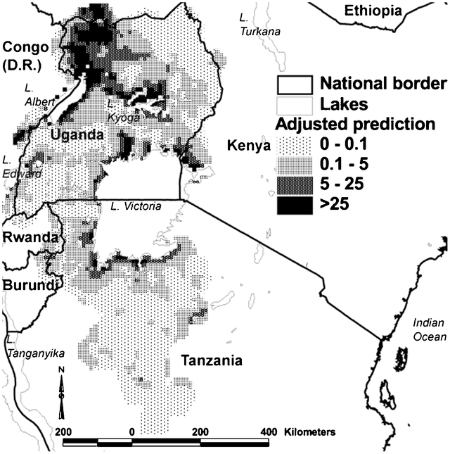
Figure 2 Predicted intensity of infection (eggs/g faeces) with Schistosoma mansoni in East Africa, adjusted for ...
Notes:
Figure 2 Predicted intensity of infection (eggs/g faeces) with Schistosoma mansoni in East Africa, adjusted for environmental covariates (distance to perennial water body and land surface temperature) based on a Bayesian geostatistical negative binomial model (modified from Clements et al., 2006b).
Unless provided in the caption above, the following copyright applies to the content of this slide: © Royal Society of Tropical Medicine and Hygiene 2006

Slide 3
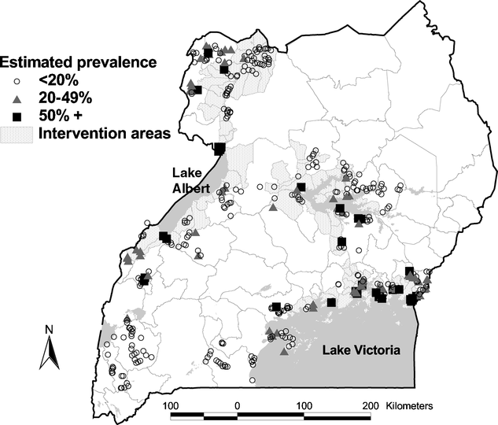
Figure 3 Distribution of Schistosoma mansoni in Uganda in 2006. Data are based on the results of a rapid mapping ...
Notes:
Figure 3 Distribution of Schistosoma mansoni in Uganda in 2006. Data are based on the results of a rapid mapping survey conducted in 31 districts using the Lot Quality Assurance Sampling (LQAS) technique.
Unless provided in the caption above, the following copyright applies to the content of this slide: © Royal Society of Tropical Medicine and Hygiene 2006

