Slide 1
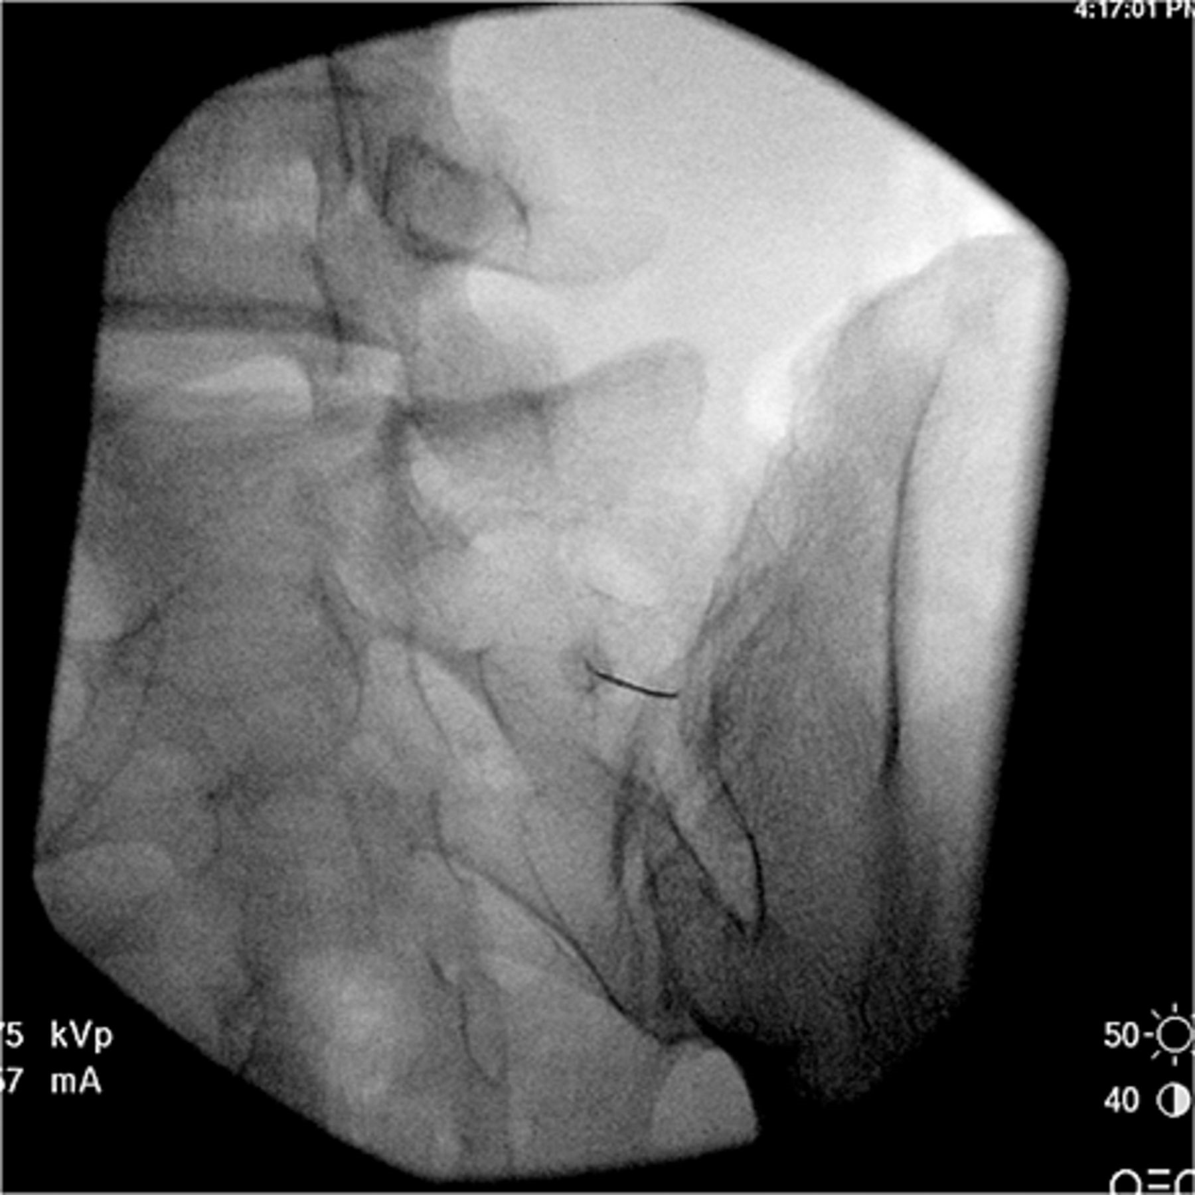
Figure 1 A contralateral oblique fluoroscopy view of a needle probing the interosseous sacroiliac ligament.
Notes:
Figure 1 A contralateral oblique fluoroscopy view of a needle probing the interosseous sacroiliac ligament.
Unless provided in the caption above, the following copyright applies to the content of this slide: © American Academy of Pain Medicine

Slide 2
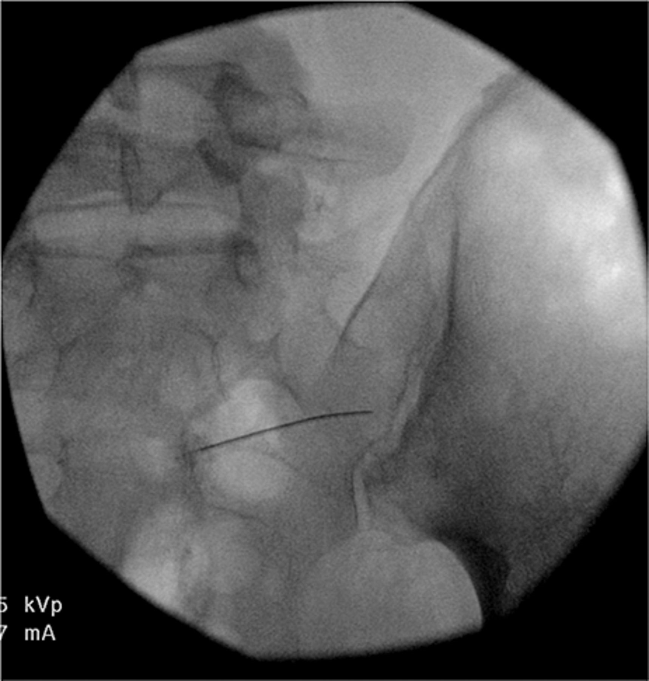
Figure 2 A postero-anterior fluoroscopy view of a needle probing the interosseous sacroiliac ligament.
Notes:
Figure 2 A postero-anterior fluoroscopy view of a needle probing the interosseous sacroiliac ligament.
Unless provided in the caption above, the following copyright applies to the content of this slide: © American Academy of Pain Medicine

Slide 3
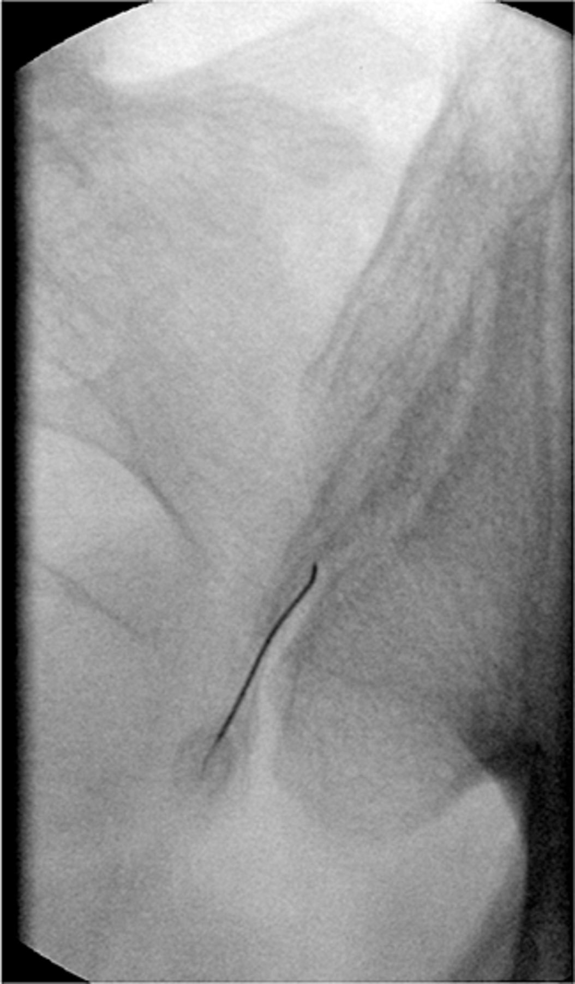
Figure 3 A postero-anterior fluoroscopy view of a needle probing the dorsal sacroiliac ligament.
Notes:
Figure 3 A postero-anterior fluoroscopy view of a needle probing the dorsal sacroiliac ligament.
Unless provided in the caption above, the following copyright applies to the content of this slide: © American Academy of Pain Medicine

Slide 4
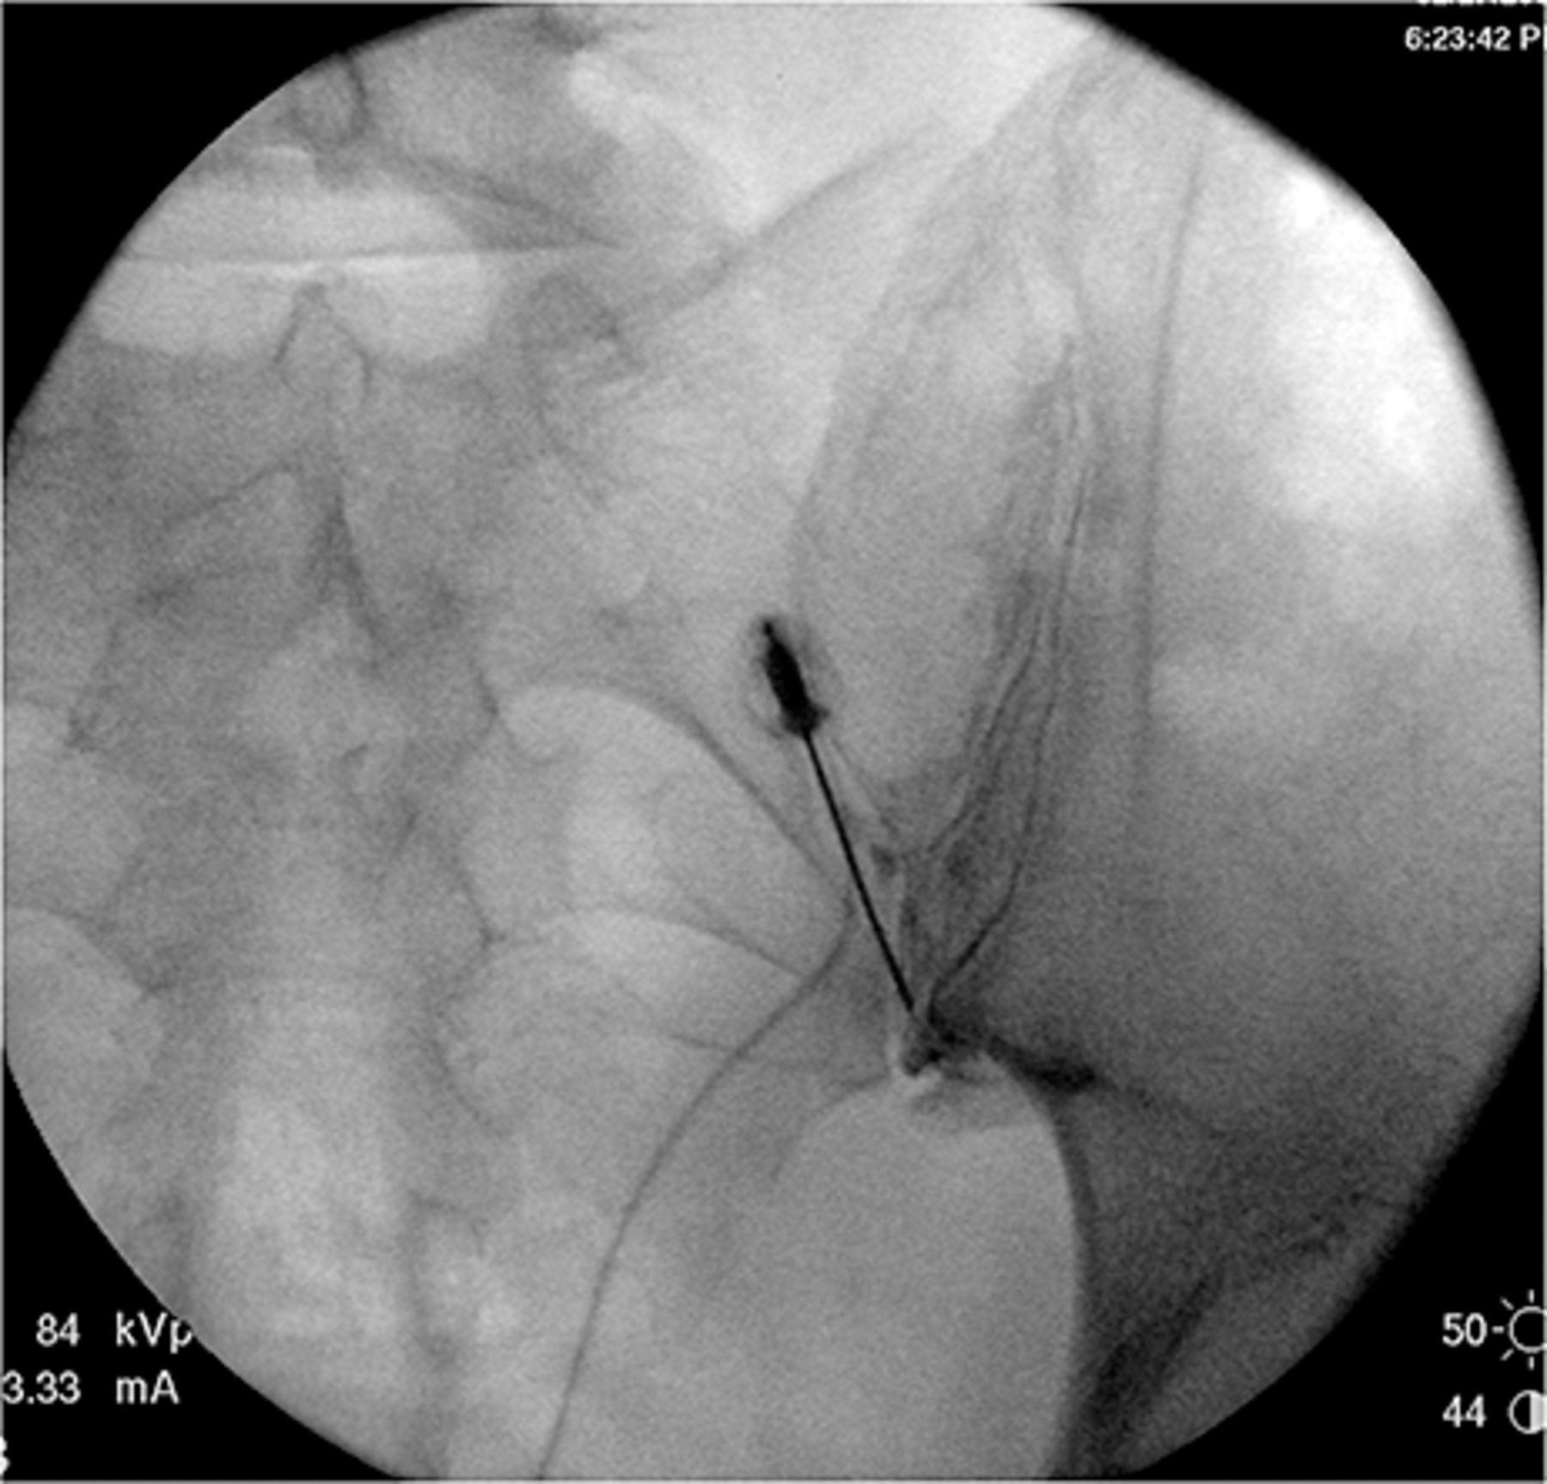
Figure 4 A postero-anterior fluoroscopy view of an arthrogram of the sacroiliac joint.
Notes:
Figure 4 A postero-anterior fluoroscopy view of an arthrogram of the sacroiliac joint.
Unless provided in the caption above, the following copyright applies to the content of this slide: © American Academy of Pain Medicine

Slide 5
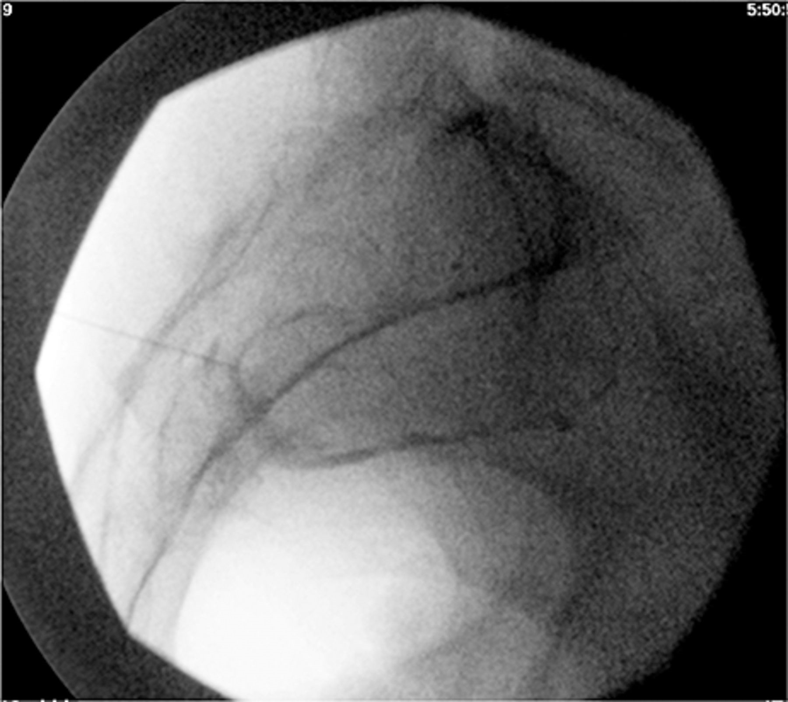
Figure 5 A lateral fluoroscopy view of an arthrogram of the sacroiliac joint.
Notes:
Figure 5 A lateral fluoroscopy view of an arthrogram of the sacroiliac joint.
Unless provided in the caption above, the following copyright applies to the content of this slide: © American Academy of Pain Medicine

Slide 6
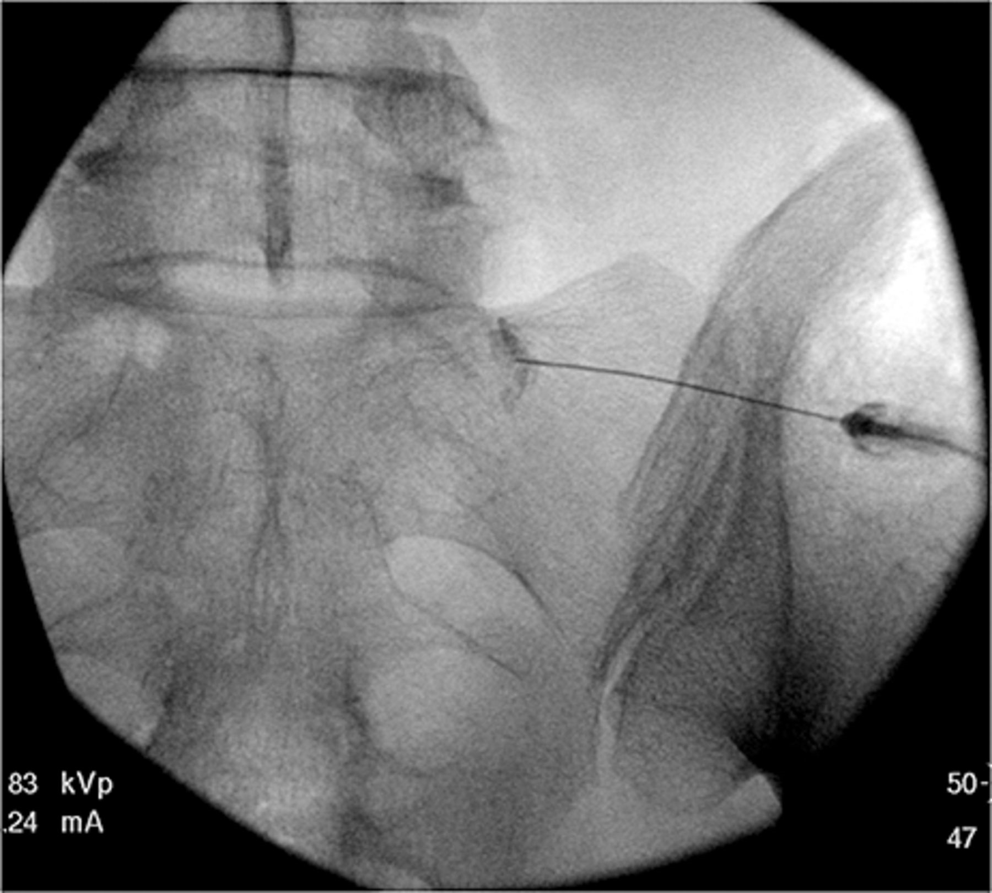
Figure 6 A postero-anterior fluoroscopy view of an injection of contrast medium prior to a L5 dorsal ramus block.
Notes:
Figure 6 A postero-anterior fluoroscopy view of an injection of contrast medium prior to a L5 dorsal ramus block.
Unless provided in the caption above, the following copyright applies to the content of this slide: © American Academy of Pain Medicine

Slide 7
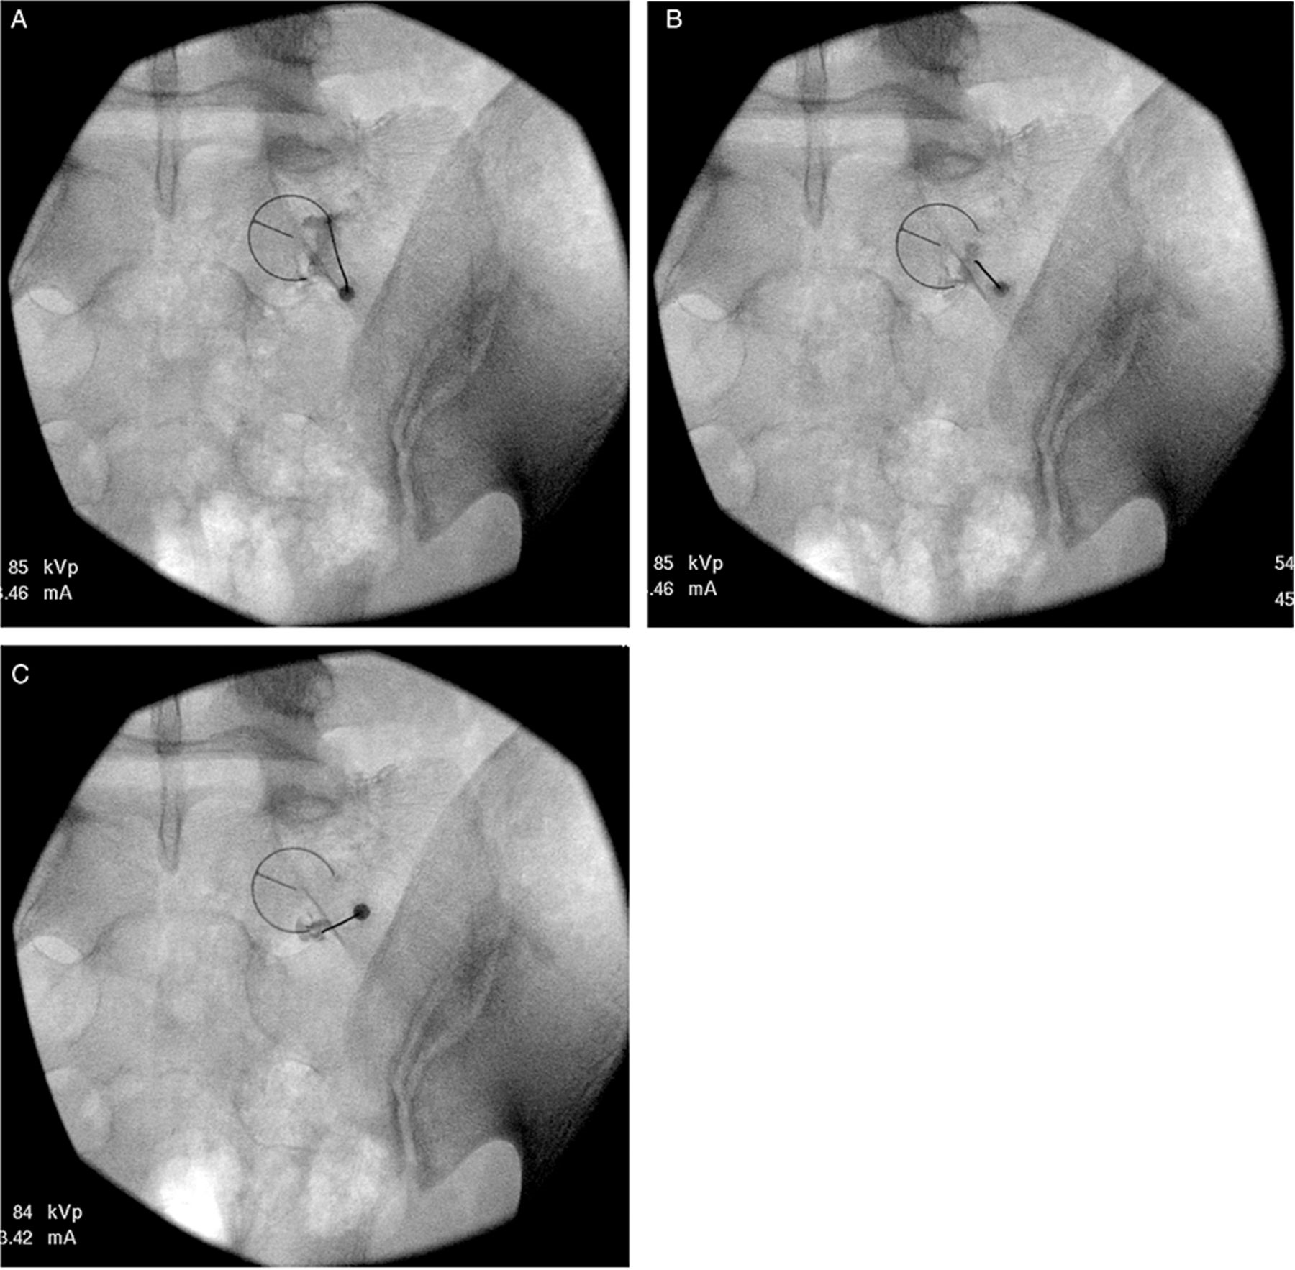
Figure 7 Postero-anterior fluoroscopy views of injections of contrast medium from needles placed at various positions ...
Notes:
Figure 7 Postero-anterior fluoroscopy views of injections of contrast medium from needles placed at various positions for S1 lateral branch blocks. (A) 2:30 position. (B) 4:00 position. (C) 5:30 position.
Unless provided in the caption above, the following copyright applies to the content of this slide: © American Academy of Pain Medicine

Slide 8
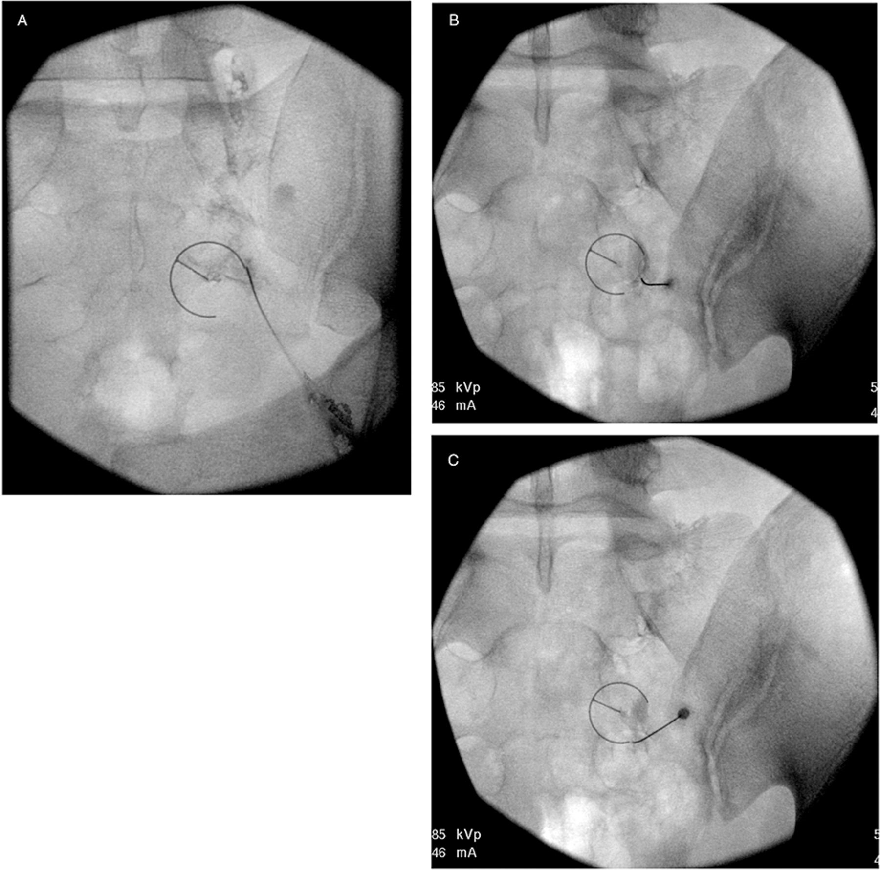
Figure 8 Postero-anterior fluoroscopy views of injections of contrast medium from needles placed at various positions ...
Notes:
Figure 8 Postero-anterior fluoroscopy views of injections of contrast medium from needles placed at various positions for S2 lateral branch blocks. (A) 2:30 position. (B) 4:00 position. (C) 5:30 position.
Unless provided in the caption above, the following copyright applies to the content of this slide: © American Academy of Pain Medicine

Slide 9
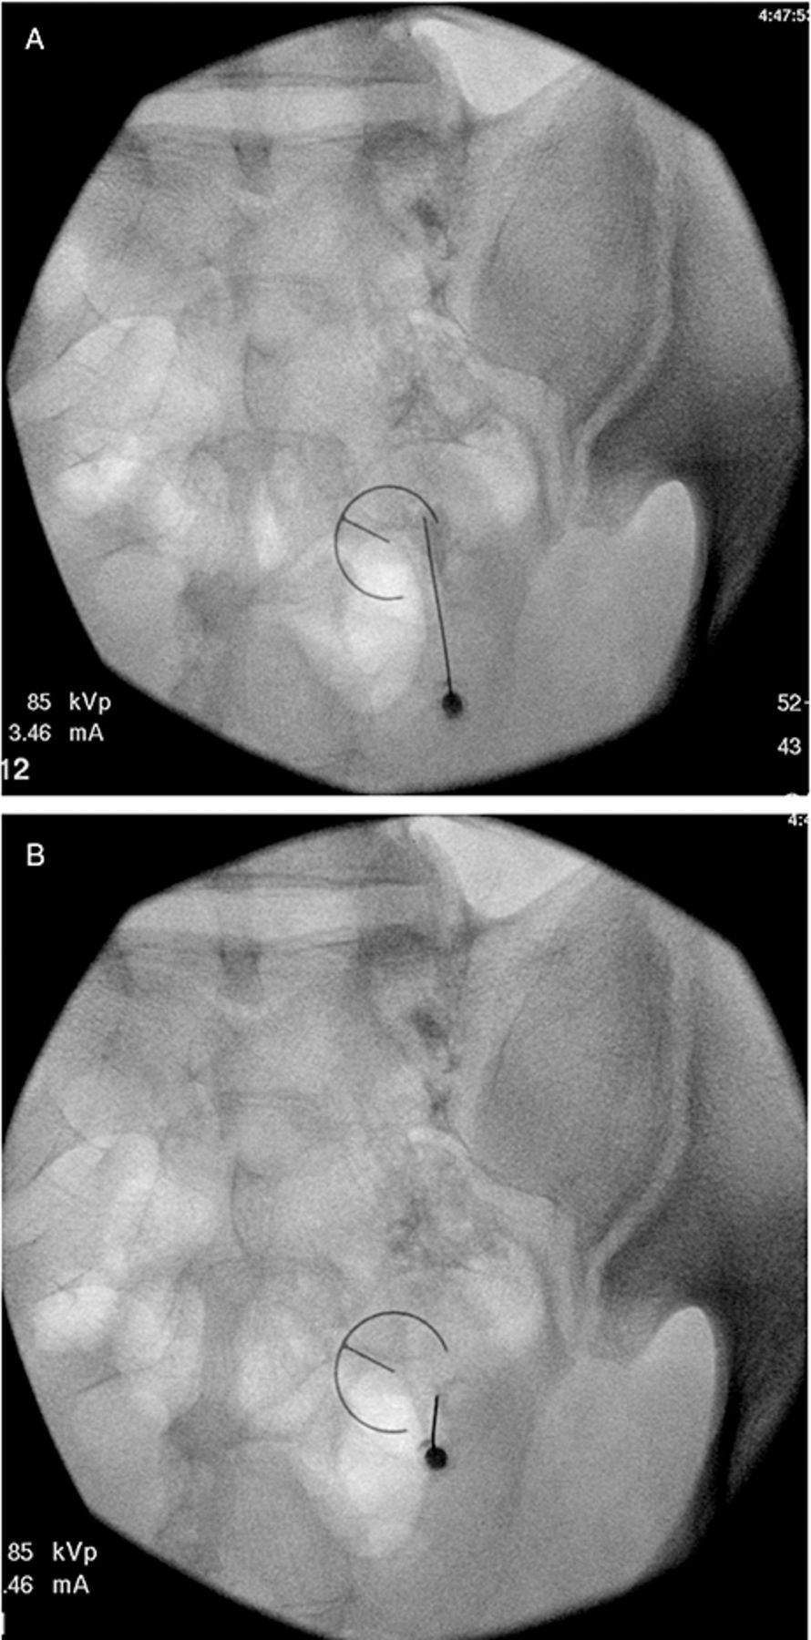
Figure 9 Postero-anterior fluoroscopy views of injections of contrast medium from needles placed at various positions ...
Notes:
Figure 9 Postero-anterior fluoroscopy views of injections of contrast medium from needles placed at various positions for S3 lateral branch blocks. (A) 2:30 position. (B) 4:00 position.
Unless provided in the caption above, the following copyright applies to the content of this slide: © American Academy of Pain Medicine

