Slide 1
Editor-in-Chief, Chris Jones
Notes:
Editor-in-Chief, Chris Jones
Unless provided in the caption above, the following copyright applies to the content of this slide: © The Author 2016. Published by Oxford University Press.This is an Open Access article distributed under the terms of the Creative Commons Attribution License (http://creativecommons.org/licenses/by/3.0/), which permits unrestricted reuse, distribution, and reproduction in any medium, provided the original work is properly cited.

Slide 2
Editor, Mathematics of Climate: Beatrice Pelloni
Notes:
Editor, Mathematics of Climate: Beatrice Pelloni
Unless provided in the caption above, the following copyright applies to the content of this slide: © The Author 2016. Published by Oxford University Press.This is an Open Access article distributed under the terms of the Creative Commons Attribution License (http://creativecommons.org/licenses/by/3.0/), which permits unrestricted reuse, distribution, and reproduction in any medium, provided the original work is properly cited.

Slide 3
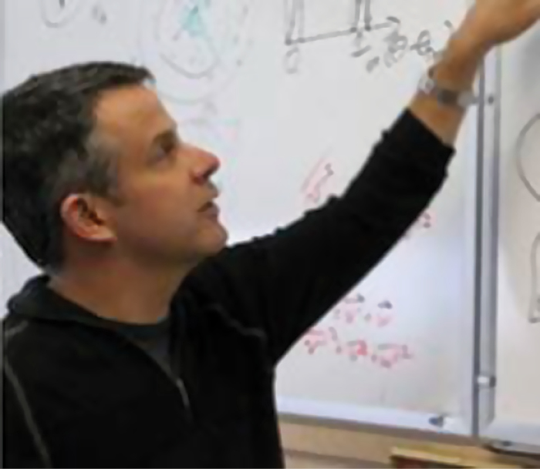
Editor, Physics of Climate: Baylor Fox-Kemper
Notes:
Editor, Physics of Climate: Baylor Fox-Kemper
Unless provided in the caption above, the following copyright applies to the content of this slide: © The Author 2016. Published by Oxford University Press.This is an Open Access article distributed under the terms of the Creative Commons Attribution License (http://creativecommons.org/licenses/by/3.0/), which permits unrestricted reuse, distribution, and reproduction in any medium, provided the original work is properly cited.

Slide 4
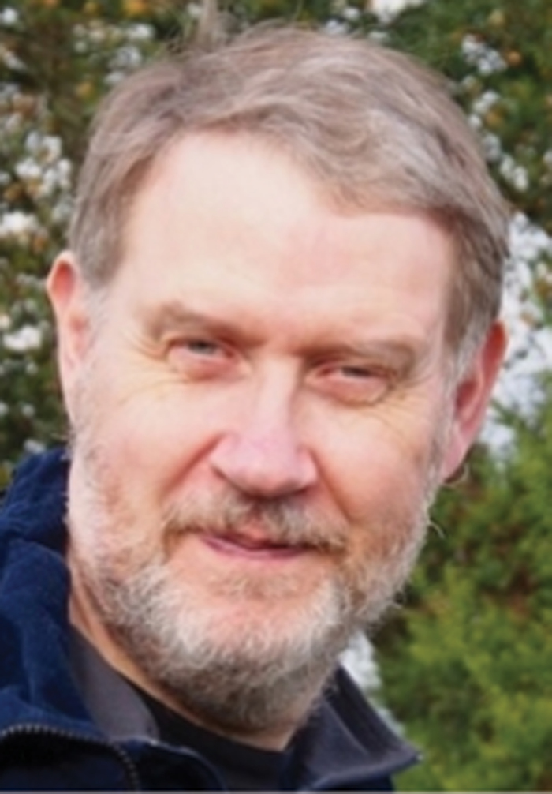
Editor, Statistics of Climate: Peter Challenor
Notes:
Editor, Statistics of Climate: Peter Challenor
Unless provided in the caption above, the following copyright applies to the content of this slide: © The Author 2016. Published by Oxford University Press.This is an Open Access article distributed under the terms of the Creative Commons Attribution License (http://creativecommons.org/licenses/by/3.0/), which permits unrestricted reuse, distribution, and reproduction in any medium, provided the original work is properly cited.

