Slide 1
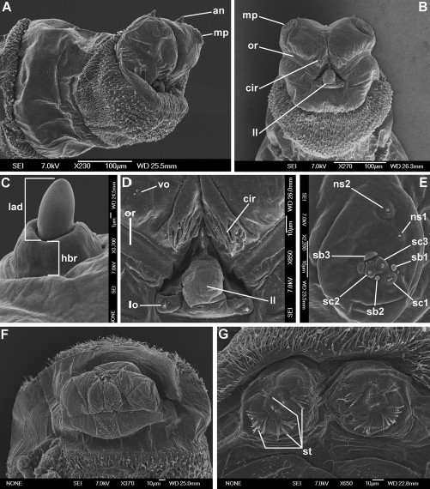
Fig. 1. First instar of C. croceipalpis. (A) Anterior end of body, antero-lateral view. (B) Anterior end of body, ...
Notes:
Fig. 1. First instar of C. croceipalpis. (A) Anterior end of body, antero-lateral view. (B) Anterior end of body, ventral view. (C) Antennal complex. (D) Functional mouth opening. (E) Maxillary palpus. (F) Anal division, ventral view. (G) Posterior spiracles. an, antennal complex; cir, cirri; hbr, height of basal ring; mp, maxillary palpus; lad, length of antennal dome; ll, labial lobe; lo, labial organ; ns1, first additional sensillum coeloconicum; ns2, second additional sensillum coeloconicum; or, oral ridges; sb1–3, sensilla basiconica; sc1–3, sensilla coeloconica; st, spiracular tufts; vo, ventral organ.
Unless provided in the caption above, the following copyright applies to the content of this slide: © 2011 Entomological Society of America

Slide 2
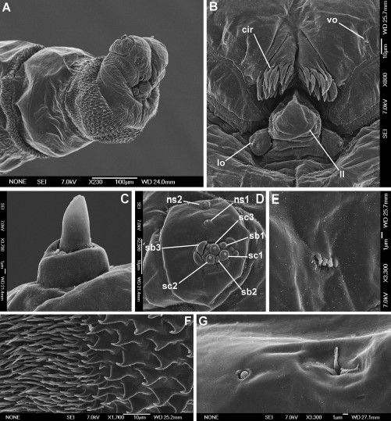
Fig. 2. First instar of Ch. marginalis. (A) Anterior end of body, antero-lateral view. (B) Functional mouth opening. ...
Notes:
Fig. 2. First instar of Ch. marginalis. (A) Anterior end of body, antero-lateral view. (B) Functional mouth opening. (C) Antennal complex. (D) Maxillary palpus. (E) Ventral organ. (F) First thoracic segment, anterior spinose band. (G) First thoracic segment, sensilla coeloconica (left) and Keilin's organ (right). cir, cirri; ll, labial lobe; lo, labial organ; ns1, first additional sensillum coeloconicum; ns2, second additional sensillum coeloconicum; sb1–3, sensilla basiconica; sc1–3, sensilla coeloconica; vo, ventral organ.
Unless provided in the caption above, the following copyright applies to the content of this slide: © 2011 Entomological Society of America

Slide 3
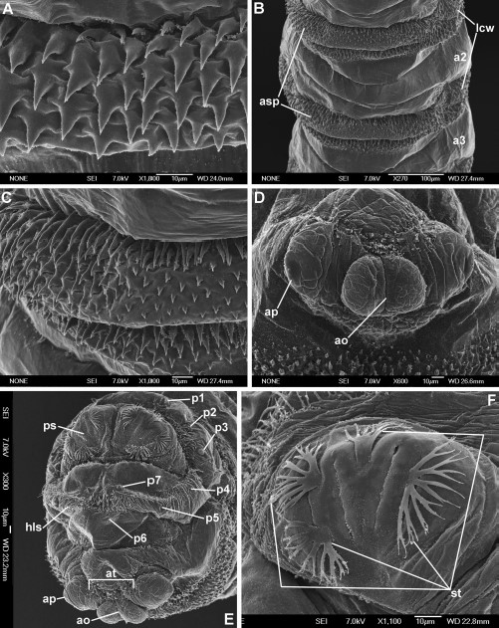
Fig. 3. First instar of Ch. marginalis. (A) Second abdominal segment, dorsal surface, anterior spinose band. (B) ...
Notes:
Fig. 3. First instar of Ch. marginalis. (A) Second abdominal segment, dorsal surface, anterior spinose band. (B) Second abdominal segment, ventral surface. (C) Second abdominal segment, ventral surface, anterior spinose band. (D) Anal pads and anal opening. (E) Anal division, posterior view. (F) Posterior spiracle. a2–3, abdominal segments; ao, anal opening; ap, anal pad; asp, anterior spinose band; at, anal tuft; hls, hair-like spines; lcw, lateral creeping welt; p1–p7, papillae around spiracular field; ps, posterior spiracle; st, spiracular tufts.
Unless provided in the caption above, the following copyright applies to the content of this slide: © 2011 Entomological Society of America

Slide 4
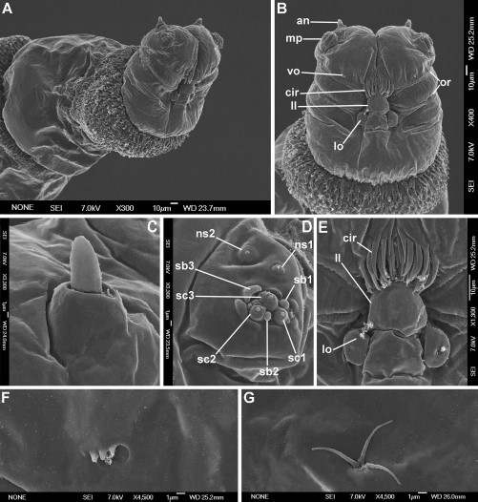
Fig. 4. First instar of Ch. chloropyga. (A) Anterior end of body, antero-lateral view. (B) Anterior end of body, ...
Notes:
Fig. 4. First instar of Ch. chloropyga. (A) Anterior end of body, antero-lateral view. (B) Anterior end of body, ventral view. (C) Antennal complex. (D) Maxillary palpus. (E) Functional mouth opening. (F) Ventral organ. (G) Keilin's organ. an, antennal complex; cir, cirri; mp, maxillary palpus; ll, labial lobe; lo, labial organ; ns1, first additional sensillum coeloconicum; ns2, second additional sensillum coeloconicum; or, oral ridges; sb1–3, sensilla basiconica; sc1–3, sensilla coeloconica; vo, ventral organ.
Unless provided in the caption above, the following copyright applies to the content of this slide: © 2011 Entomological Society of America

Slide 5
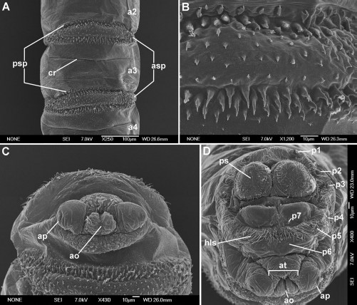
Fig. 5. First instar of Ch. chloropyga. (A) Third abdominal segment, ventral surface. (B) Third abdominal segment, ...
Notes:
Fig. 5. First instar of Ch. chloropyga. (A) Third abdominal segment, ventral surface. (B) Third abdominal segment, ventral surface, anterior spinose band. (C) Anal division, ventral surface. (D) Anal division, posterior view. a2–4, abdominal segments; ao, anal opening; ap, anal pad; asp, anterior spinose band; at, anal tuft; cr, crevice; hls, hair-like spines; p1–p7, papillae around spiracular field; ps, posterior spiracle.
Unless provided in the caption above, the following copyright applies to the content of this slide: © 2011 Entomological Society of America

Slide 6
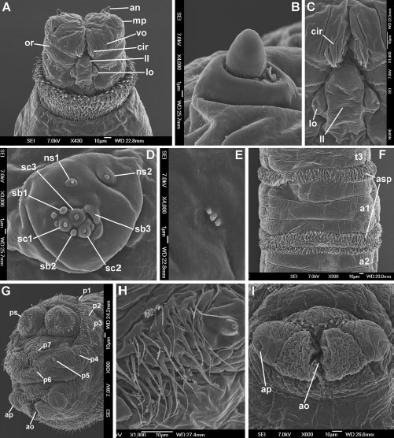
Fig. 6. First instar of Ch. putoria. (A) Anterior end of body, ventral view. (B) Antennal complex. (C) Functional ...
Notes:
Fig. 6. First instar of Ch. putoria. (A) Anterior end of body, ventral view. (B) Antennal complex. (C) Functional mouth opening. (D) Maxillary palpus. (E) Ventral organ. (F) Third abdominal segment, ventral surface. (G) Anal division, postero-lateral view. (H) Anal division, hair-like spines. (I) Anal pads and anal opening. a1–2, abdominal segments; an, antennal complex; ao, anal opening; ap, anal pad; asp, anterior spinose band; cir, cirri; mp, maxillary palpus; ll, labial lobe; lo, labial organ; ns1, first additional sensillum coeloconicum; ns2, second additional sensillum coeloconicum; or, oral ridges; p1–p7, papillae around spiracular field; ps, posterior spiracle; sb1–3, sensilla basiconica; sc1–3, sensilla coeloconica; t3, third thoracic segment; vo, ventral organ.
Unless provided in the caption above, the following copyright applies to the content of this slide: © 2011 Entomological Society of America

Slide 7
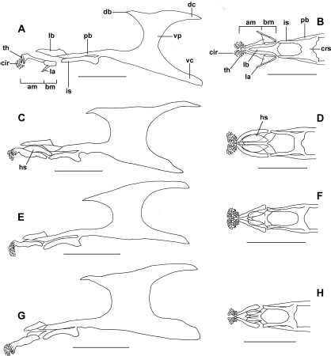
Fig. 7. Cephaloskeleton. (A) C. croceipalpis, lateral view. (B) C. croceipalpis, anterior part, ventral view. (C) Ch. ...
Notes:
Fig. 7. Cephaloskeleton. (A) C. croceipalpis, lateral view. (B) C. croceipalpis, anterior part, ventral view. (C) Ch. marginalis, lateral view. (D) Ch. marginalis, anterior part, ventral view. (E) Ch. chloropyga, lateral view. (F) Ch. chloropyga, anterior part, ventral view. (G) Ch. putoria, lateral view. (H) Ch. putoria, anterior part, ventral view. am, anterior part of mouthhook; bm, basal part of mouthhook; cir, cirri; crs, crossbeam of intermediate sclerite; db, dorsal bridge; dc, dorsal cornua; hs, hemispherical structure; is, intermediate sclerite; la, lateral arm; lb, labrum; mh, mouthhook; pb, parastomal bar; th, teeth; vc, ventral cornua; vp, vertical plate.
Unless provided in the caption above, the following copyright applies to the content of this slide: © 2011 Entomological Society of America

Slide 8
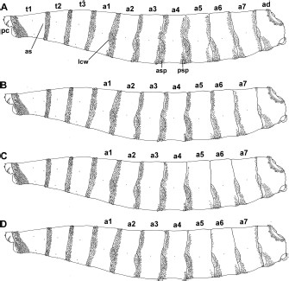
Fig. 8. Patterns of spinulation. (A) C. croceipalpis. (B) Ch. marginalis. (C) Ch. chloropyga. (D) Ch. putoria. a1–7, ...
Notes:
Fig. 8. Patterns of spinulation. (A) C. croceipalpis. (B) Ch. marginalis. (C) Ch. chloropyga. (D) Ch. putoria. a1–7, abdominal segments; ad, anal division; as, anterior spiracle; asp, anterior spinose band; lcw, lateral creeping welt; pc, pseudocephalon; psp, posterior spinose band.
Unless provided in the caption above, the following copyright applies to the content of this slide: © 2011 Entomological Society of America

Slide 9
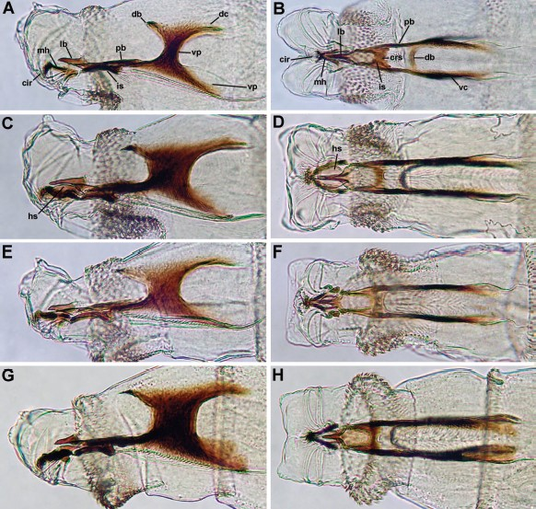
Fig. 9. Cephaloskeleton. (A) C. croceipalpis, lateral view. (B) C. croceipalpis, ventral view. (C) Ch. marginalis, ...
Notes:
Fig. 9. Cephaloskeleton. (A) C. croceipalpis, lateral view. (B) C. croceipalpis, ventral view. (C) Ch. marginalis, lateral view. (D) Ch. marginalis, ventral view. (E) Ch. chloropyga, lateral view. (F) Ch. chloropyga, ventral view. (G) Ch. putoria, lateral view. (H) Ch. putoria, ventral view. cir, cirri; crs, crossbeam of intermediate sclerite; db, dorsal bridge; dc, dorsal cornua; hs, hemispherical structure; is, intermediate sclerite; lb, labrum; mh, mouthhook; pb, parastomal bar; vc, ventral cornua; vp, vertical plate. (Online figure in color.)
Unless provided in the caption above, the following copyright applies to the content of this slide: © 2011 Entomological Society of America

Slide 10
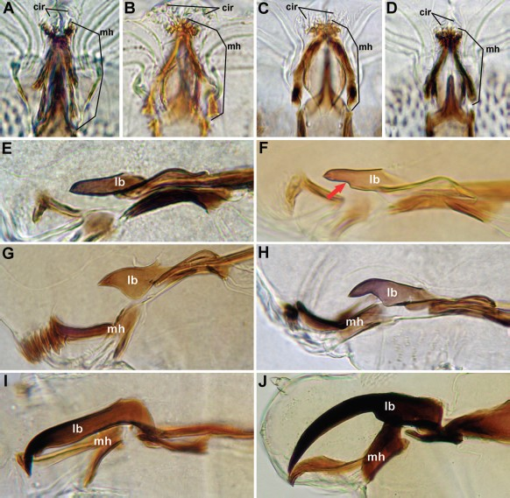
Fig. 10. Cephaloskeleton. (A) C. croceipalpis, anterior part, ventral view. (B) Ch. marginalis, anterior part, ventral ...
Notes:
Fig. 10. Cephaloskeleton. (A) C. croceipalpis, anterior part, ventral view. (B) Ch. marginalis, anterior part, ventral view. (C) Ch. chloropyga, anterior part, ventral view. (D) Ch. putoria, anterior part, ventral view. (E) L. cuprina, labrum and mouthhook. (F) L. sericata, labrum and mouthhook. (G) S. stercoraria, labrum and mouthhook. (H) M. prolapsa, labrum and mouthhook. (I) X. menuhini, labrum and mouthhook. (J) Wohlfahrtia sp., labrum and mouthhook. cir, cirri; mh, mouthhook; lb, labrum. (Online figure in color.)
Unless provided in the caption above, the following copyright applies to the content of this slide: © 2011 Entomological Society of America

