Slide 1
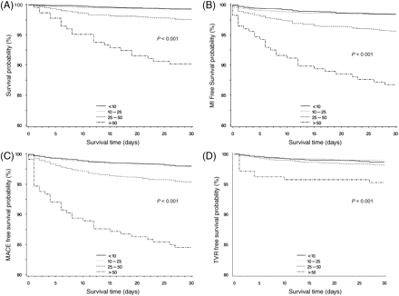
Figure 1 Time-to-event curves through 30 days for (A) death, (B) death–myocardial infarction, (C) target vessel ...
Notes:
Figure 1 Time-to-event curves through 30 days for (A) death, (B) death–myocardial infarction, (C) target vessel revascularization (TVR)–major adverse cardiac events (MACE), and (D) TVR.
Unless provided in the caption above, the following copyright applies to the content of this slide: Published on behalf of the European Society of Cardiology. All rights reserved. © The Author 2010. For permissions please email: journals.permissions@oxfordjournals.org

