Slide 1
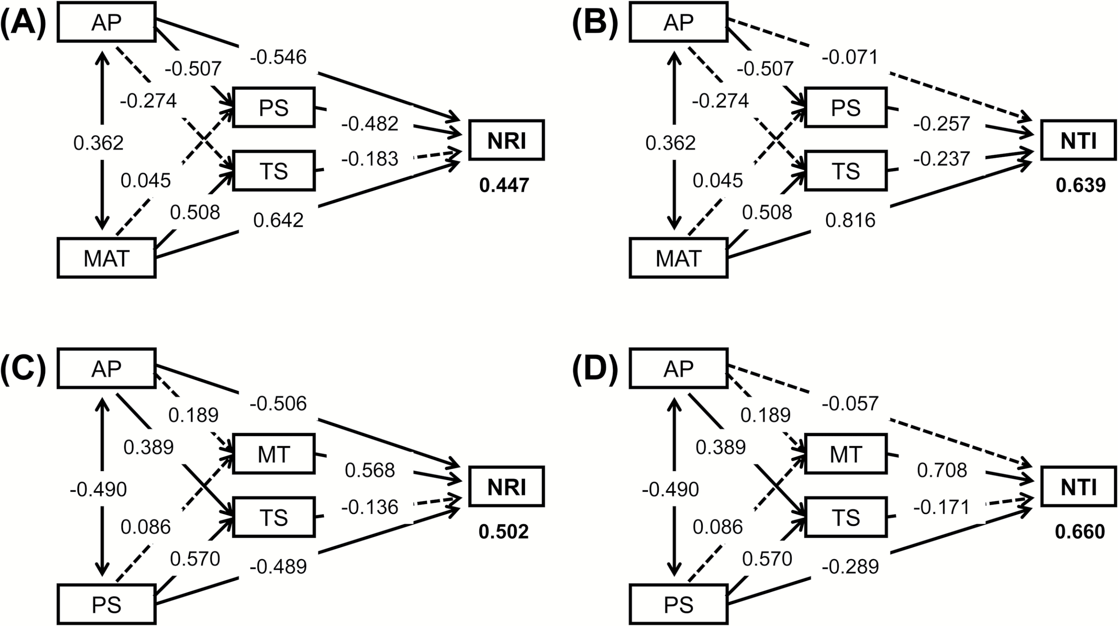
Figure 3: structural equation models (SEM) showing relationships among annual precipitation (AP), precipitation ...
Notes:
Figure 3: structural equation models (SEM) showing relationships among annual precipitation (AP), precipitation seasonality (PS), mean annual temperature (MAT), minimum temperature (MT), and temperature seasonality (TS) in explaining variation in net relatedness index (NRI) and nearest taxon index (NTI) of angiosperm woody plants along the elevational gradient. Numbers on arrow lines are standardized path coefficients; numbers below boxes for NRI and NTI are R2 values. Path coefficients with dash lines are not significant (P > 0.05).
Unless provided in the caption above, the following copyright applies to the content of this slide: © The Author(s) 2017. Published by Oxford University Press on behalf of the Institute of Botany, Chinese Academy of Sciences and the Botanical Society of China. All rights reserved. For permissions, please email: journals.permissions@oup.com

Slide 2
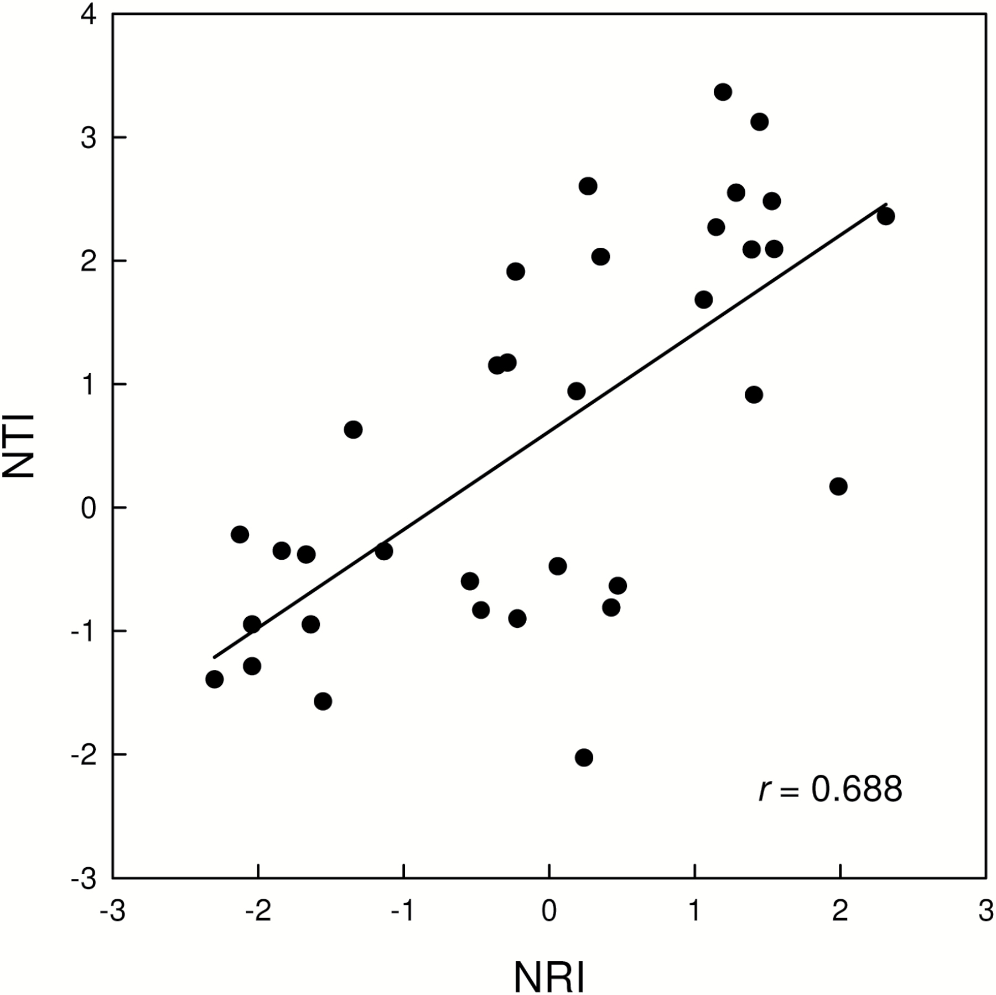
Figure 2: the relationship between net relatedness index (NRI) and nearest taxon index (NTI).
Notes:
Figure 2: the relationship between net relatedness index (NRI) and nearest taxon index (NTI).
Unless provided in the caption above, the following copyright applies to the content of this slide: © The Author(s) 2017. Published by Oxford University Press on behalf of the Institute of Botany, Chinese Academy of Sciences and the Botanical Society of China. All rights reserved. For permissions, please email: journals.permissions@oup.com

Slide 3
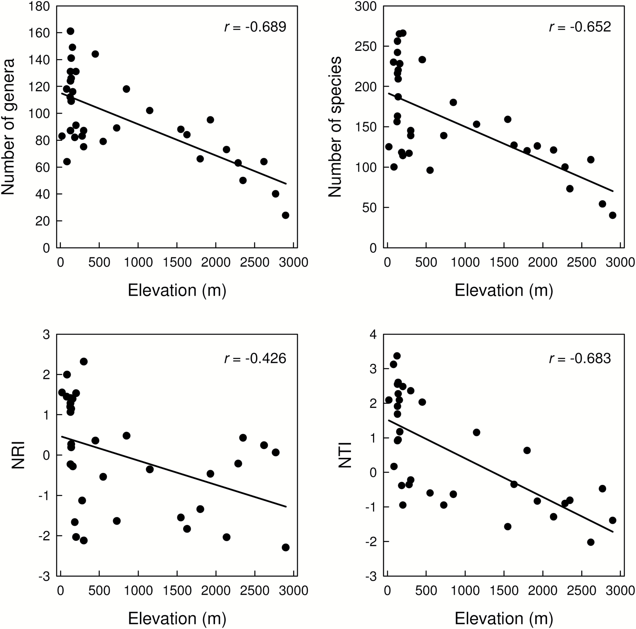
Figure 1: relationships of elevation with the number of genera, the number of species, net relatedness index (NRI) and ...
Notes:
Figure 1: relationships of elevation with the number of genera, the number of species, net relatedness index (NRI) and nearest taxon index (NTI). P < 0.05 in all cases.
Unless provided in the caption above, the following copyright applies to the content of this slide: © The Author(s) 2017. Published by Oxford University Press on behalf of the Institute of Botany, Chinese Academy of Sciences and the Botanical Society of China. All rights reserved. For permissions, please email: journals.permissions@oup.com

