Slide 1
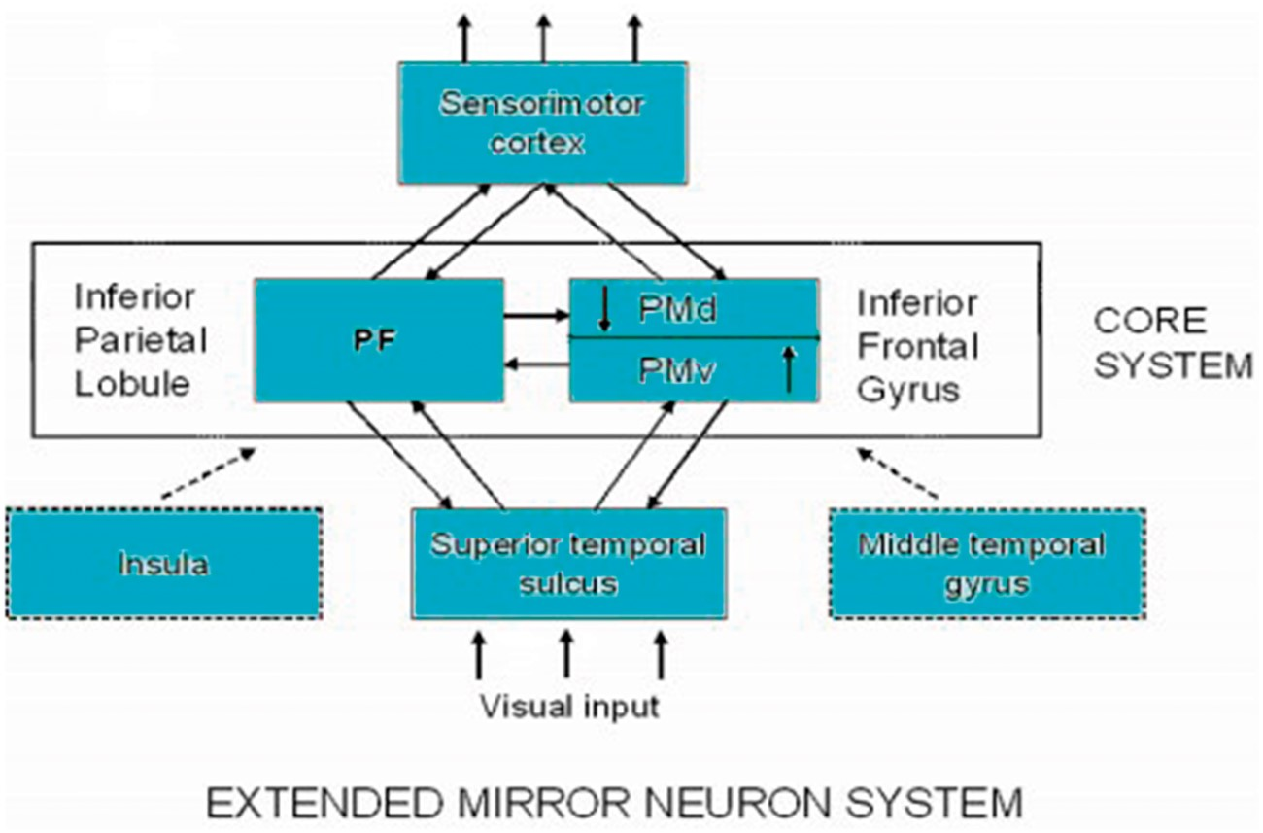
Figure 1. A causal network model of action understanding.
Notes:
Figure 1. A causal network model of action understanding.
Unless provided in the caption above, the following copyright applies to the content of this slide: © The Author 2015. Published by Oxford University Press on behalf of British Society for the Philosophy of Science. All rights reserved. For Permissions, please email: journals.permissions@oup.com

Slide 2
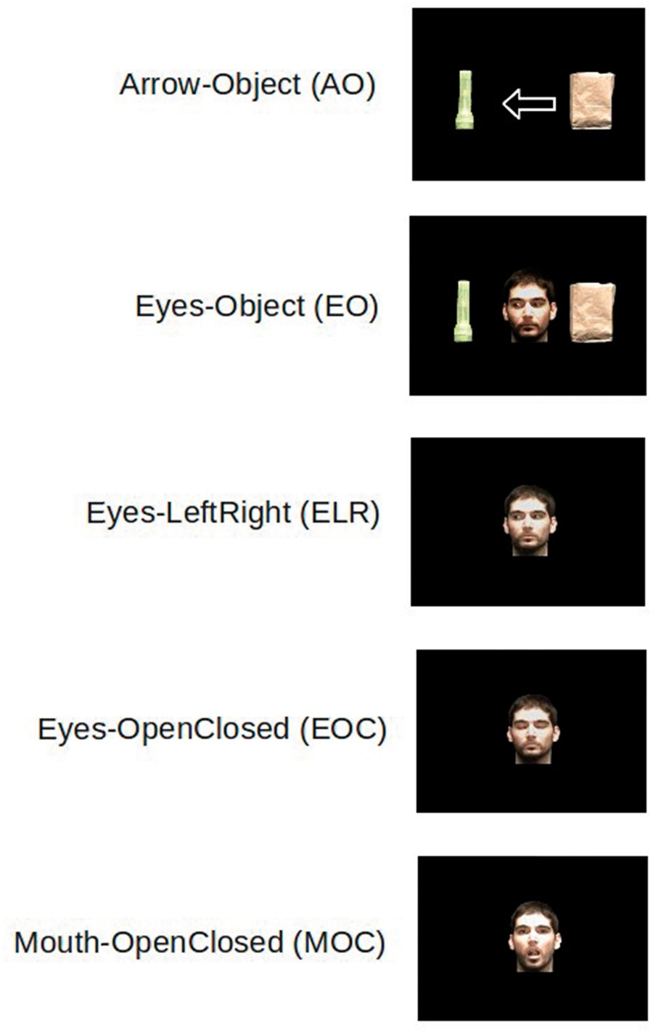
Figure 2. Stimuli in the Hanson et al. experiment.
Notes:
Figure 2. Stimuli in the Hanson et al. experiment.
Unless provided in the caption above, the following copyright applies to the content of this slide: © The Author 2015. Published by Oxford University Press on behalf of British Society for the Philosophy of Science. All rights reserved. For Permissions, please email: journals.permissions@oup.com

Slide 3
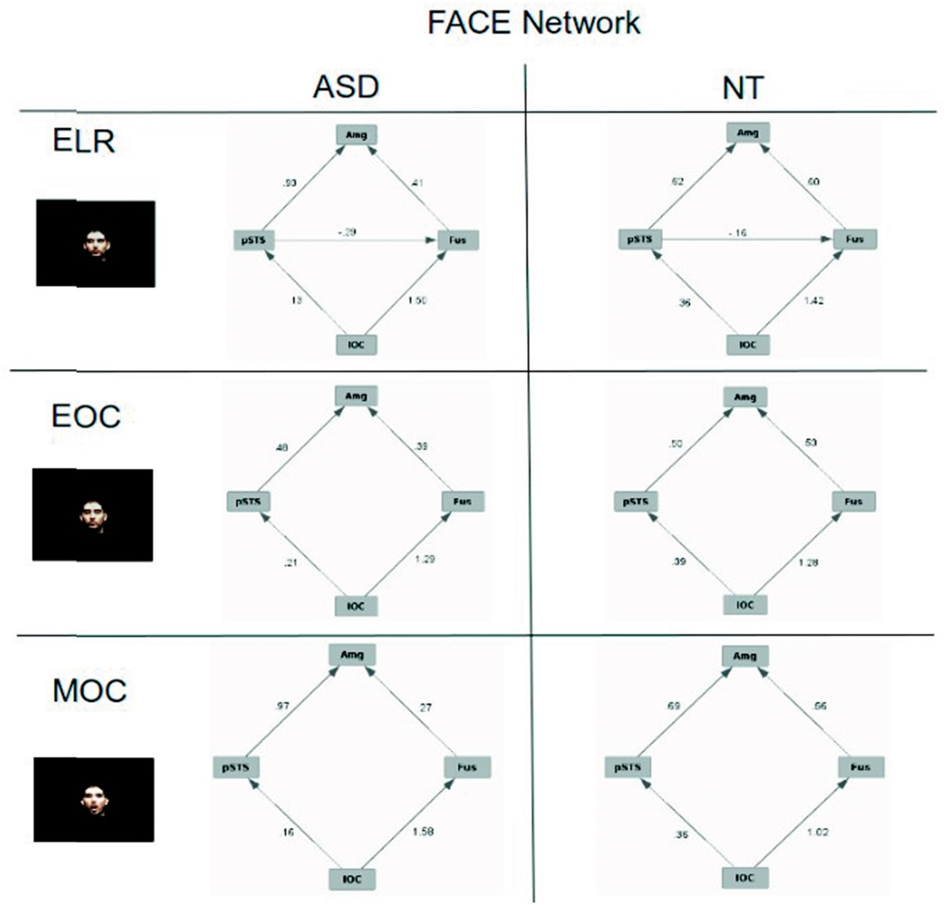
Figure 3. Causal networks for FACE stimuli.
Notes:
Figure 3. Causal networks for FACE stimuli.
Unless provided in the caption above, the following copyright applies to the content of this slide: © The Author 2015. Published by Oxford University Press on behalf of British Society for the Philosophy of Science. All rights reserved. For Permissions, please email: journals.permissions@oup.com

Slide 4
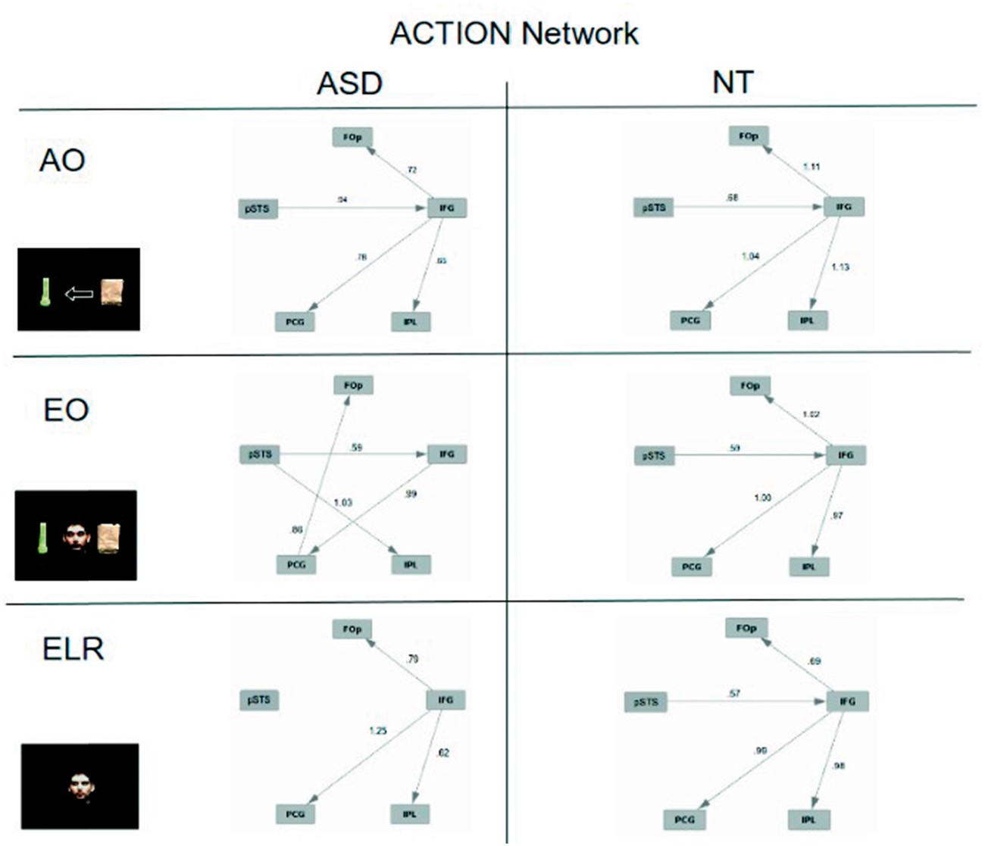
Figure 4. Causal networks for action understanding stimuli.
Notes:
Figure 4. Causal networks for action understanding stimuli.
Unless provided in the caption above, the following copyright applies to the content of this slide: © The Author 2015. Published by Oxford University Press on behalf of British Society for the Philosophy of Science. All rights reserved. For Permissions, please email: journals.permissions@oup.com

Slide 5
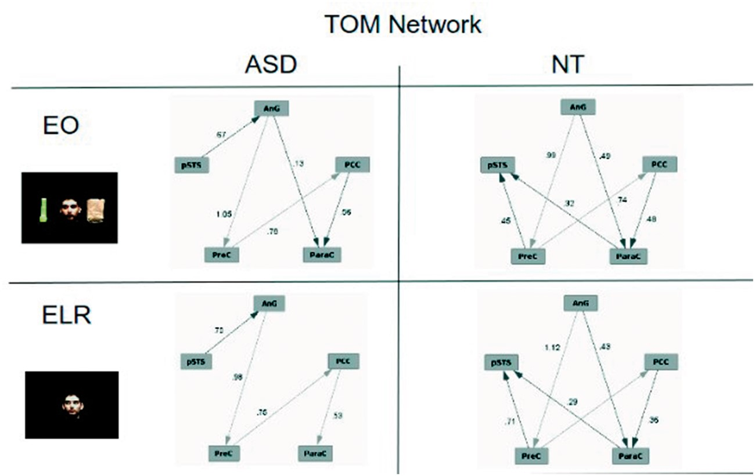
Figure 5. Causal networks for theory of mind stimuli.
Notes:
Figure 5. Causal networks for theory of mind stimuli.
Unless provided in the caption above, the following copyright applies to the content of this slide: © The Author 2015. Published by Oxford University Press on behalf of British Society for the Philosophy of Science. All rights reserved. For Permissions, please email: journals.permissions@oup.com

