Slide 1
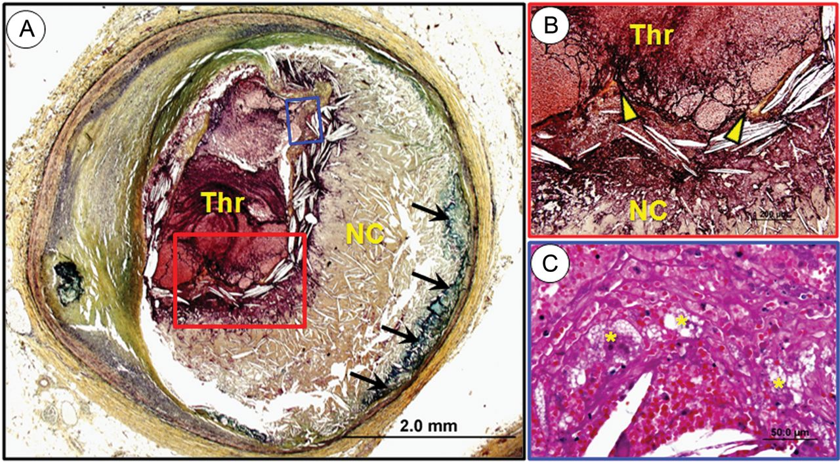
Figure 1 Plaque rupture. Cross-sectional photomicrograph of a coronary artery showing plaque rupture. (A) Note the ...
Notes:
Figure 1 Plaque rupture. Cross-sectional photomicrograph of a coronary artery showing plaque rupture. (A) Note the presence of an acute occlusive luminal thrombus with an underlying large necrotic core (NC) and almost total absence of a fibrous cap. The medial wall is destroyed and near the base of the NC note the presence of calcification (arrows). (B) Higher-magnification image of the rupture site (red box in A). Thin fibrous cap is disrupted (arrowheads). (C) Higher-magnification of thrombus with cholesterol clefts, (blue box in A), red cells, and foamy macrophages (asterisks).
Unless provided in the caption above, the following copyright applies to the content of this slide: Published on behalf of the European Society of Cardiology. All rights reserved. © The Author 2012. For permissions please email: journals.permissions@oup.com

Slide 2
Figure 2 Plaque erosion. Cross-section of a coronary artery showing plaque erosion. (A) A non-occlusive thrombus (Thr) ...
Notes:
Figure 2 Plaque erosion. Cross-section of a coronary artery showing plaque erosion. (A) A non-occlusive thrombus (Thr) is present on the surface of a plaque which consists of pathological intimal thickening, note the artery is insignificantly narrowed. There is no connection between thrombus and the lipid pool (LP) and the media is intact. (B) Higher-magnification image of the red box in (A). Note the presence of thrombus and the under lying plaque which consists of smooth muscle cells in a proteoglycan–collagen rich matrix and there is absence of inflammation. (C) Shows another case of plaque erosion. The oldest layer of the plaque (black double arrow) is an organizing thrombus and is being replaced by smooth muscle cells in a proteoglycan-rich matrix and there is an overlying acute thrombus present in the lumen of varying ages (white and yellow double arrows).
Unless provided in the caption above, the following copyright applies to the content of this slide: Published on behalf of the European Society of Cardiology. All rights reserved. © The Author 2012. For permissions please email: journals.permissions@oup.com

Slide 3
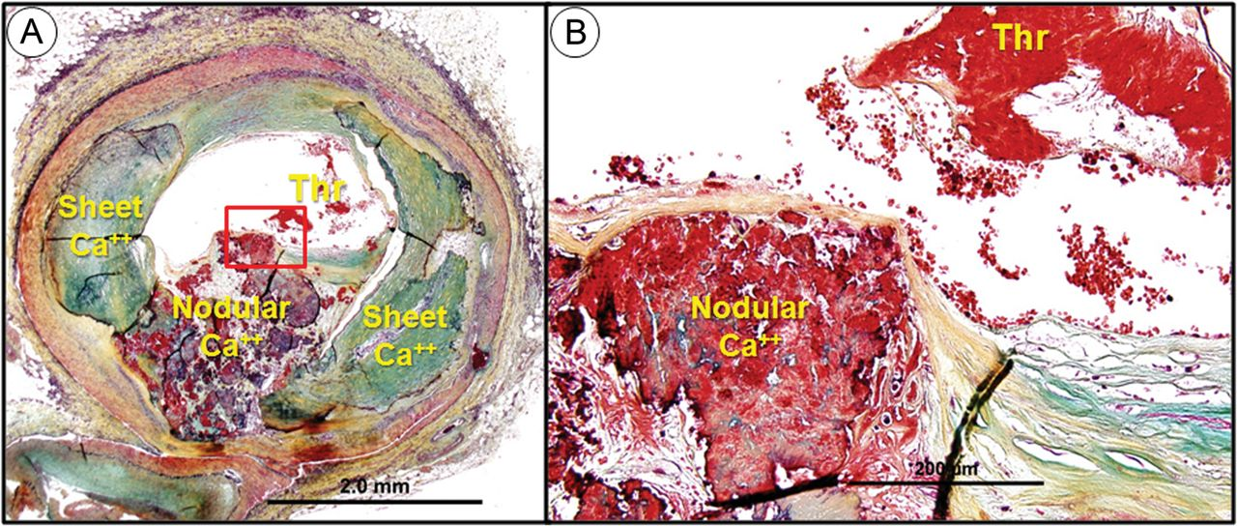
Figure 3 Calcified nodule. Cross-section of the coronary artery showing the presence of calcified nodule. Nodular ...
Notes:
Figure 3 Calcified nodule. Cross-section of the coronary artery showing the presence of calcified nodule. Nodular calcifications (Ca++) are identified between sheets of calcification. (B) Higher-magnification image of the red box in (A). The nodular calcification is protruding into the lumen area with an overlying non-occlusive thrombus.
Unless provided in the caption above, the following copyright applies to the content of this slide: Published on behalf of the European Society of Cardiology. All rights reserved. © The Author 2012. For permissions please email: journals.permissions@oup.com

Slide 4
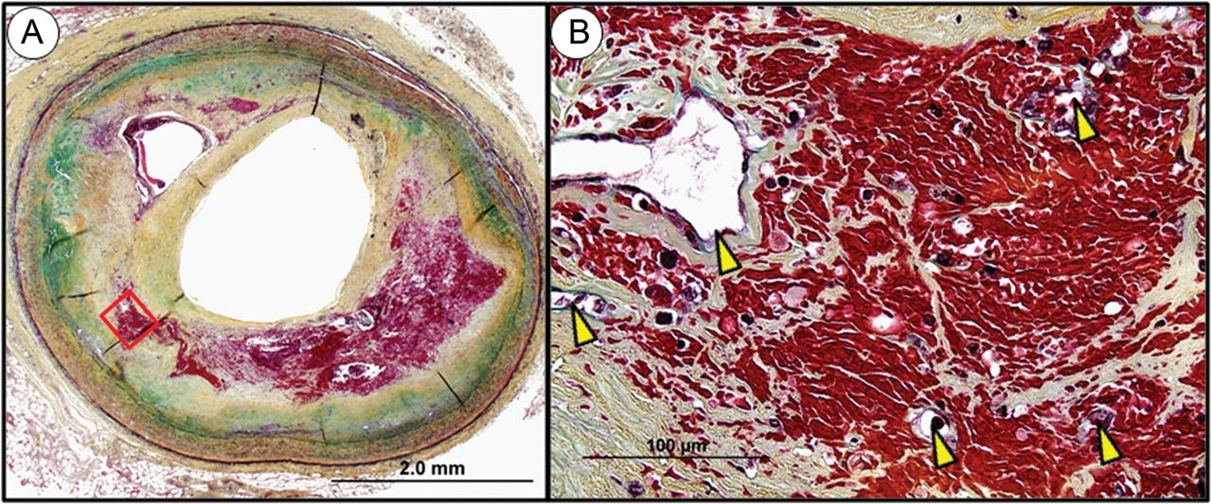
Figure 4 Intraplaque haemorrhage. Cross-section of a coronary artery showing haemorrhage into a plaque (necrotic ...
Notes:
Figure 4 Intraplaque haemorrhage. Cross-section of a coronary artery showing haemorrhage into a plaque (necrotic cores) with severe narrowing of the lumen. (B) Higher-magnification of the red box area in (A). Note the presence of a number of small capillaries of varying sizes (arrowheads) in the area of haemorrhage. However, the mere presence of neovascularization does not prove that these haemorrhages originate from these fragile low-pressure microvessels within the plaque. Another possibility is a high-pressure haemorrhage from the lumen of the artery into the plaque via a ruptured fibrous cap not revealed in this particular cross-section of the lesion.
Unless provided in the caption above, the following copyright applies to the content of this slide: Published on behalf of the European Society of Cardiology. All rights reserved. © The Author 2012. For permissions please email: journals.permissions@oup.com

Slide 5
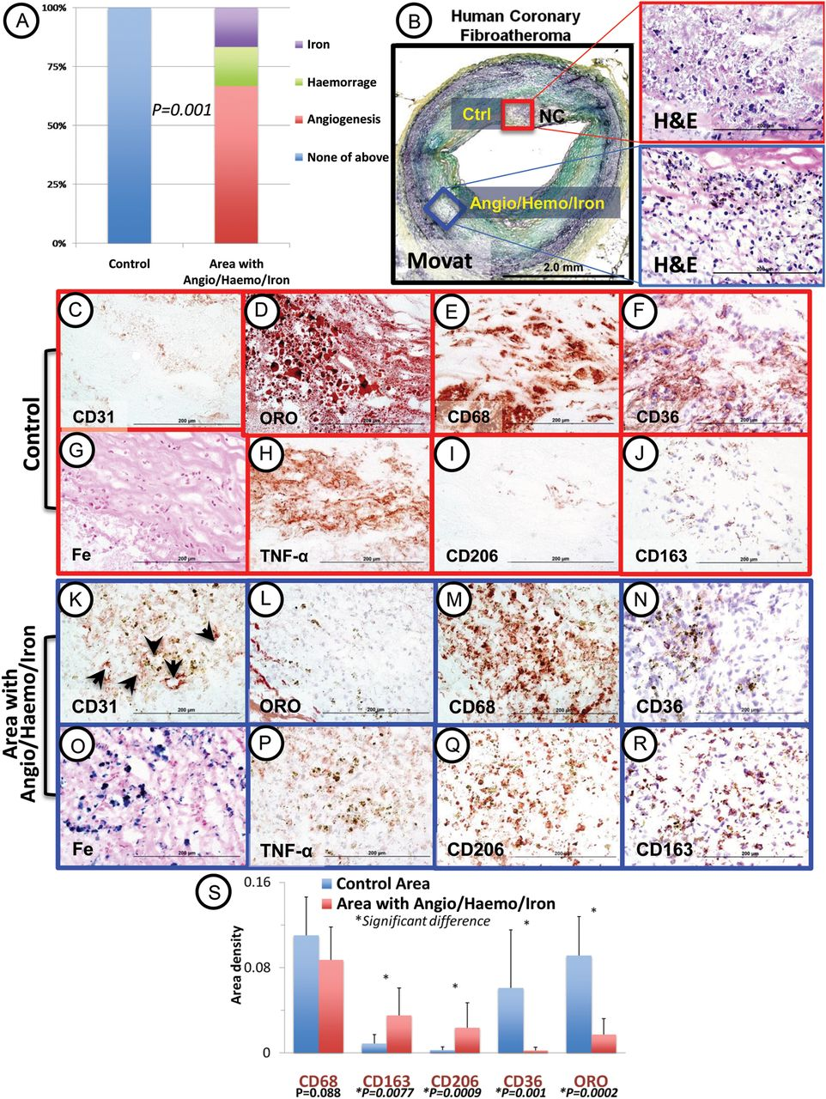
Figure 5 M2 markers CD206/CD163 are preset in human atherosclerotic lesions at the site of prior haemorrhage and are ...
Notes:
Figure 5 M2 markers CD206/CD163 are preset in human atherosclerotic lesions at the site of prior haemorrhage and are distinct from foam cells. (A) Plaque regions were identified by the presence of angiogenesis/haemorrhage/iron (Angio/Haemo/Iron) and compared with control (Ctrl) pericore regions of macrophages devoid of Angio/Haemo/Iron. (B) Representative frozen section of human coronary fibroatheroma from a 48-year-old man who died suddenly. High-power image from Ctrl (red box) shows foamy macrophages in the perinecrotic core (NC) region. The blue box shows an area rich in angiogenesis and iron. Low-power image, Movat stain; high-power images, haematoxylin and eosin (H&E) stain. Photomicrographs of the boxed areas from Ctrl (red boxes) (C–J) and area of Angio/Haemo/Iron (blue boxes) (K–R). Note that the Ctrl area shows a lack of CD31 staining (brown) (C), abundant oil red O (ORO) positivity (red) (D), macrophage infiltration (CD68, brown) (E), CD36 staining (brown) (F), and no iron staining (blue, Perl Prussian blue) (G). It also demonstrates abundant tumour necrosis factor α (TNF-α) positivity (brown) (H), but there is minimal MR (CD206, brown) (I) and CD163 (brown) (J) immunostaining. (K–R) are from an area of Angio/Haemo/Iron showing abundant CD31 staining (K, black arrows point to angiogenesis), rare positive cells for oil red O (L), but abundant C68 staining (M). This area also demonstrates minimal CD36 staining (N), but abundance of iron (O), minimal TNF-α staining (P), but positive staining for CD206 and CD163 (Q and R). Quantitative analysis (S) from Ctrl and Angio/Haemo/Iron areas from 14 plaques demonstrated equivalent macrophage area density (CD68) but higher expression of CD163 and CD206 in regions of Angio/Haemo/Iron than in Ctrl regions. Scale bars: low-power, 2 mm; high-power: 200 µm (non-normal distribution CD68 and CD163). Fe = iron. (Reproduced with permission from Finn et al.98)
Unless provided in the caption above, the following copyright applies to the content of this slide: Published on behalf of the European Society of Cardiology. All rights reserved. © The Author 2012. For permissions please email: journals.permissions@oup.com

