Slide 1
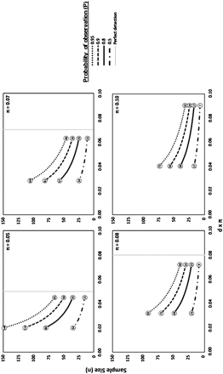
Figure 1. Effect of Parameter Values on Sample Size.
Notes:
Figure 1. Effect of Parameter Values on Sample Size.
Unless provided in the caption above, the following copyright applies to the content of this slide: © The Author 2011. Published by Oxford University Press on behalf of the American Association for Public Opinion Research. All rights reserved. For permissions, please e-mail: journals.permissions@oup.com

Slide 2
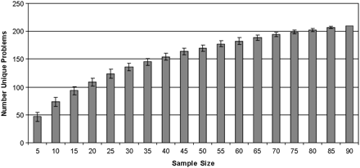
Figure 2. Mean Number of Problems per Sample Size.
Notes:
Figure 2. Mean Number of Problems per Sample Size.
Unless provided in the caption above, the following copyright applies to the content of this slide: © The Author 2011. Published by Oxford University Press on behalf of the American Association for Public Opinion Research. All rights reserved. For permissions, please e-mail: journals.permissions@oup.com

Slide 3
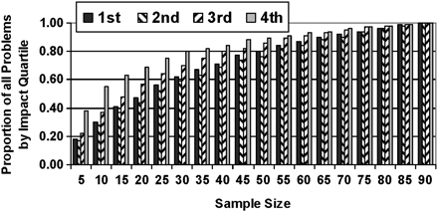
Figure 3. Proportion of Unique Problems per Impact Quartile and Sample Size.
Notes:
Figure 3. Proportion of Unique Problems per Impact Quartile and Sample Size.
Unless provided in the caption above, the following copyright applies to the content of this slide: © The Author 2011. Published by Oxford University Press on behalf of the American Association for Public Opinion Research. All rights reserved. For permissions, please e-mail: journals.permissions@oup.com

Slide 4
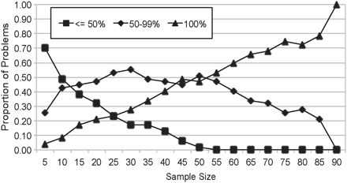
Figure 4. Proportion of High-Impact Problems in Each Likelihood Category.
Notes:
Figure 4. Proportion of High-Impact Problems in Each Likelihood Category.
Unless provided in the caption above, the following copyright applies to the content of this slide: © The Author 2011. Published by Oxford University Press on behalf of the American Association for Public Opinion Research. All rights reserved. For permissions, please e-mail: journals.permissions@oup.com

