Slide 1
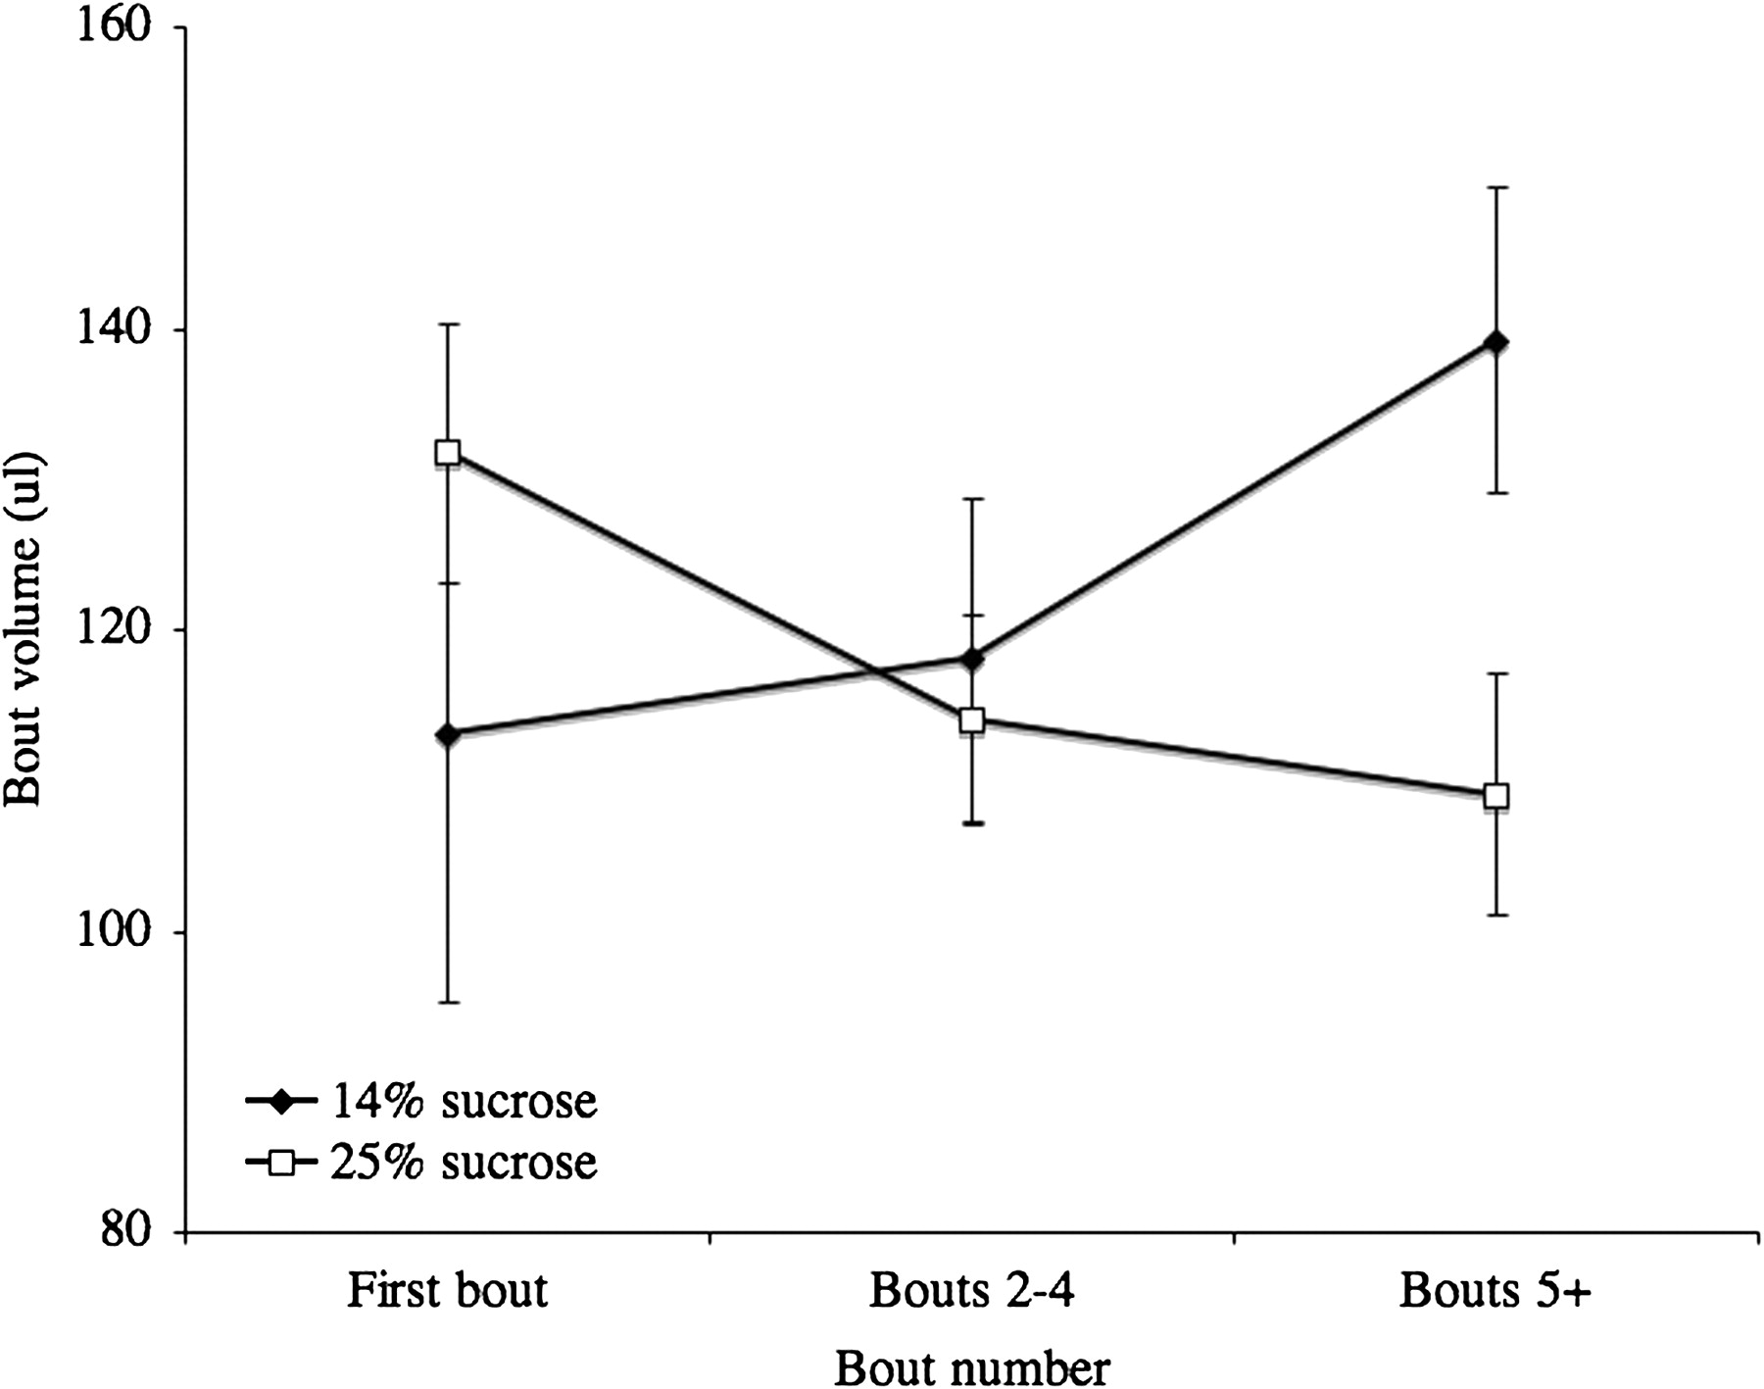
Figure 1 The average volume of the first feeding bout, the second to fourth bouts, and feeding bouts 5 onward, ...
Notes:
Figure 1 The average volume of the first feeding bout, the second to fourth bouts, and feeding bouts 5 onward, following changes from 25% to 14% sucrose (black diamonds) and 14% to 25% sucrose (open squares). Data are means and standard errors, N = 12.
Unless provided in the caption above, the following copyright applies to the content of this slide: © The Author 2011. Published by Oxford University Press on behalf of the International Society for Behavioral Ecology. All rights reserved. For permissions, please e-mail: journals.permissions@oup.com

Slide 2
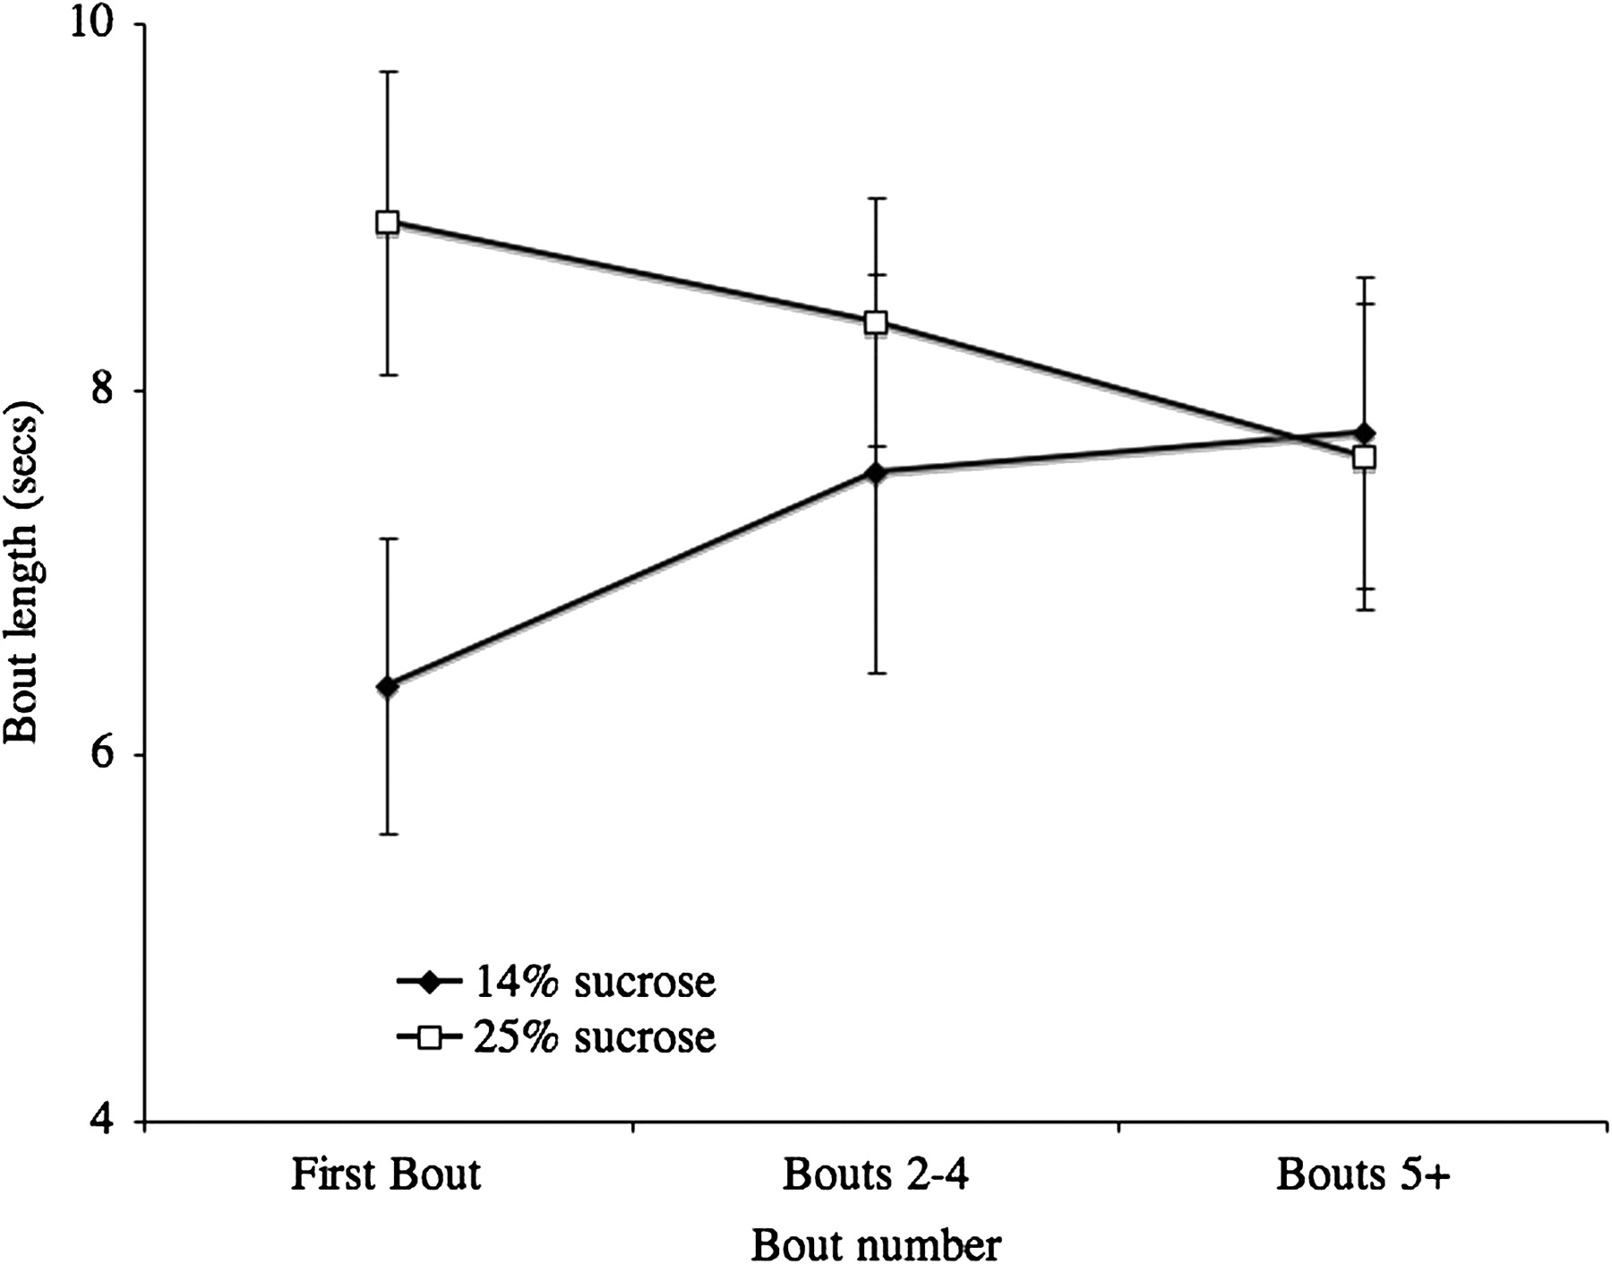
Figure 2 The average duration of the first feeding bout, the second to fourth bouts, and feeding bouts 5 onward, ...
Notes:
Figure 2 The average duration of the first feeding bout, the second to fourth bouts, and feeding bouts 5 onward, following changes from 25% to 14% sucrose (black diamonds) and 14% to 25% sucrose (open squares). Data are means and standard errors, N = 12.
Unless provided in the caption above, the following copyright applies to the content of this slide: © The Author 2011. Published by Oxford University Press on behalf of the International Society for Behavioral Ecology. All rights reserved. For permissions, please e-mail: journals.permissions@oup.com

Slide 3
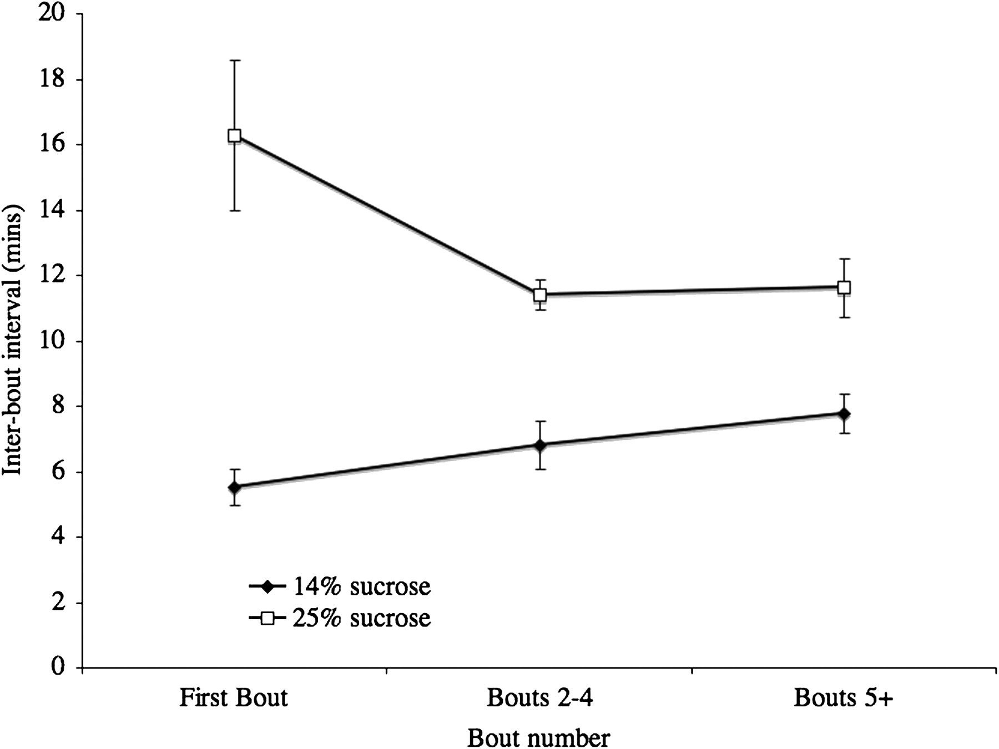
Figure 3 The average interbout interval following the first feeding bout, the second to fourth bouts, and feeding ...
Notes:
Figure 3 The average interbout interval following the first feeding bout, the second to fourth bouts, and feeding bouts 5 onward, for changes from 25% to 14% sucrose (black diamonds) and 14% to 25% sucrose (open squares). Data are means and standard errors, N = 12.
Unless provided in the caption above, the following copyright applies to the content of this slide: © The Author 2011. Published by Oxford University Press on behalf of the International Society for Behavioral Ecology. All rights reserved. For permissions, please e-mail: journals.permissions@oup.com

Slide 4
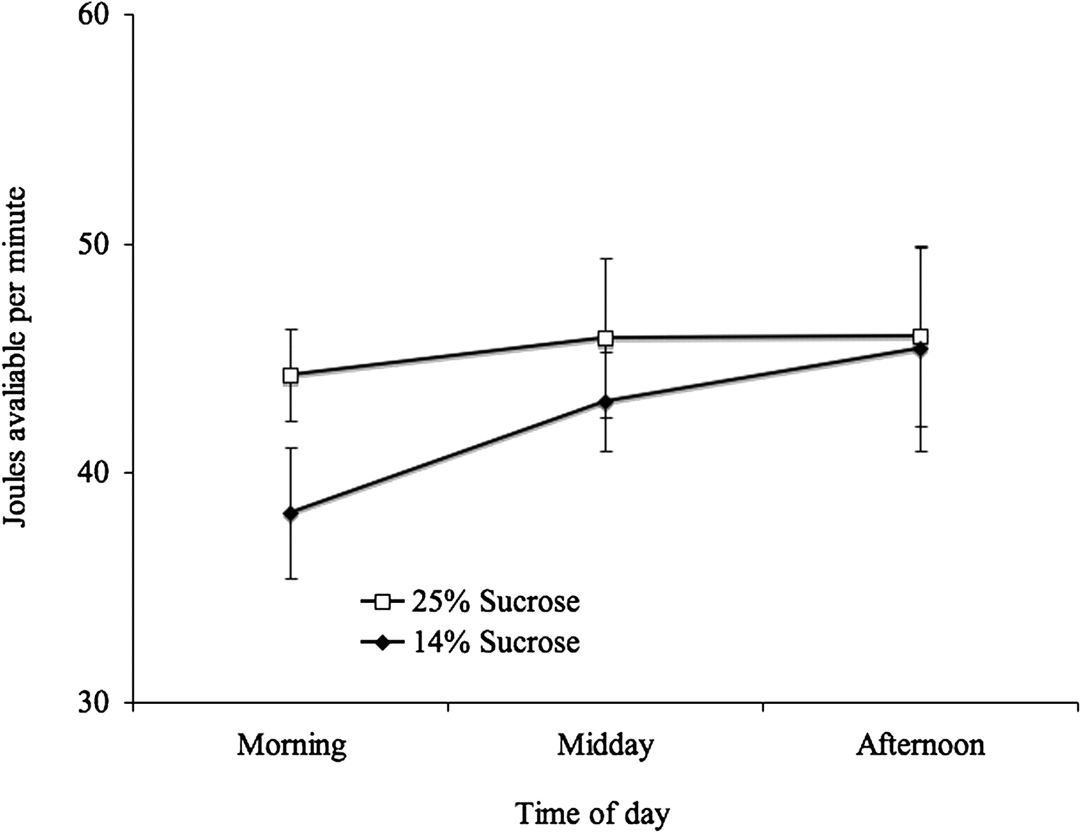
Figure 4 The average joules consumed per minute at different times of day for 14% sucrose (black diamonds) and 25% ...
Notes:
Figure 4 The average joules consumed per minute at different times of day for 14% sucrose (black diamonds) and 25% sucrose (open squares). Data are means and standard errors, N = 12.
Unless provided in the caption above, the following copyright applies to the content of this slide: © The Author 2011. Published by Oxford University Press on behalf of the International Society for Behavioral Ecology. All rights reserved. For permissions, please e-mail: journals.permissions@oup.com

