Slide 1
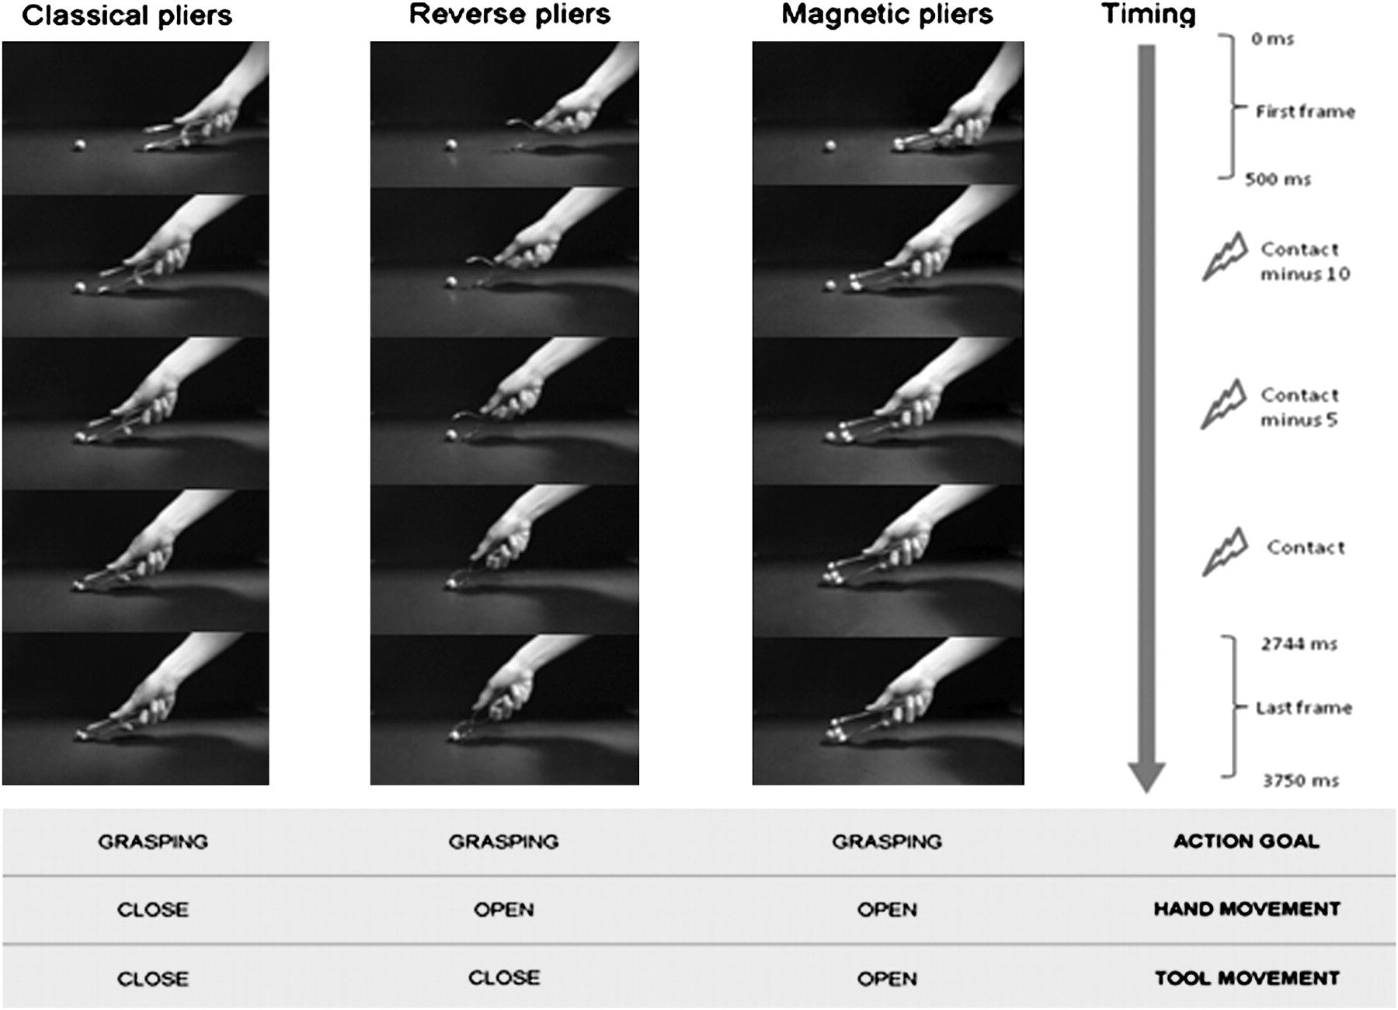
Figure 1. Schematic representation of event sequencing during a single trial for grasping with classic pliers, grasping ...
Notes:
Figure 1. Schematic representation of event sequencing during a single trial for grasping with classic pliers, grasping with reverse pliers, and grasping with magnetic pliers. For each trial, the TMS pulse could be delivered at 1 of the 3 different delays: just before the frame showing the contact of the pliers with the mothball (contact 0); 5 frames before the contact of the pliers with the mothball (contact minus 5); and 10 frames before the contact of the pliers with the mothball (contact minus 10).
Unless provided in the caption above, the following copyright applies to the content of this slide: © The Author 2011. Published by Oxford University Press. All rights reserved. For permissions, please e-mail: journals.permissions@oup.com

Slide 2
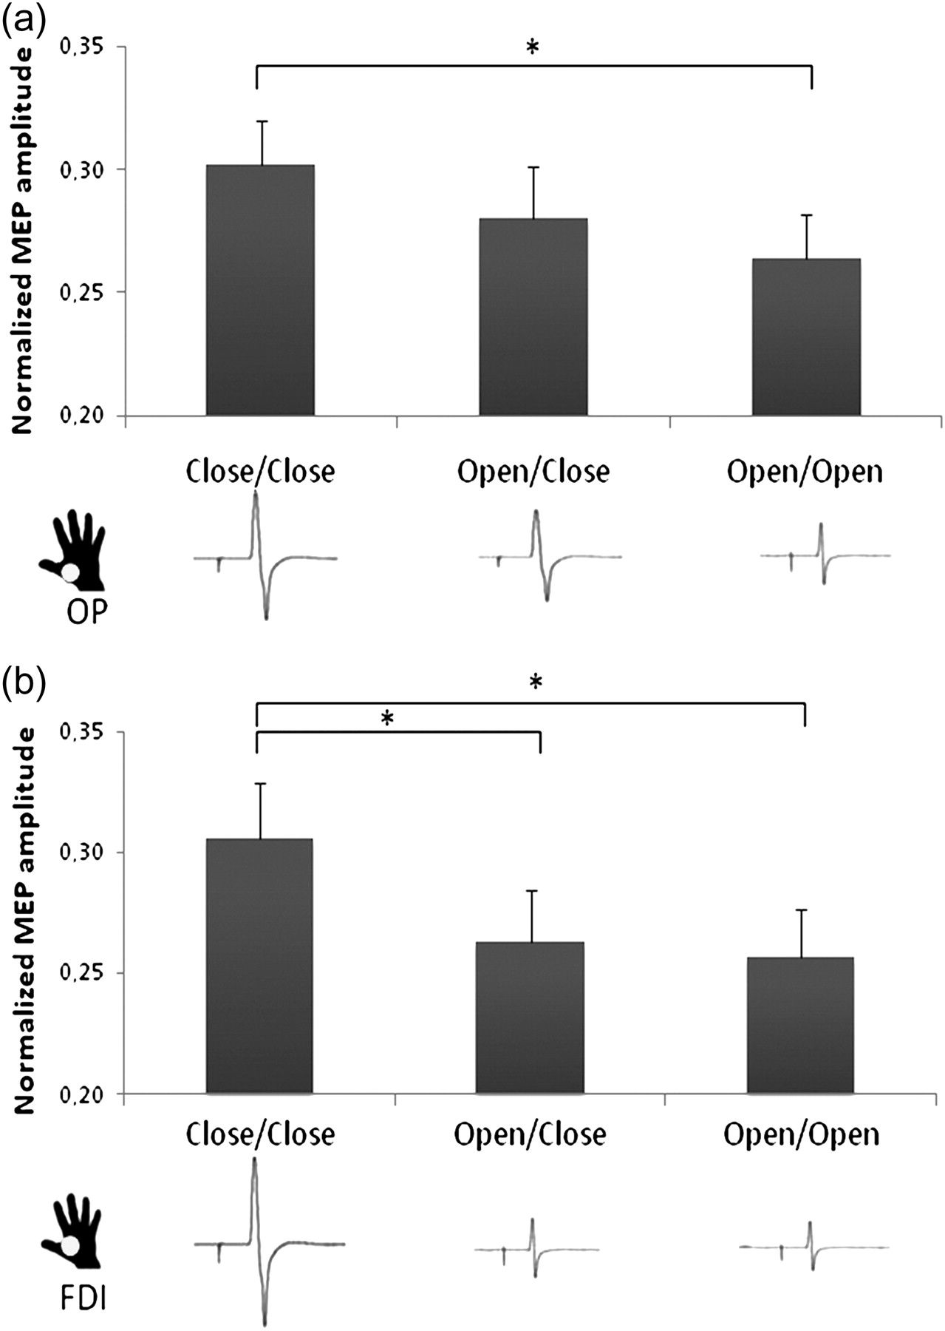
Figure 2. Normalized peak-to-peak amplitude scores recorded during the observation of different types of movement from ...
Notes:
Figure 2. Normalized peak-to-peak amplitude scores recorded during the observation of different types of movement from the OP muscle (a) and the FDI muscle (b). Gray dots indicate to which muscle MEP scores refer to. Waveforms beneath the bars show representative examples of OP and FDI MEPs for different types of movement. Vertical bars denote ±standard errors. Asterisks indicate significant post hoc comparisons (P < 0.05).
Unless provided in the caption above, the following copyright applies to the content of this slide: © The Author 2011. Published by Oxford University Press. All rights reserved. For permissions, please e-mail: journals.permissions@oup.com

Slide 3
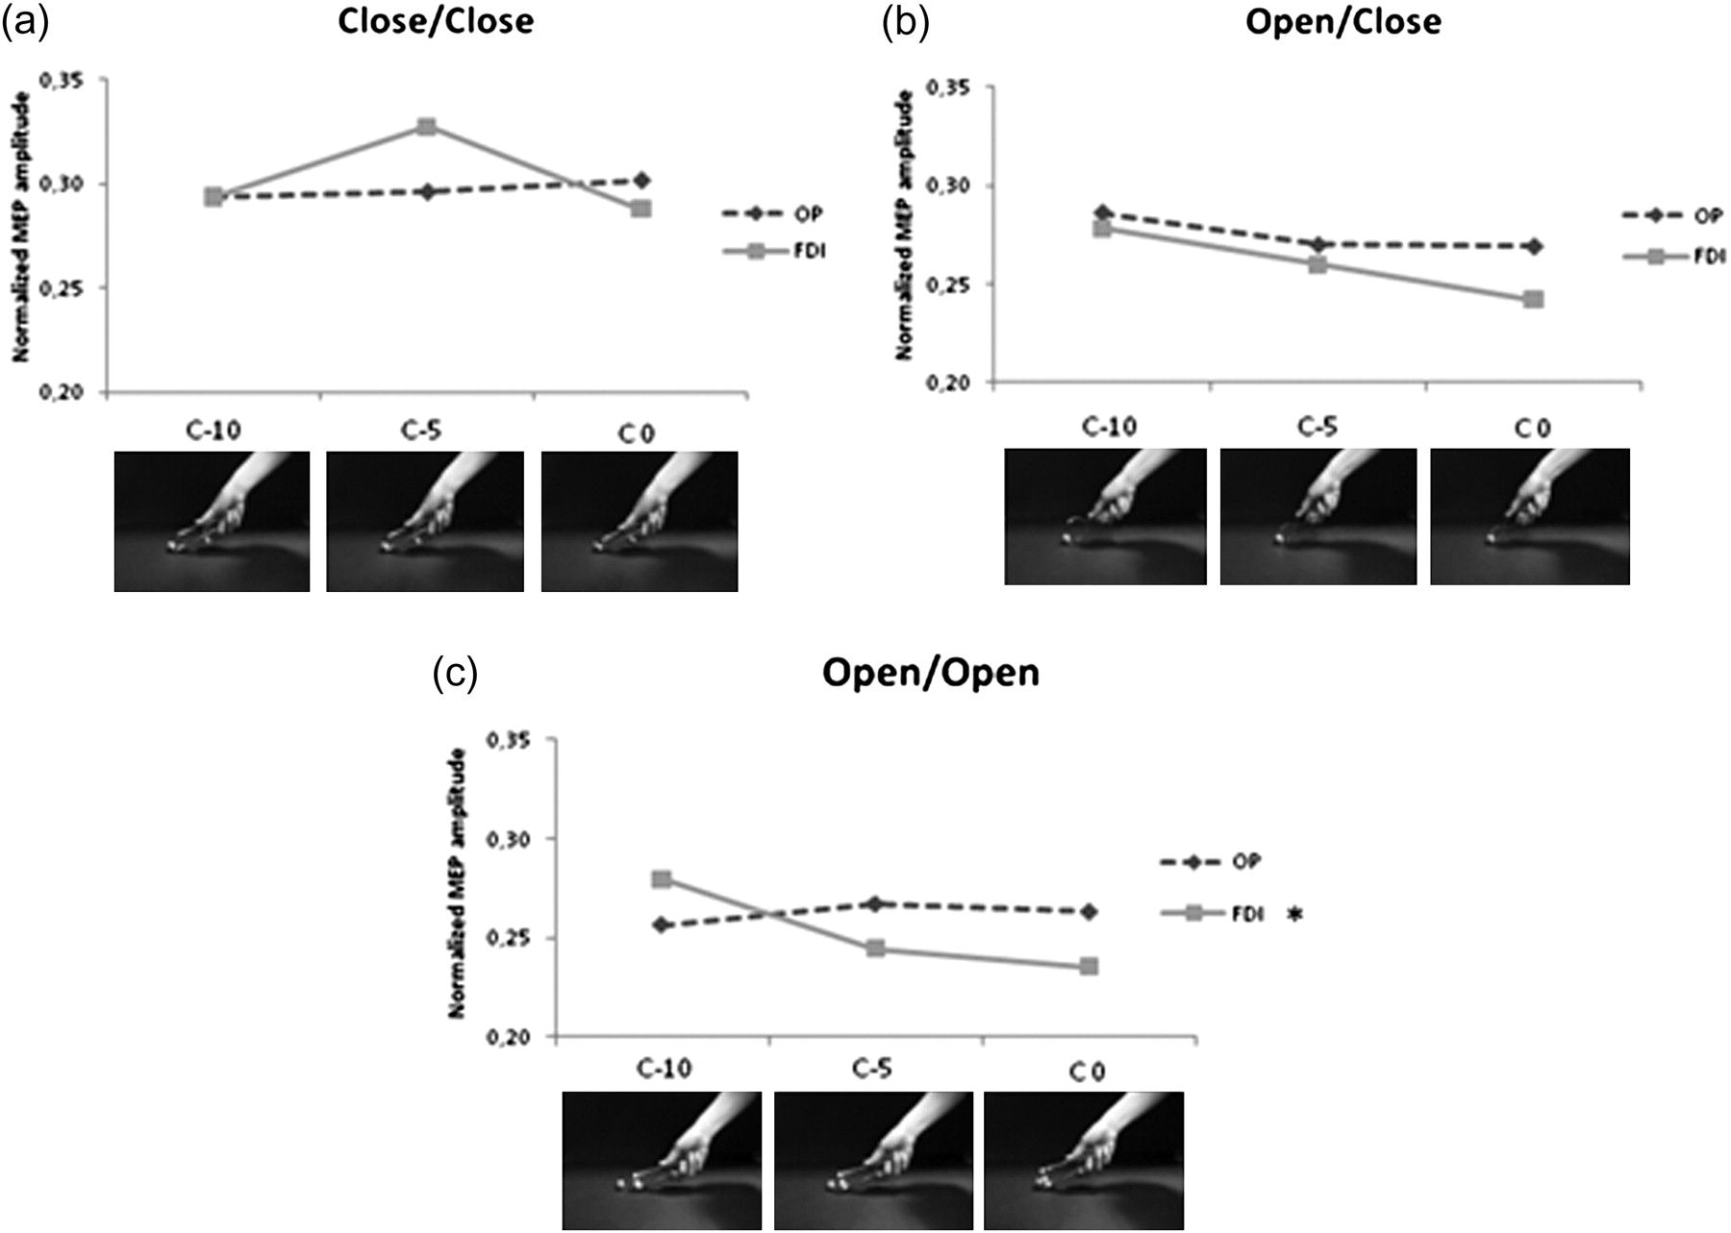
Figure 3. Representation of trigger-delay effect for the close–close (a), the open–close (b), and the open–open (c) ...
Notes:
Figure 3. Representation of trigger-delay effect for the close–close (a), the open–close (b), and the open–open (c) movement. MEPs collected from the OP and the FDI were modulated by the degree of the shown finger aperture–closure. C-10, contact-minus-10 trials; C-5, contact-minus-5; C 0, contact-0 trials. Asterisk indicates a statistically significant effect of trigger delay (P < 0.01).
Unless provided in the caption above, the following copyright applies to the content of this slide: © The Author 2011. Published by Oxford University Press. All rights reserved. For permissions, please e-mail: journals.permissions@oup.com

