Slide 1
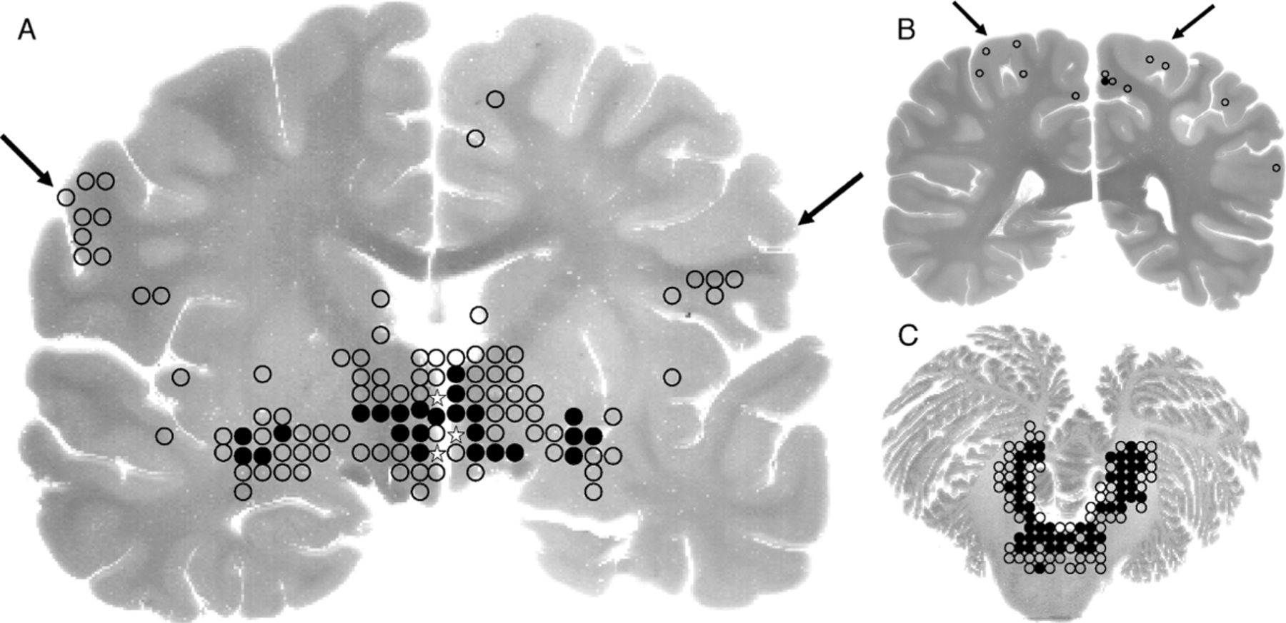
FIGURE 1. (A) Whole brain coronal sections of cerebral hemispheres with distribution of inflammation indicated by black ...
Notes:
FIGURE 1. (A) Whole brain coronal sections of cerebral hemispheres with distribution of inflammation indicated by black dots (>half-field inflamed) and circles (<half-field inflamed), and viral antigens by stars. In the 3 separate areas where viral antigens were detected, only a total of approximately 5 neuronal bodies and/or their processes were positive. Inflammation was most intense around the hypothalamus area and least intense in the cerebral cortex, including the motor cortex (arrows). (B) Whole brain coronal sections of cerebral hemispheres (at the level of the splenium) with distribution of inflammation indicated by dots and circles. Immunohistochemistry for viral antigens was not performed in these sections. (C) Horizontal section of cerebellum and midpons showing the distribution of inflammation (dots and circles), but no viral antigens were detected. Inflammation was most intense in the tegmentum and dentate nucleus. The cerebellar cortex and anterior pontine nuclei areas were uninflamed.
Unless provided in the caption above, the following copyright applies to the content of this slide: Copyright © 2008 by the American Association of Neuropathologists, Inc.

Slide 2
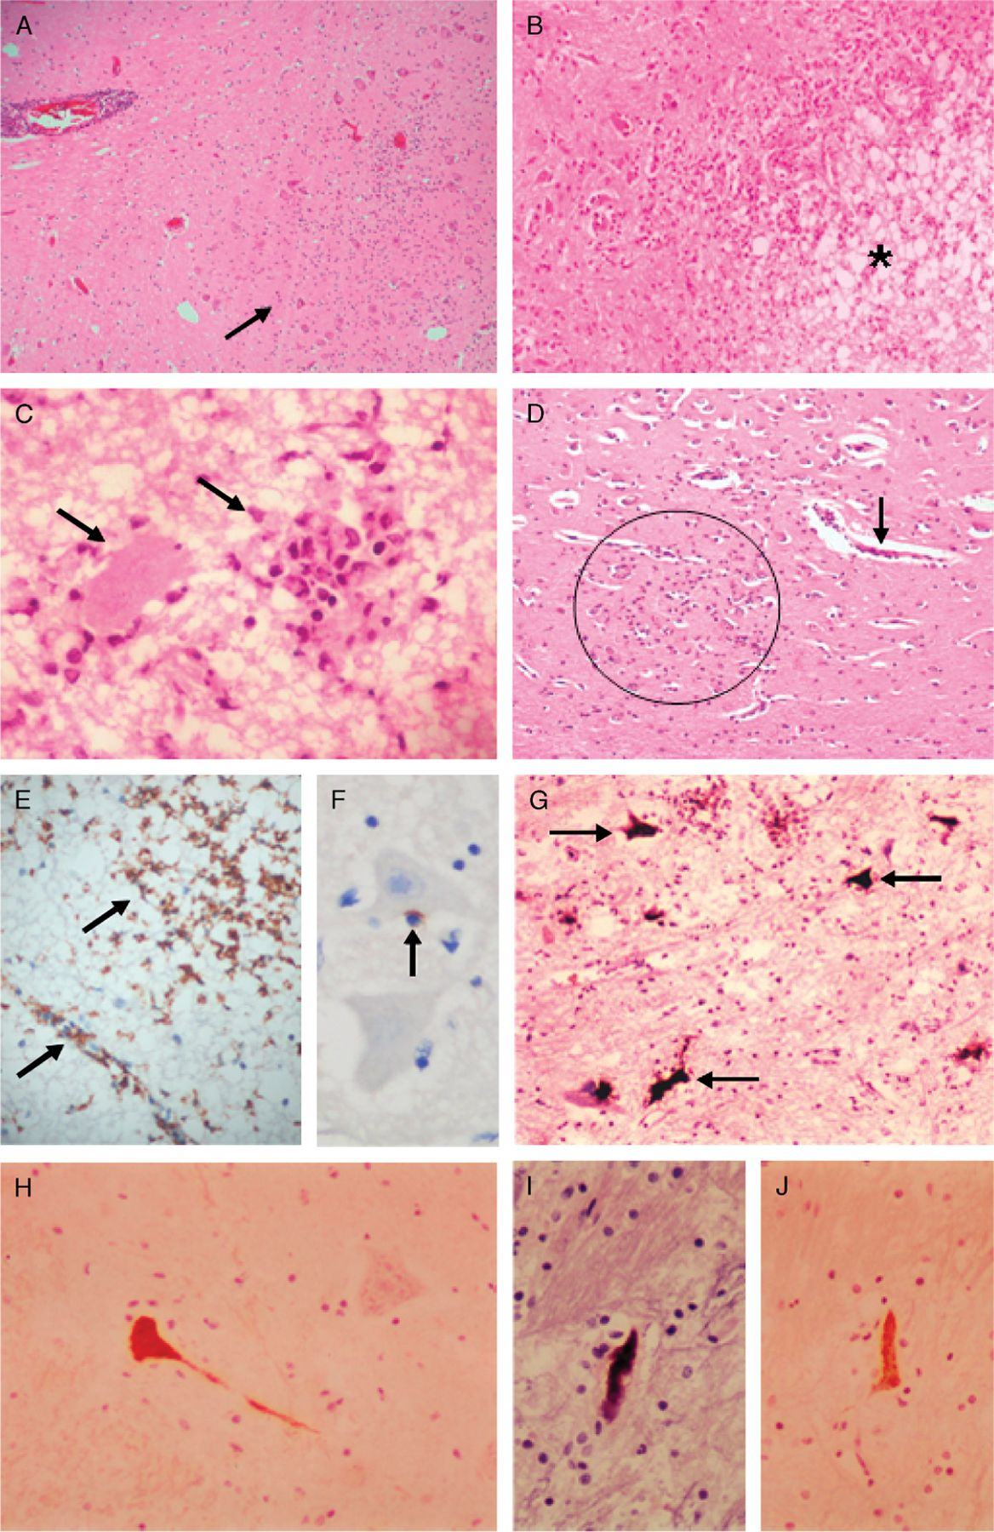
FIGURE 2. Parenchymal inflammation (arrows) and perivascular cuffing in the inferior olivary nucleus area of the ...
Notes:
FIGURE 2. Parenchymal inflammation (arrows) and perivascular cuffing in the inferior olivary nucleus area of the medulla (A). In more severely inflamed areas (B), there may be varying degrees of edema (*) and neuronophagia (C, arrows). More subtle inflammation in the motor cortex is indicated by very mild perivascular cuffing (arrow) and parenchymal inflammatory cells (circle) (D). Numerous CD68-positive macrophages/microglial in the parenchyma and perivascular location (E), and a CD8-positive lymphocyte adjacent to a neuron (F). Viral RNA in the anterior horn cells of the spinal cord (G) and viral antigens in neuronal body and process in the hypothalamus (H). Adjacent sections of the same neuron that was positive for viral RNA (I) and antigens (J). (A-D: hematoxylin and eosin stains; E, F, H, J: immunohistochemistry/peroxidase/DAB; G, I: ISH/ nitroblue tetrazolium/5-bromo-4-chloro-3-indolyl phosphate stains. Original magnification: (A) 4×; (B, D) 10×; (C, F) 40×; (G, H, I, J) 20×.
Unless provided in the caption above, the following copyright applies to the content of this slide: Copyright © 2008 by the American Association of Neuropathologists, Inc.

