Slide 1
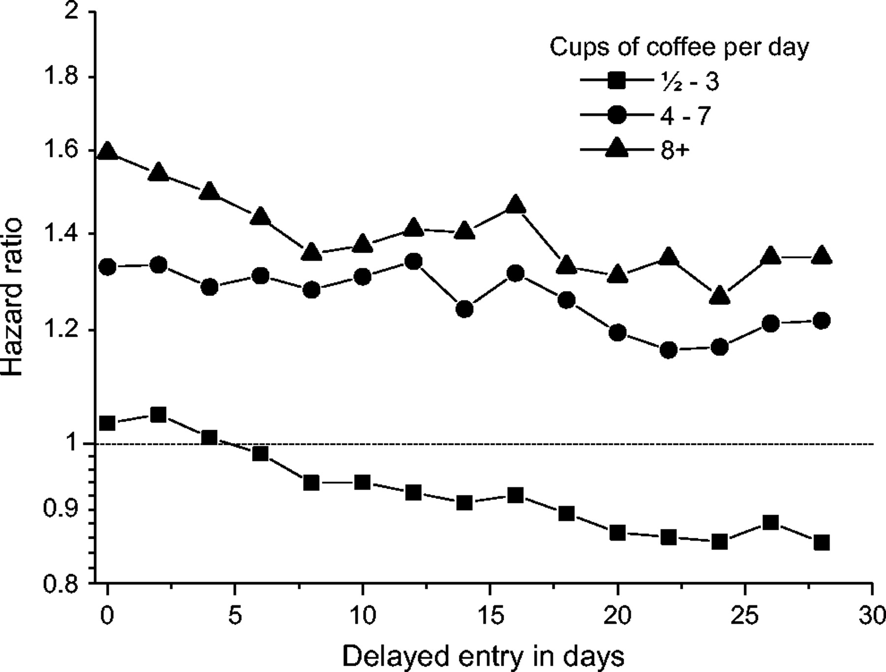
FIGURE 1. Adjusted hazard ratios for the relation between fetal death and maternal coffee consumption during pregnancy, ...
Notes:
FIGURE 1. Adjusted hazard ratios for the relation between fetal death and maternal coffee consumption during pregnancy, according to time of delayed entry into the Cox regression model, Denmark, 1996–2002. Day 0 equals the time of interview.
Unless provided in the caption above, the following copyright applies to the content of this slide: American Journal of Epidemiology Copyright © 2005 by the Johns Hopkins Bloomberg School of Public Health All rights reserved; printed in U.S.A.

