Slide 1
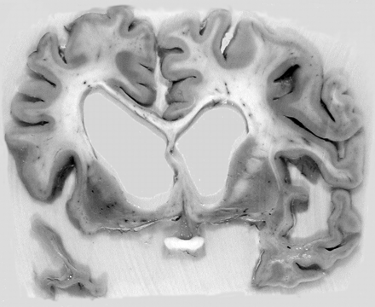
Fig. 1 Photograph of coronal brain slice anterior to temporal stem showing frontotemporal atrophy with left temporal ...
Notes:
Fig. 1 Photograph of coronal brain slice anterior to temporal stem showing frontotemporal atrophy with left temporal emphasis (Case 8).
Unless provided in the caption above, the following copyright applies to the content of this slide: © The Author (2005). Published by Oxford University Press on behalf of the Guarantors of Brain. All rights reserved. For Permissions, please email: journals.permissions@oupjournals.org

Slide 2
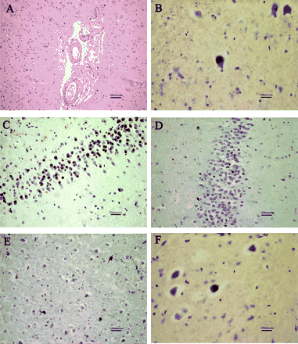
Fig. 2 Photomicrographs showing diagnostic features. (A) (Case 18: haematoxylin and eosin) Congophilic angiopathy ...
Notes:
Fig. 2 Photomicrographs showing diagnostic features. (A) (Case 18: haematoxylin and eosin) Congophilic angiopathy and cortical ischaemia. (B) (Case 18: ubiquitin immunohistochemistry) Ubiquitin-positive inclusion in the inferior olivary nucleus in Alzheimer's disease. (C) (Case 16: tau immunohistochemistry) Pick bodies in the granule cells of the dentate gyrus. (D) (Case 5: ubiquitin immunohistochemistry) Perikaryal MND inclusions in the dentate gyrus. (E) (Case 5: ubiquitin immunohistochemistry) Ubiquitin-positive neurites in neocortex. (F) (Case 5: ubiquitin immunohistochemistry) Ubiquitin-positive inclusion in the inferior olivary nucleus in MNDID.
Unless provided in the caption above, the following copyright applies to the content of this slide: © The Author (2005). Published by Oxford University Press on behalf of the Guarantors of Brain. All rights reserved. For Permissions, please email: journals.permissions@oupjournals.org

Slide 3
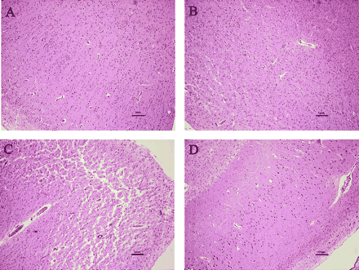
Fig. 3 Photomicrographs showing severity of neuronal loss across temporal lobe regions, sections also showing ...
Notes:
Fig. 3 Photomicrographs showing severity of neuronal loss across temporal lobe regions, sections also showing occasional Pick cells (Case 15: haematoxylin and eosin). (A) Superior temporal gyrus is well preserved, cortical laminae and columns are clearly visible. (B) Middle temporal gyrus shows moderately severe cell loss. (C) Medial bank of the collateral sulcus shows extremely severe neuronal loss. (D) Moderate neuronal loss in CA1.
Unless provided in the caption above, the following copyright applies to the content of this slide: © The Author (2005). Published by Oxford University Press on behalf of the Guarantors of Brain. All rights reserved. For Permissions, please email: journals.permissions@oupjournals.org

Slide 4
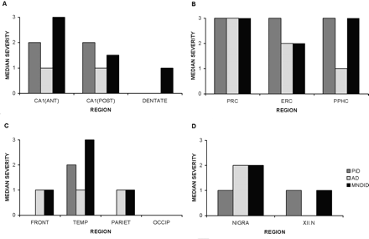
Fig. 4 Median severity of neuronal loss across brain regions by pathological subtype (Pick's disease, n = 3; ...
Notes:
Fig. 4 Median severity of neuronal loss across brain regions by pathological subtype (Pick's disease, n = 3; Alzheimer's disease n = 1; MNDID; n = 8). (A) Hippocampal subregions. (B) Parahippocampal gyrus subregions. (C) Neocortical regions. (D) Brainstem regions.
Unless provided in the caption above, the following copyright applies to the content of this slide: © The Author (2005). Published by Oxford University Press on behalf of the Guarantors of Brain. All rights reserved. For Permissions, please email: journals.permissions@oupjournals.org

