Slide 1
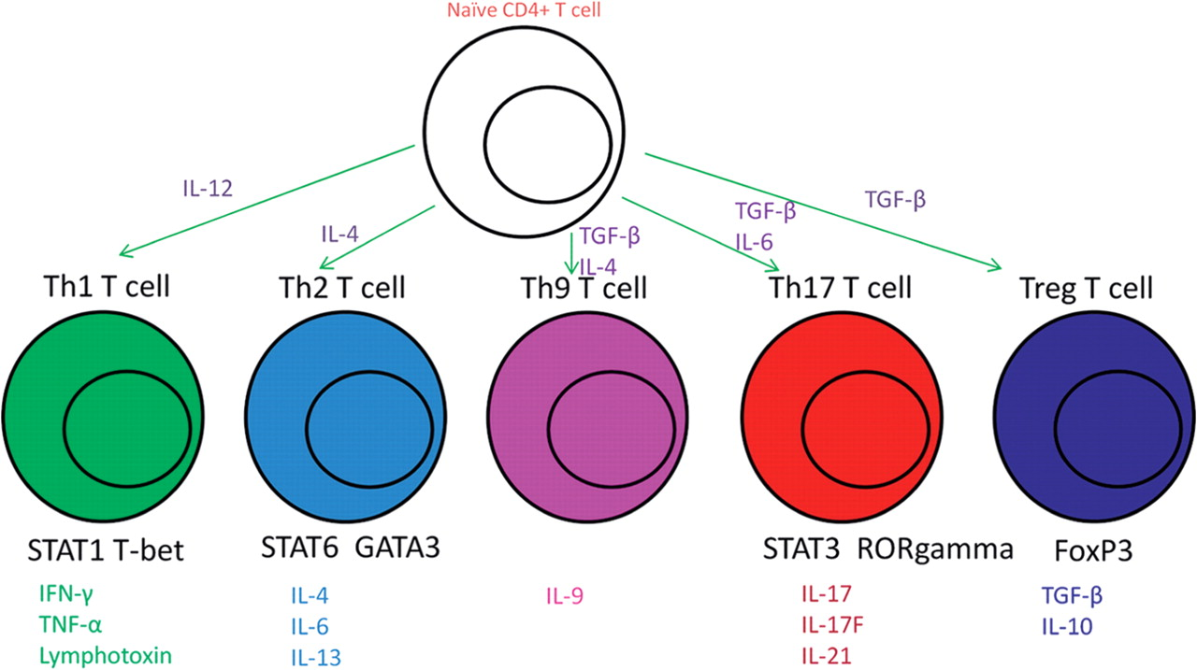
Fig. 1 CD4 T-cell differentiation pathway. CD4 T cells differentiate into effector cells with specific secretion of ...
Notes:
Fig. 1 CD4 T-cell differentiation pathway. CD4 T cells differentiate into effector cells with specific secretion of signature cytokines and specific transcription factors. Underneath the cell are the transcription factors and below that are their cytokine signatures.
Unless provided in the caption above, the following copyright applies to the content of this slide: © The Author 2012. Published by Oxford University Press on behalf of the British Society for Rheumatology. All rights reserved. For Permissions, please email: journals.permissions@oup.com

Slide 2
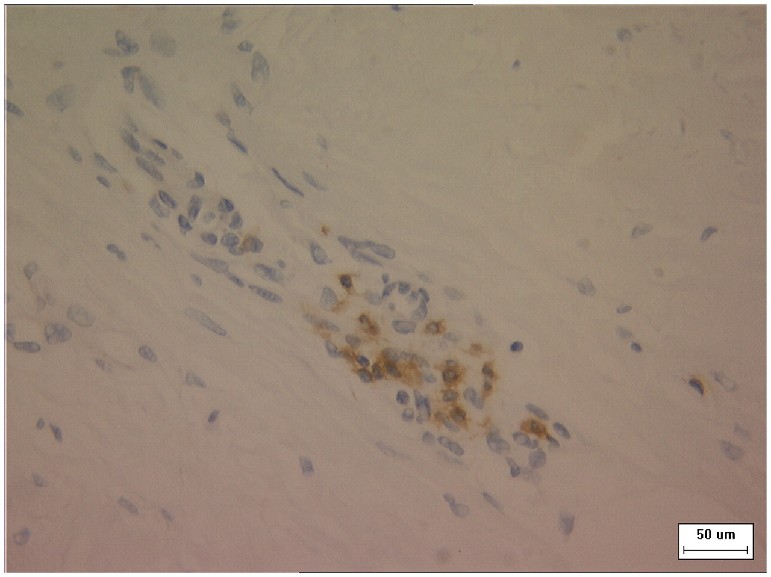
Fig. 2 Immunohistochemistry of affected SSc dermis shows CD3⁺ T cells within the inflammatory ...
Notes:
Fig. 2 Immunohistochemistry of affected SSc dermis shows CD3+ T cells within the inflammatory infiltrate. The tissue section was incubated with an anti-human CD3 antibody and then washed and incubated with the DAB substrate, and subsequently stained with haematoxylin (Meyers) for 5 min. The brown areas are CD3+ T cells.
Unless provided in the caption above, the following copyright applies to the content of this slide: © The Author 2012. Published by Oxford University Press on behalf of the British Society for Rheumatology. All rights reserved. For Permissions, please email: journals.permissions@oup.com

Slide 3
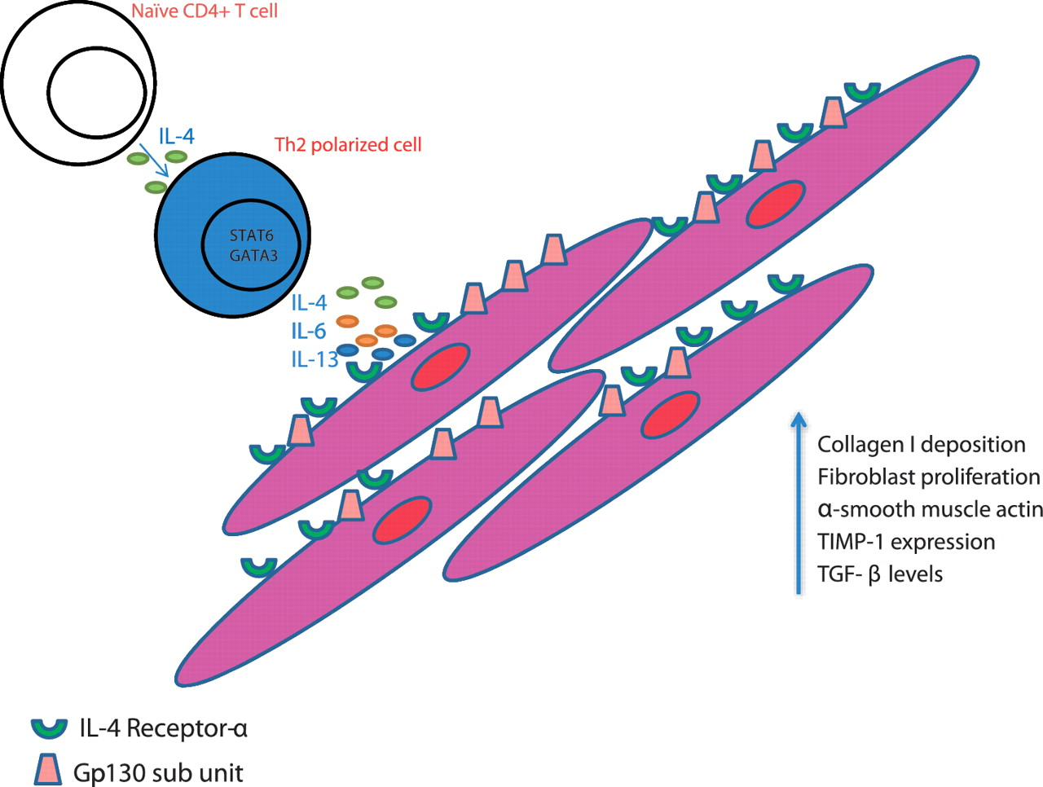
Fig. 3 Interaction between T cells, their products and resident fibroblasts. Naïve Th0 cells are polarized to Th2 ...
Notes:
Fig. 3 Interaction between T cells, their products and resident fibroblasts. Naïve Th0 cells are polarized to Th2 cells through interaction with cytokines. These Th2 cells secrete their pro-fibrotic mediators, which interact with cognate receptors on the fibroblasts leading to downstream signalling and matrix deposition. The soluble IL-6 receptor binds IL-6 and the signal transduction subunit gp130 thereby transferring signalling capacity to the cell. Antibodies directed against T-cell mediators such as IL-6 and IL-13 are a possible therapeutic target, as are transcription factors such as STATs.
Unless provided in the caption above, the following copyright applies to the content of this slide: © The Author 2012. Published by Oxford University Press on behalf of the British Society for Rheumatology. All rights reserved. For Permissions, please email: journals.permissions@oup.com

