Slide 1
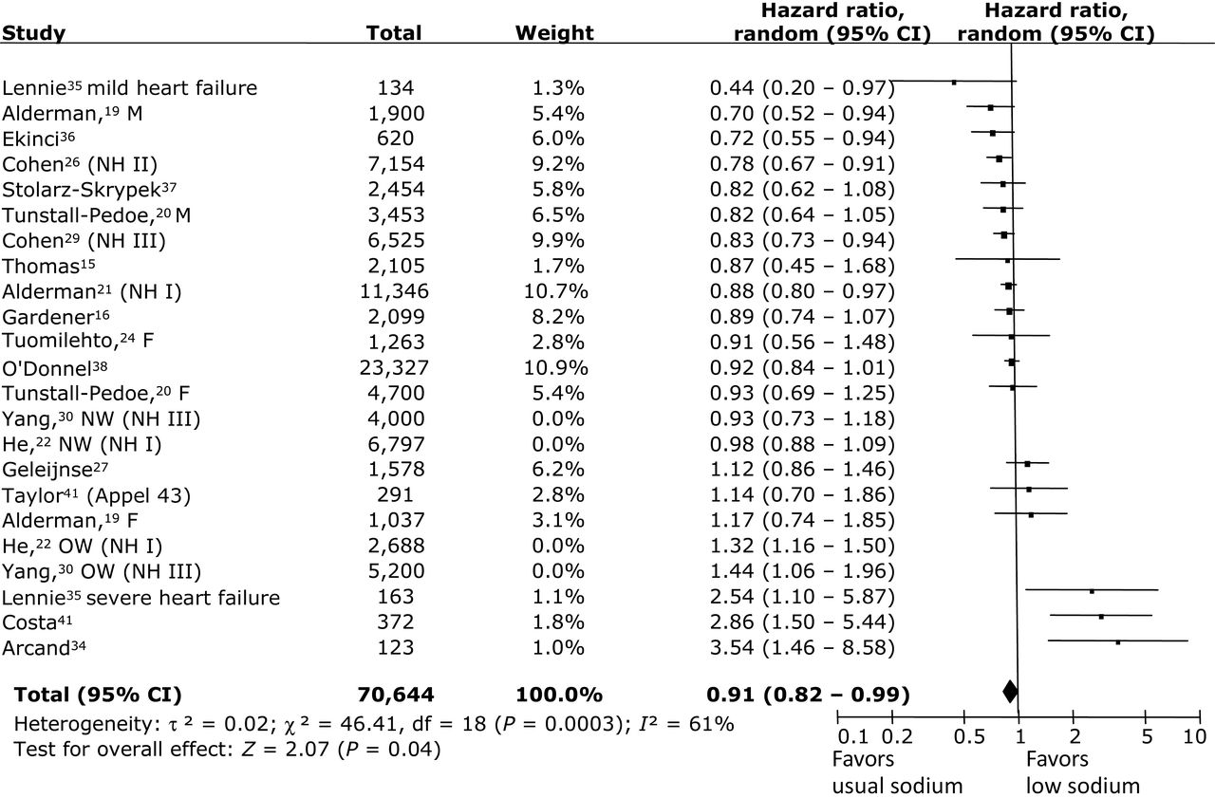
Figure 1. All-cause mortality, usual sodium vs. low sodium. Exchanging the first NHANES analyses^{21,29} with ...
Notes:
Figure 1. All-cause mortality, usual sodium vs. low sodium. Exchanging the first NHANES analyses21,29 with the reanalyses:22,30 (hazard ratio = 0.99; 95% confidence interval = 0.88–1.11; P = 0.84). Abbreviations: CI, confidence interval; F, female; M, male; NH, NHANES, NW, normal weight; OW, overweight.
Unless provided in the caption above, the following copyright applies to the content of this slide: © American Journal of Hypertension, Ltd 2014. All rights reserved. For Permissions, please email: journals.permissions@oup.com

Slide 2
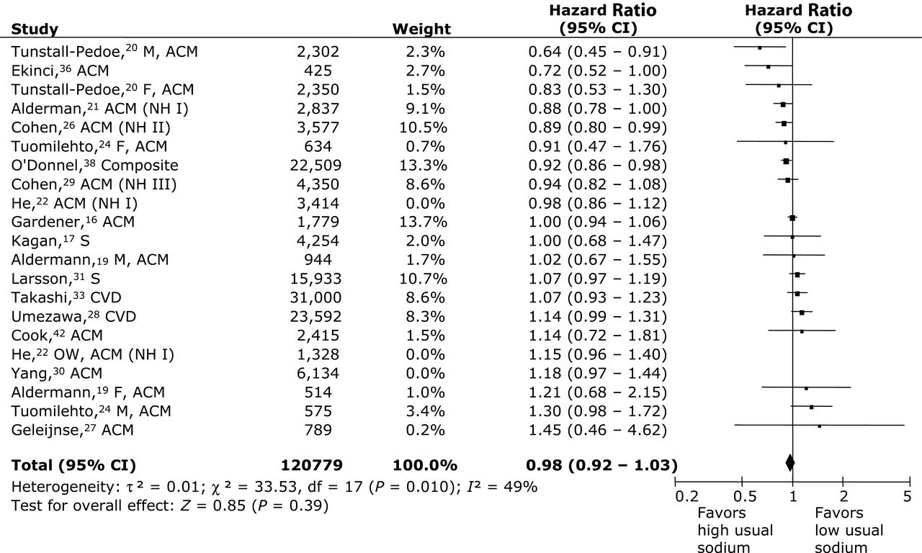
Figure 2. Composite outcome (most frequent events combined), high usual sodium vs. low usual sodium. Exchanging the ...
Notes:
Figure 2. Composite outcome (most frequent events combined), high usual sodium vs. low usual sodium. Exchanging the first NHANES analyses21,29 with the reanalyses:22,30 (hazard ratio = 1.01; 95% confidence interval = 0.95–1.07; P = 0.79). Abbreviations: ACM, all-cause mortality; CVD, cardiovascular disease; F, female; M, male; NH, NHANES; S, stroke.
Unless provided in the caption above, the following copyright applies to the content of this slide: © American Journal of Hypertension, Ltd 2014. All rights reserved. For Permissions, please email: journals.permissions@oup.com

Slide 3
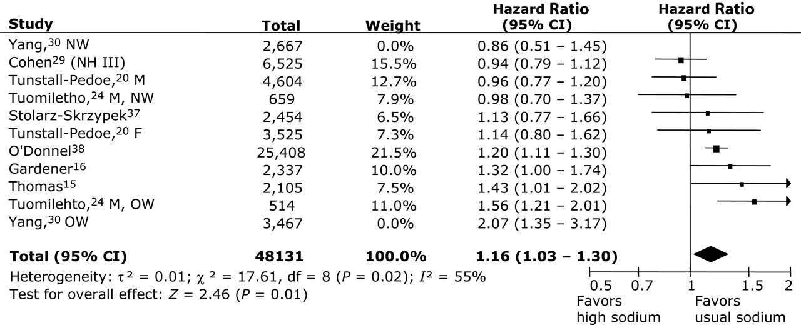
Figure 3. All-cause mortality, high sodium vs. usual sodium. Exchanging the first NHANES analysis²⁹ with the ...
Notes:
Figure 3. All-cause mortality, high sodium vs. usual sodium. Exchanging the first NHANES analysis29 with the reanalysis30 (hazard ratio = 1.22; 95% confidence interval = 1.08–1.39; P = 0.002). Abbreviations: F, female; M, male; NH, NHANES; NW, normal weight; OW, overweight.
Unless provided in the caption above, the following copyright applies to the content of this slide: © American Journal of Hypertension, Ltd 2014. All rights reserved. For Permissions, please email: journals.permissions@oup.com

