Slide 1
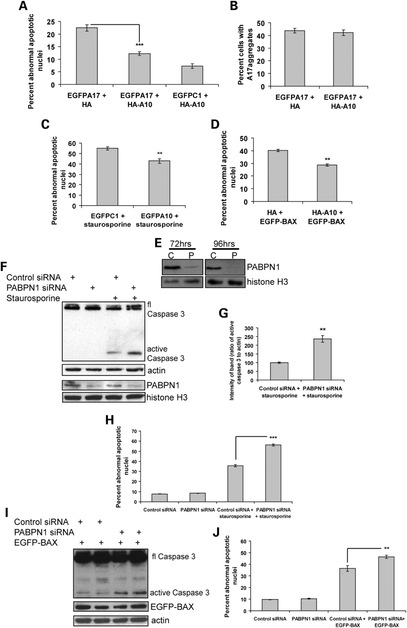
Figure 1. Wild-type PABPN1 protects against pro-apoptotic insults. (a) COS-7 cells were transiently transfected with ...
Notes:
Figure 1. Wild-type PABPN1 protects against pro-apoptotic insults. (a) COS-7 cells were transiently transfected with EGFP-tagged PABPN1 with an expanded polyalanine tract and empty vector (EGFPA17+HA), empty vector and HA-tagged wild-type PABPN1 (EGFPC1+HA-A10) or both wild-type and mutant PABPN1 (EGFPA17+HA-A10). Forty-eight hours later cells were scored for cell death based on abnormal apoptotic nuclear morphology. (B) The number of EGFP-positive cells from (A) that contained A17 aggregates was quantified. (C) COS-7 cells were transiently transfected with empty vector (EGFPC1) or wild-type PABPN1 (EGFPA10) and incubated for 48 h prior to treatment with pro-apoptotic staurosporine (3 µm for 6 h). EGFP positive cells were scored for cell death (abnormal apoptotic nuclei). (D) COS-7 cells were transiently transfected with empty vector (HA) or wild-type PABPN1 (HA-A10). Twenty-four hours later, apoptosis was induced by the transient over-expression of EGFP-tagged Bax for a further 24 h. EGFP positive cells were scored for apoptotic nuclear morphology (abnormal nuclei). (E) Western blot of nuclear extracts from COS-7 cells transfected with either control siRNA (C) or siRNA directed against PABPN1 (P), probed with an antibody to PAPN1. Histone H3 was used as a loading control. Knock-down of PABPN1was seen at 72 and 96 h post-transfection. (F) COS-7 cells were transfected with either control siRNA (Control siRNA) or siRNA directed against PABPN1 (PABPN1 siRNA) and incubated for 72 h prior to treatment with pro-apoptotic staurosporine. Cell lysates were subjected to western blotting and probed with an antibody against caspase 3 that recognizes an epitope present in both full length, inactive caspase 3 (fl caspase3) and a cleaved active form (active caspase 3). PABPN1 levels in nuclear extracts made from cells collected at the same time are shown as a control with histone H3 as a loading control. (G) Densitometric quantification of three separate experiments performed as (F). Caspase 3 band intensities are normalized to actin. (H) Cells were transfected as (F) and treated with staurosporine to induce apoptosis. Cells were scored for cell death (abnormal apoptotic nuclei). (I) COS-7 cells were transfected with control siRNA (control siRNA) or siRNA directed against PABPN1 (PABPN1 siRNA) and incubated 72 h before transfection with EGFP-tagged BAX (EGFP-BAX). Cell lysates derived were subjected to western blotting and probed with an antibody against caspase 3. (J) Cells were transfected as (H), fixed and EGFP-BAX positive cells scored for abnormal apoptotic nuclei. **P < 0.001;***P < 0.0001; n = 6 coverslips; error bars represent standard deviation.
Unless provided in the caption above, the following copyright applies to the content of this slide: © 2008 The Author(s)This is an Open Access article distributed under the terms of the Creative Commons Attribution Non-Commercial License (http://creativecommons.org/licenses/by-nc/2.0/uk/) which permits unrestricted non-commercial use, distribution, and reproduction in any medium, provided the original work is properly cited.

Slide 2
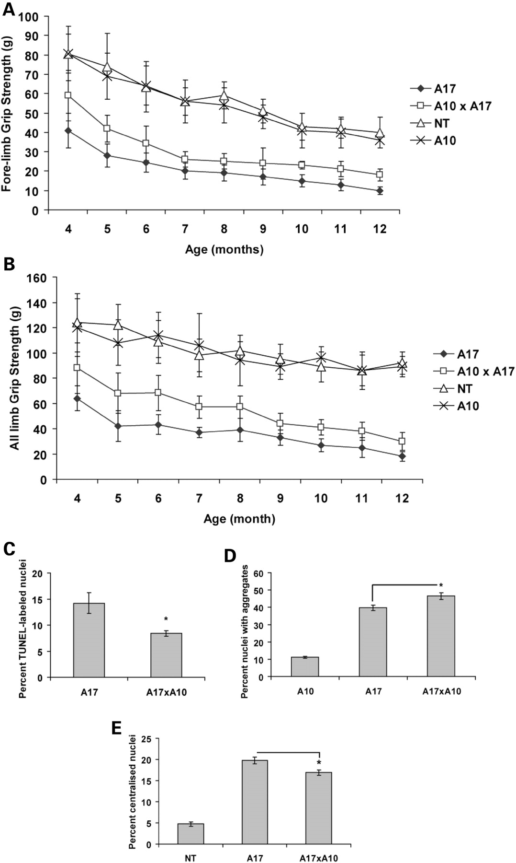
Figure 2. Wild-type PABPN1 protects from mutant PABPN1 toxicity in vivo. (A and B) Grip strength meter data from ...
Notes:
Figure 2. Wild-type PABPN1 protects from mutant PABPN1 toxicity in vivo. (A and B) Grip strength meter data from non-transgenic mice (NT; open triangle; 4 months, 5 months, 6 months, n = 12; 7 months, 8 months, 9 months, 10 months, 11 months, 12 months, n = 7), mice expressing a wild-type PABPN1 transgene (A10; cross; 4 months, 5 months, 6 months, n = 10; 7 months, 8 months, 9 months, 10 months, 11 months, 12 months, n = 7), mice expressing a mutant PABPN1 transgene (A17; black diamond; 4 months, 5 months, 6 months, n = 20; 7 months, 8 months, 9 months, 10 months, n = 17; 11 months, 12 months, n = 16) compared with double transgenics expressing both a wild-type PABPN1 and mutant PABPN1 transgene (A17×A10; open square; 4 months, 5 months, 6 months, n = 14; 7 months, n = 11; 8 months, 9 months, 10 months, 11 months, 12 months, n = 10). (A) Fore-limb grip strength is improved in A10×A17 mice compared with A17 mice at 4 months (P < 0.0001), 5 months (P < 0.0001), 6 months (P = 0.0003), 7 months (P = 0.0003), 8 months (P < 0.0001), 9 months (P = 0.01), 10 months (P = 0.002), 11 months (P < 0.0001) and 12 months (P < 0.0001) of age (t-tests). Overall effect from all treatment time points, P < 0.0001 (repeated measures ANOVA). (B) Grip strength from all limbs is also improved in double transgenics (A10×A17) compared with mutant transgenic mice (A17) at 4 months (P < 0.0001), 5 months (P < 0.0001), 6 months (P < 0.0001), 7 months (P < 0.0001), 8 months (P < 0.0001), 9 months (P = 0.001), 10 months (P < 0.0001), 11 months (P < 0.0001) and 12 months (P < 0.0001) of age (t-tests). Overall effect from all treatment time points, P < 0.0001 (repeated measures ANOVA). (C) Biceps muscle sections from 6-month-old, mutant PABPN1 (A17) and double transgenics (A10×A17) were TUNEL-labelled and the number of positive nuclei scored (as in 7). (D) Quantification of aggregate-containing nuclei in sections of biceps muscle from 6-month-old mice expressing a wild-type PABPN1 transgene (A10), mutant PABPN1 transgene (A17) and double transgenics expressing both mutant and wild-type PABPN1 transgenes (A10×A17). Sections were incubated with KCl to remove soluble protein and labelled with a PABPN1-specific antibody to detect aggregates comprising PABPN1 (7). (E) Quantification of centralized nuclei in H&E-stained sections of biceps muscle from 6-month-old mice expressing a mutant PABPN1 transgene (A17), double transgenics expressing both mutant and wild-type PABPN1 transgenes (A10×A17) and non-transgenic mice (NT). *P < 0.05; n = 3; 200 nuclei per sample scored; error bars represent standard deviation in graphs (A) and (B) and standard error of the mean in graph (C) and (D).
Unless provided in the caption above, the following copyright applies to the content of this slide: © 2008 The Author(s)This is an Open Access article distributed under the terms of the Creative Commons Attribution Non-Commercial License (http://creativecommons.org/licenses/by-nc/2.0/uk/) which permits unrestricted non-commercial use, distribution, and reproduction in any medium, provided the original work is properly cited.

Slide 3
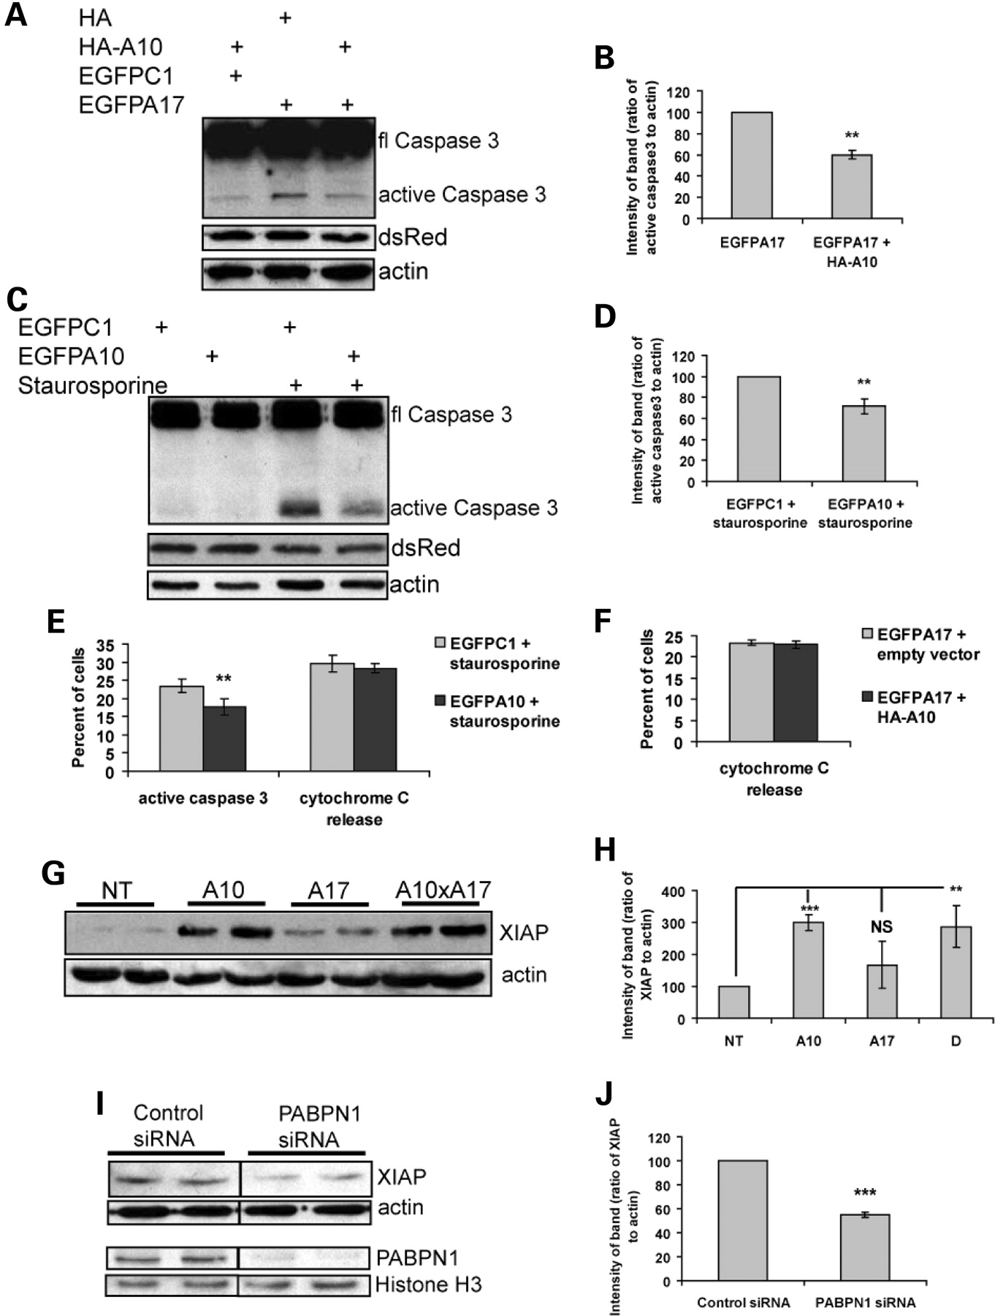
Figure 3. Wild-type PABPN1 protects cells from apoptosis by regulating levels of XIAP. (A) Western blot of lysates ...
Notes:
Figure 3. Wild-type PABPN1 protects cells from apoptosis by regulating levels of XIAP. (A) Western blot of lysates derived from cells transfected with empty vector (EGFPC1) and HA-tagged wild-type PABPN1 (HA-A10), EGFP-tagged mutant PABPN1 (EGFPA17) and empty vector (HA) or EGFPA17 and HA-A10, probed with an antibody against caspase 3. dsRed was used as a transfection control and actin as a control for equal protein loading. (B) Densitometric quantification of three separate experiments performed as (A). Caspase 3 band intensities were normalized to actin. (C) COS-7 cells were transfected with EGFP-tagged wild-type PABPN1 (EGFPA10) or empty vector (EGFPC1) and, as a transfection control, dsRed. Seventy-two hours post-transfection, cells were treated with staurosporine. Derived lysates were subjected to western blotting and probed with an antibody against caspase 3. (D) Densitometric quantification of three experiments performed as in (C). Active caspase 3 band intensities were normalized to actin. (E) Cells transfected and treated as in (C) were fixed and immuno-labelled with an antibody against active caspase 3 or cytochrome C. EGFP-positive cells were scored for active caspase 3 (bright immuno-labelling using the active caspase 3 antibody) and cytochrome C release (faint diffuse cytochrome c immuno-labelling as opposed to the bright punctuate labelling of mitochondria seen in unaffected cells). (F) Cells transfected as (A) were fixed and immunolabelled with a cytochrome c antibody. Cells were scored for cytochrome c release as in (E). (G) Western blot of biceps muscle protein lysates from 6-month-old non-transgenic mice (NT), mice expressing a wild-type PABPN1 transgene (A10), mice expressing a mutant PABPN1 transgene (A17) or double transgenic expressing both wild-type and mutant PABPN1 transgenes (A10×A17), probed with an antibody against XIAP. Actin was used as a loading control. (H) Densitometric quantification of (G). XIAP band intensities were normalized to actin. (I) XIAP levels in COS-7 cells transfected with control siRNA or siRNA against PABPN1 (PABPN1 siRNA) shown by western blotting. Actin was used as a loading control. PABPN1 levels in nuclear extracts prepared from cells collected at the same time are shown as a control with histone H3 as a loading control. Same antibody bands are from one western blot at the same exposure time. (J) Densitometric quantification of three experiments performed as (I). XIAP band intensities were normalized to actin. All western blots were performed three or more times, a representative experiment is shown. For all immunocytochemistry, n = 6 coverslips, 200 cells per coverslip were scored. **P < 0.001; ***P < 0.0001; NS, non-significant; error bars represent standard deviation.
Unless provided in the caption above, the following copyright applies to the content of this slide: © 2008 The Author(s)This is an Open Access article distributed under the terms of the Creative Commons Attribution Non-Commercial License (http://creativecommons.org/licenses/by-nc/2.0/uk/) which permits unrestricted non-commercial use, distribution, and reproduction in any medium, provided the original work is properly cited.

Slide 4
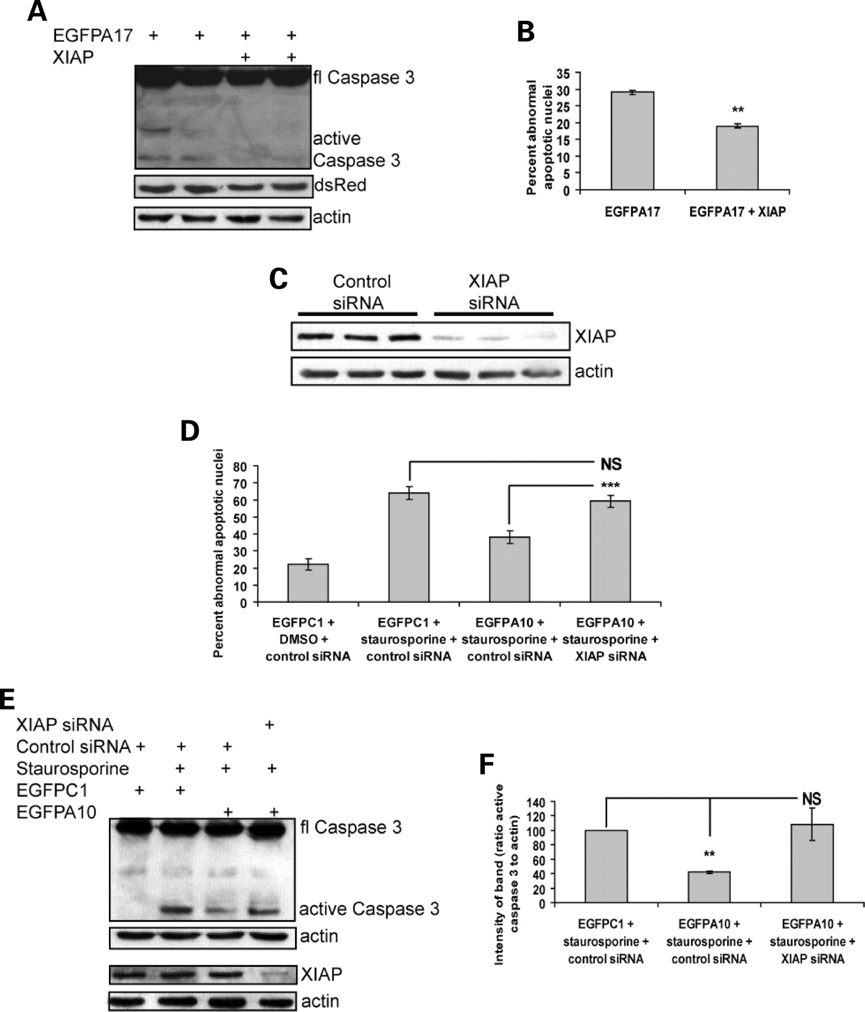
Figure 4. XIAP can protect against mutant PABPN1 toxicity. (A) COS-7 cells were transfected with EGFP-tagged mutant ...
Notes:
Figure 4. XIAP can protect against mutant PABPN1 toxicity. (A) COS-7 cells were transfected with EGFP-tagged mutant PABPN1 (EGFPA17) and either empty vector or a XIAP expression construct (XIAP). Derived lysates were subjected to western blotting and probed with an antibody against active caspase 3. dsRed served as a transfection control and actin as a control for equal protein loading. (B) Cells were transfected as in (A). Forty-eight hours later cells were scored for cell death (abnormal apoptotic nuclei). (C) siRNA knock-down of XIAP. Western blot of whole cell lysates derived from COS-7 cells transfected with either control siRNA or siRNA directed against XIAP, probed with an antibody to XIAP. Actin was used as a loading control. Knock-down of XIAP was seen at 72 h post-transfection. (D) COS-7 cells were transfected with control siRNA or siRNA against XIAP (XIAP siRNA) and EGFP-tagged wild-type PABPN1 (EGFPA10) or empty vector (EGFPC1). Cells were treated with staurosporine or, as a control, DMSO for the final 6 h of transfection. Fixed cells were scored for abnormal, apoptotic nuclei. XIAP knockdown abolishes the protective effect of A10. (E) Protein lysates derived from cells transfected as in (D) were subjected to western blotting and probed with an antibody against active caspase 3. As a control, levels of XIAP were determined in the same samples with actin as a loading control. (F) Densitometric quantification of three separate experiments performed as in (E). The intensities of active caspase 3 bands were normalized to actin. All western blots were performed three or more times, a representative experiment is shown. For all immunocytochemistry, n = 6 coverslips, 200 cells per coverslip were scored. **P < 0.001; ***P < 0.0001; NS, non-significant; error bars represent standard deviation.
Unless provided in the caption above, the following copyright applies to the content of this slide: © 2008 The Author(s)This is an Open Access article distributed under the terms of the Creative Commons Attribution Non-Commercial License (http://creativecommons.org/licenses/by-nc/2.0/uk/) which permits unrestricted non-commercial use, distribution, and reproduction in any medium, provided the original work is properly cited.

Slide 5
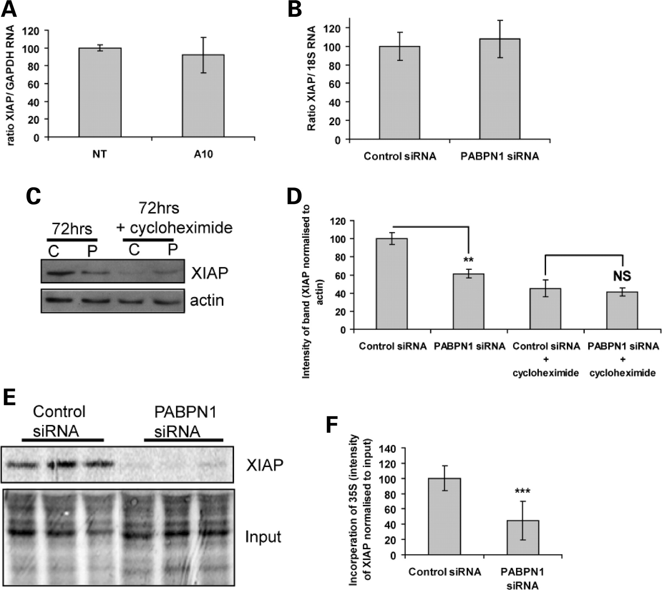
Figure 5. PABPN1 regulates the translation of XIAP. (A) XIAP RNA levels in gastrocnemius muscle from 6-month-old mice ...
Notes:
Figure 5. PABPN1 regulates the translation of XIAP. (A) XIAP RNA levels in gastrocnemius muscle from 6-month-old mice expressing a wild-type PABPN1 transgene (A10) and non-transgenic mice (NT). XIAP levels were determined by RT–PCR and normalized to levels of GAPDH RNA (n = 3). (B) Levels of XIAP RNA in COS-7 cells transfected with control siRNA or siRNA against PABPN1 (PABPN1 siRNA) determined by RT–PCR and normalized to levels of 18S RNA (n = 3). (C) COS-7 cells were transfected with control siRNA (C) or siRNA directed against PABPN1 (P) and incubated for 48 h. Cycloheximide (protein synthesis inhibitor; 10 µg/ml) was added to the cells which were incubated for a further 24 h. Cells were collected and the lysates produced were blotted and probed with an antibody against XIAP. (D) Densitometric quantification of three experiments as (C). (E) COS-7 cells were transfected with control siRNA or siRNA directed against PABPN1 (PABPN1 siRNA) and incubated for 72 h. The translation of XIAP was measured by 35S-methionine labelling of cells (100 µCi/ml for 1 h) followed by immuno-precipitation with an XIAP antibody (XIAP). The immunoprecipitates were subjected to SDS–PAGE and autoradiography. Incorporation of 35S-methionine into total cellular proteins used for the IP (Input) was used as a control. Experiment was carried with n = 9, a representative part of the gel is shown. (F) Densitometric quantification of (E). Incorporation of 35S-methoinine into XIAP was normalized to incorporation into total cell lysate that was used for the immuno-precipitation (Input), n = 9. **P < 0.001; ***P < 0.0001; NS, non-significant; error bars represent standard deviation.
Unless provided in the caption above, the following copyright applies to the content of this slide: © 2008 The Author(s)This is an Open Access article distributed under the terms of the Creative Commons Attribution Non-Commercial License (http://creativecommons.org/licenses/by-nc/2.0/uk/) which permits unrestricted non-commercial use, distribution, and reproduction in any medium, provided the original work is properly cited.

