Slide 1
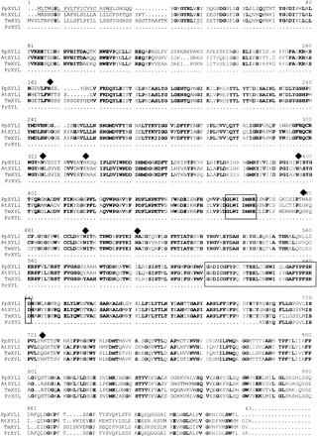
Fig. 1 Alignment of the amino acid sequence from Pinus pinaster putative α-xylosidase (PpXYL1) with known ...
Notes:
Fig. 1 Alignment of the amino acid sequence from Pinus pinaster putative α-xylosidase (PpXYL1) with known α-xylosidases from Arabidopsis thaliana (AtXYL1, Accession no. AAD37363) and Tropaeolum majus (TmXYL, accession no. CAA10382). The signal peptide is underlined and the potential N-glycosylation sites are marked with diamonds. Boxes enclose the signature sequences characteristic of family 31 glycosyl hydrolases. The translated amino acid sequence of a cDNA clone from Pinus radiata (PrXYL) is also enclosed.
Unless provided in the caption above, the following copyright applies to the content of this slide:

Slide 2
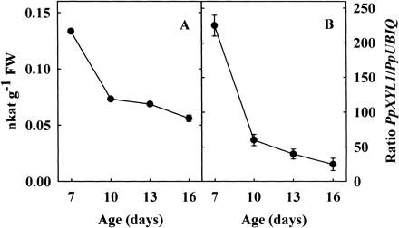
Fig. 2 Changes in α-xylosidase activity (A) and in the level of PpXYL1 transcripts (B) with seedling age. The ...
Notes:
Fig. 2 Changes in α-xylosidase activity (A) and in the level of PpXYL1 transcripts (B) with seedling age. The α-xylosidase activity was measured as the release of pentoses from a xyloglucan oligosaccharide mixture. Total RNA was extracted from whole hypocotyls at different ages and cDNAs were produced by RT and PpXYL1 mRNA was quantified by competitive PCR using ubiquitin transcript level as a reference. Mean value with ± SE (n = 3).
Unless provided in the caption above, the following copyright applies to the content of this slide:

Slide 3
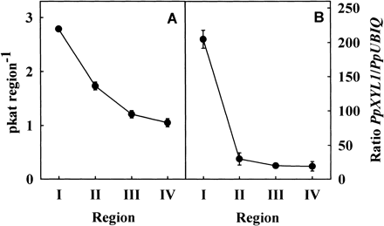
Fig. 3 Changes in α-xylosidase activity (A) and in the level of PpXYL1 transcripts (B) along the hypocotyl. ...
Notes:
Fig. 3 Changes in α-xylosidase activity (A) and in the level of PpXYL1 transcripts (B) along the hypocotyl. The hypocotyls of 10-day-old pine seedlings were divided in four 5 mm from the cotyledonary node towards the base. The α-xylosidase activity was measured as the release of pentoses from a xyloglucan oligosaccharide mixture. The mRNA was extracted from different regions of hypocotyls of 10-day-old seedlings and cDNAs were produced by RT and quantified using competitive PCR with specific primer and referred to the ubiquitin transcript levels. Mean value with ± SE (n = 3).
Unless provided in the caption above, the following copyright applies to the content of this slide:

Slide 4
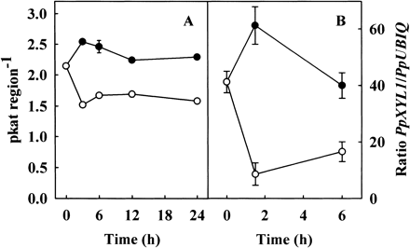
Fig. 4 Effect of auxin on the α-xylosidase activity (A) and in the level of PpXYL1 transcripts (B) from ...
Notes:
Fig. 4 Effect of auxin on the α-xylosidase activity (A) and in the level of PpXYL1 transcripts (B) from hypocotyl segments incubated for different times. The mRNA was extracted from hypocotyls sections incubated with 10–4 M IAA (closed symbols) or without (open symbols), and cDNAs were produced by RT and quantified using competitive PCR with specific primer and referred to the ubiquitin transcript levels. Mean value with ± SE (n = 3).
Unless provided in the caption above, the following copyright applies to the content of this slide:

Slide 5
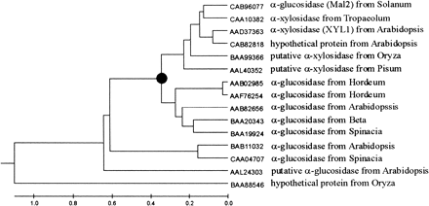
Fig. 5 Phylogenetic relationships between plant α-glycosyl hydrolases of family 31. The closed circle shows ...
Notes:
Fig. 5 Phylogenetic relationships between plant α-glycosyl hydrolases of family 31. The closed circle shows the probable point where plant cell wall α-xylosidases begun to diverge from α-glucosidases.
Unless provided in the caption above, the following copyright applies to the content of this slide:

