Slide 1
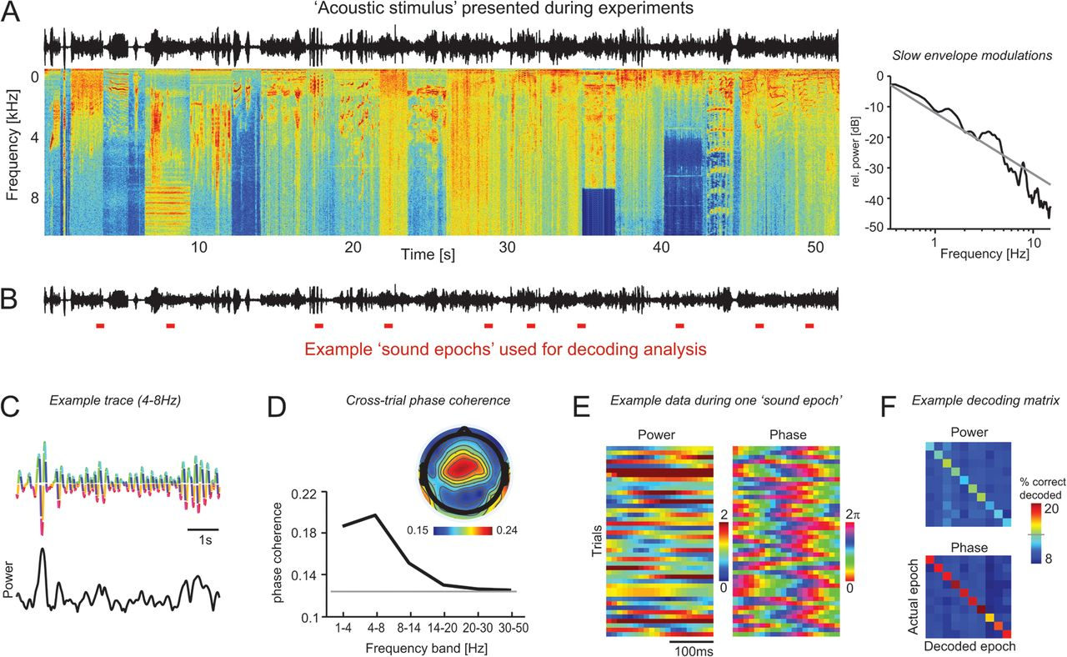
Figure 1. Illustration of the acoustic stimulus, epoch selection for decoding, and example data. (A) The acoustic ...
Notes:
Figure 1. Illustration of the acoustic stimulus, epoch selection for decoding, and example data. (A) The acoustic stimulus presented during the experiments consisted of a 52 s long sequence composed of various natural sounds without periods of intermittent silence. The figure displays the sound wave, the spectrogram (red color indicates high sound intensity), and the frequency spectrum of the slow sound envelope modulations (right panel). (B) Schematic of the sound epoch selection for decoding analysis. Sets consisting of 10 epochs (red bars) were randomly selected from within the acoustic stimulus. In total, 300 such sets were used, and the epoch duration was varied from 120 to 360 ms. (C) Example traces of the central EEG signal on a single trial showing the phase (upper) and power (lower) of the 4–8 Hz band. (D) EEG phase coherence. The upper panel displays the topography of the 4–8 Hz band phase coherence, the lower panel the frequency dependence (subject median for central electrodes, n = 6). The gray line indicates the significance level (P < 0.01) obtained from a randomization test, performed across all frequency bands. (E) Example data of the 4–8 Hz power and phase across multiple trials during one sound epoch used for decoding. This figure reveals a higher reliability of the phase value across trials, visible as a better alignment of the same signal values (color code) across trials for phase. (F) Example decoding matrices. The decoding matrix indicates the percentage of trials in which a given “actual epoch” was decoded as each “decoded epoch.” Diagonal entries denote correctly decoded trials. The gray line on the color bar indicates above-the significance level (P < 0.01). Note that for power, only 3 stimuli are decoded with above chance performance.
Unless provided in the caption above, the following copyright applies to the content of this slide: © The Author 2012. Published by Oxford University Press. All rights reserved. For permissions, please e-mail: journals.permissions@oup.com

Slide 2
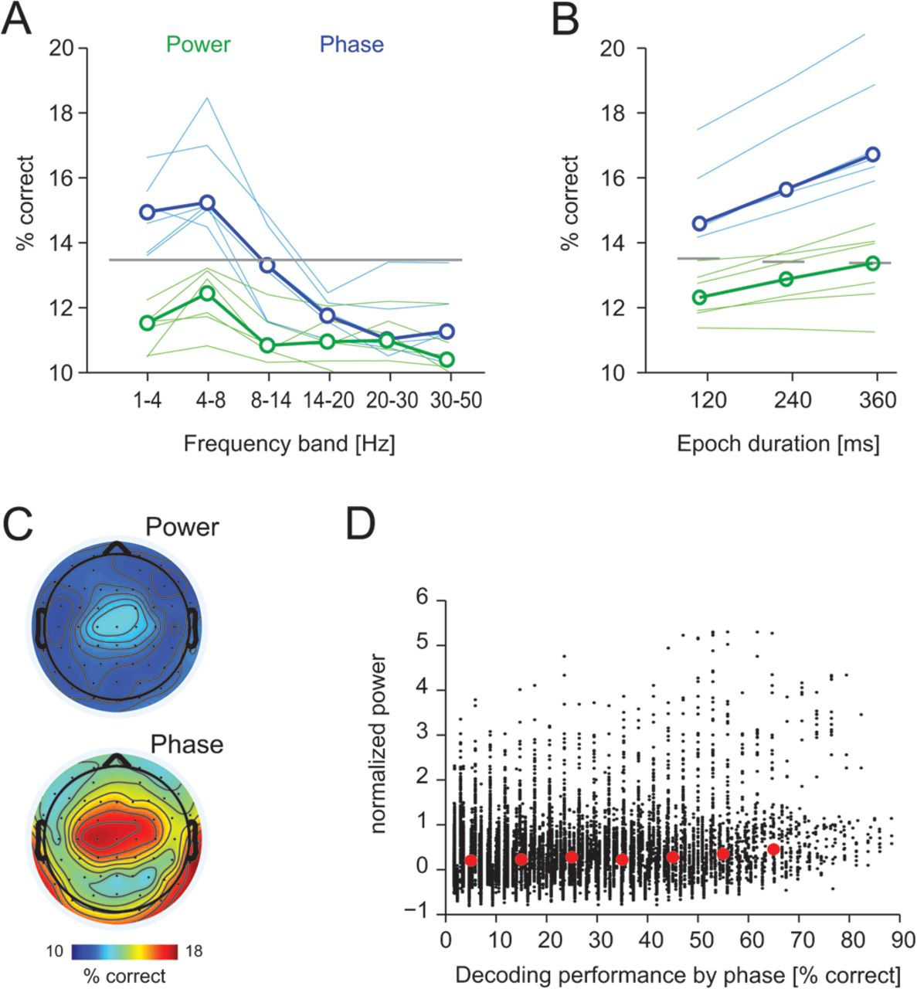
Figure 2. Sound epoch decoding from EEG data. (A) Decoding performance shown as the percentage correctly decoded trials ...
Notes:
Figure 2. Sound epoch decoding from EEG data. (A) Decoding performance shown as the percentage correctly decoded trials as a function of frequency band (using epochs of 240-ms duration). Thick lines denote the median across subjects (n = 6), and the gray line indicates the significance level (P < 0.01) from a randomization test (a common significance level across all frequencies was computed). Thin lines indicate single subject data. (B) Decoding performance as a function of sound epoch duration for the theta (4–8 Hz) band. Conventions as in (A). (C) Topography of decoding performance shown as the subject-averaged decoding performance for the theta (4–8 Hz) band. (D) Decoding performance using theta phase as a function of theta power in the same sound epoch across sound epochs and subjects. Each dot corresponds to a single sound epoch. Power values were normalized to a prestimulus period (1-s period before stimulus onset) using z-score. Red circles indicate the mean power per 10% range of decoding performance.
Unless provided in the caption above, the following copyright applies to the content of this slide: © The Author 2012. Published by Oxford University Press. All rights reserved. For permissions, please e-mail: journals.permissions@oup.com

Slide 3
Figure 3. Sound epoch decoding from intracranial LFPs and firing rates. (A) Example data from one recording site ...
Notes:
Figure 3. Sound epoch decoding from intracranial LFPs and firing rates. (A) Example data from one recording site showing traces of the theta (4–8 Hz) band LFP and spike raster of one unit. The phase of the LFP was color-coded, and the raster shows the timing of individual action potentials across trials for a 3 s excerpt of the full 52 s acoustic stimulus. (B) Decoding performance shown as the percentage correctly decoded trials as a function of frequency band (using epochs of 240-ms duration), for LFP power, LFP phase, and firing rates. Lines denote the median across recording sites (n = 36), and the gray line indicates the significance level (P < 0.01) from a randomization test (a common significance level across all frequencies was computed). (C) Decoding performance as a function of sound epoch duration for the LFP theta (4–8 Hz) band and firing rates. Conventions as in (B).
Unless provided in the caption above, the following copyright applies to the content of this slide: © The Author 2012. Published by Oxford University Press. All rights reserved. For permissions, please e-mail: journals.permissions@oup.com

Slide 4
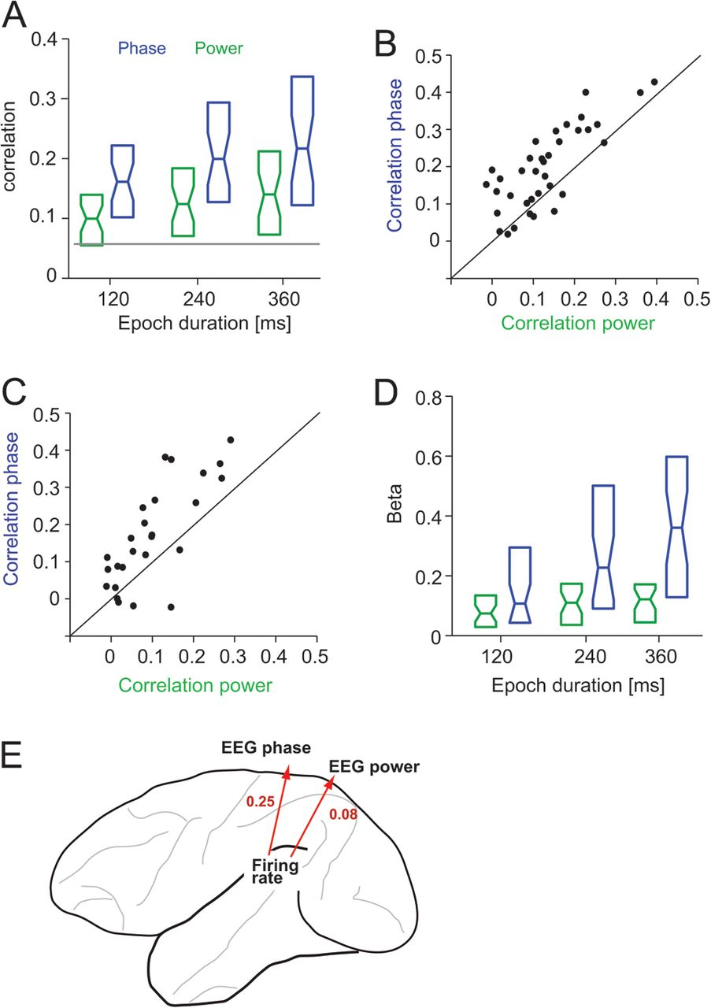
Figure 4. Correlation of sound epoch selectivity in oscillations and firing rates. (A) Correlation of decoding ...
Notes:
Figure 4. Correlation of sound epoch selectivity in oscillations and firing rates. (A) Correlation of decoding performance between theta (4–8 Hz) band LFP phase/power and firing rates recorded from the same sites (240-ms epoch duration). The correlation was computed considering only the performance of correctly decoding individual stimuli (diagonal of the decoding matrix) and was calculated across all 300 stimulus sets. Box plots display the median and 25th and 75th percentiles (boxes) across sites (n = 36). (B) Individual correlation values for LFP phase and power (240-ms epoch duration, 4–8 Hz band), each dot corresponds to one recording site. The difference was highly significant (sign-rank test P < 10−3). (C) Correlation of decoding performance between LFP phase/power and firing rates when considering the full decoding matrix (240-ms epoch duration, 4–8 Hz band). The difference was highly significant (sign-rank test P < 10−4). (D) Normalized beta values of a multiple regression analysis modeling the decoding performance of firing rates using that of theta-band LFP phase and power. Box plots display the median and 25th and 75th percentiles (boxes) across sites (n = 36). (E) Correlation of the total decoding performance (percentage of total correctly decoded trials) computed across the 300 stimulus sets between firing rates and theta-band EEG phase/power (240-ms epoch duration).
Unless provided in the caption above, the following copyright applies to the content of this slide: © The Author 2012. Published by Oxford University Press. All rights reserved. For permissions, please e-mail: journals.permissions@oup.com

