Slide 1
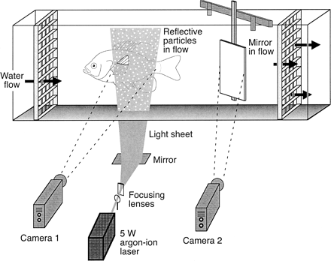
Fig. 1. Schematic illustration of the technique of digital particle image velocimetry (DPIV) as applied to ...
Notes:
Fig. 1. Schematic illustration of the technique of digital particle image velocimetry (DPIV) as applied to the study of locomotion in fishes. Fish swim in the center of the working area of a recirculating flow tank (delimited by upstream and downstream collimator grids); water in the flow tank is seeded with near-neutrally buoyant, reflective particles (hollow silver-coated glass spheres, 12 μm mean diameter). Light from a continuous-wave argon-ion laser is focused into a sheet approximately 1–2 mm thick and 10 cm wide, and projected into the working area where this light is reflected by particles in the water. As fish swim, their fins break the plane of the light sheet and shed a wake into the water illuminated by the laser. Images of this water motion are recorded by a high-speed video camera (Camera 1). Simultaneous images of the fish in a perpendicular perspective are obtained from a second, synchronized video camera (Camera 2) which views the position of the fin within the laser light sheet via a small mirror located downstream at a 45-degree angle to the flow (exaggerated in size in this schematic figure). After Drucker and Lauder (1999)
Unless provided in the caption above, the following copyright applies to the content of this slide: The Society for Integrative and Comparative Biology

Slide 2
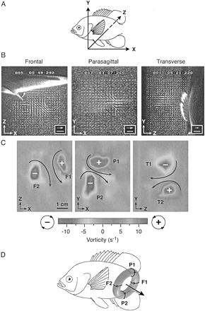
Fig. 2. Overview of experimental approach used to reconstruct the three-dimensional morphology of the wake of ...
Notes:
Fig. 2. Overview of experimental approach used to reconstruct the three-dimensional morphology of the wake of swimming fishes. A. By reorienting focusing lenses and mirrors (cf.,Fig. 1), laser light sheets may be arranged in three separate perpendicular planes: frontal (XZ), parasagittal (XY) and transverse (YZ). For each plane, flow velocity fields (B) and vorticity components (C) can be calculated. Based on such data in three dimensions, the geometry of large-scale structures in the wake can be determined. In the case illustrated, the pectoral fin stroke of bluegill sunfish swimming at 0.5 body length sec−1 produces paired counterrotating vortices in each plane (B) (curved arrow in frontal-plane image shows the direction of pectoral fin movement near the end of the upstroke; free-stream velocity from left to right has been subtracted from each vector matrix). Corresponding centers of vorticity are visible in each plane (C) (centers of counterclockwise and clockwise flow indicated by + and −, respectively). These vorticity patterns can be reconstructed as a single vortex ring, rotated laterally and inclined relative to the horizontal, produced during each fin beat (D). In C and D, the labels F1–2, P1–2 and T1–2 indicate the centers of vorticity observed in each planar view of the wake. In D, curved arrows represent vortices observed in perpendicular laser light sheets and the straight arrow indicates the mean orientation of the fluid jet passing through the center of the vortex ring. Scales in B: arrow, 20 cm sec−1; bar, 1 cm. Adapted from Drucker and Lauder (1999)
Unless provided in the caption above, the following copyright applies to the content of this slide: The Society for Integrative and Comparative Biology

Slide 3
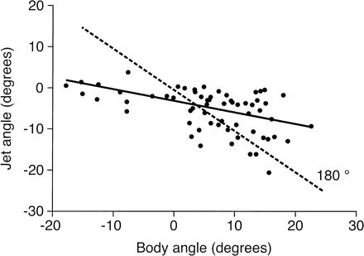
Fig. 3. Angle of the central fluid jet through vortex rings generated by the tail of white sturgeon plotted ...
Notes:
Fig. 3. Angle of the central fluid jet through vortex rings generated by the tail of white sturgeon plotted as a function of body angle during steady horizontal locomotion and vertical maneuvering at 1.2 body length sec−1. Solid line indicates significant linear regression (P < 0.001; N = 62 tail beats). Vortex ring jet angle was measured from parasagittal-plane flow fields. Determining the orientation of the locomotor reaction force relative to body angle provides information about the force balance on swimming fishes. If the sturgeon tail functioned to generate force directly posteriorly (i.e., parallel to the orientation of the body), data points would be expected to fall along the dashed line representing a constant angular deviation of 180°. Indeed, during steady swimming, the mean body angle (+7°) is effectively equal but opposite to the jet angle (−6°). However, these flow visualization measurements show that sturgeon can actively modulate the direction of force production with their tail during rising and sinking maneuvers: during swimming at high body angles, the jet angle is greater than expected, while at low body angles the jet angle is less than predicted. From Liao and Lauder (2000)
Unless provided in the caption above, the following copyright applies to the content of this slide: The Society for Integrative and Comparative Biology

Slide 4
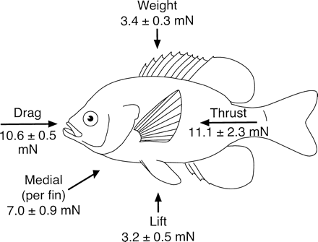
Fig. 4. Experimentally determined three-dimensional force balance on bluegill sunfish swimming with the ...
Notes:
Fig. 4. Experimentally determined three-dimensional force balance on bluegill sunfish swimming with the pectoral fins alone at 0.5 body length (L) sec−1 (10.7 cm sec−1). Reported thrust and lift values (mean ± SEM; N = 10, 12) were calculated from hydrodynamic data on vortex rings shed into the wake, and represent the mean reaction forces experienced by both the left and right pectoral fins together over the course of the fin-stroke period. Total body drag was measured directly by anesthetizing the same fish used in DPIV experiments and towing them individually from a force transducer within the flow tank at a current speed 0.5 L sec−1. Observed differences between the measured thrust and drag forces are not statistically significant. Similarly, the stroke-averaged lift force calculated from vortex rings matches the body weight of sunfish under water. On opposite sides of the body, each pectoral fin experiences a relatively large medially directed reaction force, exceeding the per-fin thrust force by 25% on average. From Drucker and Lauder (1999)
Unless provided in the caption above, the following copyright applies to the content of this slide: The Society for Integrative and Comparative Biology

Slide 5
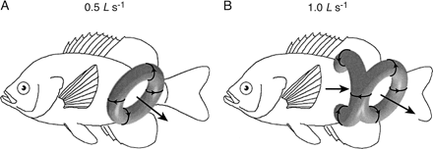
Fig. 5. Effect of swimming speed on the structure of the vortex wake in bluegill sunfish. A. At 0.5 body ...
Notes:
Fig. 5. Effect of swimming speed on the structure of the vortex wake in bluegill sunfish. A. At 0.5 body length (L) sec−1 (half of the maximal labriform swimming speed) the pectoral fin wake consists of a single vortex ring produced per fin beat cycle. B. At 1.0 L sec−1 (the maximal pectoral-fin swimming speed) the wake is composed of one complete vortex ring generated on the downstroke of the pectoral fin and a linked vortex filament produced by the upstroke, which terminates on the flank of the fish to form a second, incomplete ring attached to the body. In these schematic reconstructions of wake morphology, curved arrows represent centers of vorticity observed in perpendicular laser light sheets, and straight arrows indicate the direction of jet flow through the center of each vortex ring. Modified from Drucker and Lauder (1999)
Unless provided in the caption above, the following copyright applies to the content of this slide: The Society for Integrative and Comparative Biology

Slide 6
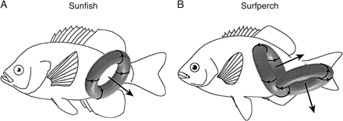
Fig. 6. Interspecific differences in the structure of the vortex wake in labriform swimmers. The pectoral fin ...
Notes:
Fig. 6. Interspecific differences in the structure of the vortex wake in labriform swimmers. The pectoral fin wake of bluegill sunfish and black surfperch is shown with each fish at 50% of its respective maximal pectoral-fin swimming speed (cf.,Fig. 7). Sunfish generate a single, laterally oriented vortex ring during each stroke cycle (A), whereas surfperch shed paired vortex rings, each of which having a downstream-directed fluid jet (B). Curved arrows represent centers of vorticity observed in perpendicular planar sections of the wake, and straight arrows signify the direction of the jet through the center of each vortex ring. Modified from Drucker and Lauder (2000)
Unless provided in the caption above, the following copyright applies to the content of this slide: The Society for Integrative and Comparative Biology

Slide 7
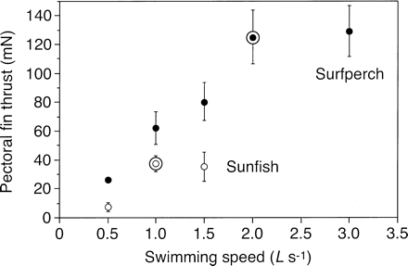
Fig. 7. Pectoral fin thrust calculated from wake flow data for sunfish and surfperch plotted as a function of ...
Notes:
Fig. 7. Pectoral fin thrust calculated from wake flow data for sunfish and surfperch plotted as a function of swimming speed in body lengths L traveled per second. Data are shown as mean ± SEM (N = 3–6 fin beats) and represent average forward thrust generated by both pectoral fins together over the stride period. The maximal labriform swimming speed for each species is circled. Note that pectoral fin thrust reaches a plateau for sunfish at 1.0 L sec−1 while the comparable plateau for surfperch begins at 2.0 L sec−1. At speeds greater than 1.0 L sec−1 sunfish recruit the caudal and dorsal fins to supplement pectoral fin thrust. Modified from Drucker and Lauder (2000)
Unless provided in the caption above, the following copyright applies to the content of this slide: The Society for Integrative and Comparative Biology

Slide 8
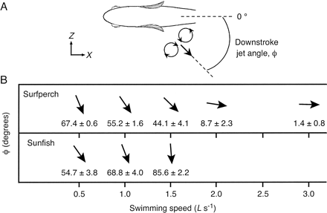
Fig. 8. Orientation of the fluid jet passing through the center of pectoral-fin vortex rings over a range of ...
Notes:
Fig. 8. Orientation of the fluid jet passing through the center of pectoral-fin vortex rings over a range of swimming speeds in bluegill sunfish and black surfperch. A. Downstroke jet angle (ϕ), as measured in the frontal (XZ) plane, is defined as 0° when velocity vectors within the jet are oriented on average directly downstream. Positive values for this angle reflect a lateral component of velocity within the jet. B. For both species, mean ϕ (reported with SEM; N = 3–8 fin beats) is represented by the orientation of black arrows. With increasing swimming speed, the wake jet of surfperch rotates into a more downstream orientation providing increased thrust. In sunfish, the jet is progressively reoriented laterally as swimming speed increases, limiting the thrust available to overcome drag. L, total body length. From Drucker and Lauder (2000)
Unless provided in the caption above, the following copyright applies to the content of this slide: The Society for Integrative and Comparative Biology

Slide 9
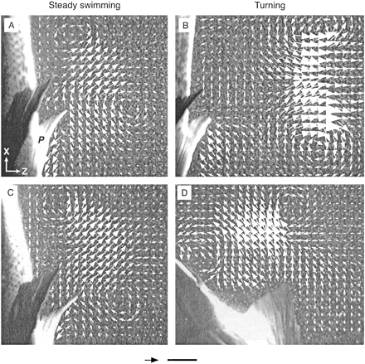
Fig. 9. Wake flow patterns in the frontal (XZ) plane during steady labriform locomotion and pectoral-fin ...
Notes:
Fig. 9. Wake flow patterns in the frontal (XZ) plane during steady labriform locomotion and pectoral-fin turning maneuvers in bluegill sunfish. Water velocity fields are shown at the final stage of the upstroke of the pectoral fin (labeled P). Free-stream velocity of 0.5 body length (L) sec−1 (11.2 cm sec−1) has been subtracted from the X-component of each velocity vector to reveal vortical wake structures. A. Pattern of fluid flow in the wake of the pectoral fin during steady swimming at 0.5 L sec−1. B. Wake flow produced by the pectoral fin during turning elicited by a stimulus issued from the right. This pectoral fin beat cycle immediately follows the steady fin beat illustrated in A. As this strong-side wake develops, with a laterally directed fluid jet, the body rotates in the opposite direction to the left. C. Pattern of fluid flow during a separate, steady pectoral fin beat. D. Turning wake generated subsequent to the fin beat in C in response to a stimulus issued from the left. This weak-side wake arises on the upstroke and contains jet flow oriented nearly parallel to the body axis. The reaction to this momentum flow causes the fish to translate upstream (toward the bottom of the page) away from the source of the stimulus. Scales: arrow, 10 cm sec−1; bar, 1 cm. From Drucker and Lauder (2001b)
Unless provided in the caption above, the following copyright applies to the content of this slide: The Society for Integrative and Comparative Biology

Slide 10
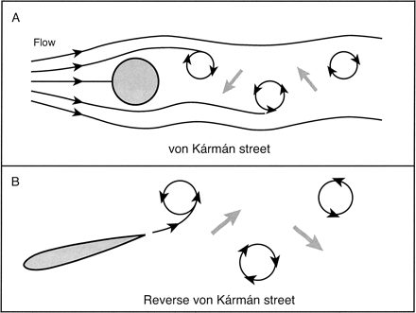
Fig. 10. Comparison of theoretically expected patterns of wake flow behind a stationary cylinder (A) and a ...
Notes:
Fig. 10. Comparison of theoretically expected patterns of wake flow behind a stationary cylinder (A) and a heaving and pitching foil (B). Incident fluid flow in both panels is from left to right. The bluff body in A generates a drag wake composed of staggered counterrotating vortices with interspersed jet flow (gray arrows) oriented upstream (i.e., a von Kármán street). As the streamlined foil in B oscillates it also leaves a staggered wake of vortices, but because the sense of vortex rotation is opposite to that shown in A this wake is termed a reverse von Kármán street. This actively generated wake produces jet flow between alternating vortex pairs that is oriented downstream. In reaction to these momentum jets, forward thrust is exerted on the foil
Unless provided in the caption above, the following copyright applies to the content of this slide: The Society for Integrative and Comparative Biology

Slide 11
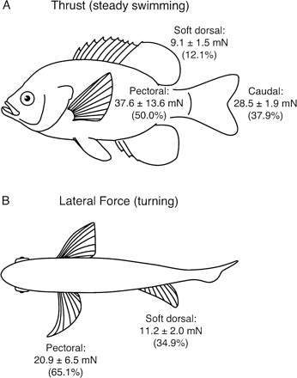
Fig. 11. Summary of the components of wake force contributed by different fins of bluegill sunfish during ...
Notes:
Fig. 11. Summary of the components of wake force contributed by different fins of bluegill sunfish during steady swimming and turning behavior. All forces are stroke-averaged and reported as mean ± SEM (N = 6–11 fin beats). For each behavior, the percentage of total force generated by each fin is given in parentheses. A. Thrust generated during steady swimming at 1.1 body length sec−1 by the soft dorsal fin, tail and both pectoral fins together (per complete stroke cycle). B. Laterally oriented force produced by the strong-side pectoral fin during the early stage of a turning maneuver (cf.,Fig. 9B) and by the soft dorsal fin during the latter stage of the turn. The partitioning of force among fins in A and B underlines the ability of teleost fishes to use multiple propulsors simultaneously and independently during locomotion. The observed contribution of the soft dorsal fin to locomotor force (12% of thrust; 35% of lateral force) supports an active role of this fin in propulsion for perciform fishes. Force data from Drucker and Lauder (1999, 2001a,b)
Unless provided in the caption above, the following copyright applies to the content of this slide: The Society for Integrative and Comparative Biology

Slide 12
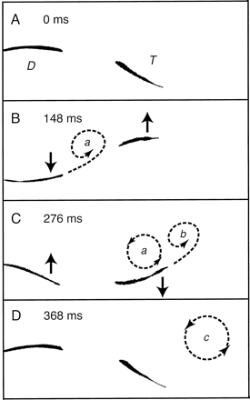
Fig. 12. Interaction between vortices generated by the soft dorsal fin (D) and the dorsal lobe of the tail ...
Notes:
Fig. 12. Interaction between vortices generated by the soft dorsal fin (D) and the dorsal lobe of the tail (T) proposed to enhance thrust production by fishes. Dorsal-view silhouettes of the fins in bluegill sunfish are shown in images from a high-speed video sequence of steady locomotion at 1.1 body length sec−1. DPIV wake visualization within a horizontal plane intersecting both fins reveals vortices (represented schematically by dashed lines) that are produced during the course of the stroke cycle. The direction of fin movement is indicated by solid-line arrows. Vortex a is shed as the soft dorsal fin sweeps laterally (A–B) and migrates downstream during the development of an analogous tail vortex b (C). As the tail completes its stroke, the two counterclockwise-rotating vortices merge, forming a single larger downstream vortex c (D). The process illustrated in A–D is repeated on both sides of the body to yield the tail's reverse von Kármán street wake (cf.,Fig. 10B). Reinforcement of developing circulation around the tail through interception of the dorsal fin's vortices is proposed as a mechanism for enhancing thrust. Modified from Drucker and Lauder (2001a)
Unless provided in the caption above, the following copyright applies to the content of this slide: The Society for Integrative and Comparative Biology

