Slide 1
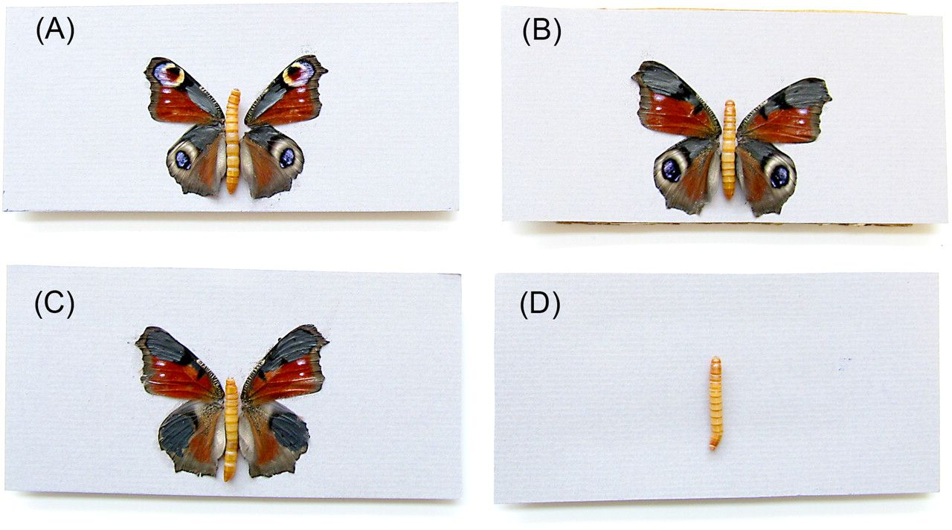
Figure 1 The 3 prey types used in the experiment: (A) all 4 eyespots visible, (B) only the 2 eyespots on the hind ...
Notes:
Figure 1 The 3 prey types used in the experiment: (A) all 4 eyespots visible, (B) only the 2 eyespots on the hind wings visible, and (C) all 2 eyespots covered. Notice that to control for the effect of the black felt tip pen that was used to cover eyespots, an equal area adjacent to all visible eyespots was also painted. The butterfly body was replaced with a mealworm to provide the birds with a reward. Prior to the experiment the birds were trained by presenting them with mealworm but no wings (D).
Unless provided in the caption above, the following copyright applies to the content of this slide: © The Author 2011. Published by Oxford University Press on behalf of the International Society for Behavioral Ecology. All rights reserved. For permissions, please e-mail: journals.permissions@oup.com

Slide 2
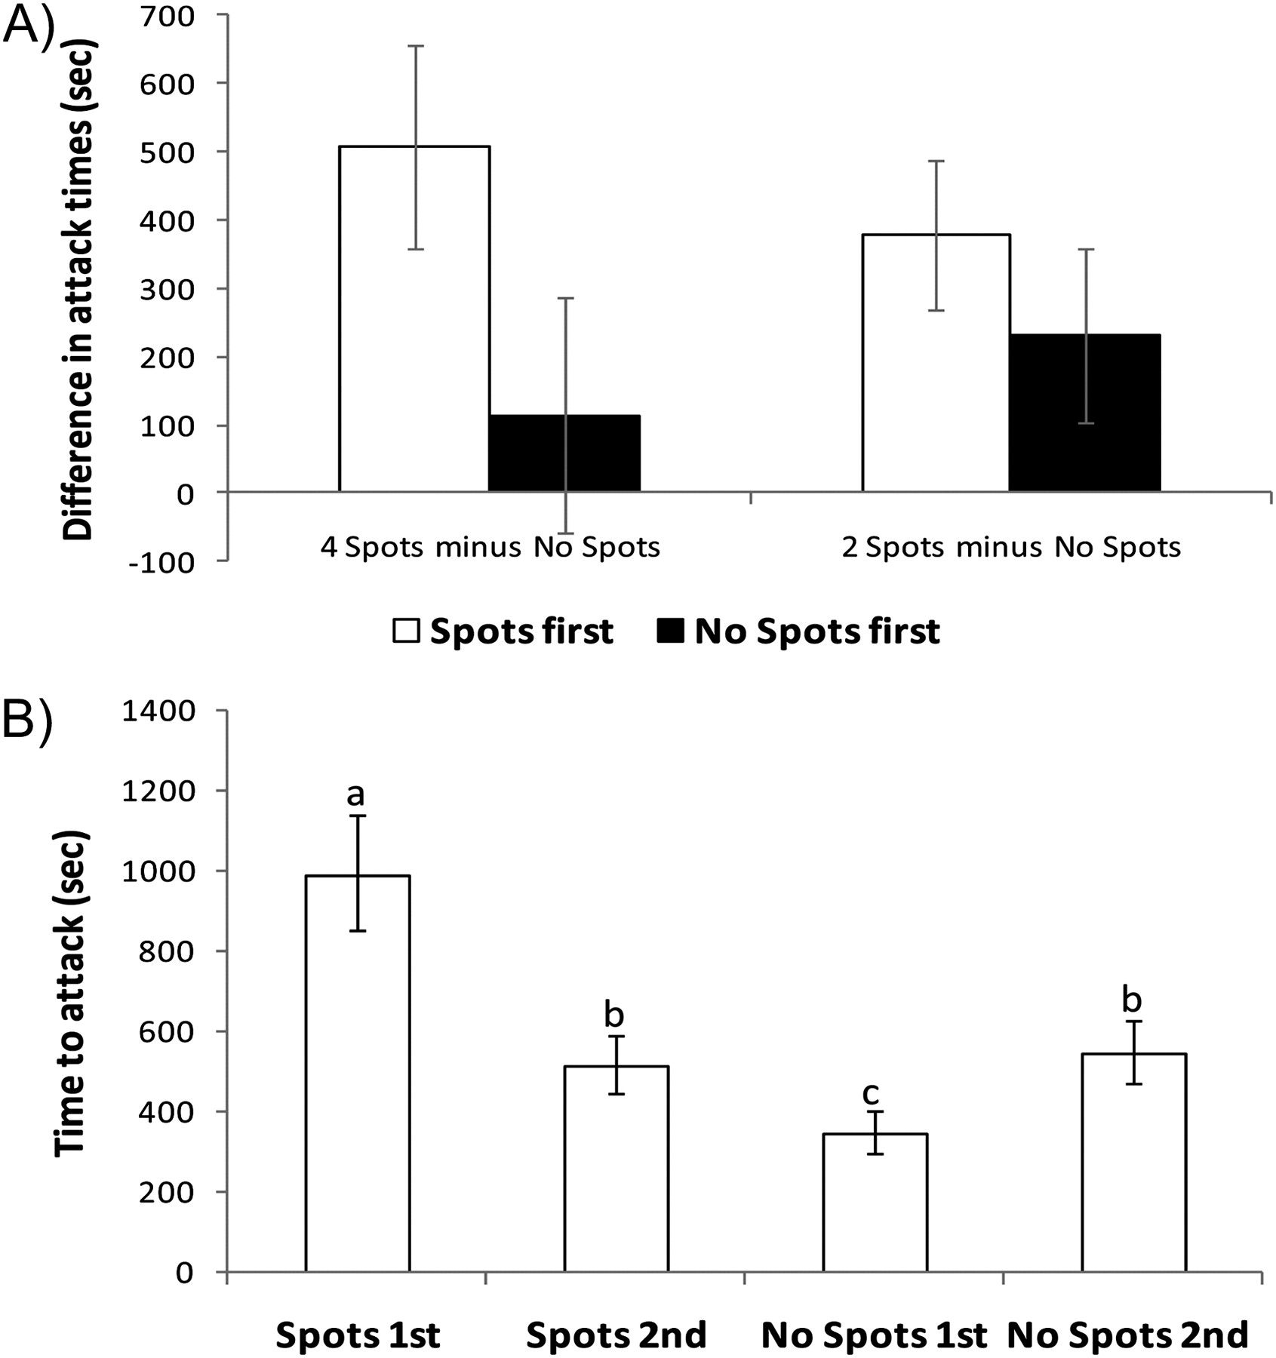
Figure 2 Half of the birds received a prey that had all 4 eyespots visible (4 Spots) and a prey with all eyespots ...
Notes:
Figure 2 Half of the birds received a prey that had all 4 eyespots visible (4 Spots) and a prey with all eyespots covered (No Spots). The other half received a prey that had 2 eyespots visible (2 Spots) and a prey with all eyespots covered (No Spots). A bird received either the prey that had visible eyespots first (Spots first) or the prey that had all eyespots covered first (No Spots first). (A) Mean ± standard error (SE) of the difference in attack times between the spotted and the spotless prey. (B) Mean ± back-transformed SE of attack times. Because the number of eyespots did not significantly influence attack times, the data were pooled for the presentations in which the prey that had visible eyespots (Spots) and for the presentations in which the prey that had no eyespots visible (No Spots). First and second refer to presentation order. Different letters between 2 groups indicate that post-hoc test (6 paired and 2-sample t-tests corrected sequential Bonferroni method for multiple testing) was significant between those 2 groups.
Unless provided in the caption above, the following copyright applies to the content of this slide: © The Author 2011. Published by Oxford University Press on behalf of the International Society for Behavioral Ecology. All rights reserved. For permissions, please e-mail: journals.permissions@oup.com

