Slide 1
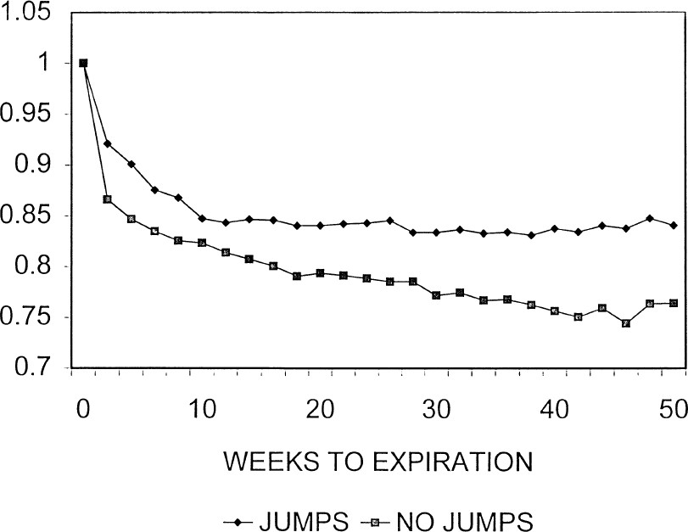
Figure 1 Graph of the early exercise boundary for an American put option The early exercise boundary is shown as a ...
Notes:
Figure 1 Graph of the early exercise boundary for an American put option The early exercise boundary is shown as a proportion of the exercise price of the option. The jump graph shows the early exercise boundary when the underlying stock price follows a jump diffusion. The no-jump graph shows the early exercise boundary when the underlying stock price follows a pure diffusion process.
Unless provided in the caption above, the following copyright applies to the content of this slide: Oxford University Press

