Slide 1
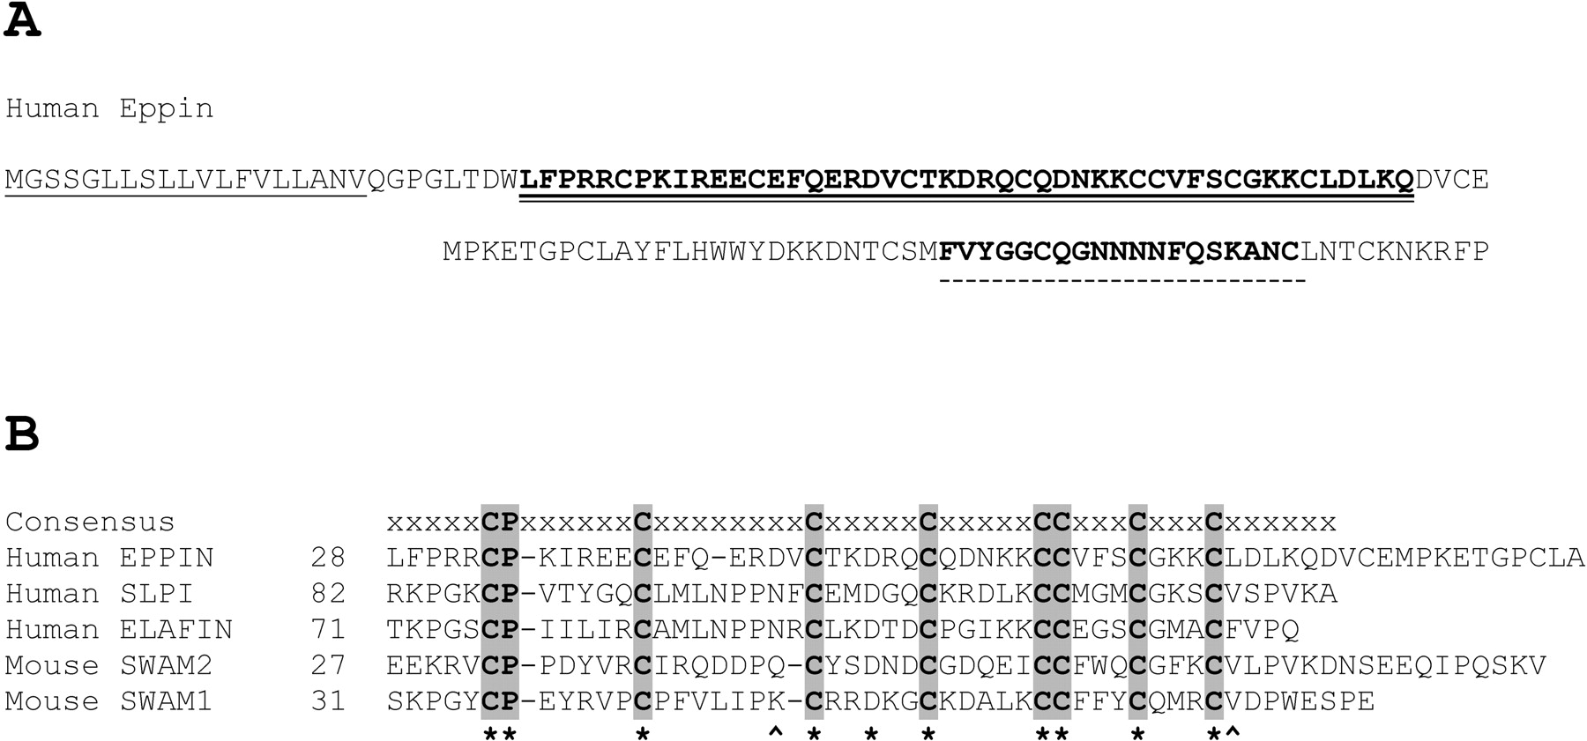
Fig. 1 Amino acid sequence of EPPIN and other WAP motif proteins. A) Amino acid sequence of EPPIN. Signal peptide is ...
Notes:
Fig. 1 Amino acid sequence of EPPIN and other WAP motif proteins. A) Amino acid sequence of EPPIN. Signal peptide is single underlined; WAP-type motif is in bold and double-underlined. Kunitz-type signature sequence is in bold and dash-underlined. B) Comparison of the WAP motif of EPPIN with other WAP motif proteins. The consensus amino acid sequence of WAP motif is also shown on top of the protein sequences. An asterisk indicates identical amino acids, and a circumflex (^) indicates similar amino acids. The number indicates the position of the first amino acid shown in this sequence
Unless provided in the caption above, the following copyright applies to the content of this slide: © 2004 by the Society for the Study of Reproduction, Inc.

Slide 2
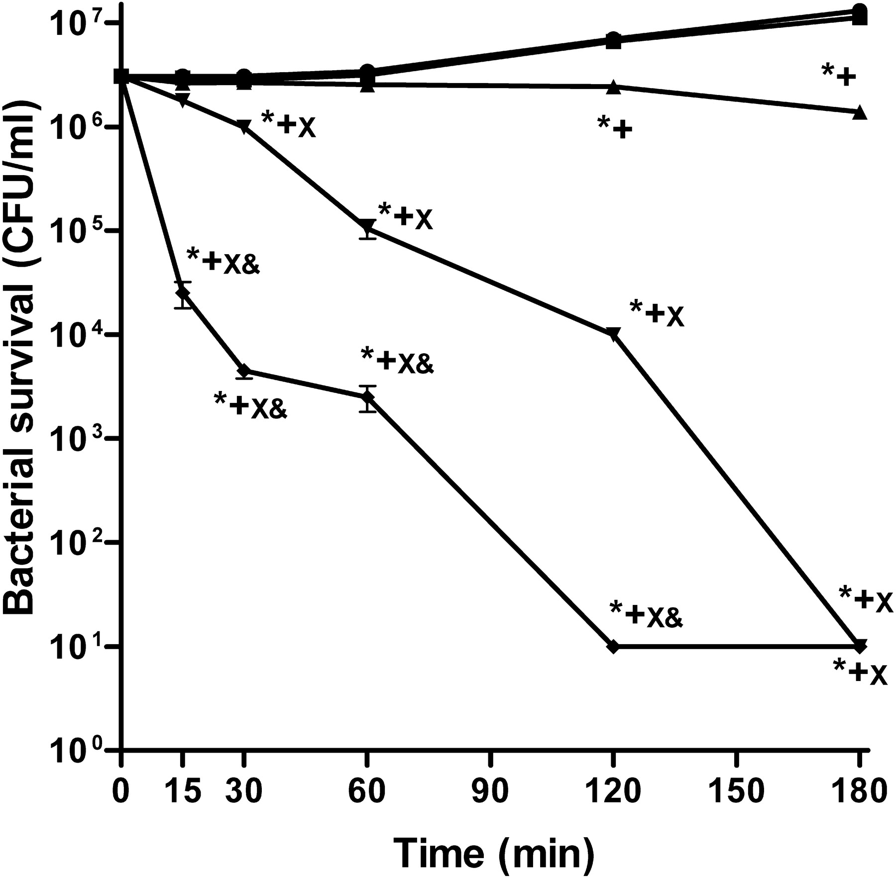
Fig. 2 CFU assay showing antibacterial activity of EPPIN. Escherichia coli were incubated with 0 μg/ml (black ...
Notes:
Fig. 2 CFU assay showing antibacterial activity of EPPIN. Escherichia coli were incubated with 0 μg/ml (black circles), 10 μg/ml (black squares), 25 μg/ml (black triangles), 50 μg/ml (black inverted triangles), and 100 μg/ml (black diamonds) of EPPIN. Values shown are the mean ± SD. *P < 0.01 compared to 0 μg/ml, +P < 0.01 compared to 10 μg/ml, XP < 0.01 compared to 25 μg/ml, &P < 0.01 compared to 50 μg/ml
Unless provided in the caption above, the following copyright applies to the content of this slide: © 2004 by the Society for the Study of Reproduction, Inc.

Slide 3
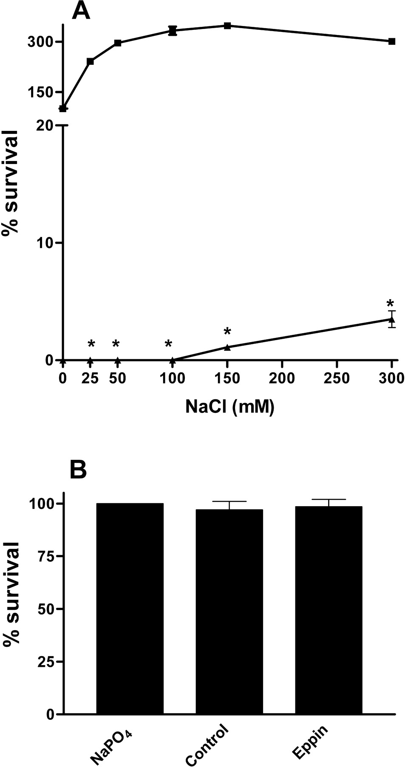
Fig. 3 Salt sensitivity and structural dependence of EPPIN antibacterial activity. A) Escherichia coli were ...
Notes:
Fig. 3 Salt sensitivity and structural dependence of EPPIN antibacterial activity. A) Escherichia coli were incubated with 100 μg/ml of EPPIN in 10 mM sodium phosphate buffer containing 0–300 mM NaCl. Both NaCl alone (black squares) and NaCl with EPPIN (black triangles) are shown. Values shown are the mean ± SD. *P < 0.001 compared to NaCl alone. B) Escherichia coli were incubated with 100 μg/ml of reduced and alkylated EPPIN for 2 h. The NaPO4 indicates bacteria incubated with only sodium phosphate buffer; control indicates sodium phosphate buffer treated without EPPIN to determine whether residual reduction and alkylating reagents affected antibacterial assays. Values shown are the mean ± SD
Unless provided in the caption above, the following copyright applies to the content of this slide: © 2004 by the Society for the Study of Reproduction, Inc.

Slide 4
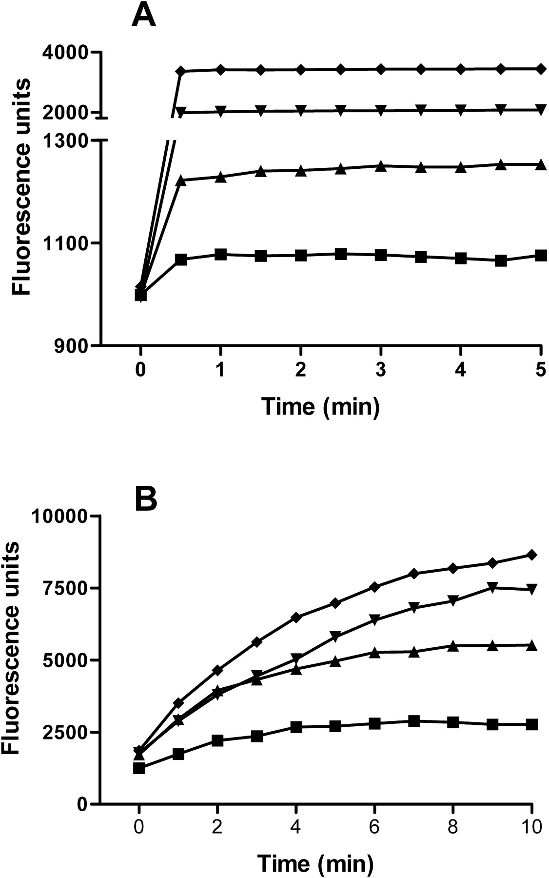
Fig. 4 Escherichia coli membrane permeabilization by EPPIN. A) Outer membrane permeabilization. B) Inner membrane ...
Notes:
Fig. 4 Escherichia coli membrane permeabilization by EPPIN. A) Outer membrane permeabilization. B) Inner membrane permeabilization. Test concentrations of 10 μg/ml (black squares), 25 μg/ml (black triangles), 50 μg/ml (black inverted triangles), and 100 μg/ml (black diamonds) are shown
Unless provided in the caption above, the following copyright applies to the content of this slide: © 2004 by the Society for the Study of Reproduction, Inc.

Slide 5
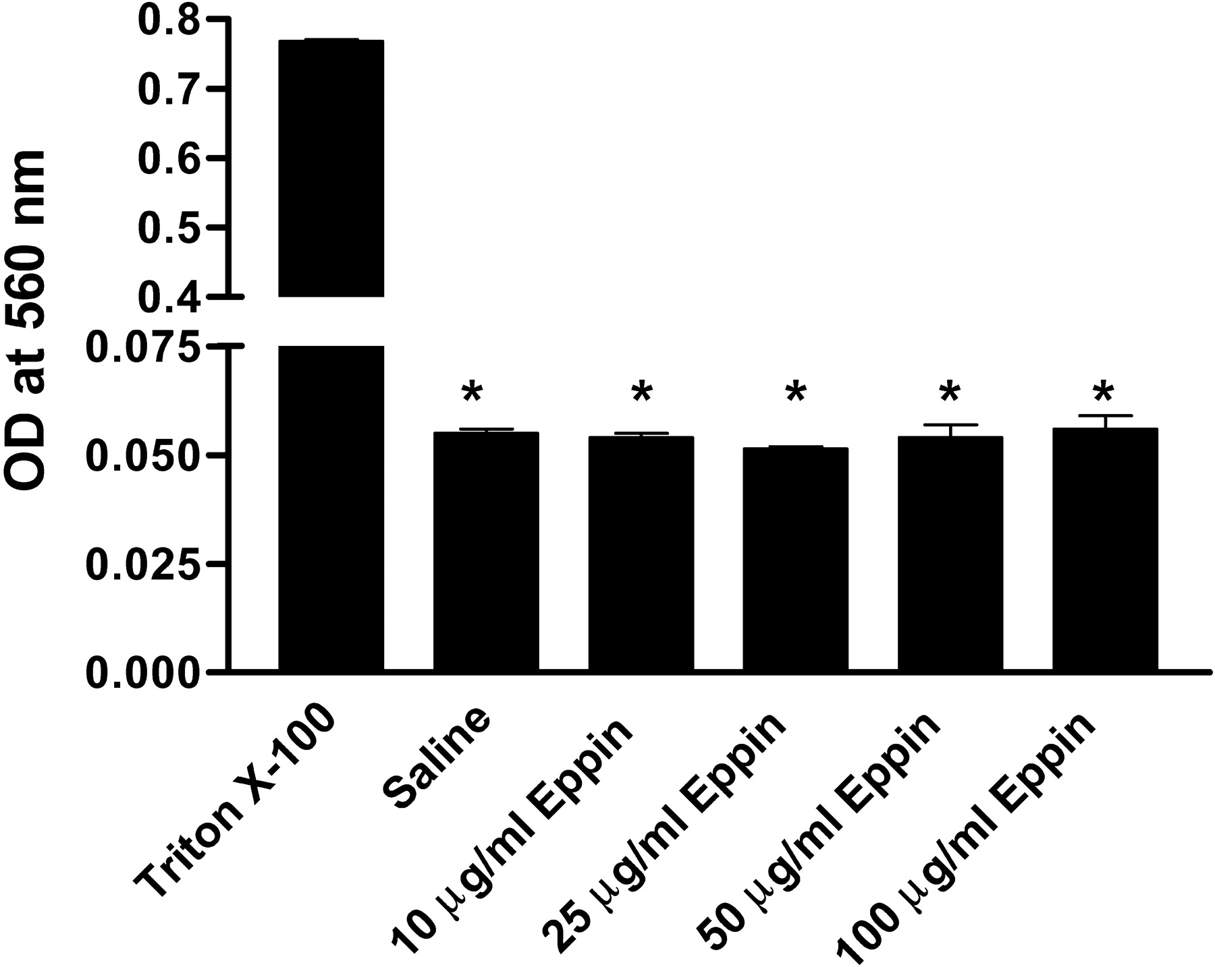
Fig. 5 EPPIN lacks hemolytic activity. Rat erythrocytes were incubated with 10–100 μg/ml of EPPIN for 1 h. Triton ...
Notes:
Fig. 5 EPPIN lacks hemolytic activity. Rat erythrocytes were incubated with 10–100 μg/ml of EPPIN for 1 h. Triton X-100 and saline were considered to be 100% and 0% controls, respectively. Values shown are the mean ± SD. *P < 0.001 compared to Triton X-100
Unless provided in the caption above, the following copyright applies to the content of this slide: © 2004 by the Society for the Study of Reproduction, Inc.

Slide 6
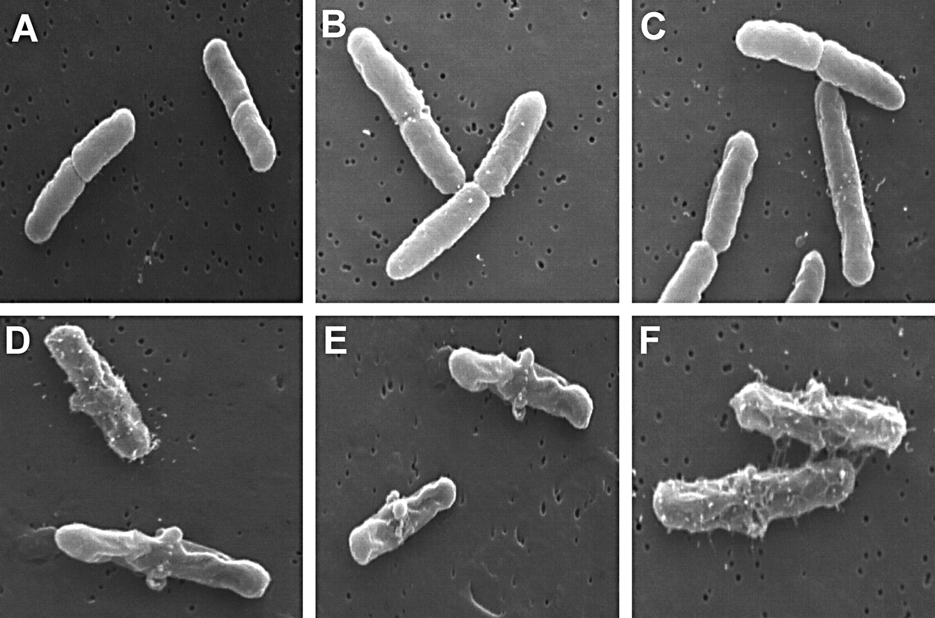
Fig. 6 Scanning electron micrographs of Escherichia coli with and without EPPIN treatment. The E. coli were ...
Notes:
Fig. 6 Scanning electron micrographs of Escherichia coli with and without EPPIN treatment. The E. coli were incubated without (A–C) or with (D–F) 25 μg/ml of EPPIN for 2 h. Original magnification, ×13 500
Unless provided in the caption above, the following copyright applies to the content of this slide: © 2004 by the Society for the Study of Reproduction, Inc.

