Slide 1
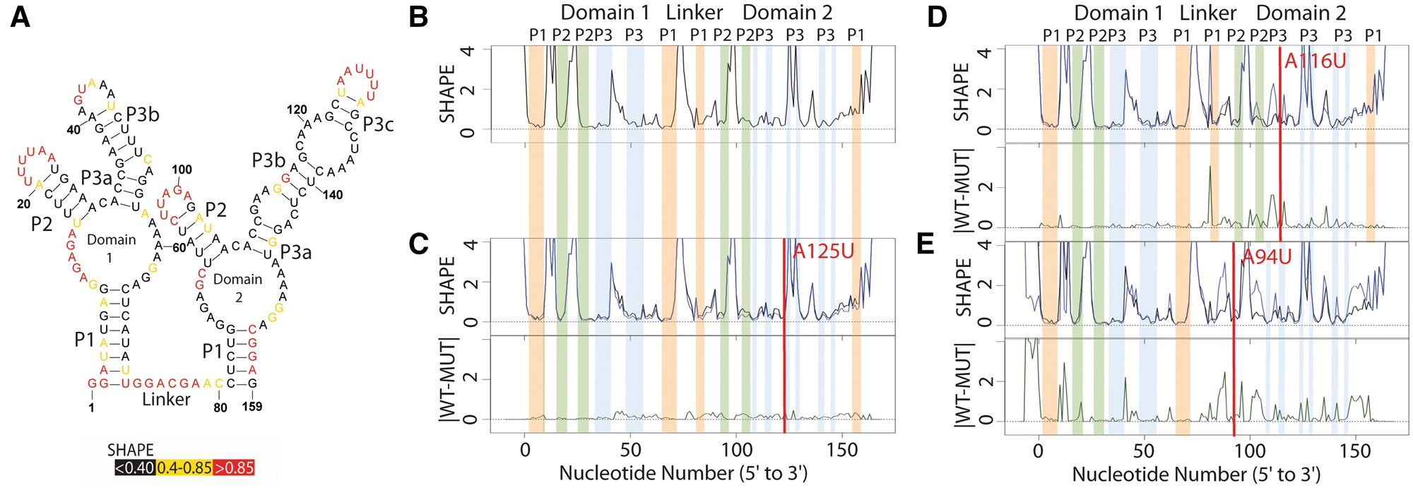
Fig. 1 Structure change patterns in SHAPE trace data for the glycine riboswitch aptamers from Fusobacterium ...
Notes:
Fig. 1 Structure change patterns in SHAPE trace data for the glycine riboswitch aptamers from Fusobacterium nucleatum. (A) Published WT structure for the apo glycine riboswitch aptamers consistent with the crystal structure and multiple independent structure probing experiments (Butler et al., 2011; Kladwang et al., 2011a,b,c). Red nucleotides indicate high SHAPE reactivity, yellow indicates mid-range reactivity, and black indicates low reactivity. (B) The individual WT trace is shown in black; the colored bars indicate the structural regions for each of the aptamers: P1 (orange), P2 (green) and P3 (blue). (C) The WT trace (black) is overlaid with the mutant SHAPE trace (dark blue), and the absolute difference between the WT and mutant traces is below (dark green). A red bar on the traces shows the mutation site. The A125U mutation is a mutation that leads to no appreciable differences in structure. 100% of experts that classified this mutant labeled it as a non-changer. (D) The A116U mutation leads to a local structure change, where the mutant trace reactivity increases at the mutation site disrupting the P3 region of domain 2. 66% of experts that classified the A116U mutant labeled it as a local changer. (E) The A94U mutation leads to a global structure change, where the mutant trace reactivity increases at both the mutation site and at nucleotides distant in sequence space disrupting both the P1 and P2 regions of domain 2. 66% of experts that classified the A94U mutant labeled it as a global changer (Color version of this figure is available at Bioinformatics online.)
Unless provided in the caption above, the following copyright applies to the content of this slide: © The Author 2017. Published by Oxford University Press.This is an Open Access article distributed under the terms of the Creative Commons Attribution Non-Commercial License (http://creativecommons.org/licenses/by-nc/4.0/), which permits non-commercial re-use, distribution, and reproduction in any medium, provided the original work is properly cited. For commercial re-use, please contact journals.permissions@oup.com

Slide 2
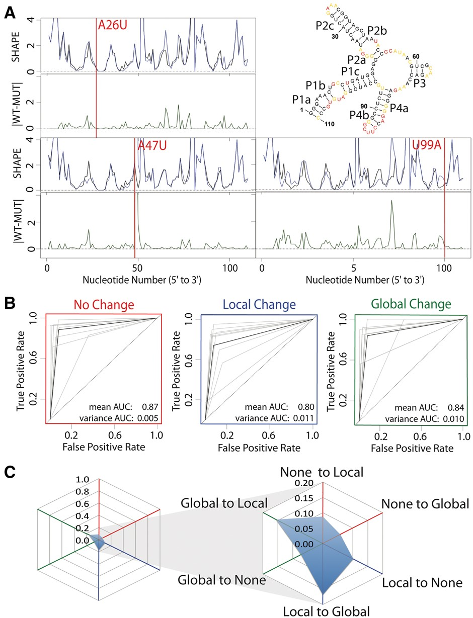
Fig. 2 Expert evaluation of RNA structure change in SHAPE data. (A) Accepted WT structure for the 16S four-way ...
Notes:
Fig. 2 Expert evaluation of RNA structure change in SHAPE data. (A) Accepted WT structure for the 16S four-way junction domain from the E.coli ribosome in agreement with the crystal structure and multiple structure probing experiments (Cordero and Das, 2015; Tian et al., 2014; Zhang et al., 2009). Red nucleotides indicate high SHAPE reactivity, yellow indicates mid-range reactivity, and black indicates low reactivity. For each mutant, the WT trace (black) is overlaid with the mutant SHAPE trace (dark blue). The absolute difference between the WT and mutant traces is depicted below (dark green). 100% of experts that evaluated the A26U WT mutant pair agree that there is no difference or a small difference. 88% of experts agree that the A47U mutation creates a local difference. Experts are split on the U99A mutation. 37.5% of experts indicated that the mutation creates no difference or a small difference, 37.5% of experts indicated that the mutation creates a local difference and 25% of experts indicated the mutation creates a global or distant mutation. (B) ROC curve analysis was used to compare expert classification to the majority vote consensus. The gray curves represent individual expert performances, while the black curves show the average performance among experts. The ROC curves are depicted for performance in identifying non-changers (red), local changers (blue) and global changers (green). (C) Cobweb plots show the percentage of mutants mislabeled by the expert majority vote with non-changers on the red axes, local changers on the blue axes, and global changers on the green axes. Expert classification is least consistent on differences between global and local changers with a higher percentage of global changers mislabeled as local changers, and local changers mislabeled as global changers (Color version of this figure is available at Bioinformatics online.)
Unless provided in the caption above, the following copyright applies to the content of this slide: © The Author 2017. Published by Oxford University Press.This is an Open Access article distributed under the terms of the Creative Commons Attribution Non-Commercial License (http://creativecommons.org/licenses/by-nc/4.0/), which permits non-commercial re-use, distribution, and reproduction in any medium, provided the original work is properly cited. For commercial re-use, please contact journals.permissions@oup.com

Slide 3
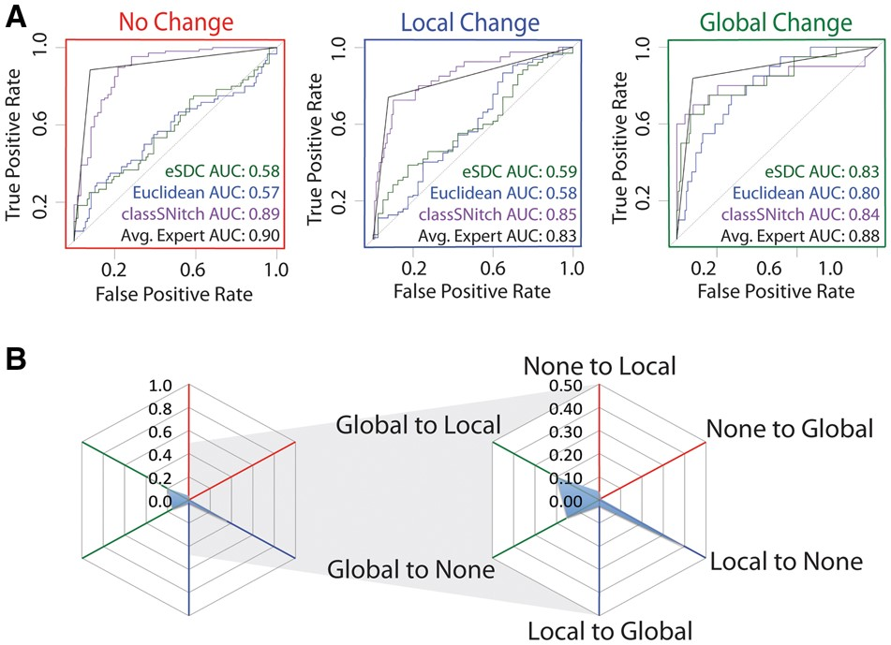
Fig. 3 classSNitch performance. (A) ROC curve analysis comparing methods for classifying structure change to the ...
Notes:
Fig. 3 classSNitch performance. (A) ROC curve analysis comparing methods for classifying structure change to the majority consensus by experts. The ROC curves are depicted for performance in identifying non-changers (red), local changers (blue) and global changers (green). The methods used for experimental classification are classSNitch (purple), eSDC (green), Euclidean norm (blue) and the mean expert human performance (black). Consistently, classSNitch performs comparably to the mean expert evaluation. classSNitch outperforms eSDC and the Euclidean norm, which are the current metrics for classifying RNA structure change in SHAPE data. (B) The cobweb plot shows the percentage of traces mislabeled by classSNitch; a higher percentage of local changers are misclassified (Color version of this figure is available at Bioinformatics online.)
Unless provided in the caption above, the following copyright applies to the content of this slide: © The Author 2017. Published by Oxford University Press.This is an Open Access article distributed under the terms of the Creative Commons Attribution Non-Commercial License (http://creativecommons.org/licenses/by-nc/4.0/), which permits non-commercial re-use, distribution, and reproduction in any medium, provided the original work is properly cited. For commercial re-use, please contact journals.permissions@oup.com

Slide 4
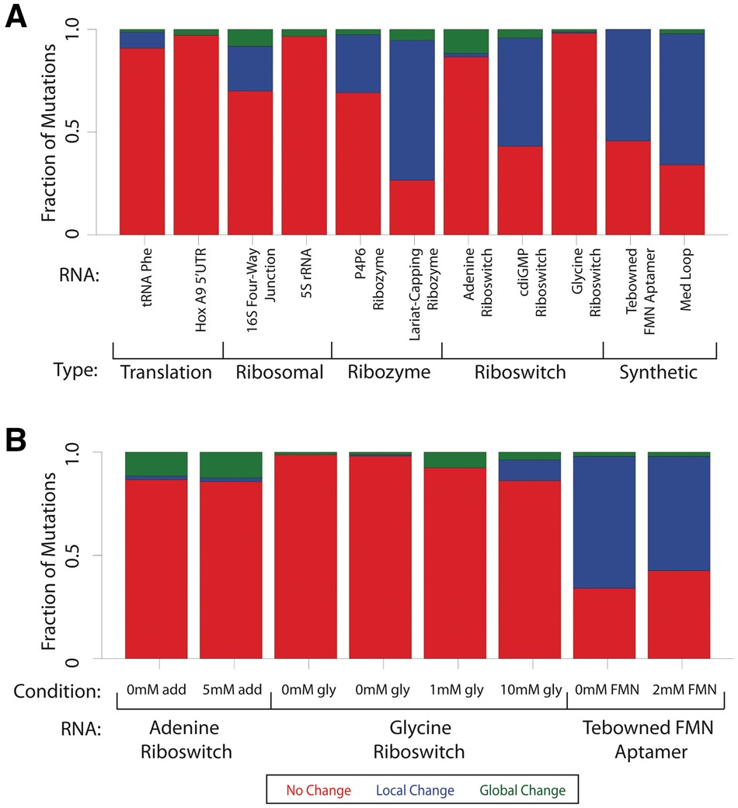
Fig. 4 Fraction of disruption for individual RNAs. (A) The fraction of mutations that cause no change (red), local ...
Notes:
Fig. 4 Fraction of disruption for individual RNAs. (A) The fraction of mutations that cause no change (red), local change (blue) or global change (green) for each RNA as classified by classSNitch. The RNAs are grouped by biological function: translation, ribosomal, ribozyme, riboswitch or synthetic. The experimental conditions for each of these RNAs are listed in Supplementary Material, Table S1. (B) The fraction of mutations that cause aptamers to change structure in the absence or presence of differing amounts of ligand for the adenine riboswitch, glycine riboswitch and Tebowned FMN aptamer (Color version of this figure is available at Bioinformatics online.)
Unless provided in the caption above, the following copyright applies to the content of this slide: © The Author 2017. Published by Oxford University Press.This is an Open Access article distributed under the terms of the Creative Commons Attribution Non-Commercial License (http://creativecommons.org/licenses/by-nc/4.0/), which permits non-commercial re-use, distribution, and reproduction in any medium, provided the original work is properly cited. For commercial re-use, please contact journals.permissions@oup.com

Slide 5
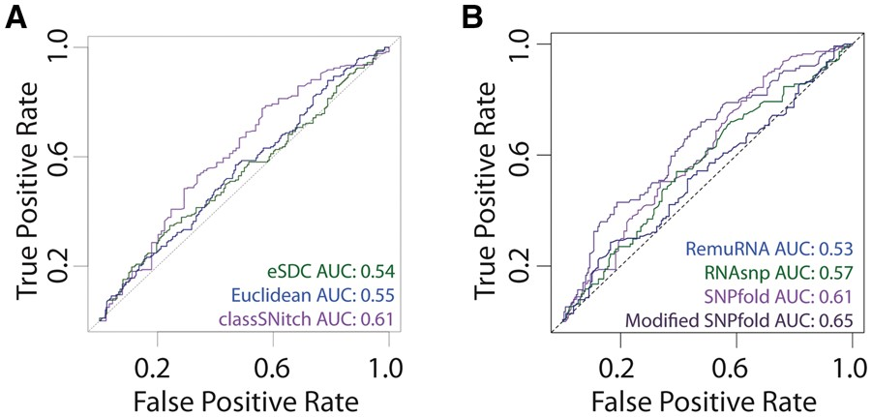
Fig. 5 Improving the performance of structure change prediction algorithms (Halvorsen et al., 2010; Sabarinathan et ...
Notes:
Fig. 5 Improving the performance of structure change prediction algorithms (Halvorsen et al., 2010; Sabarinathan et al., 2013; Salari et al., 2013). (A) We performed ROC curve analysis for SNPfold, a structure change prediction algorithm, using classSNitch (purple), eSDC (green) and the Euclidean norm (blue) to classify the experimental data using the 10% tails strategy (Corley et al., 2015). (B) We compare the performance of structure change prediction algorithms on the classSNitch classification for SNPfold (purple), RNAsnp (green) and RemuRNA (blue). Each of these algorithms predicts structure change in RNA using only sequence information. SNPfold, remuRNA and RNAsnp all make ab initio predictions on whether a mutation alters the RNA structure; none of the algorithms benchmarked used SHAPE-directed structure prediction since we are using the WT and mutant SHAPE data for experimental validation. We improved the SNPfold prediction (dark purple) using Equation 1. The ROC curves for local and global change predictions are included in Supplementary Materials, Figure S8 (Color version of this figure is available at Bioinformatics online.)
Unless provided in the caption above, the following copyright applies to the content of this slide: © The Author 2017. Published by Oxford University Press.This is an Open Access article distributed under the terms of the Creative Commons Attribution Non-Commercial License (http://creativecommons.org/licenses/by-nc/4.0/), which permits non-commercial re-use, distribution, and reproduction in any medium, provided the original work is properly cited. For commercial re-use, please contact journals.permissions@oup.com

