Slide 1
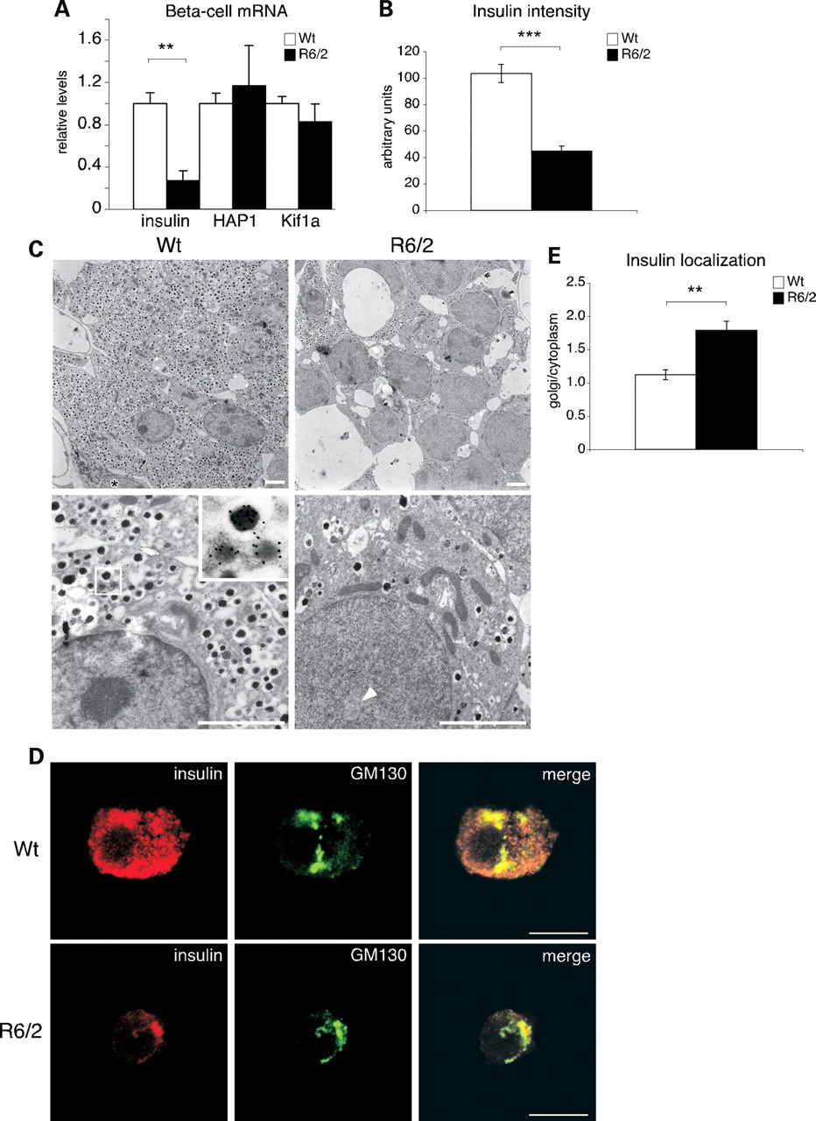
Figure 1. Insulin content and localization in R6/2-mice. (A) mRNA levels of insulin, HAP1 and kinesin family member 1a ...
Notes:
Figure 1. Insulin content and localization in R6/2-mice. (A) mRNA levels of insulin, HAP1 and kinesin family member 1a (Kif 1a) in beta cells from 12-week-old R6/2 mice and controls. Insulin mRNA levels are decreased to 26.8 ± 9.3%, P < 0.01. Error bars: ± SEM. (B) Insulin intensity in the cytoplasm of R6/2 and wt animals. Error bars: ± SEM. Student's t-test, ***P < 0.001. (C) Electron micrographs of pancreatic β-cells with immunogold labeling for insulin, in R6/2 and Wt animals. Top panels: overview pictures (×2950); asterisk indicates an α-cell. Bottom panels: high magnification (×8900), arrowhead shows a probable huntingtin inclusion in the nucleus of an R6/2 cell. Scale bars: 2 µm. (D) Co-localization of insulin (red) and the cis-Golgi marker GM130 (green) in 12-week-old Wt (top panel) and R6/2 (lower panel) β-cells. Scale bars: 10 µm. (E) Localization of insulin signal in R6/2 and Wt animals (Golgi/cytoplasm ratio). Error bars: ± SEM. Student's t-test, **P < 0.01.
Unless provided in the caption above, the following copyright applies to the content of this slide: © The Author 2009. Published by Oxford University Press. All rights reserved. For Permissions, please email: journals.permissions@oxfordjournals.org

Slide 2
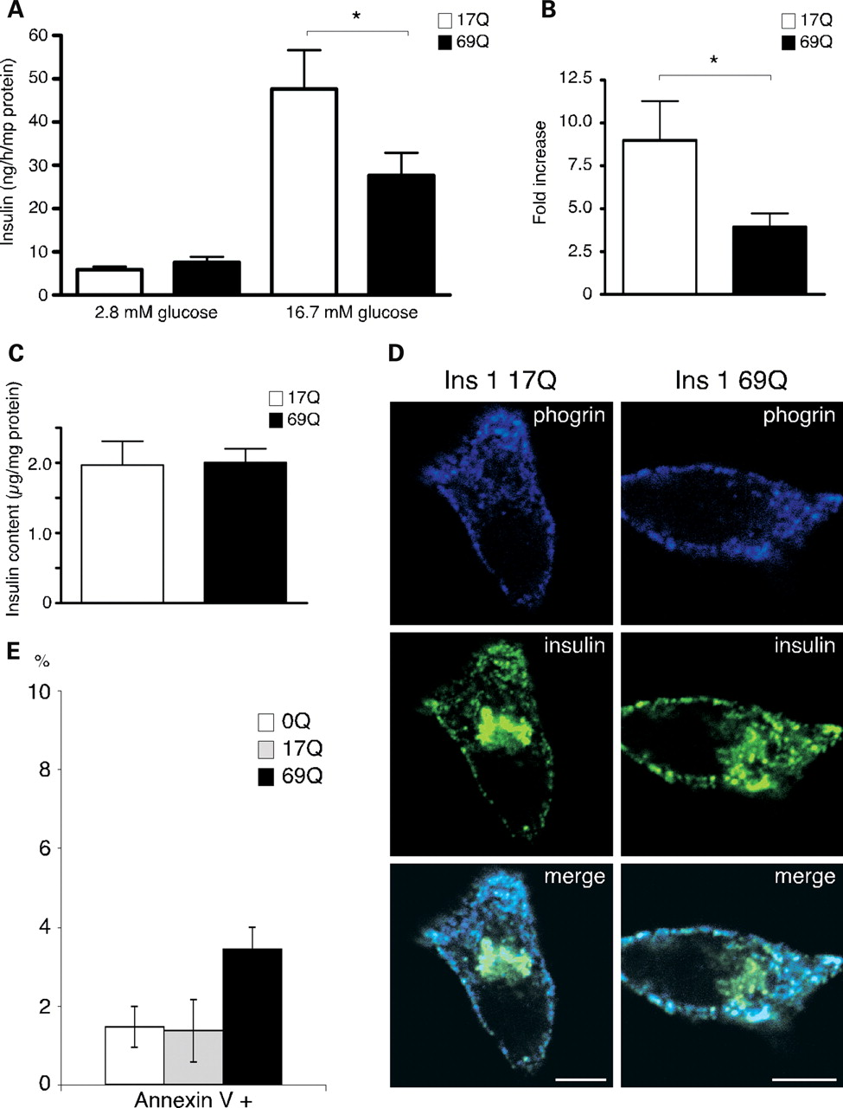
Figure 2. Insulin synthesis is not affected, but insulin secretion is impaired by mutant huntingtin in 832/13 INS-1 ...
Notes:
Figure 2. Insulin synthesis is not affected, but insulin secretion is impaired by mutant huntingtin in 832/13 INS-1 cells. (A) Absolute values of insulin release in 832/13 INS-1 cells overexpressing 17Q or 69Q huntingtin under baseline or stimulatory conditions. Insulin levels at low glucose (17Q 5.9 ± 0.66; 69Q 7.6 ± 1.2, P= NS), at high glucose (17Q 47.6 ± 9.0; 69Q 27.7 ± 5.2, P = 0.03). (B) Fold changes of insulin section at high- compared with low-glucose levels in 17Q and 69Q cells (17Q 9.0 ± 2.3; 69Q 3.9 ± 0.8, P = 0.03). Error bars: ± SEM, *P < 0.05. (C) Total insulin content in 832/13 INS-1 cells expressing 17Q or 69Q huntingtin. (D) Insulin and phogrin double-immunostaining in 832/13 INS-1 cells overexpressing 17Q or 69Q huntingtin. The patterns of expression are similar. Scale bars: 5 µm. (E) Cell death in 832/13 INS-1 cells transduced with 17Q or 69Q huntingtin or non-transduced (0Q) control cells. Cell death was assessed with annexin V-FITC. Y-axis: percentage of total cell number. Error bars: ± SEM.
Unless provided in the caption above, the following copyright applies to the content of this slide: © The Author 2009. Published by Oxford University Press. All rights reserved. For Permissions, please email: journals.permissions@oxfordjournals.org

Slide 3
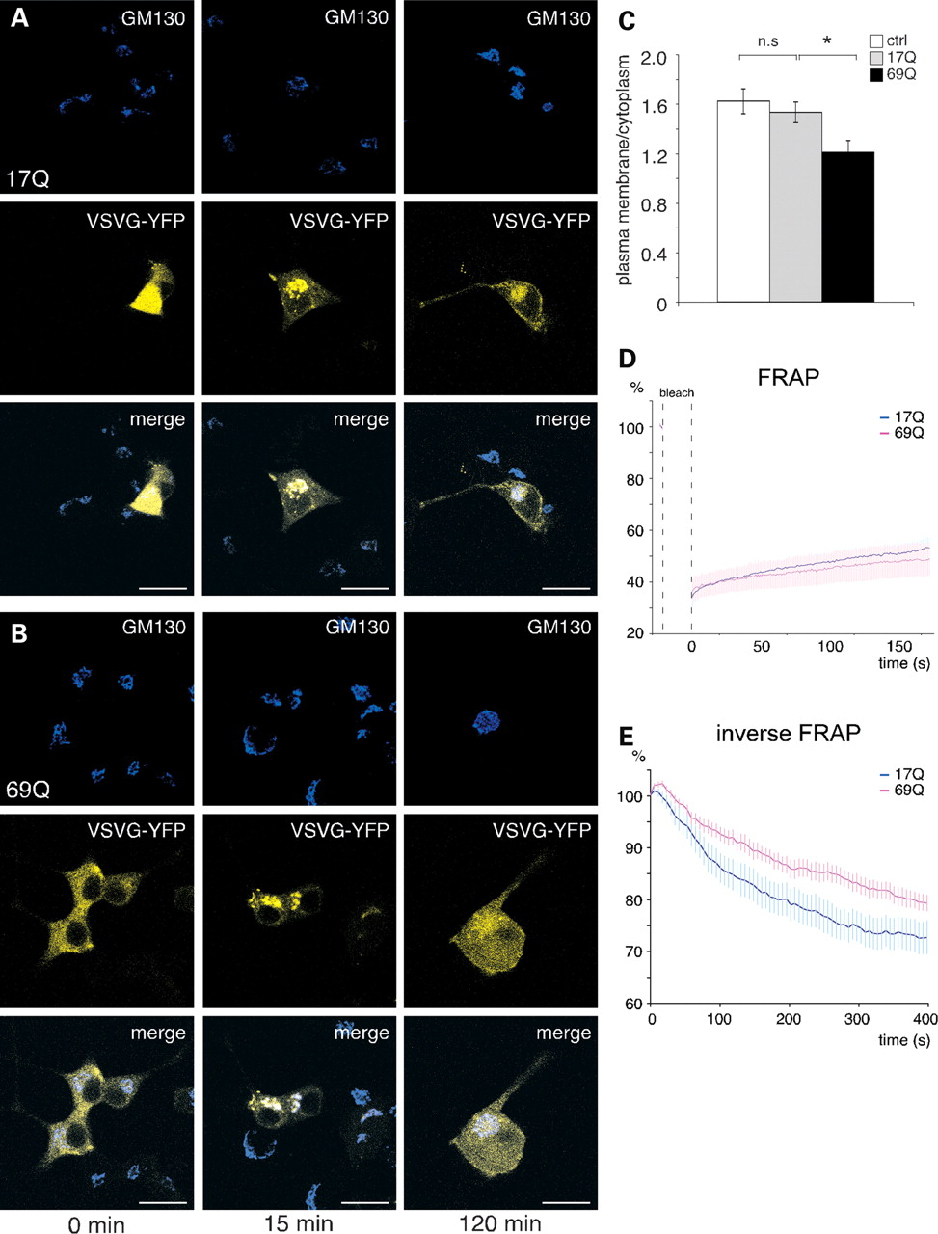
Figure 3. Trafficking in 832/13 INS-1 cells. VSVG-YFP was transfected into 832/13 INS-1 cells along with 17Q (A) or 69Q ...
Notes:
Figure 3. Trafficking in 832/13 INS-1 cells. VSVG-YFP was transfected into 832/13 INS-1 cells along with 17Q (A) or 69Q (B) huntingtin. The cells were transferred to 33°C for the indicated times (0, 15, 120 min) before fixation and analysis. GM130, a cis-Golgi marker, was used to localize the Golgi apparatus. Scale bars: 10 µm. (C) Quantification of one representative (out of three independent experiments) experiment. There are no differences between non-huntingtin transfected cells (ctrl) and cells transfected with 17Q huntingtin (P = 0.49). *P < 0.05, error bars ± SEM (Wt n = 16, 17Q n = 13, 69Q n = 23). (D) FRAP experiment showing the recovery of fluorescence in the Golgi after photobleaching. 17Q n = 9, 69Q n = 7. (E) Inverse FRAP demonstrating the loss of fluorescence in the Golgi after photobleaching of the rest of the cell. 17Q n = 13, 69Q n = 15. Repeated-measures ANOVA, time–genotype interaction, P < 0.05. Error bars: ± SEM. Both figures show one representative experiment out of three.
Unless provided in the caption above, the following copyright applies to the content of this slide: © The Author 2009. Published by Oxford University Press. All rights reserved. For Permissions, please email: journals.permissions@oxfordjournals.org

Slide 4
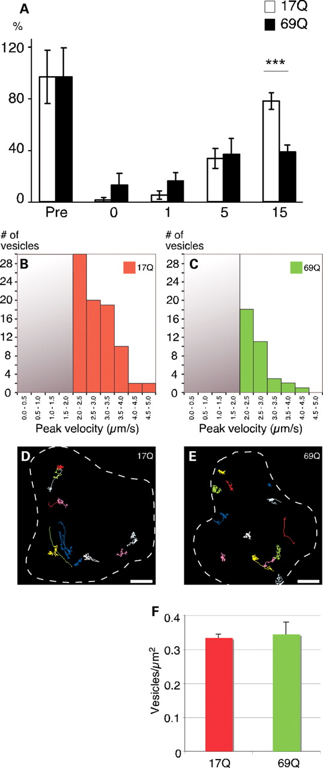
Figure 4. Vesicular trafficking and exocytosis in 832/13 INS-1 cells. (A) CD4-phogrin release in cells expressing 17Q ...
Notes:
Figure 4. Vesicular trafficking and exocytosis in 832/13 INS-1 cells. (A) CD4-phogrin release in cells expressing 17Q or 69Q huntingtin. Cells were stimulated for 0, 1, 5 or 15 min in the presence of CD4 antibodies. The number of vesicles undergoing exocytosis during this period was counted and normalized to non-stimulated permeabilized cells (Pre). Error bars: ± SEM, ***P < 0.001. (B and C) Vesicles in 832/13 INS-1 cells have been binned according to peak vesicular speed and are represented in histograms. (B) Vesicles in 17Q cells. (C) Vesicles in 69Q cells. n = 19 cells/genotype. (D and E) Representative vesicle trajectories in a 17Q cell (D) and a 69Q cell (E). Cells are outlined with a dashed white line. Scale bars: 2 µm. (F) Total number of vesicles in 17Q (0.33 ± 0.01) and 69Q (0.34 ± 0.04) cells. Y-axis shows the number of vesicles per µm2. Error bars: ± SEM.
Unless provided in the caption above, the following copyright applies to the content of this slide: © The Author 2009. Published by Oxford University Press. All rights reserved. For Permissions, please email: journals.permissions@oxfordjournals.org

Slide 5
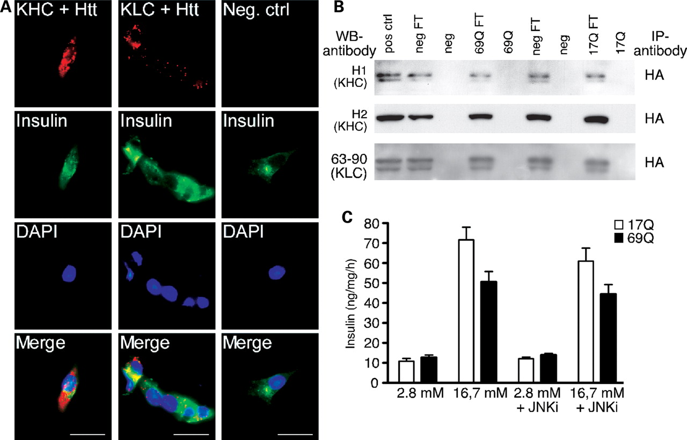
Figure 5. Kinesin interactions and effects of JNK inhibition. (A) Kinesin heavy chain and light chain are closely ...
Notes:
Figure 5. Kinesin interactions and effects of JNK inhibition. (A) Kinesin heavy chain and light chain are closely co-localized as indicated by PLA dots in red (top panel). Cells were counter-stained with insulin (middle panel) and DAPI (bottom panel). Scale bars: 10 µm. (B) Kinesins are not pulled down by exon 1 huntingtin using the HA tag of the huntingtin constructs. KHC, kinesin heavy chain; KLC, kinesin light chain; FT, flow through; neg, negative control. (C) JNK inhibition experiment. Insulin release was studied in 832/13 INS-1 cells in the absence or presence of 10 µm of the JNK inhibitor SP600125. No significant positive effects were detected.
Unless provided in the caption above, the following copyright applies to the content of this slide: © The Author 2009. Published by Oxford University Press. All rights reserved. For Permissions, please email: journals.permissions@oxfordjournals.org

Slide 6
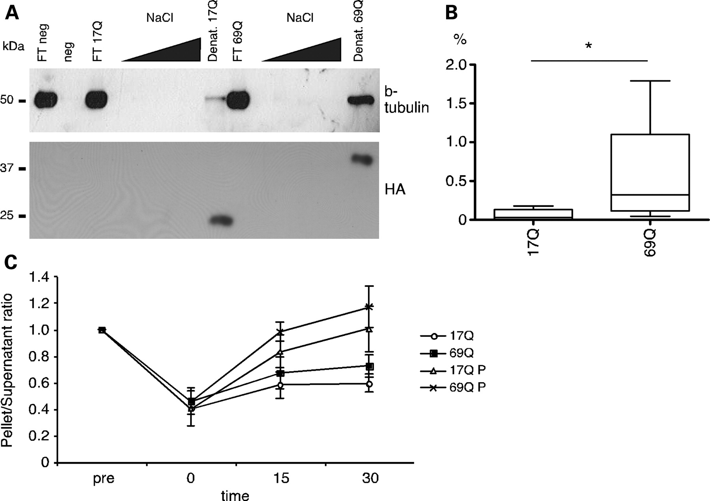
Figure 6. Huntingtin exon 1 interacts with β-tubulin. (A) We pulled down exon 1 huntingtin with 17 or 69Q with ...
Notes:
Figure 6. Huntingtin exon 1 interacts with β-tubulin. (A) We pulled down exon 1 huntingtin with 17 or 69Q with antibodies directed against the HA tag in the viral constructs. We eluted the bound protein in increasing salt concentrations and finally denatured in Laemmli buffer. Membranes are blotted against β-tubulin (upper panel) and HA (lower panel). One example blot is shown for each condition. (B) Box plot showing the percentage of the total β-tubulin present in the elute lane for 17Q and 69Q huntingtin. *P < 0.05, n = 5. (C) Microtubular repolymerization experiment. We subjected cells to nocodazole treatment and then allowed the microtubules to repolymerize for 0, 15 or 30 min. Results are presented as pellet/supernatant ratios relative to non-nocodazole-treated cells (pre). P, paclitaxel treatment. n = 4 per genotype and time point.
Unless provided in the caption above, the following copyright applies to the content of this slide: © The Author 2009. Published by Oxford University Press. All rights reserved. For Permissions, please email: journals.permissions@oxfordjournals.org

Slide 7
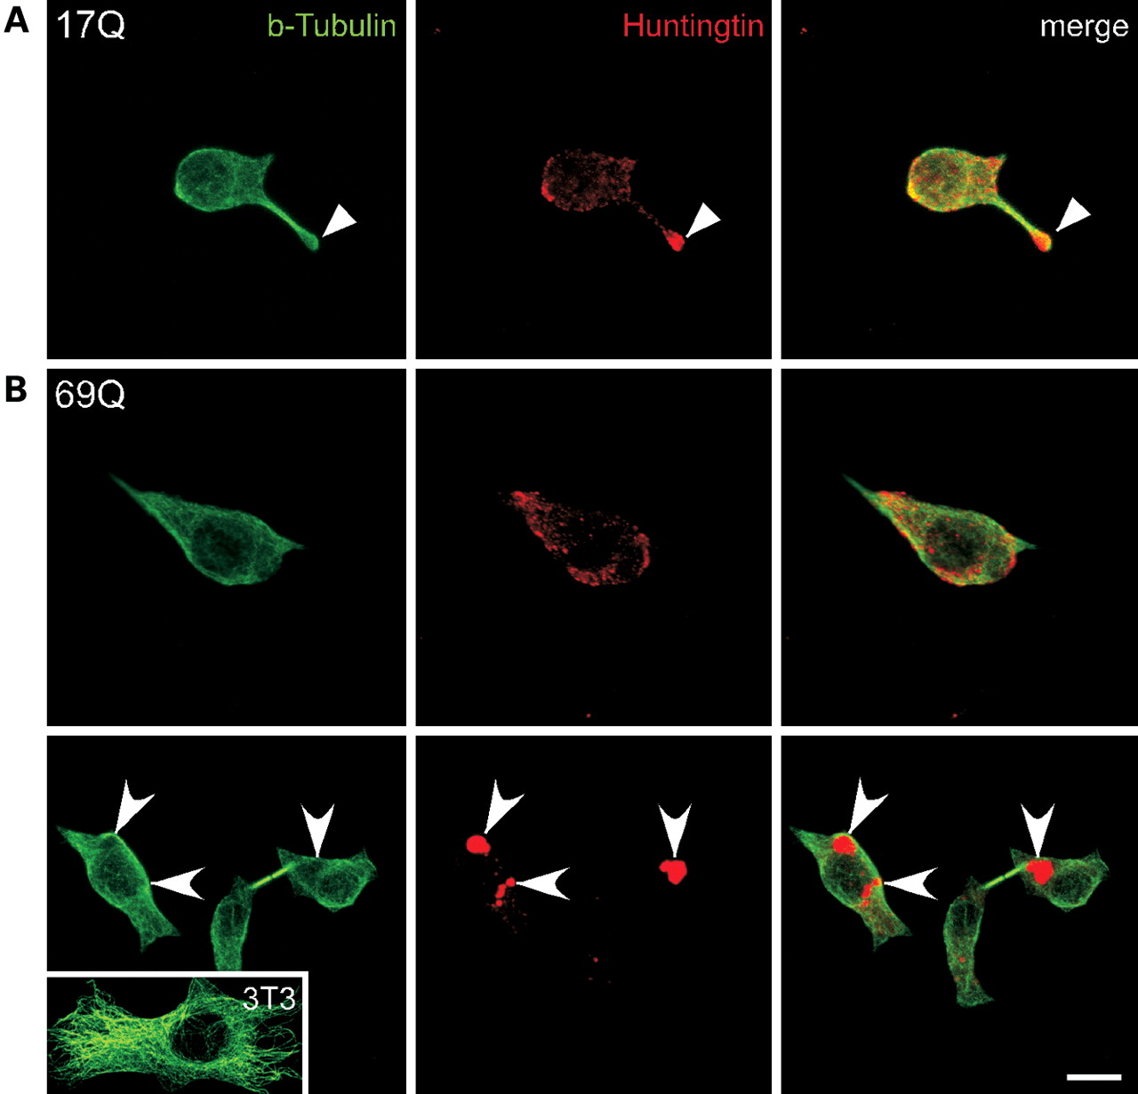
Figure 7. Confocal images showing co-localization between β-tubulin (green) and huntingtin (red) in 17Q (A) and 69Q (B) ...
Notes:
Figure 7. Confocal images showing co-localization between β-tubulin (green) and huntingtin (red) in 17Q (A) and 69Q (B) INS-1 cells. (A) In wt (17Q) huntingtin-expressing cells, β-tubulin partially overlaps with huntingtin. High amounts of huntingtin appear at the tip of the cellular processes (arrowheads). (B) Similar overlapping appearance is observed in the mutant (69Q) huntingtin-expressing cells. Different-sized cytoplasmic huntingtin aggregates are formed, they still appear closely associated with β-tubulin (arrows). A fibroblast cell (3T3) is shown as a control of typical β-tubulin staining in the same experiment. Scale bar: 5 µm.
Unless provided in the caption above, the following copyright applies to the content of this slide: © The Author 2009. Published by Oxford University Press. All rights reserved. For Permissions, please email: journals.permissions@oxfordjournals.org

Slide 8
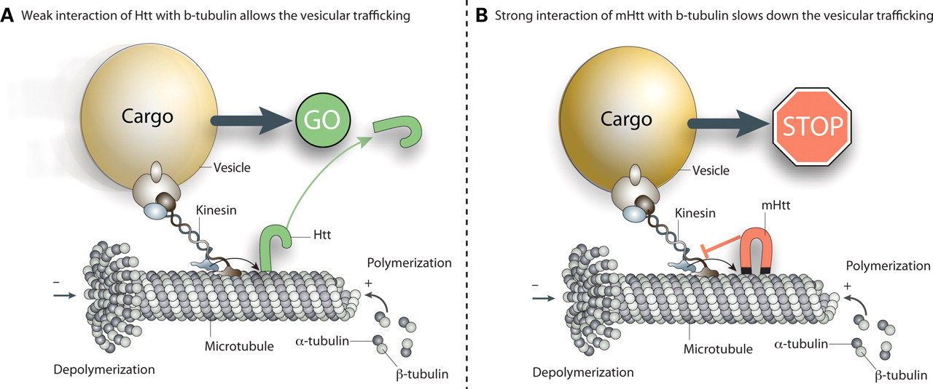
Figure 8. Proposed mechanistic model. Mutant huntingtin (B) binds more strongly to β-tubulin than does wt huntingtin ...
Notes:
Figure 8. Proposed mechanistic model. Mutant huntingtin (B) binds more strongly to β-tubulin than does wt huntingtin (A), thereby accumulating over time on the microtubules. This causes a physical block to transport and gradually makes intracellular transport less efficient.
Unless provided in the caption above, the following copyright applies to the content of this slide: © The Author 2009. Published by Oxford University Press. All rights reserved. For Permissions, please email: journals.permissions@oxfordjournals.org

