Slide 1
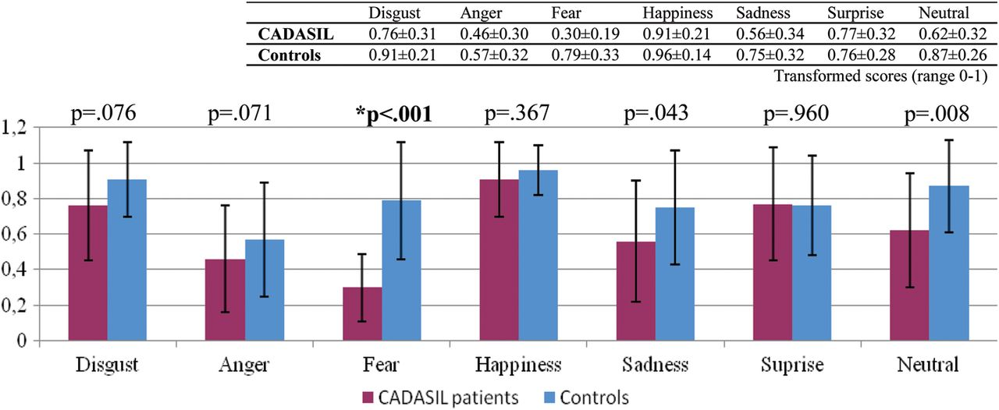
Fig. 1. Test of recognition of facial expressions in CADASIL patients and controls. *Mann–Whitney U test and ...
Notes:
Fig. 1. Test of recognition of facial expressions in CADASIL patients and controls. *Mann–Whitney U test and Bonferroni correction for multiple comparisons.
Unless provided in the caption above, the following copyright applies to the content of this slide: © The Author 2012. Published by Oxford University Press. All rights reserved. For permissions, please e-mail: journals.permissions@oup.com

