Slide 1
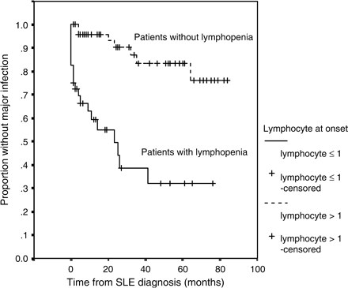
Figure 1. Cumulative probability of infection-free survival for the complete follow-up period in SLE patients with or ...
Notes:
Figure 1. Cumulative probability of infection-free survival for the complete follow-up period in SLE patients with or without lymphopenia (⩽1.0 × 109/l) at presentation (n = 82).
Unless provided in the caption above, the following copyright applies to the content of this slide: © The Author 2006. Published by Oxford University Press on behalf of the Association of Physicians. All rights reserved. For Permissions, please email: journals.permissions@oxfordjournals.org

Slide 2
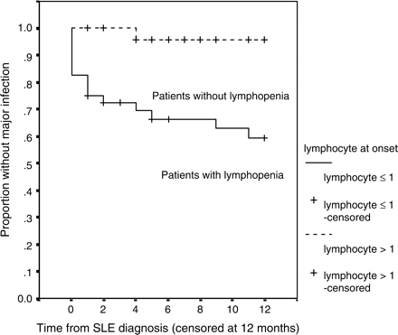
Figure 2. Cumulative probability of infection-free survival for the initial 12 months of follow-up in SLE patients with ...
Notes:
Figure 2. Cumulative probability of infection-free survival for the initial 12 months of follow-up in SLE patients with or without lymphopenia (⩽1.0 × 109/l) at presentation (n = 82).
Unless provided in the caption above, the following copyright applies to the content of this slide: © The Author 2006. Published by Oxford University Press on behalf of the Association of Physicians. All rights reserved. For Permissions, please email: journals.permissions@oxfordjournals.org

Slide 3
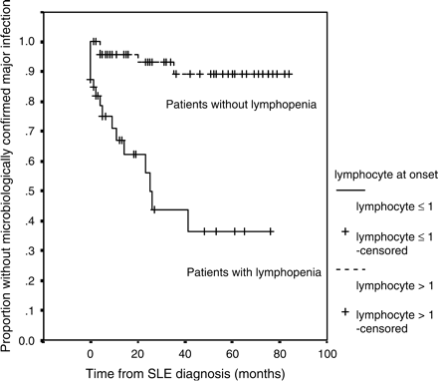
Figure 3. Cumulative probability of infection-free survival (for microbiologically confirmed major infections) for the ...
Notes:
Figure 3. Cumulative probability of infection-free survival (for microbiologically confirmed major infections) for the complete follow-up period in SLE patients with or without lymphopenia (⩽1.0 × 109/l) at presentation (n = 82).
Unless provided in the caption above, the following copyright applies to the content of this slide: © The Author 2006. Published by Oxford University Press on behalf of the Association of Physicians. All rights reserved. For Permissions, please email: journals.permissions@oxfordjournals.org

