Slide 1
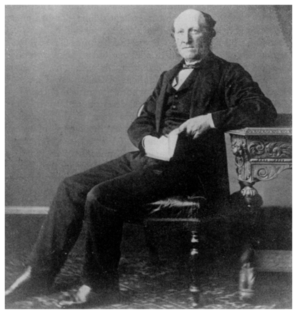
Figure 1 Jacob Augustus Lockhart Clarke (1817–80) (reproduced courtesy of the National Library of Medicine, Bethesda, ...
Notes:
Figure 1 Jacob Augustus Lockhart Clarke (1817–80) (reproduced courtesy of the National Library of Medicine, Bethesda, MD, USA).
Unless provided in the caption above, the following copyright applies to the content of this slide: © The Author (2010). Published by Oxford University Press on behalf of the Guarantors of Brain. All rights reserved. For Permissions, please email: journals.permissions@oxfordjournals.org

Slide 2
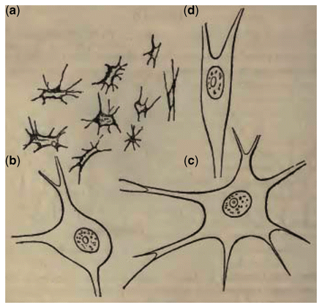
Figure 2 Lockhart Clarke’s original drawings published in Case 1 (Radcliffe and Lockhart Clarke, 1862). He depicts ...
Notes:
Figure 2 Lockhart Clarke’s original drawings published in Case 1 (Radcliffe and Lockhart Clarke, 1862). He depicts ‘atrophied cells from the cervical enlargement, magnified 420 diameters’ (a) with ‘healthy cells from the same quarter, and magnified to the same extent’ (b–d).
Unless provided in the caption above, the following copyright applies to the content of this slide: © The Author (2010). Published by Oxford University Press on behalf of the Guarantors of Brain. All rights reserved. For Permissions, please email: journals.permissions@oxfordjournals.org

Slide 3
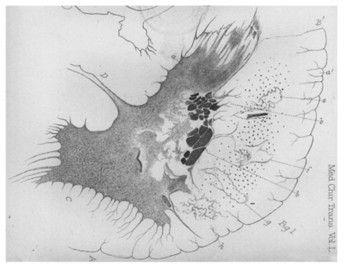
Figure 3 Lockhart Clarke’s original drawings showing the right lateral half of a transverse section of the spinal cord ...
Notes:
Figure 3 Lockhart Clarke’s original drawings showing the right lateral half of a transverse section of the spinal cord in the second case described (Lockhart Clarke and Hughlings Jackson, 1867). His own legend reads thus, with e, f, g and h clearly demonstrating his recognition of corticospinal tract involvement: ‘A: The anterior white column; B: The lateral white column; B′: The posterior lateral fissure; C: The anterior cornu; D: The transverse commissure; a and a′: The caput cornu posterioris; b and b′: Dark masses enclosed in a network of fibres and blood vessels, along the right border of the grey substance; e–h: Patches of transparent disintegration in the lateral column’.
Unless provided in the caption above, the following copyright applies to the content of this slide: © The Author (2010). Published by Oxford University Press on behalf of the Guarantors of Brain. All rights reserved. For Permissions, please email: journals.permissions@oxfordjournals.org

