Slide 1
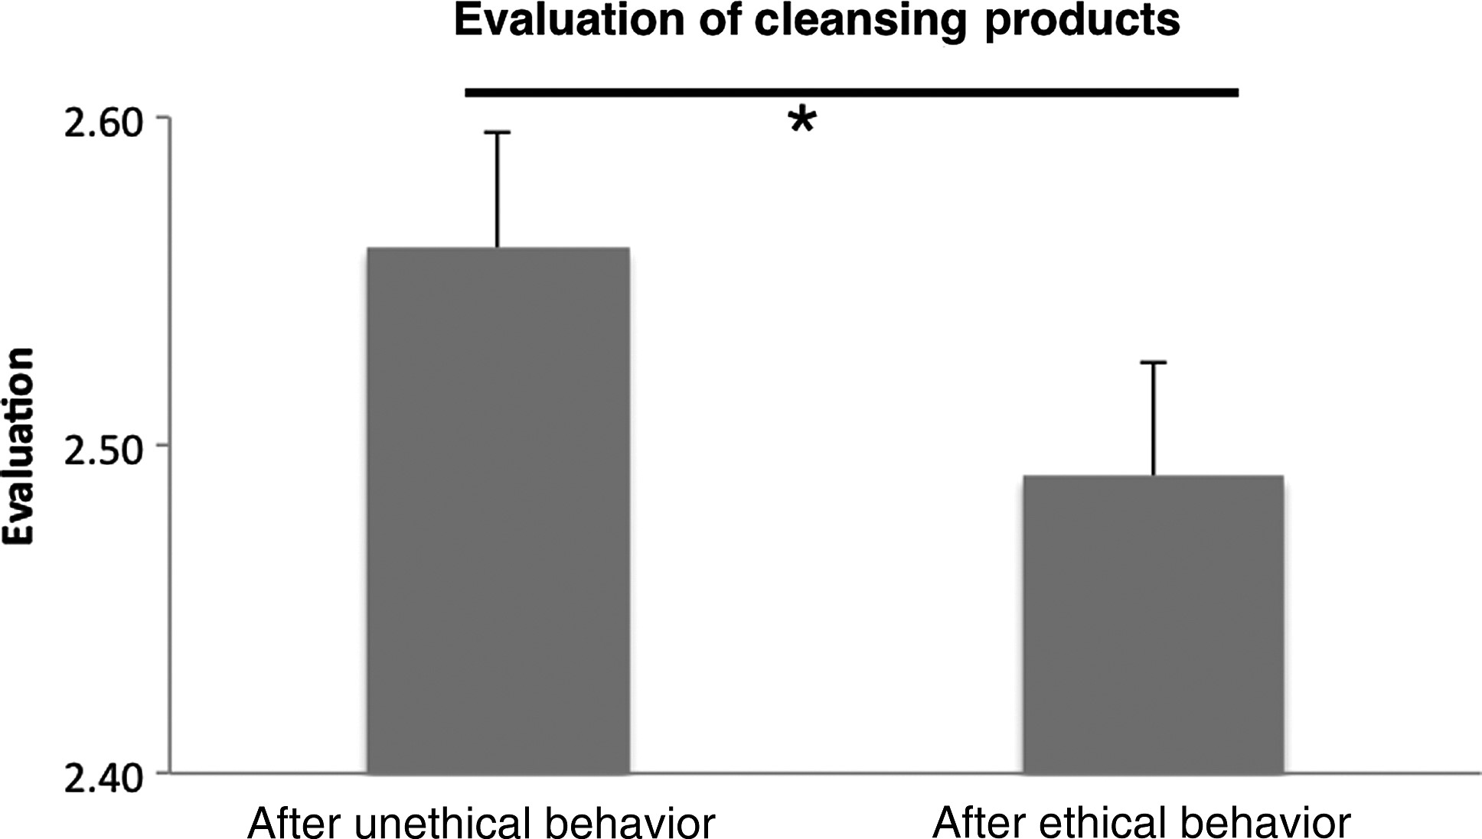
Figure 1. Participants' mean evaluation (+standard errors) of cleansing products after unethical (lying) or ethical ...
Notes:
Figure 1. Participants' mean evaluation (+standard errors) of cleansing products after unethical (lying) or ethical acts (telling the truth). Cleansing products were evaluated significantly higher when participants performed an unethical deed before.
Unless provided in the caption above, the following copyright applies to the content of this slide: © The Author 2014. Published by Oxford University Press. All rights reserved. For Permissions, please e-mail: journals.permissions@oup.com

Slide 2
Figure 2. Statistical maps showing brain activation while participants were leaving a lie on a voice mail (relative to ...
Notes:
Figure 2. Statistical maps showing brain activation while participants were leaving a lie on a voice mail (relative to rest, FWE corrected). Areas of significant fMRI signal change are shown as color overlays on the T1-MNI reference brain. Circles mark sensorimotor activation.
Unless provided in the caption above, the following copyright applies to the content of this slide: © The Author 2014. Published by Oxford University Press. All rights reserved. For Permissions, please e-mail: journals.permissions@oup.com

Slide 3
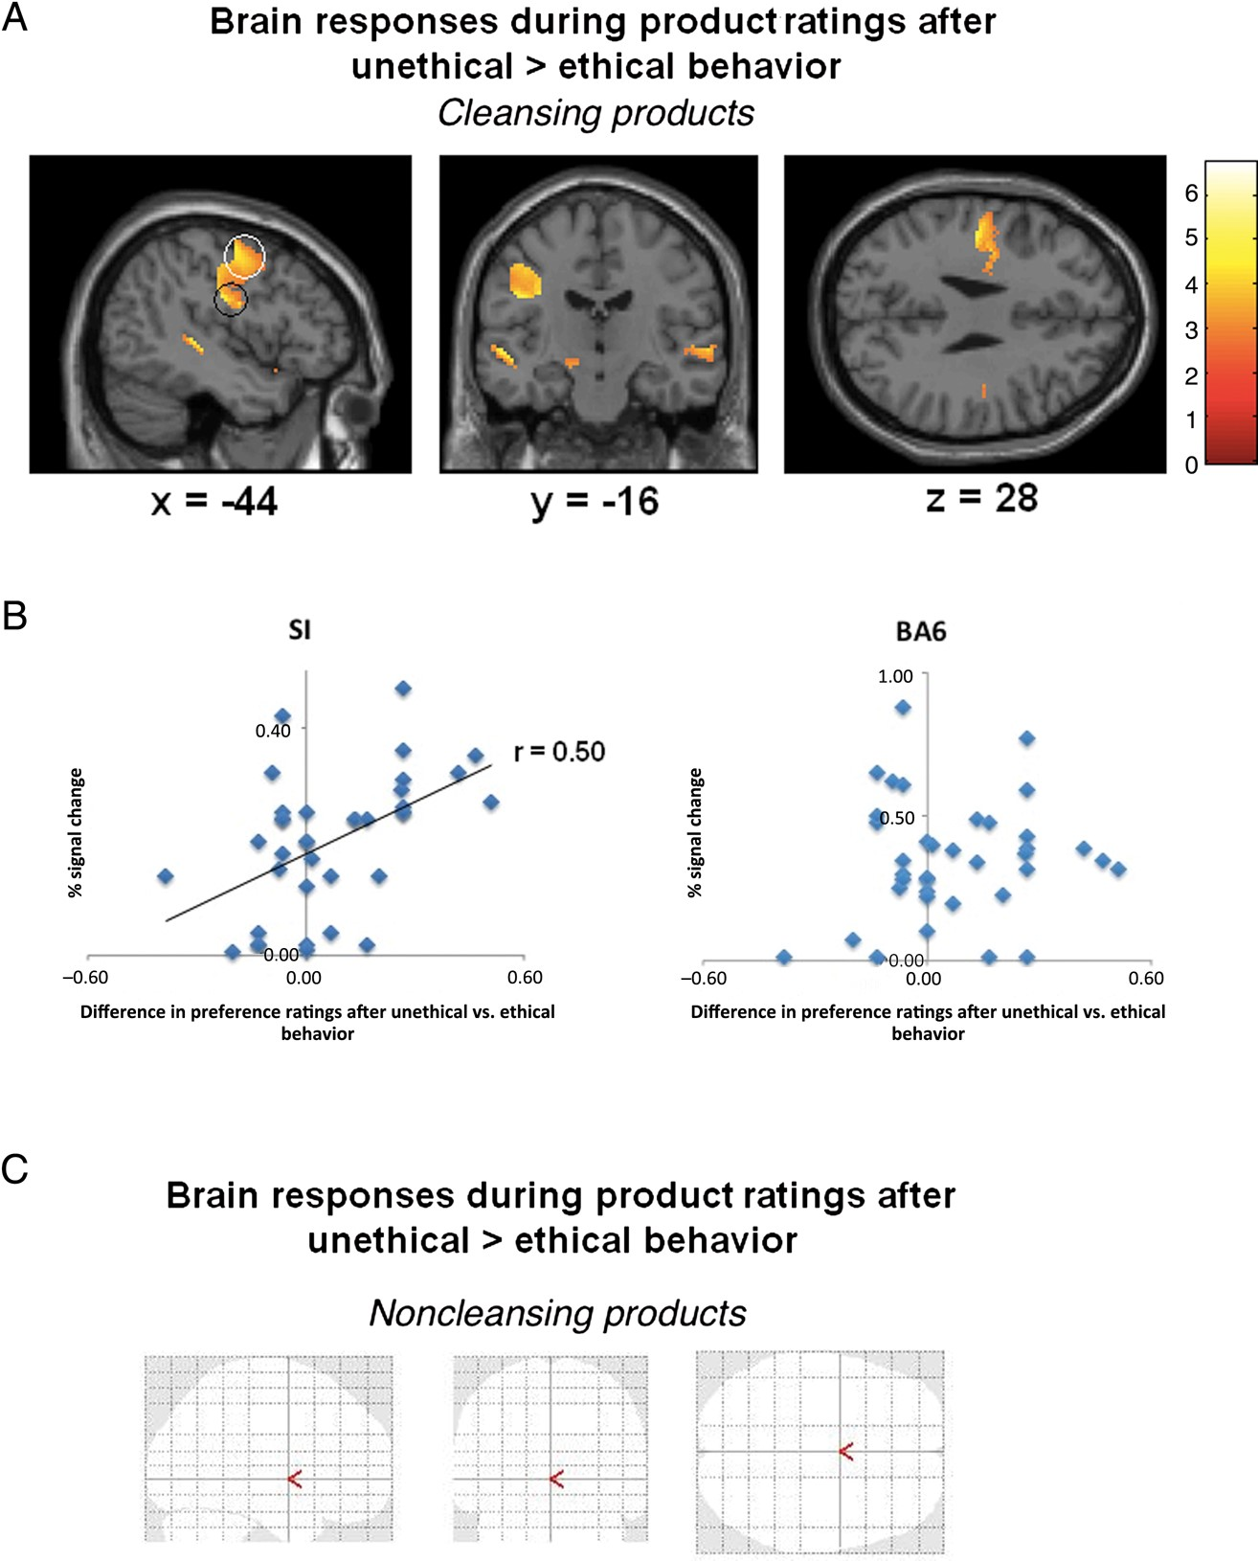
Figure 3. Statistical maps showing brain activation while participants assessed different sets of products. (A) Brain ...
Notes:
Figure 3. Statistical maps showing brain activation while participants assessed different sets of products. (A) Brain responses revealed activation in sensorimotor brain areas (black circle: SI and white circle: BA6) when participants were lying before (relative to telling the truth in the previous task). (B) Activity in the left SI could significantly predict the increased desirability of cleansing products after unethical deeds. Activity in BA6 failed to show a significant correlation. There were no other significant correlations. (C) Brain responses after unethical deeds were not altered when participants had to evaluate noncleansing products.
Unless provided in the caption above, the following copyright applies to the content of this slide: © The Author 2014. Published by Oxford University Press. All rights reserved. For Permissions, please e-mail: journals.permissions@oup.com

Slide 4
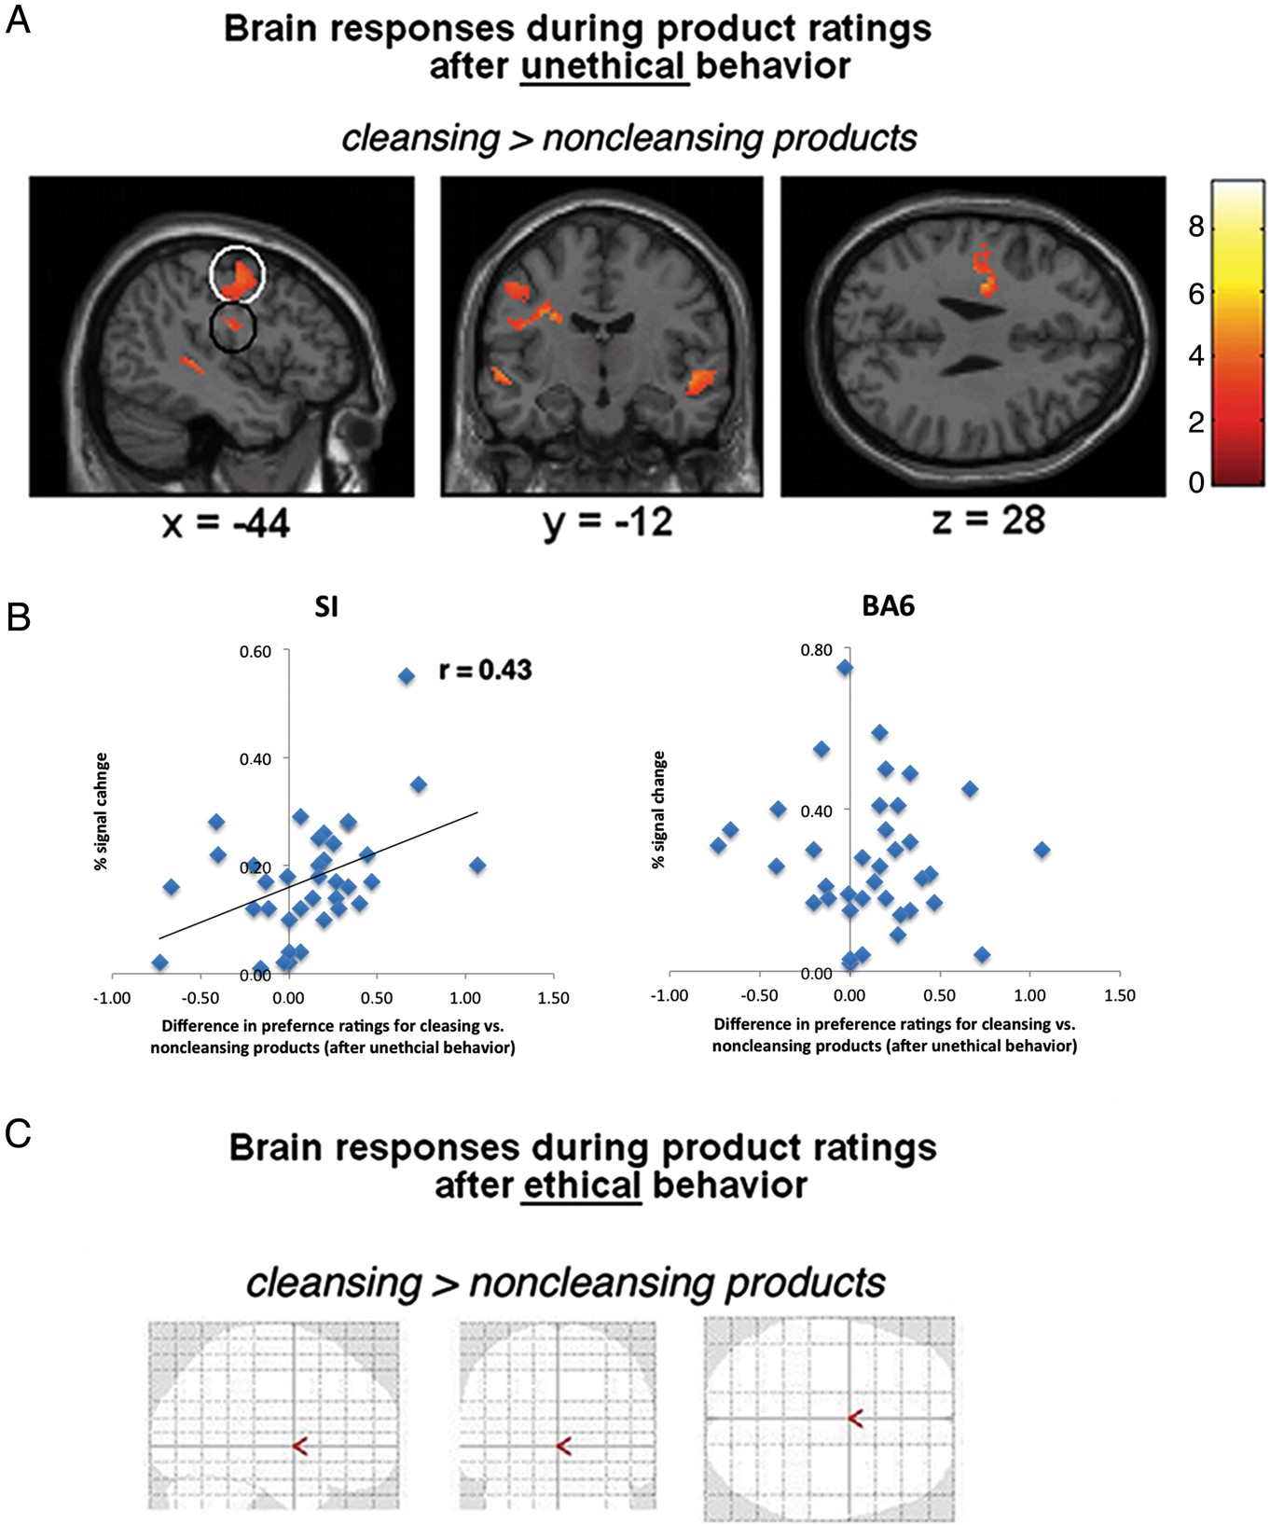
Figure 4. Statistical maps showing brain responses after unethical and ethical behavior. (A) Brain responses after ...
Notes:
Figure 4. Statistical maps showing brain responses after unethical and ethical behavior. (A) Brain responses after unethical behavior revealed activation in sensorimotor brain areas (black circle: SI and white circle: BA6) for cleansing relative to noncleansing products. (B) Activity in the left SI could significantly predict the increased desirability of cleansing relative to noncleansing products after unethical deeds. There were no other significant correlations. (C) Brain responses for product ratings after ethical deeds were not different with respect to cleansing versus noncleansing products.
Unless provided in the caption above, the following copyright applies to the content of this slide: © The Author 2014. Published by Oxford University Press. All rights reserved. For Permissions, please e-mail: journals.permissions@oup.com

