Slide 1
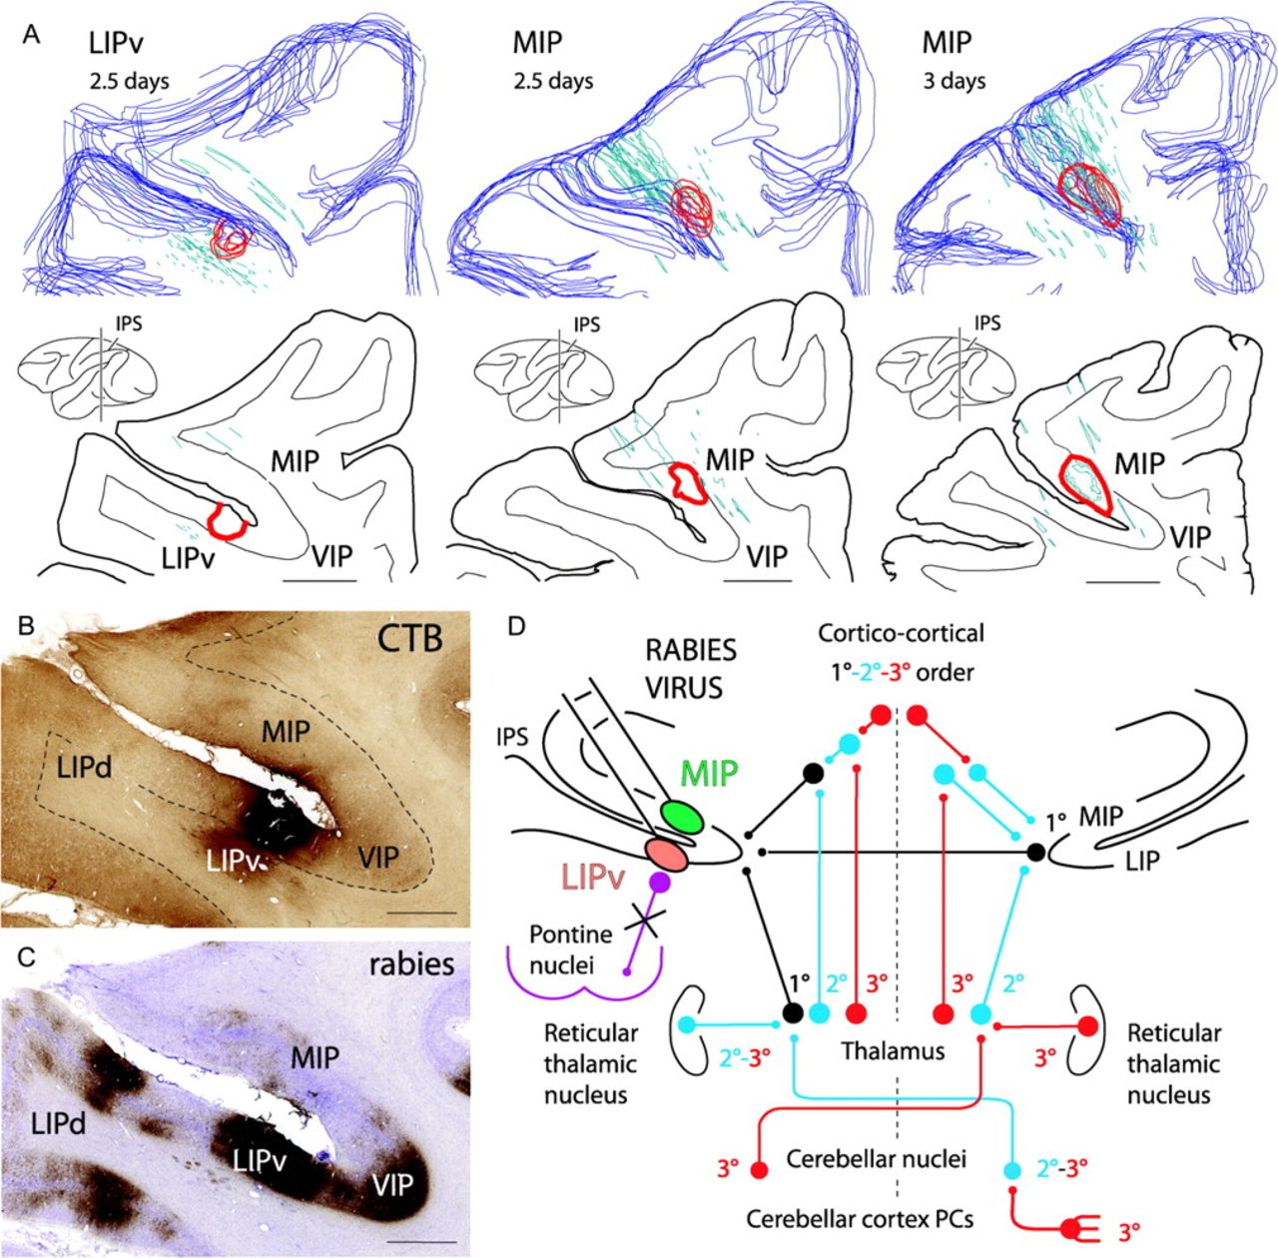
Figure 1. (A) 3D reconstructions and coronal sections of the injection area (red outlines) into the LIPv or the MIP at ...
Notes:
Figure 1. (A) 3D reconstructions and coronal sections of the injection area (red outlines) into the LIPv or the MIP at the level of the middle rostrocaudal third of the IPS, visualized by CTB immunolabeling at 2.5 or 3 days after injection of a mixture of rabies and CTB. Blue outlines: cortical surface. Green outlines: reconstructions of electrode tracts from previous recordings. (B, C) Photomicrographs of adjoining sections at the LIPv injection site, immunolabeled for CTB and rabies virus (same level as in A, left). Note that the injection area is easily identifiable with CTB (B) but not with rabies virus (C) at 2.5 days because of strong rabies immunolabeling of short-distance projections neurons in the IPS. In (B), shading in the white matter ventral to LIPv is background staining of an area of fibrosis due to multiple recording traces in that region. (D) Summary of the pathways of rabies retrograde transneuronal transfer to the cerebellar nuclei after coinjection of rabies virus and CTB into ventral MIP or LIPv: 1° (black), first-order neurons (conventional tracer, CTB) in the ipsilateral thalamus and cortical areas (ipsilateral corticocortical inputs, callosal inputs from homotopic IPS areas); 2° (blue), second-order neurons labeled transneuronally (rabies virus) at 2.5 days in the contralateral cerebellar nuclei, in the ipsilateral thalamic nuclei and reticular thalamic nucleus, and in the contralateral thalamic nuclei (the latter reflecting projections to IPS areas of the right hemisphere); 3° (red), third-order neurons labeled at 3 days in the contralateral cerebellar cortex (PCs) and contralateral reticular thalamic nucleus. Anterograde transneuronal transfer (e.g., to the pontine nuclei) did not occur (violet). Scale bar = 4000 μm in (A), 2000 μm in (B) (also applies to C).
Unless provided in the caption above, the following copyright applies to the content of this slide: © The Author 2009. Published by Oxford University Press. All rights reserved. For permissions, please e-mail: journals.permissions@oxfordjournals.org

Slide 2
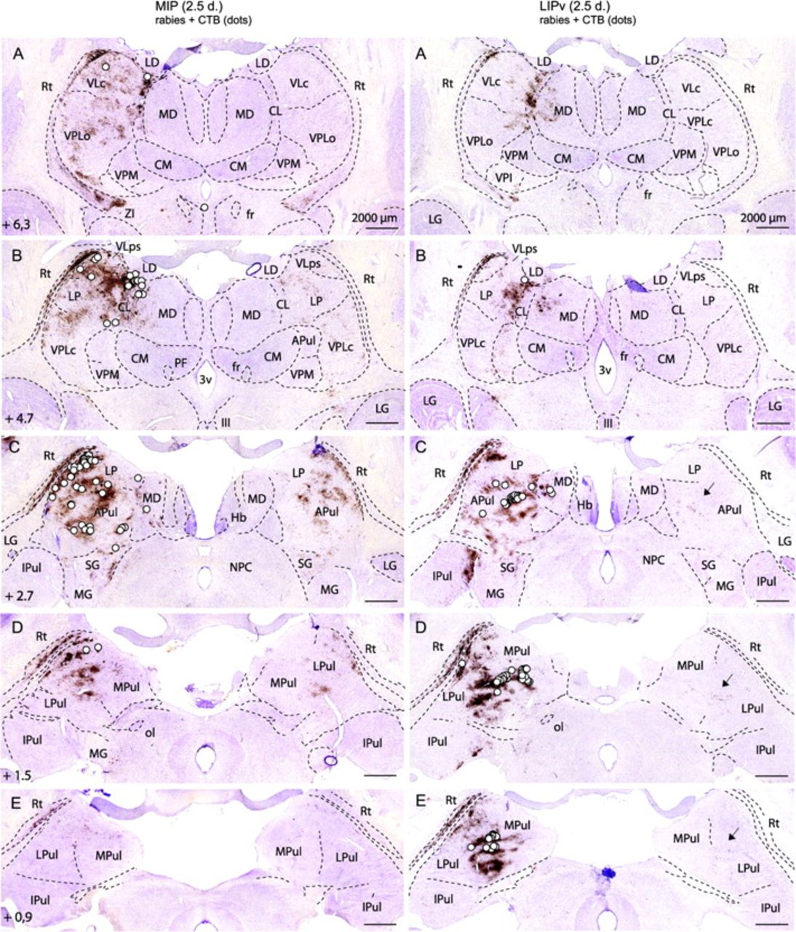
Figure 2. Differences in thalamic (direct and second-order) inputs to the MIP (left) versus the LIPv (right) at 2.5 ...
Notes:
Figure 2. Differences in thalamic (direct and second-order) inputs to the MIP (left) versus the LIPv (right) at 2.5 days after coinjection of rabies virus and the conventional tracer CTB. In each row, the left side is ipsilateral. The rostrocaudal distance of the coronal sections from the interaural axis is indicated. White dots: first-order neurons (CTB); note the topographical differences of neurons targeting MIP (dorsal and lateral) versus LIPv (caudal, medial, and ventral). Location: pulvinar complex, LP, VLps and VLc, CL, MD. Brown: rabies retrograde transneuronal labeling at 2.5 days, involving second-order neurons in the reticular thalamic (Rt) nucleus ipsilaterally and additional thalamic nuclei on both sides. Second-order neurons (brown) contralaterally (for LIPv, see arrows in C–E) mirror the distribution of first-order neurons (white dots) ipsilaterally. In both MIP and LIPv experiments, no labeling is found in Rt (third order) contralaterally, showing that third-order neurons are not yet labeled at 2.5 days (see also Fig. 1D). Other abbreviations: CM, centromedian; fr, fasciculus retroflexus; Hb, habenula; IPul, inferior pulvinar; LD, lateral dorsal; LG, lateral geniculate; MG, medial geniculate; MPul, medial pulvinar; NPC, nucleus of the posterior commissure; ol, olivary pretectal nucleus; PF, parafascicular; SG, suprageniculate; VPLc, ventral posterior lateral, pars caudalis; VPLo, ventral posterior lateral, pars oralis; VPM, ventral posterior medial; ZI, zona incerta; 3v, third ventricle; III, oculomotor nucleus.
Unless provided in the caption above, the following copyright applies to the content of this slide: © The Author 2009. Published by Oxford University Press. All rights reserved. For permissions, please e-mail: journals.permissions@oxfordjournals.org

Slide 3
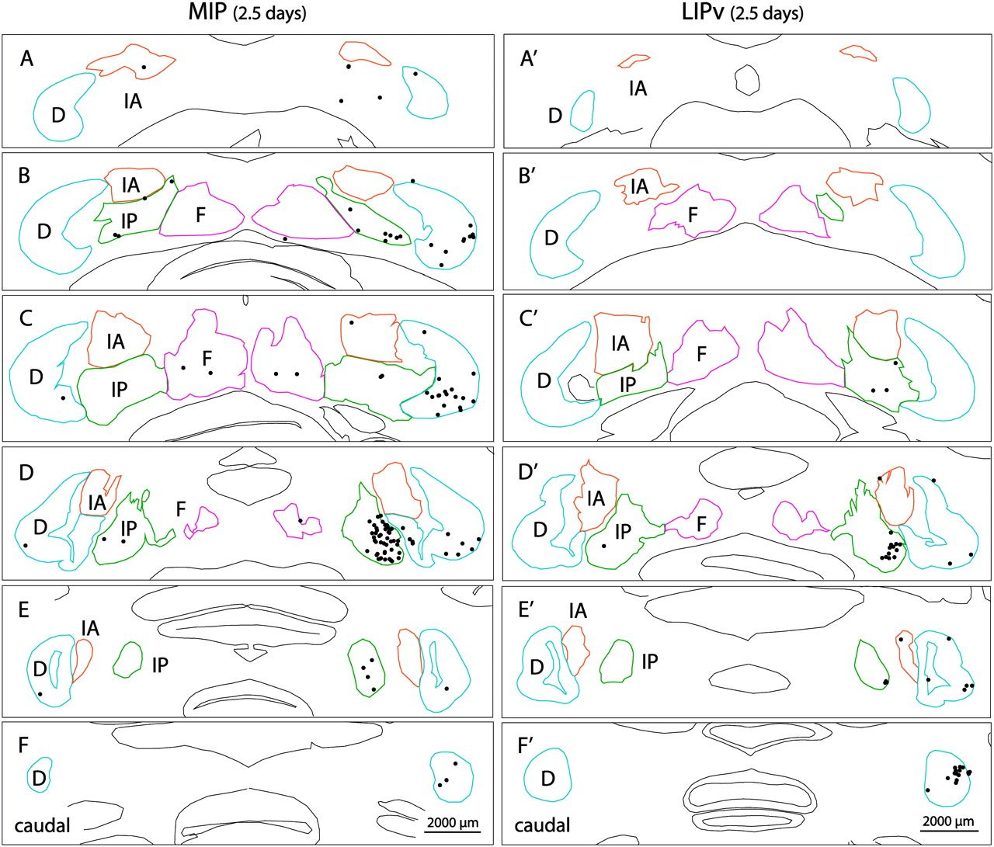
Figure 3. Differences in second-order inputs from the cerebellar nuclei to the MIP versus the LIPv (2.5 days). ...
Notes:
Figure 3. Differences in second-order inputs from the cerebellar nuclei to the MIP versus the LIPv (2.5 days). Projections to MIP are derived, mostly contralaterally, from the ventrolateral part of the IP and from mainly ventral domains of the caudal two-thirds of the D, especially middle third. Fewer inputs originate from the IA (especially rostral half) and the F nuclei. By contrast, inputs to LIPv are derived from a more restricted portion of ventrolateral IP and from the caudal pole of the D. In the IA, neurons targeting LIPv are caudal to those targeting MIP; labeling of F is negligible. Cross sections are arranged rostrocaudally from A to F (levels indicated in Fig. 4). Cerebellar nuclei are color coded (blue: D; green: IP; orange-brown: IA; magenta: F).
Unless provided in the caption above, the following copyright applies to the content of this slide: © The Author 2009. Published by Oxford University Press. All rights reserved. For permissions, please e-mail: journals.permissions@oxfordjournals.org

Slide 4
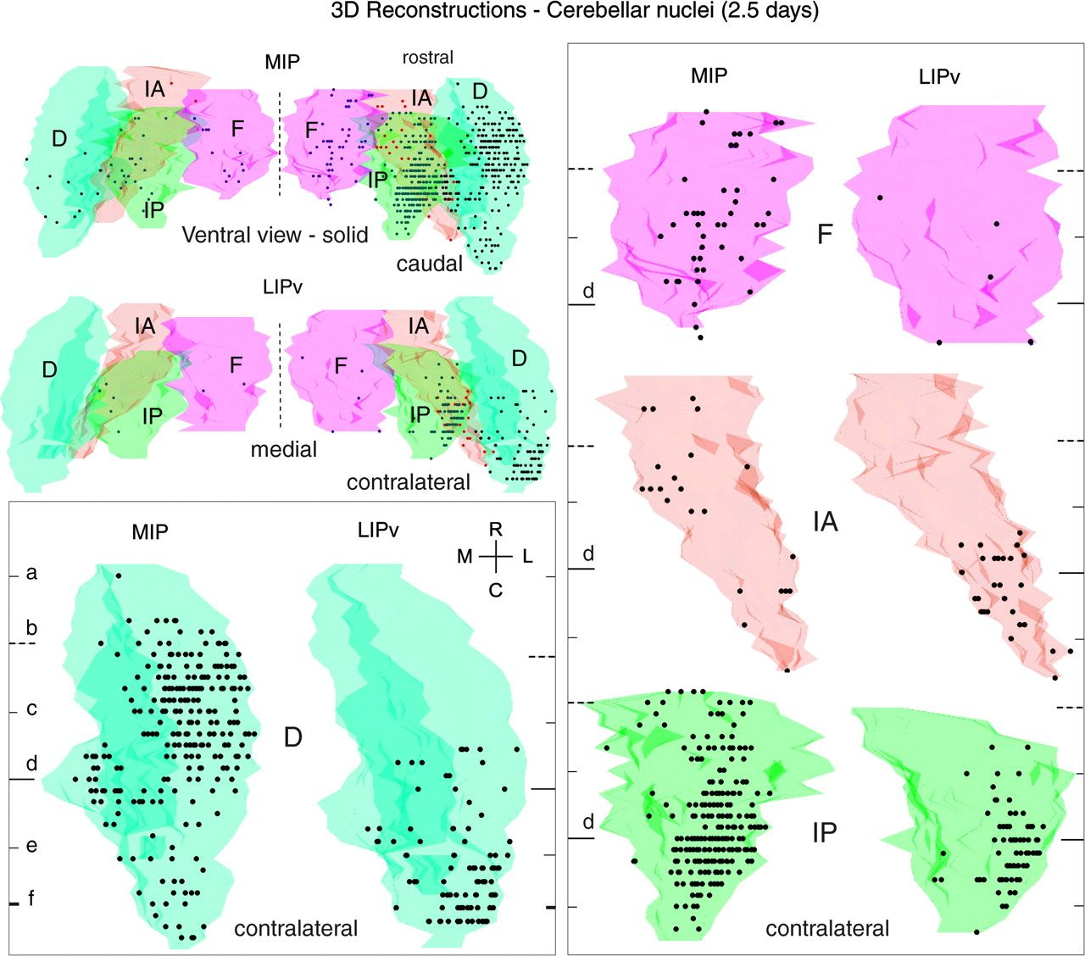
Figure 4. 3D reconstructions of the cerebellar nuclei, showing differences in second-order cerebellar nuclear inputs to ...
Notes:
Figure 4. 3D reconstructions of the cerebellar nuclei, showing differences in second-order cerebellar nuclear inputs to the MIP versus the LIPv at 2.5 days (disynaptic inputs via cerebellothalamocortical projections). The 3D reconstructions were made using Neurolucida by stacking together serial 50-μm sections (200-μm spacing). Ventral views (−90° rotation from the plane of the cross sections in Fig. 3, viewed using Solid Model) are shown here in solid mode, without perspective, for the ensemble of the cerebellar nuclei (top left) and for individual contralateral nuclei (boxed images). In this figure and Figure 8, ventral views have been flipped on the y-axis to show the contralateral (right) cerebellum on the right side. In boxed images, horizontal lines indicate the levels of the cross sections shown in Figure 3 (same letter index). Cerebellar nuclei are color coded as in Figure 3 (blue: D; green: IP; orange-brown: IA; magenta: F). Note the predominantly contralateral distribution of transneuronally labeled neurons (dots), with major input to both MIP and LIPv from IP and D and minor contributions from IA and F, and the prominent topographical differences of the cerebellar populations targeting MIP versus LIPv.
Unless provided in the caption above, the following copyright applies to the content of this slide: © The Author 2009. Published by Oxford University Press. All rights reserved. For permissions, please e-mail: journals.permissions@oxfordjournals.org

Slide 5
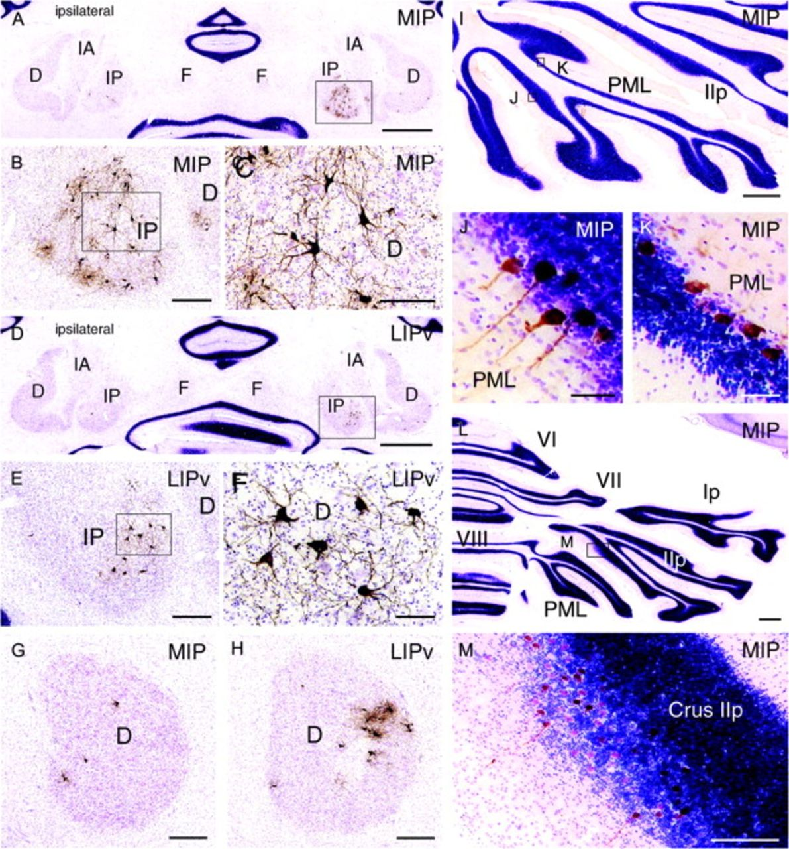
Figure 5. (A–H) Photomicrographs showing transneuronally labeled neurons in the cerebellar nuclei that target ...
Notes:
Figure 5. (A–H) Photomicrographs showing transneuronally labeled neurons in the cerebellar nuclei that target disynaptically the MIP and the LIPv, labeled at 2.5 days, and (I–M) cerebellar cortex PCs with trisynaptic inputs to MIP, labeled at 3 days. (A–C) MIP: labeling in ventrolateral IP and D (level shown in Fig. 3D); boxed area in (A) is enlarged in (B) (ventrolateral IP); high-power view in (C). (D–F) LIPv: labeling in ventrolateral IP and D (level shown in Fig. 3D). Boxed area in (D) is enlarged in (E) (ventrolateral IP); high-power view in (F). Note the more restricted distribution of labeled IP neurons that target LIPv (E) versus MIP (B). (G, H) Caudal pole of the D: at this level, D neurons targeting LIPv (H) are much more numerous than those targeting MIP (G), contrary to more rostral D levels (Figs 3, 4, and 6). (I–K) Distribution of labeled PC strips in PML, level shown in Fig. 7d, boxed areas in (I) are enlarged in (J, K). (L, M) Labeled PCs in Crus IIp (level shown in Fig. 7b). Boxed area in (L) is enlarged in (M). Scale bar = 2000 μm in (A) (also applies to D), 400 μm in (B) (also applies to E, G, H, M), 200 μm in (C), 100 μm in (F), 1000 μm in (I) (also applies to L), and 50 μm in (J) (also applies to K).
Unless provided in the caption above, the following copyright applies to the content of this slide: © The Author 2009. Published by Oxford University Press. All rights reserved. For permissions, please e-mail: journals.permissions@oxfordjournals.org

Slide 6
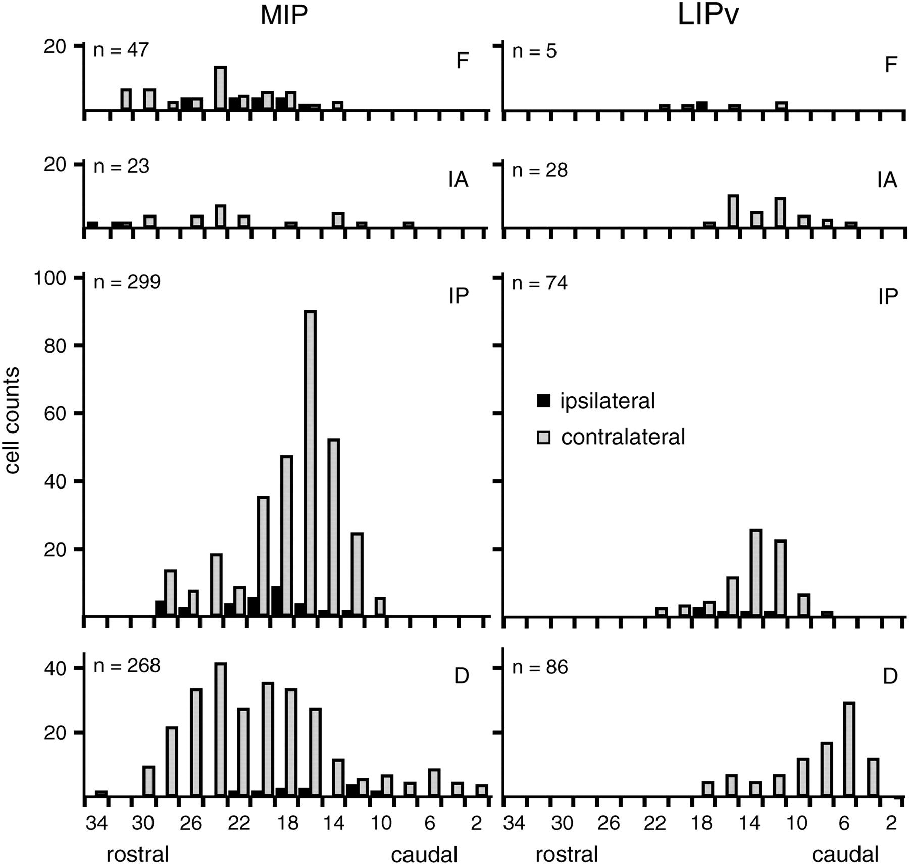
Figure 6. Histograms showing differences in number and rostrocaudal distribution of second-order neurons in the ...
Notes:
Figure 6. Histograms showing differences in number and rostrocaudal distribution of second-order neurons in the cerebellar nuclei (D, IP, IA, F) that target the MIP area and the LIPv area. Both areas receive major inputs from IP and D. Cell counts from 2 series of sections (spacing 200 μm). Black: ipsilateral; gray: contralateral. Sections are numbered (horizontal axis) from the caudal end of D. Total number of labeled cells is indicated on top of each histogram.
Unless provided in the caption above, the following copyright applies to the content of this slide: © The Author 2009. Published by Oxford University Press. All rights reserved. For permissions, please e-mail: journals.permissions@oxfordjournals.org

Slide 7
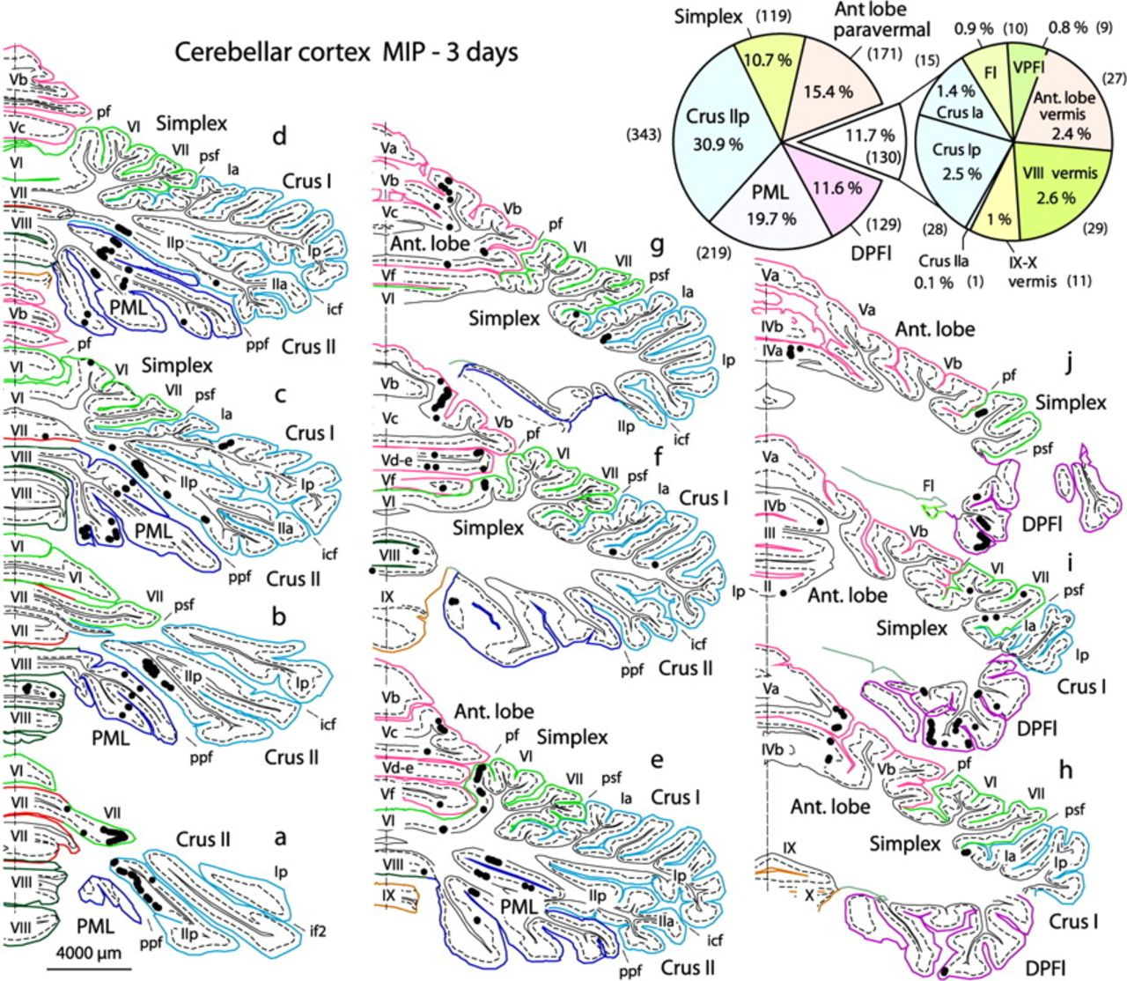
Figure 7. Right cerebellar cortex: distribution of PCs with trisynaptic inputs to the left MIP area, labeled ...
Notes:
Figure 7. Right cerebellar cortex: distribution of PCs with trisynaptic inputs to the left MIP area, labeled transneuronally at 3 days with rabies virus. Cross-section levels (a–j): from caudal to rostral. Cerebellar lobules are named and color coded; fissures are named and indicated by a mark. Most labeled PCs are found in 3 main groups: obliquely oriented bands in the depth of Crus IIp and PML, multiple bands in DPFl, longitudinal bands in paravermal AL and simplex. Pie chart (top right): percentages and absolute numbers (in brackets) of labeled PCs in the different cerebellar subdivisions. Fl, flocculus; VPFl, ventral paraflocculus. Fissures (f): icf, intercrural f; if2, intracrural f 2; pf, primary f; ppf, prepyramidal f; psf, posterior superior f. See also Figures 5 and 8.
Unless provided in the caption above, the following copyright applies to the content of this slide: © The Author 2009. Published by Oxford University Press. All rights reserved. For permissions, please e-mail: journals.permissions@oxfordjournals.org

Slide 8
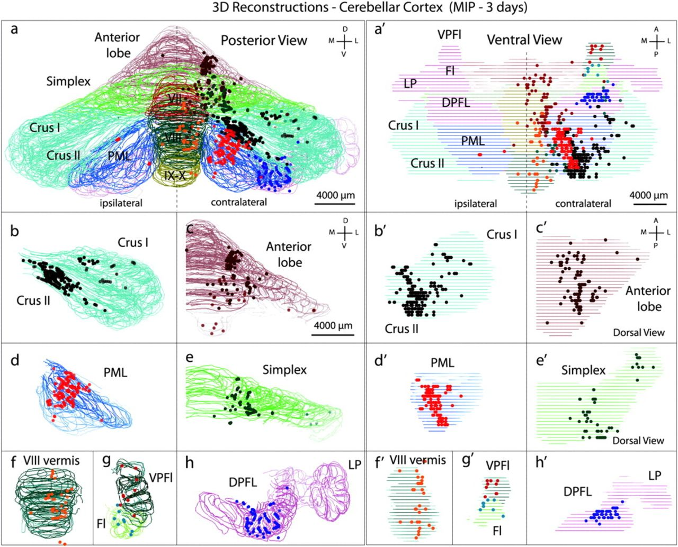
Figure 8. 3D reconstruction of the cerebellar cortex, showing the organization of PCs providing trisynaptic inputs to ...
Notes:
Figure 8. 3D reconstruction of the cerebellar cortex, showing the organization of PCs providing trisynaptic inputs to MIP (3 days). 3D reconstructions were made using Neurolucida. Posterior views (left) and ventral views (right) are shown here in wireframe mode for the entire cerebellar cortex (a, a’) and for individual divisions on the right (framed images b–h and b’–h’). Cerebellar divisions are color coded as in Figure 7 (cross sections). Most labeled PCs are found in Crus IIp and PML, DPFl, and paravermal AL and simplex. Other abbreviations: D, dorsal; Fl, flocculus; M, medial; L, lateral; LP, lobus petrosus; V, ventral; VPFl, ventral paraflocculus.
Unless provided in the caption above, the following copyright applies to the content of this slide: © The Author 2009. Published by Oxford University Press. All rights reserved. For permissions, please e-mail: journals.permissions@oxfordjournals.org

